Slide 1
DEW

Slide 2
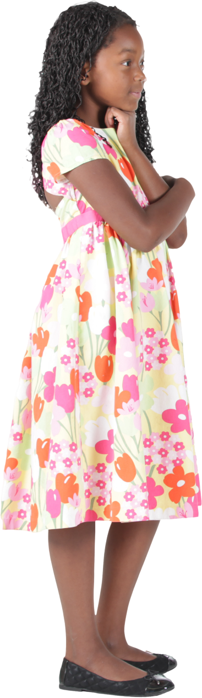

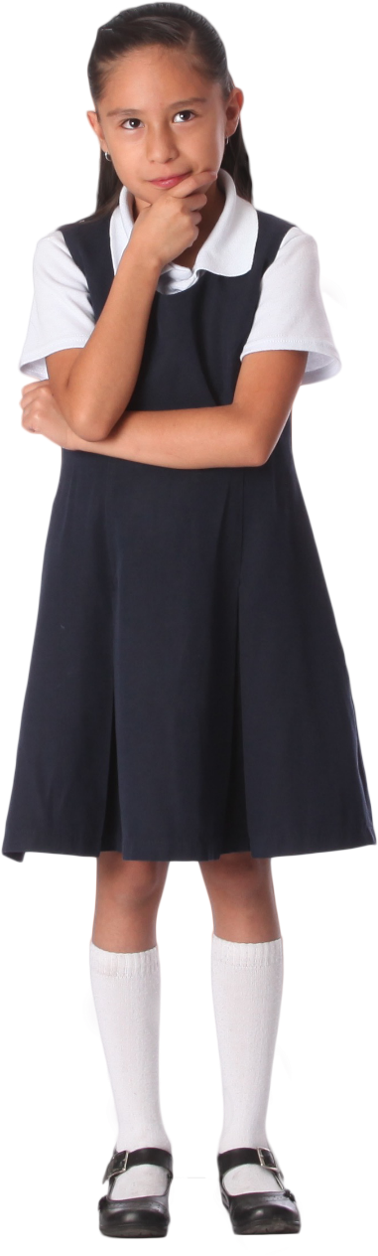
MP 5: Use appropriate tools strategically.

Slide 3
Welcome

Slide 4
Ohio Department of Education and Workforce Priorities
Literacy
Learning Acceleration
Workforce Readiness
Student Wellness
Notes:
The math plan looks to connect. To department priorities in the following areas:
Literacy Achievement: Building a foundation for lifelong success by ensuring every student is reading at or above grade level.
Learning Acceleration: Empowering each learner to reach their full potential through individualized, evidence-based support.
Student Wellness: Fostering safe and supportive environments that engage students and enable them to thrive.
Workforce Readiness: Preparing students for the future fully equipped with the skills needed to take the next steps in their career journeys.
Our strongest connection to the Department’s priorities is around learning acceleration. In mathematics, we want every student to be able to accelerate their learning. This means they can access the proactive, research-. And evidence-based, and individualized support they need to succeed. To achieve this priority, all students must have the opportunity to engage in grade-level core instruction regardless of ability, which requires replacing remediation (the practice of teaching below grade-level content) with the just-in-time intervention that allows students to complete unfinished learning and access grade-level instruction (or above).

Slide 5
Session Norms
Listen
Listen with the intent to understand. Ask questions!
Focus
Focus on how this applies to your daily work.
Imagine the possibilities!
Create
Create a safe place to air confusion and raise questions.
Support
Support ideas with evidence. Bring your vast experience to the table. Support participation of all.
Notes:
Welcome everyone. We want to take a moment to ground us in our Session Norms.
We want to Listen with the intent to understand. Ask question!
We want to Focus on how this applies to your daily work. Imagine the possibilities!
We want to Create a safe place to air confusion and raise questions.
We went to Support ideas with evidence. Bring your vast experience to the table. Encourage everyone’s participation. Part of Supporting others is to make sure we are providing space for all in group to share. In addition, we have noticed a few participants have invited an AI presence to curate notes for them during the session. While we appreciate the use of productivity tools, unfortunately, MS TEAMS does not know how to deal with these “non-human” participants and this is affecting breakout rooms, so going forward, we will not be admitting AI participants into our community meetings each month. If there are questions or concerns, please contact one of the Dept team on this session. Thank you!

Slide 6
Purpose:
Connect
Ohio’s Mathematics Vision from Ohio’s Plan for K-12 Mathematics to the Mathematical Practices.
Explore
MP 3: Construct Viable Arguments and Critique the Reasoning of Others through grade band-aligned instructional tasks.
Identify
Resources to support instruction aligned to Math Practice 3: Construct Viable Arguments and Critique the Reasoning of Others.
Utilize
Resources to help recognize and collect evidence of MP 3: Construct Viable Arguments and Critique the Reasoning of Others.

Slide 7
Agenda
What: | Why: | How:
Welcome and Introductions 5-10 minutes | To establish the session norms and outline the focus of the session | Facilitator presentation
Ohio’s Plan for K-12 Mathematics 5 minutes | To learn about Ohio’s Vision for Mathematics as outlined in Ohio’s Plan for K-12 Mathematics | Facilitator presentation
Resource Exploration and Discussions 45-60 minutes | Learn about and explore various resources aligned to the MP 5: Use appropriate tools strategically. Discover how MP 5 connects to Ohio’s Mathematics Vision. | Breakout Rooms and Whole Group Discussion
Closing 5 minutes | Address lingering questions and provide session feedback | Department contact information

Slide 8
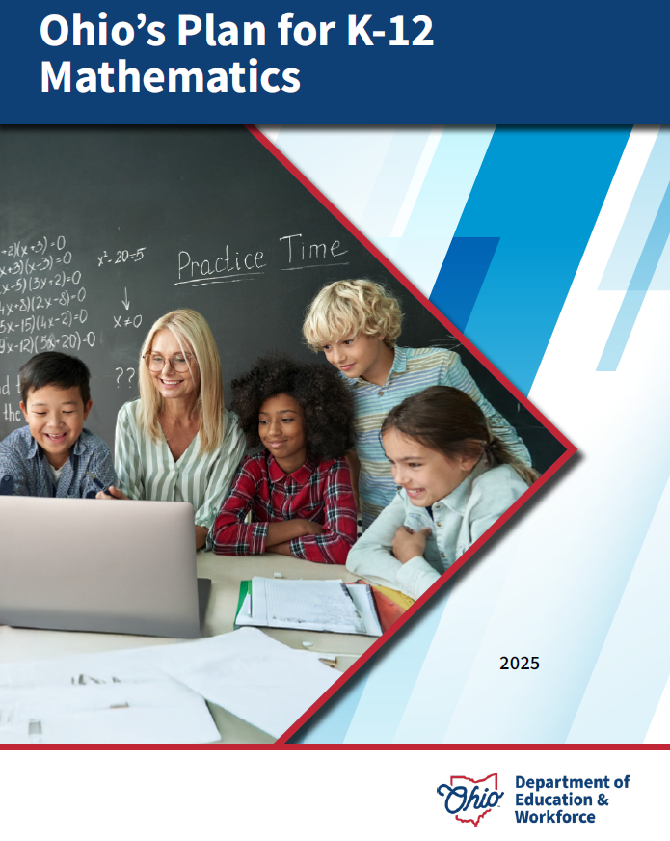
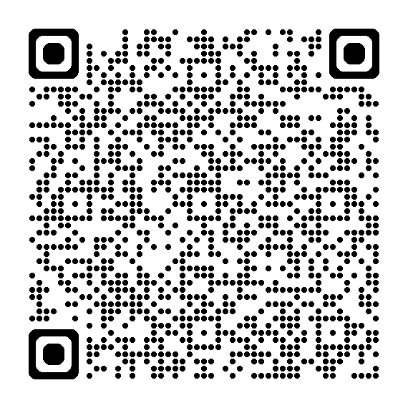
OHIO’S PLAN FOR
K-12 MATHEMATICS
education.ohio.gov/math

Slide 9
STRUCTURE OF OHIO’S PLAN
Why?
What?
How?
Section 1: Why a Comprehensive Mathematics Plan is Needed
Section 2: Ohio’s Mathematics Vision
Section 4: Strategies and Activities
Section 3: Ohio’s Theory of Action
Notes:
This session will connect best with Section 2: Ohio’s Mathematics Vision, which is outlined in Ohio’s Plan for K-12 Mathematics.

Slide 10
SECTION 2:
OHIO’S MATHEMATICS VISION
The Importance of Mathematics
A Shift Toward Rigor
Ohio’s Vision for Mathematics Instruction
Notes:
This section defines mathematics and sets the vision
Outlines that across the state, all students must have access to rigorous instruction that advances their growth and confidence in mathematics.
Section 2 sets the foundation and expectations for mathematics instruction, focusing grounded in the effective math teaching practices and student practices.

Slide 11
OHIO’S MATHEMATICS VISION
Ohio’s vision is to empower students with the confidence and ability to apply mathematical concepts, procedures, and reasoning, enabling students to thrive in a variety of contexts, life experiences, and career pathways.
Notes:
Improving mathematics outcomes for all Ohio students — across districts and grade levels and with special attention to those who are furthest behind — requires a thoughtful, multi-pronged strategy. Ohio’s Plan for K-12 Mathematics leverages multiple strands of activity and investment into a single, coherent theory of action. This theory builds upon existing math-related policies and initiatives in Ohio and proposes additional strategies to cultivate rigorous, high-quality mathematics instruction in every classroom and for all students. Ohio’s theory of action combines five interdependent strands of action. It is important to emphasize that these five strands of work are not sequential but should interact with and support one another in service of improved student learning.

Slide 12
A SHIFT TOWARD RIGOR
Learning acceleration
Just-in-time interventions
Access
Notes:
It is not enough for some students to participate in a rigorous math curriculum. To ensure a full array of college and career opportunities for every graduate, all Ohio students must have opportunities to develop and advance their conceptual understanding, procedural skills and fluency, and application of mathematics. That requires a shared commitment to the following principles in all Ohio mathematics classrooms:
Learning acceleration: Every student accelerates their learning in math and has access to the proactive, evidence-based, and individualized support they need to succeed. All students must have the opportunity to engage in grade-level core instruction regardless of ability, which requires replacing remediation (the practice of teaching below grade-level content) with the just-in-time intervention that allows students to complete unfinished learning and access grade-level instruction (or above).
(Note: This term is not equivalent to grade-level or course acceleration, which occurs when advanced learners move ahead an entire grade level in one or more subject areas.)
Just-in-time intervention: Current learning data is used to identify gaps that would prevent students from accessing grade-level instruction, plan scaffolds to provide that access, and then remove those scaffolds as soon as they are no longer needed.
Access: Providing learning “access” means removing or accommodating any barriers that would prevent a student from successfully and equitably engaging with the grade-level curriculum. Ohio commits to providing equitable access to a grade-level (or above) curriculum for learners of all backgrounds and abilities.

Slide 13
OHIO’S VISION FOR MATHEMATICS INSTRUCTION
Recommended Instructional Focus
Standards for Mathematical Practice
Effective Mathematics Teaching Practices
Notes:
The Ohio Learning Standards for mathematics were updated based on a review process led by educators and the Department in 2017. The revised standards define what learners should know and be able to do and guide districts in modifying local curricula, instructional plans, and materials to ensure all students have access to coherent, rigorous, grade-level instruction.
Ohio’s mathematics vision builds on long-accepted research about how students learn mathematics and the instructional practices that cultivate rigor.
Outlined in Ohio’s Vision for Mathematics Instruction, is first and foremost, an alignment to the Standards. In the Math Plan, we identify the recommended instructional focus for Pre-K through High Schools. These major topics or themes are taken from the Ohio Learning Standards and have been around since 2011.
Next, we have encouragement to utilize a more student-centered focus to mathematics learning through the inclusion of the Standards for Mathematical Practice. These outline ways that students can show their understanding of mathematics in every grade level and course.
Last, we highlight the importance of using the evidence-based Effective Mathematics Teaching Practices from the National Council of Teachers of Mathematics or NCTM. These Teaching Practices identify what teachers can do in the delivery of high-quality instruction.

Slide 14

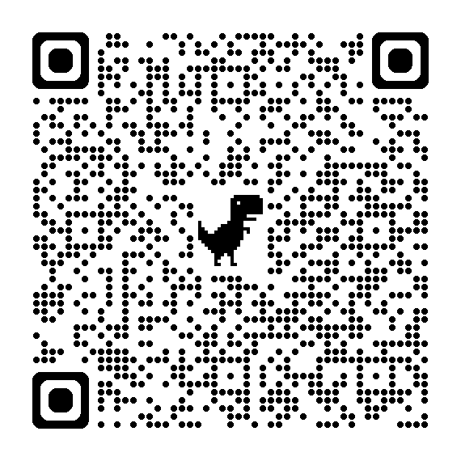
STANDARDS FOR MATHEMATICAL PRACTICE
MP 1: Make sense of problems and persevere in solving them.
MP 2: Reason abstractly and quantitatively. ​​
MP 3: Construct viable arguments and critique the reasoning of others.
MP 4: Model with mathematics.
MP 5: Use appropriate tools strategically.
MP 6: Attend to precision.
MP 7: Look for and make use of structure.
MP 8: Look for and express regularity in repeated reasoning.
Notes:
Links:
Standards for Mathematics Practice: https://education.ohio.gov/Topics/Learning-in-Ohio/Mathematics/Model-Curricula-in-Mathematics/Standards-for-Mathematical-Practice
The eight Standards for Mathematical Practice outlined in Ohio’s Learning Standards for Mathematics describe varieties of expertise that mathematics educators at all grade levels should seek to develop in their students.
These eight practices rest on important “processes and proficiencies” with longstanding importance in mathematics education. This includes the process standards of problem-solving, reasoning, communication, representation, and connections described by the National Council of Teachers of Mathematics and the five strands of mathematical proficiency described by the National Research Council.

Slide 15
MP 5: Use appropriate tools strategically.
Notes:
This is what CCSS-M says about MP5. Now, let’s break down what this MP means and what evidence to look for at your grade level or course.
Mathematically proficient students consider the available tools when solving a mathematical problem. These tools might include pencil and paper, concrete models, a ruler, a protractor, a calculator, a spreadsheet, a computer algebra system, a statistical package, or dynamic geometry software. Proficient students are sufficiently familiar with tools appropriate for their grade or course to make sound decisions about when each of these tools might be helpful, recognizing both the insight to be gained and their limitations. For example, mathematically proficient high school students analyze graphs of functions and solutions generated using a graphing calculator. They detect possible errors by strategically using estimation and other mathematical knowledge. When making mathematical models, they know that technology can enable them to visualize the results of varying assumptions, explore consequences, and compare predictions with data. Mathematically proficient students at various grade levels are able to identify relevant external mathematical resources, such as digital content located on a website, and use them to pose or solve problems. They are able to use technological tools to explore and deepen their understanding of concepts.

Slide 16
Manipulatives
What are some common physical or virtual manipulatives used in the classroom?
Notes:
Manipulatives are a tool familiar to many early childhood and elementary educators. Stated, manipulatives are physical objects that teachers and students can use to discover, illustrate, and model mathematics (Moore & Rimbey, 2022, p. 2).
Mathematically proficient students choose tools, such as physical or virtual manipulatives, that are relevant and useful to the problem at hand. What are some common physical or virtual manipulatives you or your teachers use in the classroom?
Expected responses should include (but not be limited to):
Counting bears
Counting chips
Base-10 Blocks
Linking Cubes or Connecting Cubes
Unifix Cubes
Tangrams
Five-frams or Ten-frames
Cuisenaire Rods
Geoboards
Fraction Tiles
Protractors
Rulers
Meter Sticks
Yard Sticks
Tape measures
100s charts
10 x 10 grids
Algebra tiles
Clocks
Pattern blocks
Scales

Slide 17
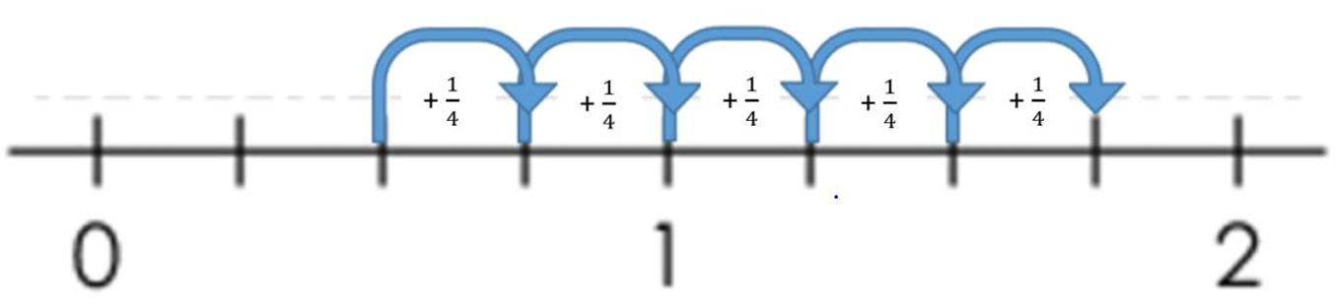
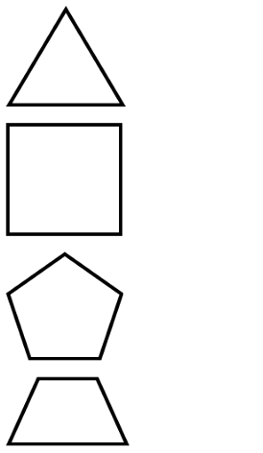
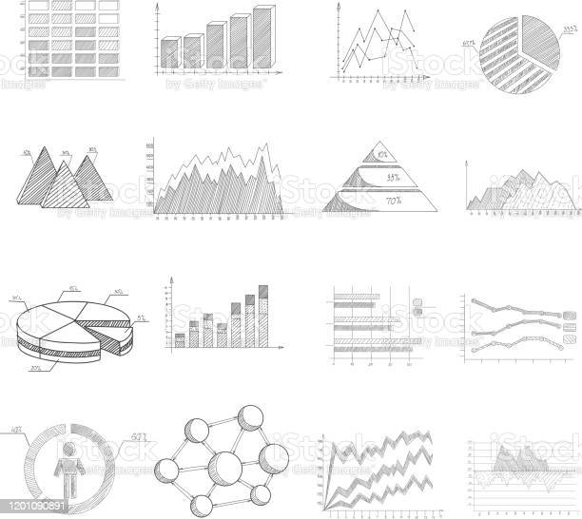
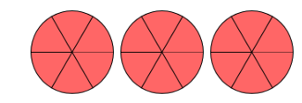

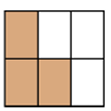
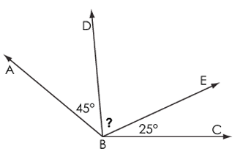
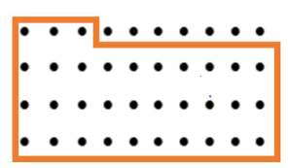
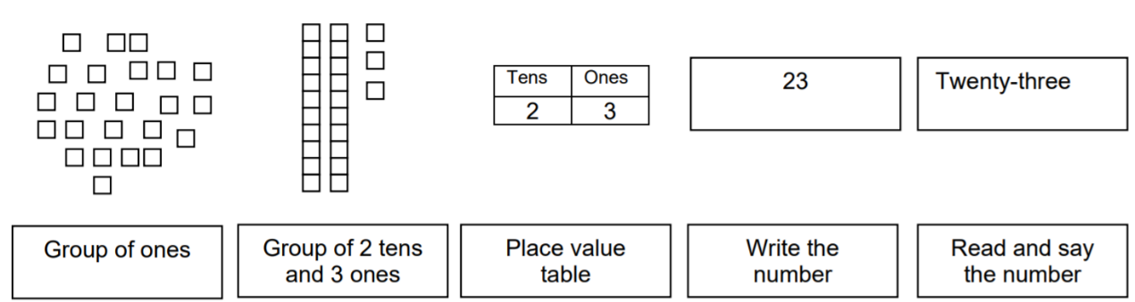


Drawings
Notes:
A drawing may be the most appropriate way for children to express their ideas (Van de Wall, p. 31), and drawings are a great way for students to demonstrate when they understand the math at all (Sharma, 2024).
In the Ohio Learning Standards, “drawings need not show details, but should show the mathematics in the problem. This applies wherever drawings are mentioned in the Standards.” Think about that as you look again at the drawings in the slide. Notice how each drawing shows a different level of detail. Notice how none of them are directly associated with a particular context?

Slide 18
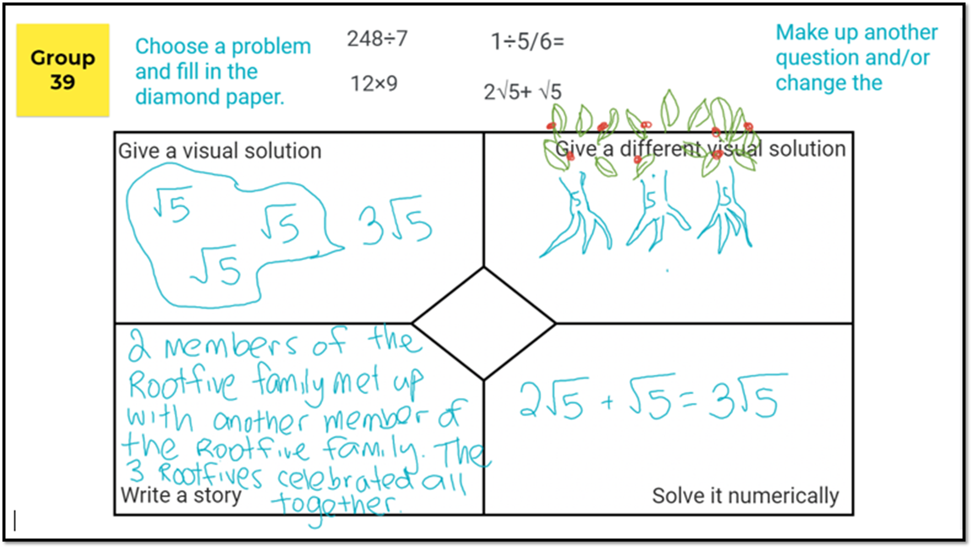
Organizers
Notes:
You can even use organizers like this one that allows the student to choose a problem from the top and then fill in the diamond paper to give a visual solution, give a different visual solution, write a story, and solve it numerically. If you cannot understand the visual solution, you can read the story the student wrote: 2 members of the root five family met up with another member of the root five family. The 3 root fives celebrated all together. Look at that cute “Root-5-family” the student drew to give a different visual solution!
Graphic organizers can be an excellent support for struggling learners to help them to engage in grade level or course content.

Slide 19
Discussions
Notes:
What types of tools are available in your math classroom?
Do students have opportunities to use tools to explore math tasks?

Slide 20
A PENCIL AND an eraser
The pencil costs 75 cents. The eraser costs 20 cents less than the pencil. How much does the eraser cost?
How might Grade 2 students solve this problem?
Task modified from Illustrative Mathematics

Slide 21
Postage stamps
The post office packages stamps like this:
10 stamps in each row.
10 rows of 10 in each sheet.
Yesterday, a student was at the post office. They saw 4 full sheets, 7 rows, and 2 extra stamps. How many stamps did they see?
How might Grade 2 students solve this problem?
Task modified from Illustrative Mathematics

Slide 22
Who Sold the most chocolate?
Jared sold 194 Boy Scout chocolate bars.
Matthew sold three times as many as Jared.
Gary sold 297 fewer than Matthew.
How many bars did Gary sell?
Notes:
Jared x 3 = Matthew so 194 x 3 =582
Matthew - 297 = Gary so 582- 297 =285
Gary sold 285 bars.

Slide 23
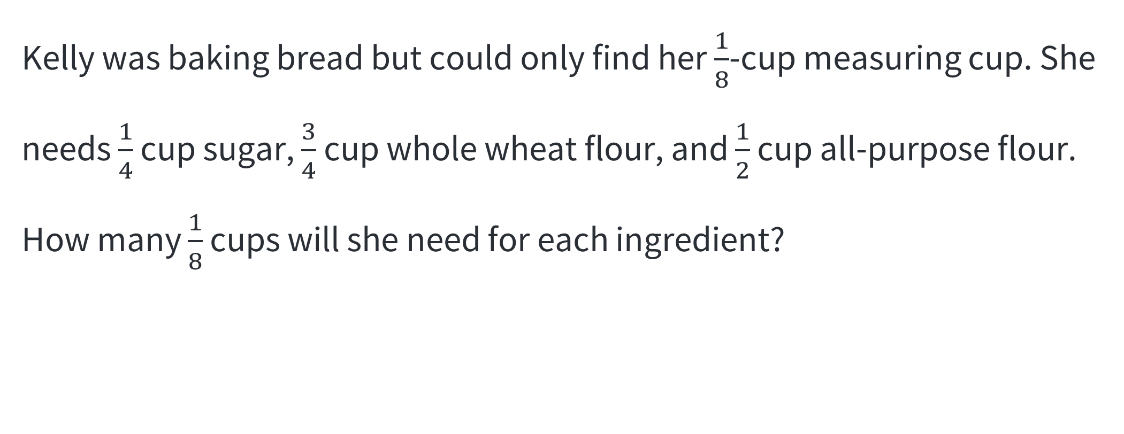
Baking Bread
Kelly was baking bread but could only find her $\frac{1}{8}$-cup measuring cup. She needs $\frac{1}{4}$ cup sugar, $\frac{3}{4}$ cup whole wheat flour, and $\frac{1}{2}$ cup all-purpose flour. How many $\frac{1}{8}$ cups will she need for each ingredient?
Notes:
Students may use equivalent fractions to change each measurement into eighths, then decompose the fractions to determine the number of in each measurement.
Sugar = 2/8 or 2 measurements of 1/8 cup
Whole wheat flour = 6/8 or 6 measurements of 1/8 cup
All purpose flour = 4/8 or 4 measurements of 1/8

Slide 24
What is the difference?
What is the difference between the two expressions? Convince me.
20% of 50 AND 50% of 20

Slide 25
Difference of 2.45
Table 1: Difference of 2.5
3.4 | 6.05 | 17.21 | 12.91
14.76 | 5.85 | 10.46 | 8.5
Find a pair of numbers that has a difference of 2.45.
Explain how you selected your numbers.
Tasking modified from Mine the Gap for Mathematical Understanding by John SanGiovanni and Jennifer Novak

Slide 26
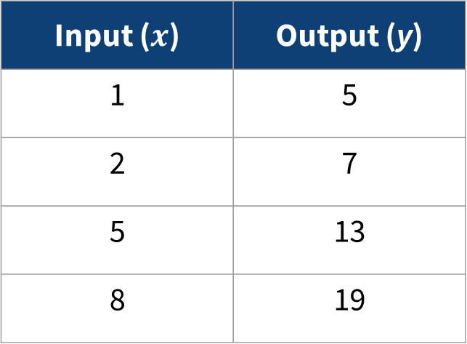
Function Table
Write a rule for the function table.
Input ($x$) | Output (y)
1 | 5
2 | 7
5 | 13
8 | 19
Tasking modified from Mine the Gap for Mathematical Understanding by John SanGiovanni and Jennifer Novak

Slide 27



Picking candy
A teacher has a bag of candy. There are 12 candies in the bag. There are 7 milk chocolate candies in the and 5 bubble gum candies.
What is the probability that the teacher takes 2 pieces of candy from the bag and they are both candies are chocolate candies or both bubble gum candies?
How do you know?

Slide 28
Painting a Cube
A teacher has a bag of candy. There are 12 candies in the bag. There are 7 candies with milk chocolate in the center and 5 other candies with bubble gum in the center.

Slide 29
discussions debrief
Notes:
Share out some of the tools and manipulatives you use the most at your grade band.
What are the tools that you could use at your grade band to help students be more successful?
What are the commonalities and differences across the grade bands you notice as you listen to the responses?

Slide 30

Choice
Notes:
Choice of tools is another big part of this math practice standard. Find the link to some videos on the facilitator guide and watch this video of 3rd grade. There are videos for other grades but particularly in 3rd grade we can watch. While you are watching, notice who decides what manipulatives the students are going to use. Stop this recording and watch at least the third-grade video, or if you have the time or are part of a group that includes multiple grade levels, you can watch whatever grade level you support. After watching the video, use the discussion questions and then come back to this presentation.
Video 3rd Grade
Students using different manipulatives
https://www.insidemathematics.org/common-core-resources/mathematical-practice-standards/standard-5-use-appropriate-tools-strategically
Where are the manipulatives?
Who decides what manipulatives to use?

Slide 31
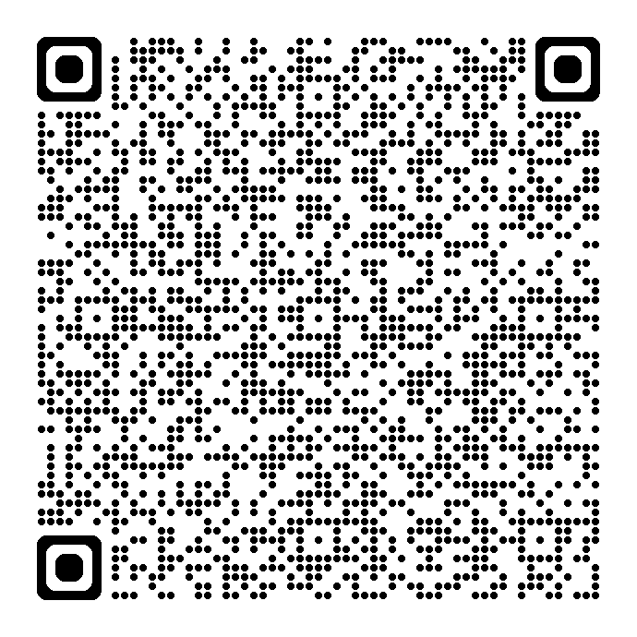
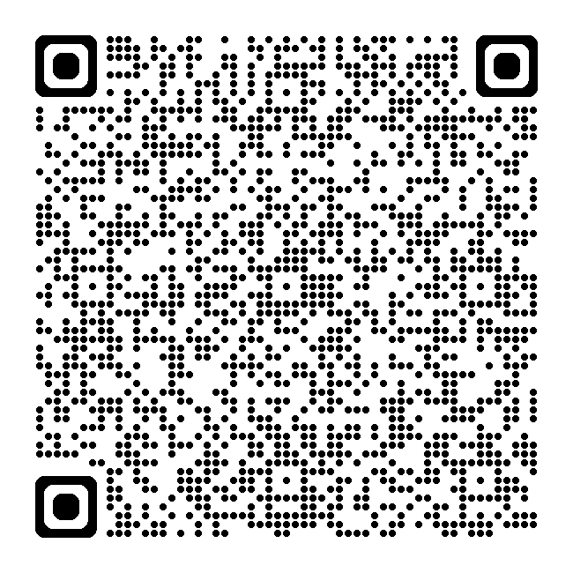
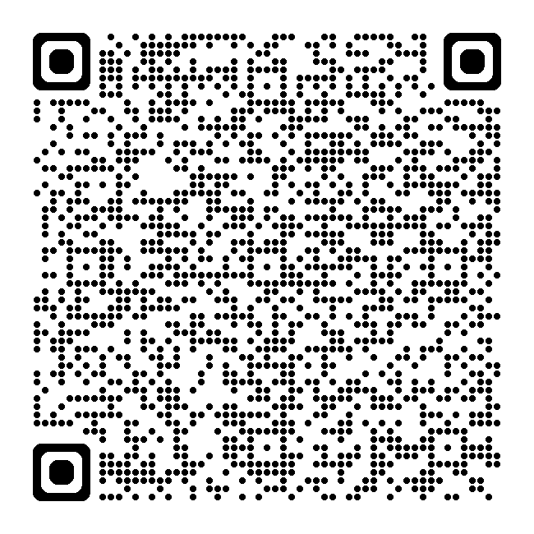
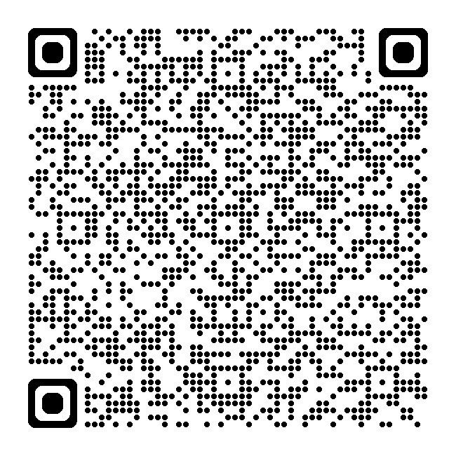
Math Practice Progressions
Explore the progressions. What does Math Practice 5 look like at your grade/course, and those grades/courses before and after?
Standards for Mathematical Practice
Kindergarten - Grade 5
Grades 6-8
High School
Notes:
MPs: https://education.ohio.gov/getattachment/Topics/Learning-in-Ohio/Mathematics/Model-Curricula-in-Mathematics/Standards-for-Mathematical-Practice/Standards-for-Mathematical-Practice.pdf.aspx

Slide 32
DISCUSSIONS DEBRIEF
Notes:
How do you see students' use of mathematical tools evolving from elementary through high school? Can you share specific examples of how students in different grade levels use tools to solve problems?
In what ways do you encourage students to reflect on the effectiveness and limitations of the tools they choose? How do you guide them to make strategic decisions about which tools to use in various mathematical contexts?
How do you integrate technology into your instruction to support students in using appropriate tools strategically? Can you provide examples of how technology has enhanced students' understanding and problem-solving abilities?

Slide 33
Putting The Tools Together

Slide 34
MP 5: Use appropriate tools strategically.
Consider and use tools as a way to understand, represent, and solve problems
Tools refers to language, materials, and symbols that help students record and communicate their solution method(s)
Common tools may include:
    Pencils/paper
    Physical or virtual manipulatives
    Pictures or drawings
    Calculators
    Etc.
Notes:
In MP 5, students must consider and use tools as a way to understand, represent, and solve problems. Students learn to use tools to construct and make sense of concepts for themselves; not just watch others demonstrate using the tools. The phrases mathematical tools refers to language, materials, symbols that help students record and communicate their solution method. Tools help shape the way students think about and understand certain math concepts. Teachers must expose students to various tools from physical manipulatives to software so students can use the tools to support their learning and deepen understanding. In elementary, students should be encouraged to develop and use tools that make sense to them. Often these tools will be those tools that directly model the task at hand. Typical tools for these tasks may include pencils/paper, physical manipulatives, fingers, pictures, drawings, or calculators. In middle and high school, students progress to using more abstract models and representations. Middle and high school may continue to use concrete models. They expand their use of tools to include more sophisticated tools such as dynamic graphing software or or other advanced technologies. .

Slide 35

Math Practice 5 Tools
Consider
Decide
Use
Implications?

Slide 36
Questions to Develop Mathematical Thinking
What mathematical tools could we use to visualize and represent the situation?
What approach are you considering trying first?
Why was it helpful to use . . . ?
Notes:
“Implementing Standards for Mathematical Practice”
“Math Practice Prompts”

Slide 37
Questions to Develop Mathematical Thinking Cont’d
What can using… show us that… may not?
In what situation might it be more informative or helpful to use…?
In this situation, could it be helpful to use a graph, number line, ruler, diagram, calculator, manipulatives…?

Slide 38
Resources

Slide 39
MP 5: Use appropriate tools strategically rubric
MP | Needs Improvement | Emerging | Proficient | Exemplary
MP 5: Use appropriate tools strategically. | Needs teacher or classmate to instruct them on which tool to choose. | Selects an appropriate tool but is unsure how to use the tool to complete the task. Able to use the tool with some assistance. | Makes sound decisions about the use of specific tools; chooses and uses tools including technology independently to complete tasks. | Makes sound decisions about multiple tools including technology flexibly to complete tasks finding appropriate alternatives when typical tools are not available.
 | Struggles or forgets to consider whether or tool is effective or has limitations. | Evaluates some of the effectiveness or limitations of a tool. | Thoroughly evaluates effectiveness or limitations of a tool. | Evaluates effectiveness or limitation or limitations of a tool and leverages that knowledge when analyzing a solution to a problem.
 | Has difficulty using tools including technology correctly or efficiently; has difficulty using tools appropriately in exploration of concepts | Uses tools including technology correctly but inefficiently; uses tools appropriately to explore understanding of concepts but struggles to reach conclusions. | Uses tools including technology correctly, efficiently, and strategically; uses technological tools appropriately to explore understanding of concepts and is able to reach conclusions. | Uses tools including technology correctly, efficiently, and strategically; uses technological tools to deepen understanding of concepts, visualize the results of assumptions, explore consequences, and compare predictions with data.
 | Struggles or forgets to consider when a solution provided by technology does not make sense. | Realizes when a solution provided by technology does not make sense. | Evaluates the results produced by technology to detect possibly errors by strategically using estimation and other mathematical knowledge. | Evaluates the results produced by technology to detect possibly errors, adjusting the tool, revising solutions or choosing other technological platforms when necessary.
Notes:
To support teachers in their professional development, particularly in the math practices, there are some rubrics available to help teachers look for evidence of student understanding of the math practices. Here is an example of one created by Ohio.

Slide 40
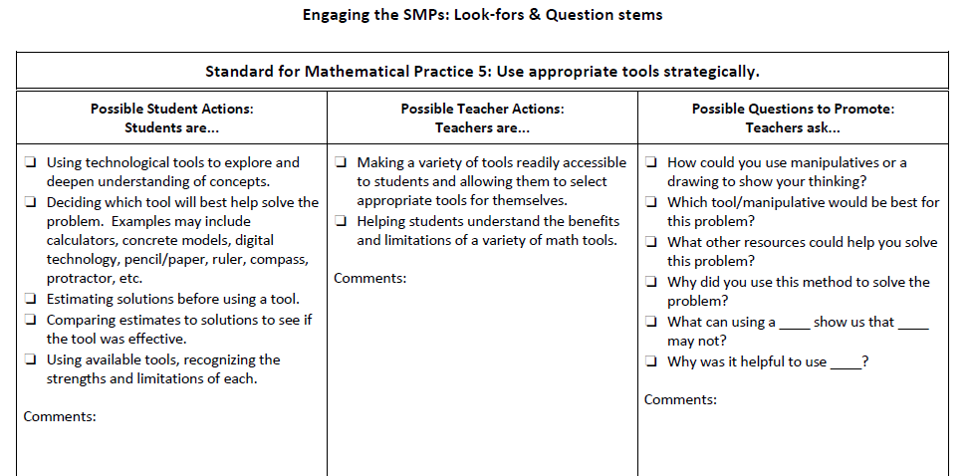
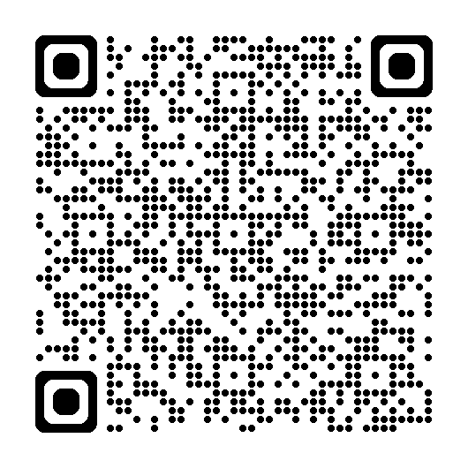
Look-Fors and Question Stems
Source: Mathleadership.com, work from Math Specialists.org , a resource from the Georgia Department of Education and work from the National Council of Teachers of Mathematics (NCTM) Principles to Action Toolkit.
Notes:
https://www.education.ky.gov/curriculum/standards/kyacadstand/Documents/SMP_Look_Fors_and_Question_Stems.pdf

Slide 41
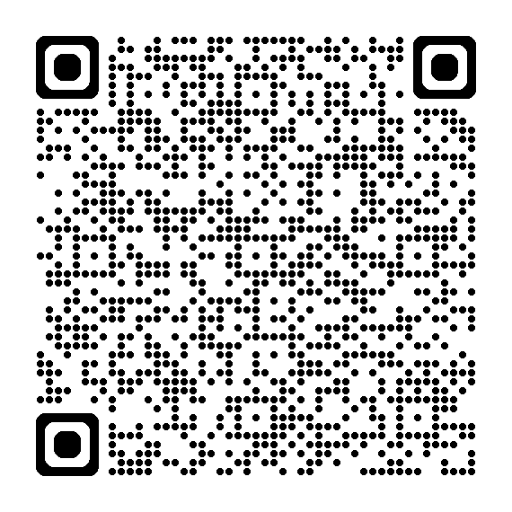
Rubric for Implementing MPs
PROFICIENT (teacher mostly models) | EXEMPLARY (students take ownership)
Task: Lends itself to multiple learning tools. Gives students opportunity to develop fluency in mental computations. Teacher: Choose appropriate learning tools for student use. Models error checking by estimation. | Task: Requires multiple learning tools (i.e., graph paper, calculator, manipulatives). Requires students to demonstrate fluency in mental computations. Teacher: Allows students to choose appropriate learning tools. Creatively finds appropriate alternatives where tools are not available.
Source: Institute for Advanced Study/Park City Mathematics Institute
Notes:
Rubric for Implementing SMPs.pdf

Slide 42
Mathematics Questions?
Email
Mathematics@education.ohio.gov

Slide 43
Questions

Slide 44
DEW 2

