Slide 2

Math Practice 6: Attend to precision

Slide 3
Welcome

Slide 4
Ohio Department of Education and Workforce Priorities
Literacy
Learning Acceleration
Workforce Readiness
Student Wellness
Notes:
The math plan looks to connect. To department priorities in the following areas:
Literacy Achievement: Building a foundation for lifelong success by ensuring every student is reading at or above grade level.
Learning Acceleration: Empowering each learner to reach their full potential through individualized, evidence-based support.
Student Wellness: Fostering safe and supportive environments that engage students and enable them to thrive.
Workforce Readiness: Preparing students for the future fully equipped with the skills needed to take the next steps in their career journeys.
Our strongest connection to the Department’s priorities is around learning acceleration. In mathematics, we want every student to be able to accelerate their learning. This means they can access the proactive, research-. And evidence-based, and individualized support they need to succeed. To achieve this priority, all students must have the opportunity to engage in grade-level core instruction regardless of ability, which requires replacing remediation (the practice of teaching below grade-level content) with the just-in-time intervention that allows students to complete unfinished learning and access grade-level instruction (or above).

Slide 5
Session Norms
Listen
Listen with the intent to understand. Ask questions!
Focus
Focus on how this applies to your daily work.
Imagine the possibilities!
Create
Create a safe place to air confusion and raise questions.
Support
Support ideas with evidence. Bring your vast experience to the table. Support participation of all.
Notes:
Welcome everyone. We want to take a moment to ground us in our Session Norms.
We want to Listen with the intent to understand. Ask question!
We want to Focus on how this applies to your daily work. Imagine the possibilities!
We want to Create a safe place to air confusion and raise questions.
We went to Support ideas with evidence. Bring your vast experience to the table. Encourage everyone’s participation. Part of Supporting others is to make sure we are providing space for all in group to share. In addition, we have noticed a few participants have invited an AI presence to curate notes for them during the session. While we appreciate the use of productivity tools, unfortunately, MS TEAMS does not know how to deal with these “non-human” participants and this is affecting breakout rooms, so going forward, we will not be admitting AI participants into our community meetings each month. If there are questions or concerns, please contact one of the Dept team on this session. Thank you!

Slide 6
Purpose:
Connect
Ohio’s Mathematics Vision from Ohio’s Plan for K-12 Mathematics to the Mathematical Practices.
Explore
MP 3: Construct Viable Arguments and Critique the Reasoning of Others through grade band-aligned instructional tasks.
Identify
Resources to support instruction aligned to Math Practice 3: Construct Viable Arguments and Critique the Reasoning of Others.
Utilize
Resources to help recognize and collect evidence of MP 3: Construct Viable Arguments and Critique the Reasoning of Others.

Slide 7
Agenda
What: | Why: | How:
Welcome and Introductions 5-10 minutes | To establish the session norms and outline the focus of the session | Facilitator presentation
Ohio’s Plan for K-12 Mathematics 5 minutes | To learn about Ohio’s Vision for Mathematics as outlined in Ohio’s Plan for K-12 Mathematics | Facilitator presentation
Resource Exploration and Discussions 45-60 minutes | Explore various Ohio resources aligned to MP 6: Attend to precision and identify its connections to Ohio’s Mathematics Vision. | Breakout Rooms and Whole Group Discussion
Closing 5 minutes | Address lingering questions and provide session feedback | Department contact information

Slide 8

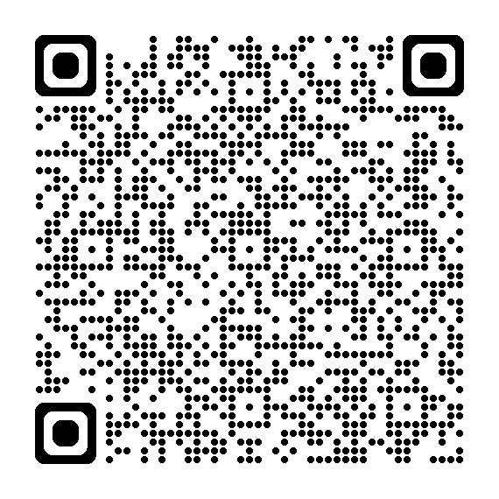
OHIO’S PLAN FOR
K-12 MATHEMATICS
education.ohio.gov/math

Slide 9
STRUCTURE OF OHIO’S PLAN
Why?
What?
How?
Section 1: Why a Comprehensive Mathematics Plan is Needed
Section 2: Ohio’s Mathematics Vision
Section 4: Strategies and Activities
Section 3: Ohio’s Theory of Action
Notes:
This session will connect best with Section 2: Ohio’s Mathematics Vision, which is outlined in Ohio’s Plan for K-12 Mathematics.

Slide 10
SECTION 2:
OHIO’S MATHEMATICS VISION
The Importance of Mathematics
A Shift Toward Rigor
Ohio’s Vision for Mathematics Instruction
Notes:
This section defines mathematics and sets the vision
Outlines that across the state, all students must have access to rigorous instruction that advances their growth and confidence in mathematics.
Section 2 sets the foundation and expectations for mathematics instruction, focusing grounded in the effective math teaching practices and student practices.

Slide 11
OHIO’S MATHEMATICS VISION
Ohio’s vision is to empower students with the confidence and ability to apply mathematical concepts, procedures, and reasoning, enabling students to thrive in a variety of contexts, life experiences, and career pathways.
Notes:
Improving mathematics outcomes for all Ohio students — across districts and grade levels and with special attention to those who are furthest behind — requires a thoughtful, multi-pronged strategy. Ohio’s Plan for K-12 Mathematics leverages multiple strands of activity and investment into a single, coherent theory of action. This theory builds upon existing math-related policies and initiatives in Ohio and proposes additional strategies to cultivate rigorous, high-quality mathematics instruction in every classroom and for all students. Ohio’s theory of action combines five interdependent strands of action. It is important to emphasize that these five strands of work are not sequential but should interact with and support one another in service of improved student learning.

Slide 12
A SHIFT TOWARD RIGOR
Learning acceleration
Just-in-time interventions
Access
Notes:
It is not enough for some students to participate in a rigorous math curriculum. To ensure a full array of college and career opportunities for every graduate, all Ohio students must have opportunities to develop and advance their conceptual understanding, procedural skills and fluency, and application of mathematics. That requires a shared commitment to the following principles in all Ohio mathematics classrooms:
Learning acceleration: Every student accelerates their learning in math and has access to the proactive, evidence-based, and individualized support they need to succeed. All students must have the opportunity to engage in grade-level core instruction regardless of ability, which requires replacing remediation (the practice of teaching below grade-level content) with the just-in-time intervention that allows students to complete unfinished learning and access grade-level instruction (or above).
(Note: This term is not equivalent to grade-level or course acceleration, which occurs when advanced learners move ahead an entire grade level in one or more subject areas.)
Just-in-time intervention: Current learning data is used to identify gaps that would prevent students from accessing grade-level instruction, plan scaffolds to provide that access, and then remove those scaffolds as soon as they are no longer needed.
Access: Providing learning “access” means removing or accommodating any barriers that would prevent a student from successfully and equitably engaging with the grade-level curriculum. Ohio commits to providing equitable access to a grade-level (or above) curriculum for learners of all backgrounds and abilities.

Slide 13
OHIO’S VISION FOR MATHEMATICS INSTRUCTION
Recommended Instructional Focus
Standards for Mathematical Practice
Effective Mathematics Teaching Practices
Notes:
The Ohio Learning Standards for mathematics were updated based on a review process led by educators and the Department in 2017. The revised standards define what learners should know and be able to do and guide districts in modifying local curricula, instructional plans, and materials to ensure all students have access to coherent, rigorous, grade-level instruction.
Ohio’s mathematics vision builds on long-accepted research about how students learn mathematics and the instructional practices that cultivate rigor.
Outlined in Ohio’s Vision for Mathematics Instruction, is first and foremost, an alignment to the Standards. In the Math Plan, we identify the recommended instructional focus for Pre-K through High Schools. These major topics or themes are taken from the Ohio Learning Standards and have been around since 2011.
Next, we have encouragement to utilize a more student-centered focus to mathematics learning through the inclusion of the Standards for Mathematical Practice. These outline ways that students can show their understanding of mathematics in every grade level and course.
Last, we highlight the importance of using the evidence-based Effective Mathematics Teaching Practices from the National Council of Teachers of Mathematics or NCTM. These Teaching Practices identify what teachers can do in the delivery of high-quality instruction.

Slide 14

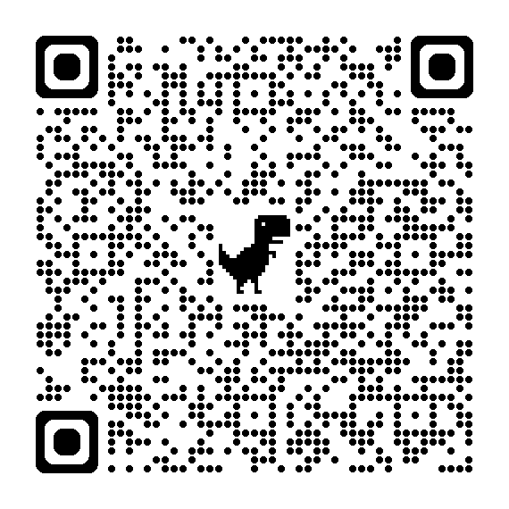
STANDARDS FOR MATHEMATICAL PRACTICE
MP 1: Make sense of problems and persevere in solving them.
MP 2: Reason abstractly and quantitatively. ​​
MP 3: Construct viable arguments and critique the reasoning of others.
MP 4: Model with mathematics.
MP 5: Use appropriate tools strategically.
MP 6: Attend to precision.
MP 7: Look for and make use of structure.
MP 8: Look for and express regularity in repeated reasoning.
Notes:
Links:
Standards for Mathematics Practice: https://education.ohio.gov/Topics/Learning-in-Ohio/Mathematics/Model-Curricula-in-Mathematics/Standards-for-Mathematical-Practice
The eight Standards for Mathematical Practice outlined in Ohio’s Learning Standards for Mathematics describe varieties of expertise that mathematics educators at all grade levels should seek to develop in their students.
These eight practices rest on important “processes and proficiencies” with longstanding importance in mathematics education. This includes the process standards of problem-solving, reasoning, communication, representation, and connections described by the National Council of Teachers of Mathematics and the five strands of mathematical proficiency described by the National Research Council.

Slide 15
How do you integrate MP 6 into your classroom?

Slide 16
Share Out

Slide 17
Discussion
Notes:
Break out room slide

Slide 18
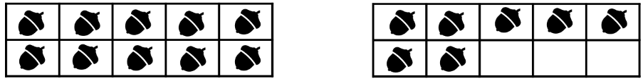
Kindergarten - Grade 2 Tasks
Continue counting on to 100 starting at 57.
How many acorns are there? How do you know?
Show me 9 buttons. (When given a collection of more than 9 buttons as manipulatives)
True or False? Identify the true expressions.
1 + 5 = 6 | 5 – 1 = 6 | 6 = 6 | 5 = 11 – 6
6 = 5 + 1 | 5 + 1 = 4 + 2 | 6 + 2 = 9 | 6 = 1 - 5
Tasks taken from Illustrative Mathematics: tasks.illustrativemathematics.org)
Notes:
Task from Illustrative Mathematics is aligned to 1.OA.7
http://tasks.illustrativemathematics.org/content-standards/1/OA/D/7/tasks/466

Slide 19

Kindergarten - Grade 2 Tasks
How many dots do you see? How do you see them?
Solve using mental math.
Kindergarten | Grade 1 | Grade 2 | Grade 3
2 + 2 2 + 3 3 + 3 3 + 4 | 7 + 7 7 + 6 7 + 8 8 + 8 | 50 + 50 49 + 49 48 + 49 48 + 48 49 + 51 | 128 + 34 119 + 36 56 + 129 126 + 49
Tasks taken from: Number Talks: Whole Number Computation, Grades K-5 by Sherry Parrish
Tasks taken from Number Talks: Whole Number Computation, Grades K-5 by Sherry Parrish
Notes:
Tasks taken from: Number Talks: Whole Number Computation, Grades K-5 by Sherry Parrish

Slide 20
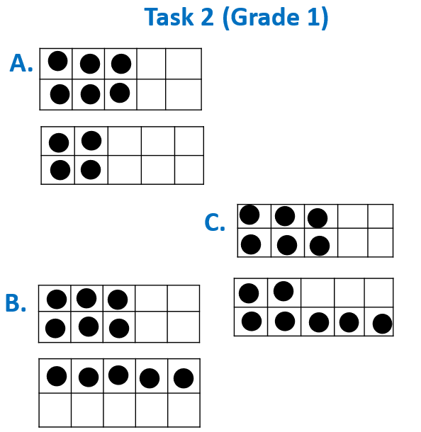
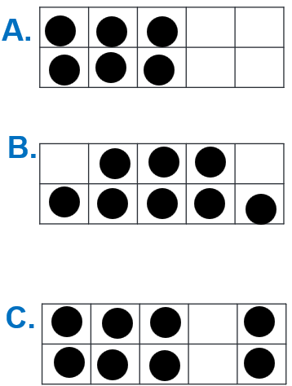
Kindergarten - Grade 2 Tasks
How many dots do you see? How do you see them?
Task 1 (Kindergarten)
Tasks taken from Number Talks: Whole Number Computation, Grades K-5 by Sherry Parrish
Tasks taken from Number Talks: Whole Number Computation, Grades K-5 by Sherry Parrish
Notes:
Where in the task are their opportunities for students to show their understanding of MP 6?
As a teacher, how would you highlight this with your instruction?
Tasks taken from Number Talks: Whole Number Computation, Grades K-5 by Sherry Parrish

Slide 21
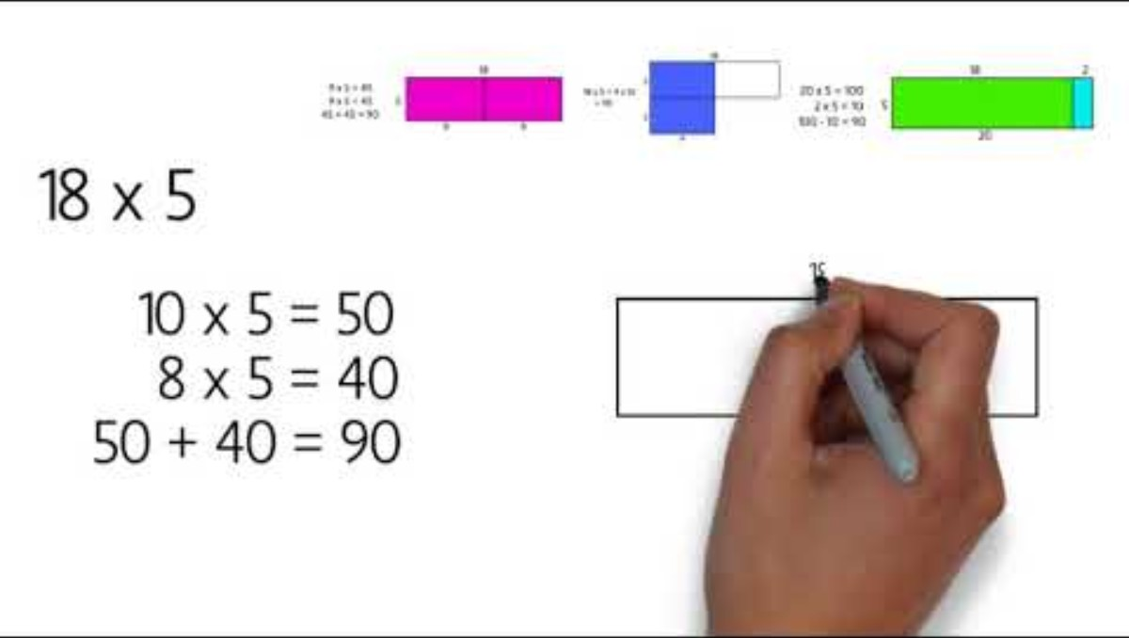
Grades 3-5 Tasks
Notes:
Boaler video: https://www.youtube.com/watch?v=&t=151s

Slide 22
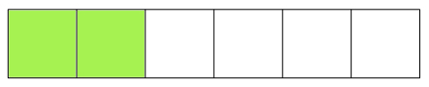
Grades 3-5 Tasks
Mrs. Frances drew a picture on the board.
Then she asked her students what fraction it represents.
Emily said that the picture represents 26. Label the picture to show how Emily's answer can be correct.
Raj said that the picture represents 23. Label the picture to show how Raj's answer can be correct.
Alejandra said that the picture represents 2. Label the picture to show how Alejandra's answer can be correct.
Tasks taken from Illustrative Math - tasks.illustrativemathematics.org)
Notes:
Illustrative Mathematics Task is aligned to 3.NF.1
http://tasks.illustrativemathematics.org/content-standards/3/NF/A/1/tasks/833

Slide 23
Grades 3-5 Tasks Cont’d
A slab of soap on one pan of a scale balances ¾ of a slab of soap and a ¾ pound weight on the other pan. How much does the full slab of soap weigh?
6 × 4 = ___ × 3
Write an expression that records the calculations described below, but do not evaluate.
    Add 2 and 4 and multiply the sum by 3. Next, add 5 to that product and then double the result.
Tasks taken from Number Talks: Fractions, Decimals, and Percentages by Sherry Parrish
Notes:
Illustrative Mathematics Task is aligned to 4.NF.3c.
Illustrative Mathematics task is aligned to 5.OA.2.
http://tasks.illustrativemathematics.org/content-standards/5/OA/A/2/tasks/556

Slide 24



Grades 3-5 Tasks
Cont’d 2
Which of these models represent ¼ of the whole? How do you know?
Where should ____ be placed on the number line? How do you know?
$\frac{5}{8}?$
$$\frac{5}{6}?$$
A. |  | B. |  | C.
$$\frac{1}{4}$$
$$\frac{1}{3}$$
Tasks taken from Number Talks: Fractions, Decimals, and Percentages by Sherry Parrish
Notes:
Tasks taken from: Number Talks: Fractions, Decimals, and Percentages by Sherry Parrish

Slide 25
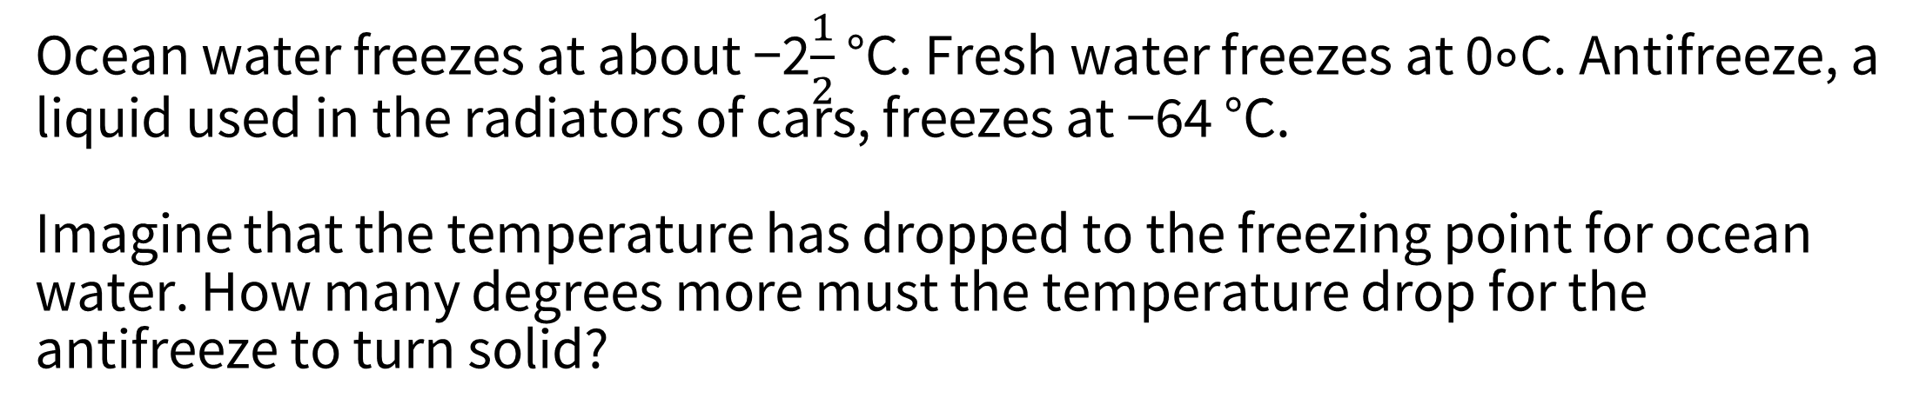
Grades 6-8 Tasks
Ocean water freezes at about −2$\frac{1}{2}$ °C. Fresh water freezes at 0∘C. Antifreeze, a liquid used in the radiators of cars, freezes at −64 °C.
Imagine that the temperature has dropped to the freezing point for ocean water. How many degrees more must the temperature drop for the antifreeze to turn solid?
Task taken from Illustrative Math (tasks.illustrativemathematics.org)
Notes:
Illustrative Mathematics task is aligned to 7.NS.1
http://tasks.illustrativemathematics.org/content-standards/7/NS/A/1/tasks/314

Slide 26
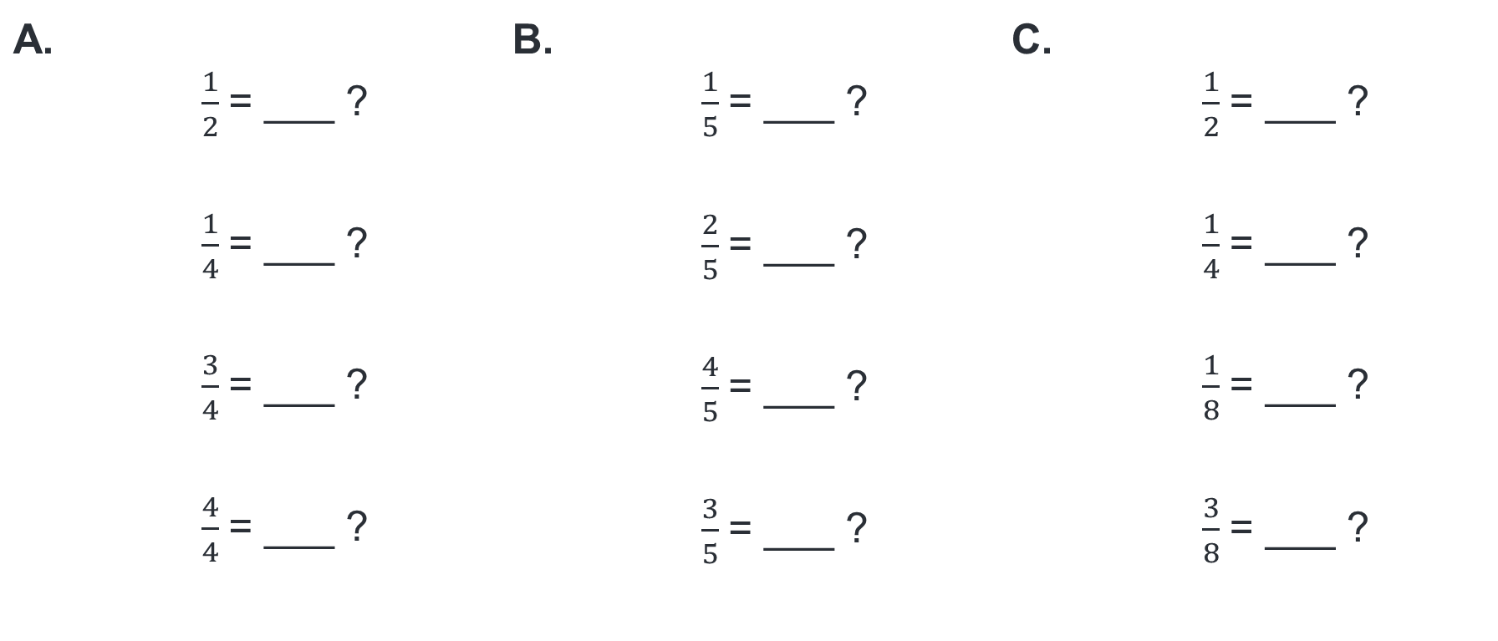
Grades 6-8 Tasks
What is the percentage equivalent of the fraction ____ ? How do you know? How can you use what we already know to solve the next problem?
A. | $\frac{1}{2}$= ___ ? $\frac{1}{4}$= ___ ? $\frac{3}{4}$= ___ ? $\frac{4}{4}$= ___ ? | B. | $\frac{1}{5}$= ___ ? $\frac{2}{5}$= ___ ? $\frac{4}{5}$= ___ ? $\frac{3}{5}$= ___ ? | C. | $\frac{1}{2}$= ___ ? $\frac{1}{4}$= ___ ? $\frac{1}{8}$= ___ ? $\frac{3}{8}$= ___ ?
Tasks taken from Number Talks: Fractions, Decimals, and Percentages by Sherry Parrish

Slide 27
Grades 6-8 Tasks Cont’d
Make up a set of eight numbers that simultaneously satisfy these constraints:
Mean: 10
Median: 9
Mode: 7
Range: 15
Tasks taken from Number Talks: Fractions, Decimals, and Percentages by Sherry Parrish

Slide 28
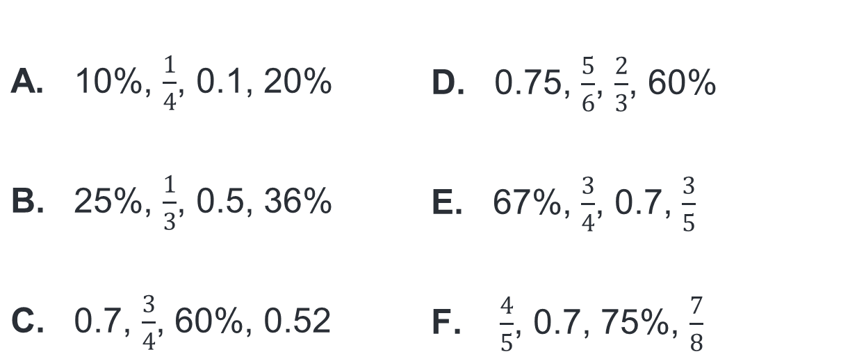
Grades 6-8 Tasks For MP 6
Task 1:
How would you order these numbers from least to greatest? How do you know?
Task 2:
Identify the missing values in the table below.
Time in Car (hr.) | Distance (mi.)
0.75 | 36
1.5
3
4.5
1
 | 108
A. 10%, $\frac{1}{4}$, 0.1, 20% B. 25%, $\frac{1}{3}$, 0.5, 36% C. 0.7, $\frac{3}{4}$, 60%, 0.52 | D. 0.75, $\frac{5}{6}$, $\frac{2}{3}$, 60% E. 67%, $\frac{3}{4}$, 0.7, $\frac{3}{5}$ F. $\frac{4}{5}$, 0.7, 75%, $\frac{7}{8}$
Task 1 taken from Number Talks: Fractions, Decimals, and Percentages by Sherry Parrish
Task 2 taken from Algebra Problem Strings by Pamela Weber Harris

Slide 29
Grades 9-12 Tasks
Solve.
(3  3)²
(2²)³
(2³)²
(a⁴)³
(a⁶)²
(3ª)³
(3²)^{b}
(xª)^{b}
(2a²)³
(-3ab¹⁰)²
Task taken from Algebra Problem Strings by Pamela Weber Harris

Slide 30
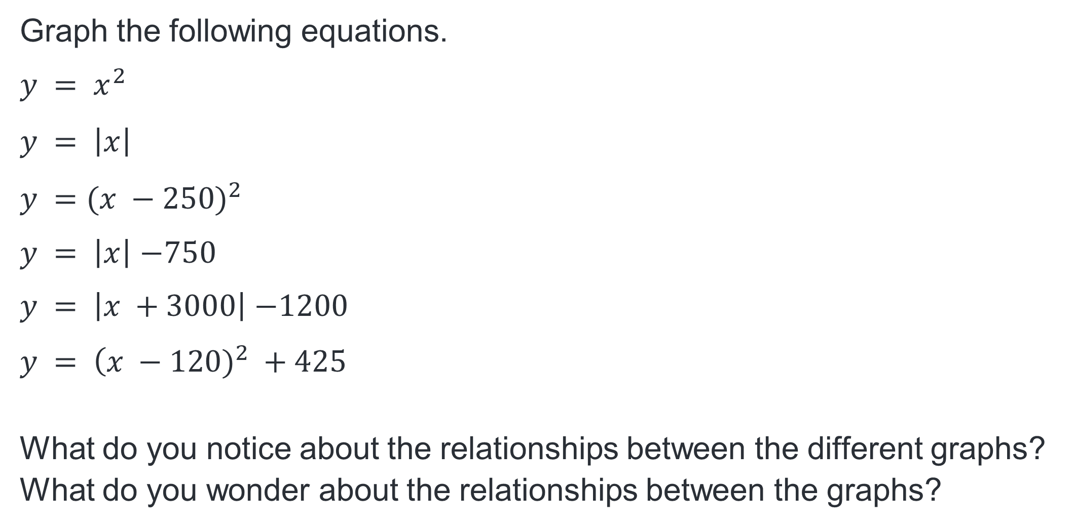
Grades 9-12 Tasks
Graph the following equations.
$$y = x^{2}$$
$$y = \left|x\right|$$
$$y =({x −250)}^{2}$$
$y = \left|x\right|$ $−750$
$y = \left|x +3000\right|$ $−1200$
$$y = \left(x − \right.{120)}^{2} +425$$
What do you notice about the relationships between the different graphs?
What do you wonder about the relationships between the graphs?
Task taken from Algebra Problem Strings by Pamela Weber Harris

Slide 31
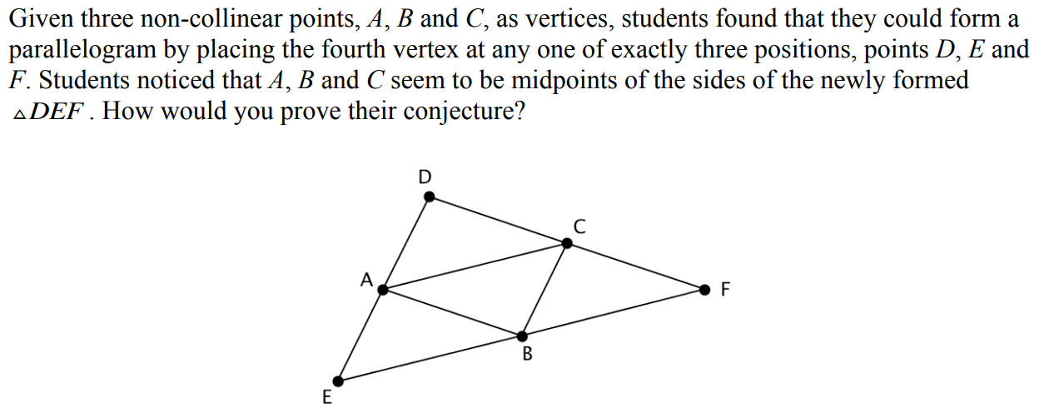
Grades 9-12 Tasks
Task taken from mathpractices.edc.org

Slide 32
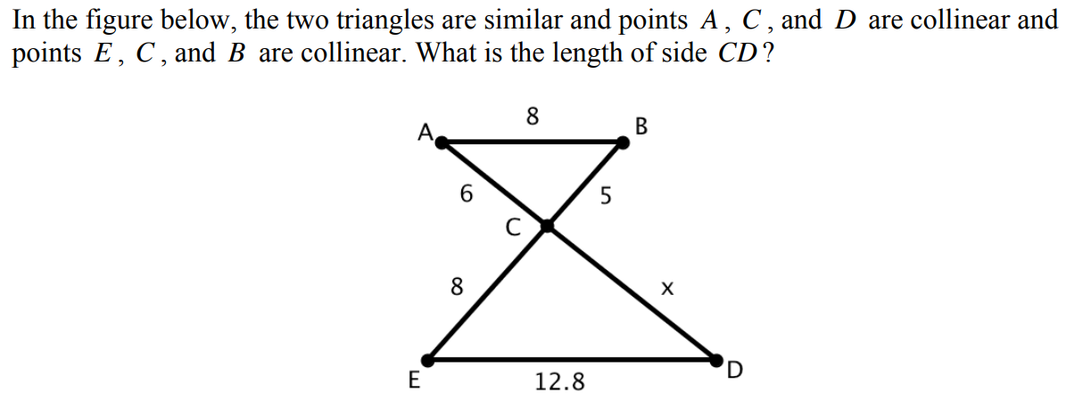
Grades 9-12 Tasks Cont’d
Task taken from mathpractices.edc.org

Slide 33
Discussion Debrief
Notes:
What do you notice in the tasks in your grade band?
What do you wonder about the tasks in your grade band?
What commonalities are evident across the tasks?
What are the differences across the tasks?
Where in the task are there opportunities for students to show their understanding of MP 6?

Slide 34
MP 6: Attend to Precision

Slide 35
MP 6: Attend to Precision.
Mathematically proficient students try to communicate precisely to others. They try to use clear definitions in discussion with others and in their own reasoning. They state the meaning of the symbols they choose, including using the equal sign consistently and appropriately. They are careful about specifying units of measure and labeling axes to clarify the correspondence with quantities in a problem. They calculate accurately and efficiently and express numerical answers with a degree of precision appropriate for the problem context. In the elementary grades, students give carefully formulated explanations to each other. By the time they reach high school they have learned to examine claims and make explicit use of definitions.
Notes:
The Ohio’s Learning Standards for Mathematical Practice (K-12) describe how students should demonstrate their mathematical proficiency. These standards “describe varieties of expertise that mathematics educators at all levels should seek to develop in their students” (Standards for Mathematical Practice, 2010). This is achieved by giving expectations for the depth of students’ understanding, the skills students should have, and how students should express what they know. Unfortunately, the MPs are written in a manner that makes them difficult for many educators to understand which makes their implementation difficult.

Slide 36
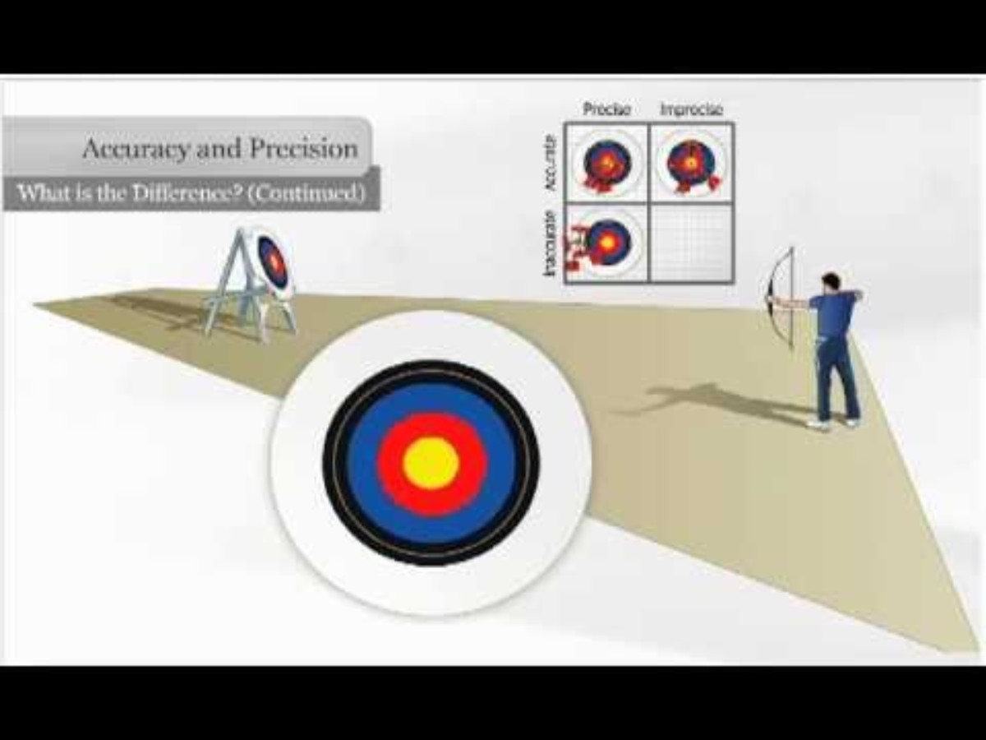
Accuracy vs. Precision
Discussion Questions
Is it better to be accurate or precise?
Defend your reasoning.
Is it better to be accurate or precise? Defend your reasoning.
Notes:
https://www.youtube.com/watch?v=8Cl5CeiT7hU

Slide 37
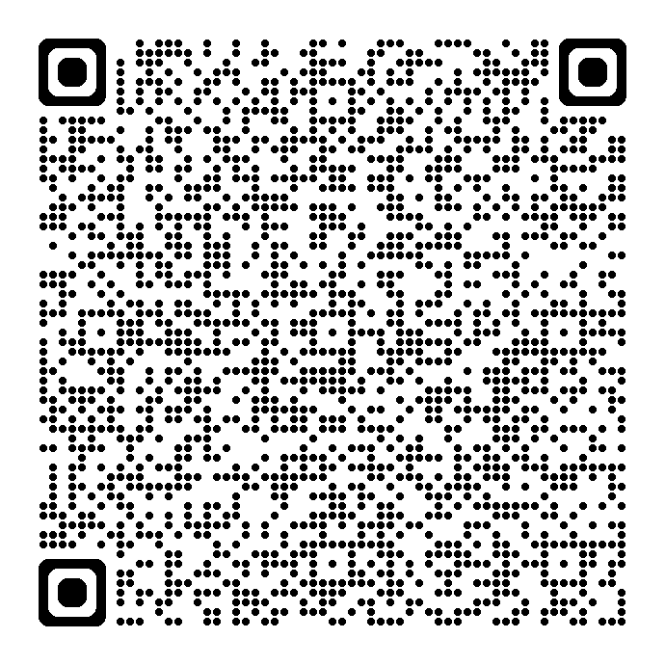

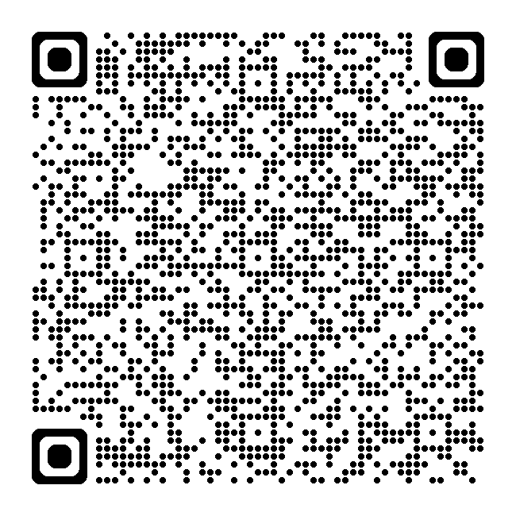
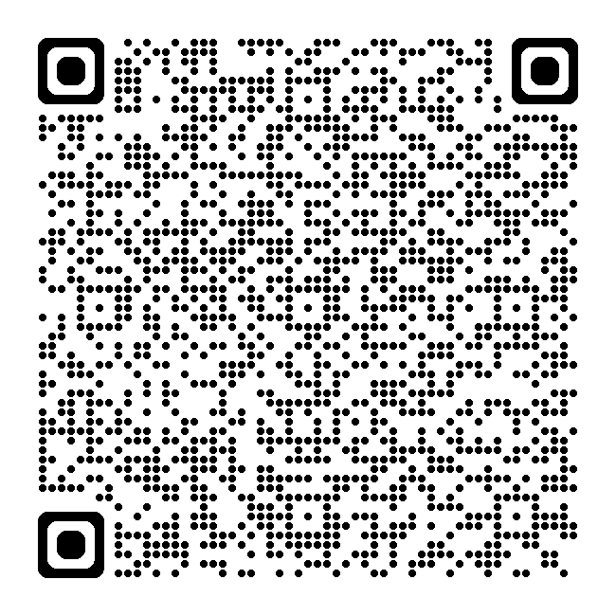
Resource Links
Standards for Mathematical Practice
Kindergarten - Grade 5
Grades 6-8
High School
Notes:
Standards for MP: https://education.ohio.gov/getattachment/Topics/Learning-in-Ohio/Mathematics/Model-Curricula-in-Mathematics/Standards-for-Mathematical-Practice/Standards-for-Mathematical-Practice.pdf.aspx

Slide 38
MP 6 Progression:
Attend to Precision

Slide 39
Discussions
Task: Review the MP progression documents.
Discussion question: What do you think Math Practice 6: Attend to Precision means or looks like at your grade level/course? How does student demonstration of MP 6 progress across the grade bands?
Notes:
Break out room slide
Discussion question: What do you think of when MP 2?
Break out time approx. 10-20 min. depending on the number of people

Slide 40
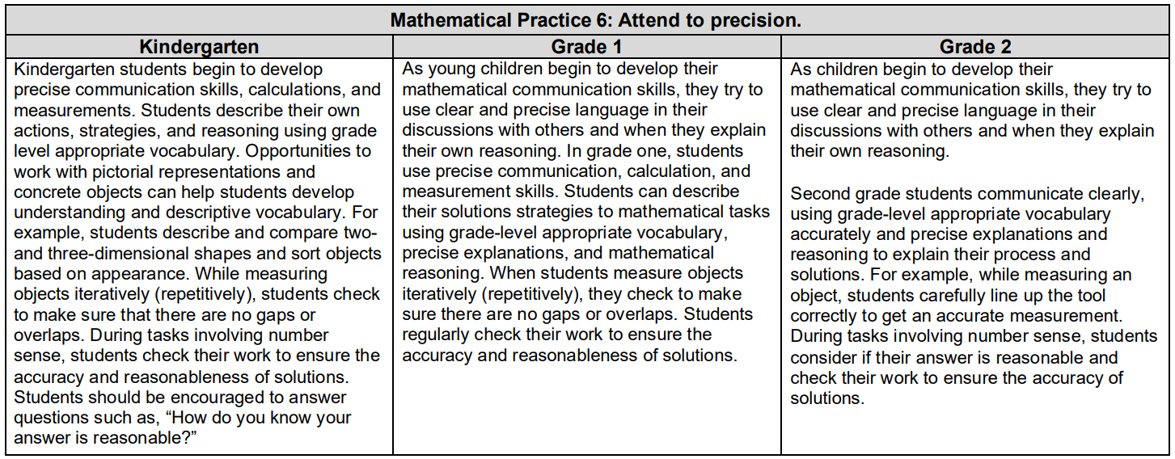

Slide 41
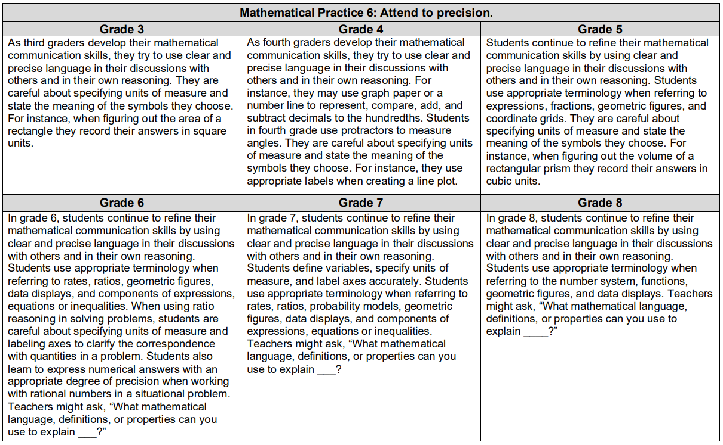

Slide 42
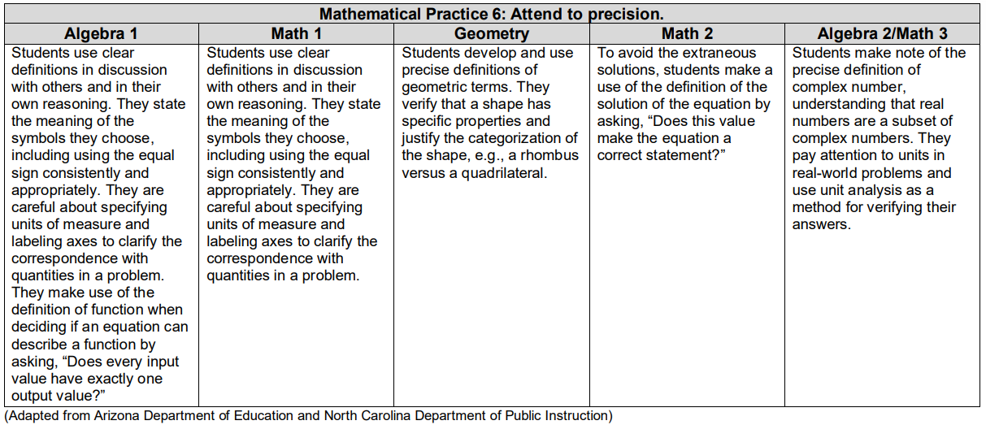

Slide 43
Discussion Share Out

Slide 44
What does MP 6:
Attend to Precision Look Like at My Grade Band?

Slide 45
MP 6: Attend to Precision.
Includes both a precision of language and number.
Explaining one’s thinking.
Asking coherent questions.
Notes:
Includes both a precision of language and number. This can be shown by students presenting their work in a way that can be understood.

Slide 46
MP 6: Attend to Precision
Define the variable in a problem.
Correctly label graphs.
Use appropriate unit when expressing quantities.
Connect their words clearly to their representations.

Slide 47

Illustrative Mathematics Elaborations for
MP 6 in Grades K-5
Use clear definitions in discussions with others and in their own reasoning.
Craft careful explanations that communicate their reasoning by referring specifically to each important mathematical element, describing the relationships among them
Notes:
Includes both a precision of language and number. This can be shown by students presenting their work in a way that can be understood. This does not mean students should be given precise vocabulary assignments or expected to recall precise definitions of mathematical terms or concepts.

Slide 48
What does MP 6 look like at K-5?
State the meaning of the symbols they choose, including using the equal sign consistently and appropriately.
Specify units of measure.
Label axes to clarify the correspondence with quantities in a problem.
Notes:
Includes both a precision of language and number. This can be shown by students presenting their work in a way that can be understood. This does not mean students should be given precise vocabulary assignments or expected to recall precise definitions of mathematical terms or concepts.

Slide 49
What does MP 6 look like at K-5?
Calculate accurately and efficiently.
Express numerical answers with a degree of precision appropriate for the problem context.
Give carefully formulated explanations to each other.
Notes:
Includes both a precision of language and number. This can be shown by students presenting their work in a way that can be understood. This does not mean students should be given precise vocabulary assignments or expected to recall precise definitions of mathematical terms or concepts.

Slide 50

Illustrative Mathematics Elaborations for MP 6 in Grades 6-8
Use clear definitions in discussions with others and in their own reasoning.
State the meaning of the symbols they choose, consistently and appropriately, such as inputs and outputs represented by function notation.
Specify units of measure, distinguishing, for example, between linear and area measures.
Notes:
What does it look like in middle school?
http://commoncoretools.me/wp-content/uploads/2014/05/2014-05-06-Elaborations-6-8.pdf

Slide 51
Illustrative Mathematics Elaborations for MP 6 in Grades 6-8
Label axes to display the correct correspondence between quantities in a problem, such as the intervals and frequencies on the axes of a histogram.
Calculate accurately and efficiently, express numerical answers with a degree of precision appropriate for the problem context and make explicit use of definitions.
Accurately apply scientific notation to large numbers and use measures of center to describe data sets.
Notes:
What does it look like in middle school?
http://commoncoretools.me/wp-content/uploads/2014/05/2014-05-06-Elaborations-6-8.pdf

Slide 52
Math Practice Rubric

Slide 53
MP | Needs Improvement | Emerging | Proficient | Exemplary
MP.6 Attend to Precision. | Does not address the question completely or directly; gives incomplete or wrong responses. | Makes an incomplete attempt to answer the question; does not formulate further responses when necessary. | Answers the question of interest thoroughly and precisely; provides carefully formulated explanations; revises responses when necessary. | Answers the question of interest thoroughly and precisely; provides carefully formulated explanations; identifies when others are not addressing the question completely.
 | Fails to communicate; unable to decipher appropriate depth of communication needed, e.g., goes off on tangents or does not provide relevant information. | Communicates with vague or incorrect terminology. | Communicates clearly with a good grasp of the mathematical terminology. uses mathematical vocabulary carefully. | Communicates clearly and concisely examining claims and makes explicit use of mathematical definitions.
 | Calculates inaccurately; forgets to specify the meaning of symbols and units and to provide labels. | Calculates accurately but not precisely, occasionally specifying the meaning of symbols and units and providing labels. | Calculates accurately and efficiently, expressing numerical answers with a degree of precision; states the meaning of symbols, specifying units of measure and providing accurate labels. | Calculates accurately and efficiently and uses proper precision in procedures; states the meaning of symbols, carefully specifying units of measure and providing accurate labels.
 | Does not determine the necessary level of precision. | Determines a level of precision; may not be the best choice. | Determines the necessary level of precision; distinguishes between exact and approximate answers and determines which is more useful depending on the context. | Determine the necessary level of precision noting error or uncertainty; distinguishes between exact and approximate answers and determines which is more useful depending on the context.

Slide 54
Resource Links
Ohio Department of Education Documents
Standards for Mathematical Practice
Kindergarten - Grade 5
Grades 6-8
High School
University of Arizona Progressions
Standards for Mathematical Practice: Commentary and Elaborations for K-5
Standards for Mathematical Practice: Commentary and Elaborations for 6-8
Other National Resources
Inside Mathematics
Illustrative Mathematics
Robert Kaplinsky: Math CCSS Math Practices Readable

Slide 55
Mathematics Questions?
Email
Mathematics@education.ohio.gov

