Slide 1
Ohio Department of Education and Workforce

Slide 2

Math Practice 7: Look for and make use of structure

Slide 3
Welcome

Slide 4
Ohio Department of Education and Workforce Priorities
Literacy
Learning Acceleration
Workforce Readiness
Student Wellness
Notes:
The math plan looks to connect. To department priorities in the following areas:
Literacy Achievement: Building a foundation for lifelong success by ensuring every student is reading at or above grade level.
Learning Acceleration: Empowering each learner to reach their full potential through individualized, evidence-based support.
Student Wellness: Fostering safe and supportive environments that engage students and enable them to thrive.
Workforce Readiness: Preparing students for the future fully equipped with the skills needed to take the next steps in their career journeys.
Our strongest connection to the Department’s priorities is around learning acceleration. In mathematics, we want every student to be able to accelerate their learning. This means they can access the proactive, research-. And evidence-based, and individualized support they need to succeed. To achieve this priority, all students must have the opportunity to engage in grade-level core instruction regardless of ability, which requires replacing remediation (the practice of teaching below grade-level content) with the just-in-time intervention that allows students to complete unfinished learning and access grade-level instruction (or above).

Slide 5
Session Norms
Listen
Listen with the intent to understand. Ask questions!
Focus
Focus on how this applies to your daily work.
Imagine the possibilities!
Create
Create a safe place to air confusion and raise questions.
Support
Support ideas with evidence. Bring your vast experience to the table. Support participation of all.
Notes:
Welcome everyone. We want to take a moment to ground us in our Session Norms.
We want to Listen with the intent to understand. Ask question!
We want to Focus on how this applies to your daily work. Imagine the possibilities!
We want to Create a safe place to air confusion and raise questions.
We went to Support ideas with evidence. Bring your vast experience to the table. Encourage everyone’s participation. Part of Supporting others is to make sure we are providing space for all in group to share. In addition, we have noticed a few participants have invited an AI presence to curate notes for them during the session. While we appreciate the use of productivity tools, unfortunately, MS TEAMS does not know how to deal with these “non-human” participants and this is affecting breakout rooms, so going forward, we will not be admitting AI participants into our community meetings each month. If there are questions or concerns, please contact one of the Dept team on this session. Thank you!

Slide 6
Purpose:
Connect
Ohio’s Mathematics Vision from Ohio’s Plan for K-12 Mathematics to the Mathematical Practices.
Explore
MP 3: Construct Viable Arguments and Critique the Reasoning of Others through grade band-aligned instructional tasks.
Identify
Resources to support instruction aligned to Math Practice 3: Construct Viable Arguments and Critique the Reasoning of Others.
Utilize
Resources to help recognize and collect evidence of MP 3: Construct Viable Arguments and Critique the Reasoning of Others.

Slide 7
Agenda
What: | Why: | How:
Welcome and Introductions 5-10 minutes | To establish the session norms and outline the focus of the session | Facilitator presentation
Ohio’s Plan for K-12 Mathematics 5 minutes | To learn about Ohio’s Vision for Mathematics as outlined in Ohio’s Plan for K-12 Mathematics | Facilitator presentation
Resource Exploration and Discussions 45-60 minutes | Explore various Ohio resources aligned to Math Practice (MP) 7: Look for and make use of structure and identify their connections to Ohio’s Mathematics Vision. | Breakout Rooms and Whole Group Discussion
Closing 5 minutes | Address lingering questions and provide session feedback | Department contact information

Slide 8

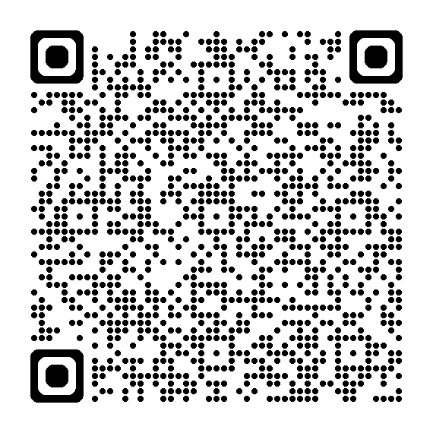
OHIO’S PLAN FOR
K-12 MATHEMATICS
education.ohio.gov/math

Slide 9
STRUCTURE OF OHIO’S PLAN
Why?
What?
How?
Section 1: Why a Comprehensive Mathematics Plan is Needed
Section 2: Ohio’s Mathematics Vision
Section 4: Strategies and Activities
Section 3: Ohio’s Theory of Action
Notes:
This session will connect best with Section 2: Ohio’s Mathematics Vision, which is outlined in Ohio’s Plan for K-12 Mathematics.

Slide 10
SECTION 2:
OHIO’S MATHEMATICS VISION
The Importance of Mathematics
A Shift Toward Rigor
Ohio’s Vision for Mathematics Instruction
Notes:
This section defines mathematics and sets the vision
Outlines that across the state, all students must have access to rigorous instruction that advances their growth and confidence in mathematics.
Section 2 sets the foundation and expectations for mathematics instruction, focusing grounded in the effective math teaching practices and student practices.

Slide 11
OHIO’S MATHEMATICS VISION
Ohio’s vision is to empower students with the confidence and ability to apply mathematical concepts, procedures, and reasoning, enabling students to thrive in a variety of contexts, life experiences, and career pathways.
Notes:
Improving mathematics outcomes for all Ohio students — across districts and grade levels and with special attention to those who are furthest behind — requires a thoughtful, multi-pronged strategy. Ohio’s Plan for K-12 Mathematics leverages multiple strands of activity and investment into a single, coherent theory of action. This theory builds upon existing math-related policies and initiatives in Ohio and proposes additional strategies to cultivate rigorous, high-quality mathematics instruction in every classroom and for all students. Ohio’s theory of action combines five interdependent strands of action. It is important to emphasize that these five strands of work are not sequential but should interact with and support one another in service of improved student learning.

Slide 12
THE IMPORTANCE OF MATHEMATICS
The Department defines mathematics as the human activity of reasoning and problem-solving with numbers, quantities, patterns, and shapes.
Notes:
The Department defines mathematics as the human activity of reasoning and problem-solving with numbers, quantities, patterns, and shapes.
Mathematics is a powerful tool for understanding the world, communication, critical thinking, and solving real-world problems. The Department recognizes that students’ mastery of mathematics ― as outlined in Ohio’s Learning Standards ― is an increasingly important factor in accessing a full range of career pathways and college options (including two-year, four-year, and technical programs). High school graduates who have a robust understanding of mathematics principles and concepts and who can apply those ideas to their work are in high demand by employers across a growing number of fields.
Mathematics is valuable in other aspects of life as well. Mathematics empowers users to understand and critique the world in all its facets (such as economic, ecological, social, political, historical, and more), make sense of the world around them, and participate as informed members of a democratic society. Mathematics is also a practical tool needed for many aspects of adult daily life, such as budgeting, scheduling time, and home repair. Lastly, mathematics, like other modes of creative expression, can be a way to experience joy, wonder, and beauty.

Slide 13
A SHIFT TOWARD RIGOR
Learning acceleration
Just-in-time interventions
Access
Notes:
It is not enough for some students to participate in a rigorous math curriculum. To ensure a full array of college and career opportunities for every graduate, all Ohio students must have opportunities to develop and advance their conceptual understanding, procedural skills and fluency, and application of mathematics. That requires a shared commitment to the following principles in all Ohio mathematics classrooms:
Learning acceleration: Every student accelerates their learning in math and has access to the proactive, evidence-based, and individualized support they need to succeed. All students must have the opportunity to engage in grade-level core instruction regardless of ability, which requires replacing remediation (the practice of teaching below grade-level content) with the just-in-time intervention that allows students to complete unfinished learning and access grade-level instruction (or above).
(Note: This term is not equivalent to grade-level or course acceleration, which occurs when advanced learners move ahead an entire grade level in one or more subject areas.)
Just-in-time intervention: Current learning data is used to identify gaps that would prevent students from accessing grade-level instruction, plan scaffolds to provide that access, and then remove those scaffolds as soon as they are no longer needed.
Access: Providing learning “access” means removing or accommodating any barriers that would prevent a student from successfully and equitably engaging with the grade-level curriculum. Ohio commits to providing equitable access to a grade-level (or above) curriculum for learners of all backgrounds and abilities.

Slide 14
OHIO’S VISION FOR MATHEMATICS INSTRUCTION
Recommended Instructional Focus
Standards for Mathematical Practice
Effective Mathematics Teaching Practices
Notes:
The Ohio Learning Standards for mathematics were updated based on a review process led by educators and the Department in 2017. The revised standards define what learners should know and be able to do and guide districts in modifying local curricula, instructional plans, and materials to ensure all students have access to coherent, rigorous, grade-level instruction.
Ohio’s mathematics vision builds on long-accepted research about how students learn mathematics and the instructional practices that cultivate rigor.
Outlined in Ohio’s Vision for Mathematics Instruction, is first and foremost, an alignment to the Standards. In the Math Plan, we identify the recommended instructional focus for Pre-K through High Schools. These major topics or themes are taken from the Ohio Learning Standards and have been around since 2011.
Next, we have encouragement to utilize a more student-centered focus to mathematics learning through the inclusion of the Standards for Mathematical Practice. These outline ways that students can show their understanding of mathematics in every grade level and course.
Last, we highlight the importance of using the evidence-based Effective Mathematics Teaching Practices from the National Council of Teachers of Mathematics or NCTM. These Teaching Practices identify what teachers can do in the delivery of high-quality instruction.

Slide 15

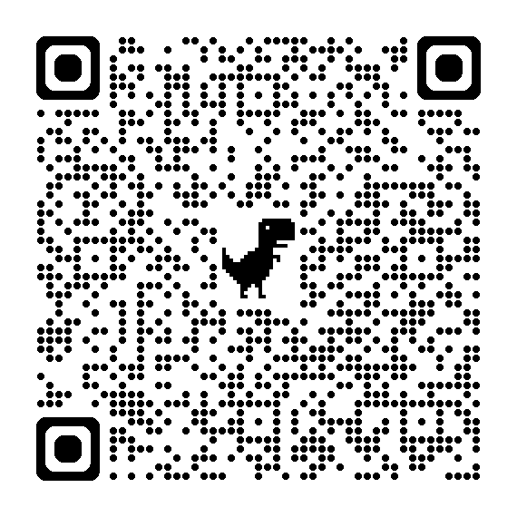
STANDARDS FOR MATHEMATICAL PRACTICE
MP 1: Make sense of problems and persevere in solving them.
MP 2: Reason abstractly and quantitatively. ​​
MP 3: Construct viable arguments and critique the reasoning of others.
MP 4: Model with mathematics.
MP 5: Use appropriate tools strategically.
MP 6: Attend to precision.
MP 7: Look for and make use of structure.
MP 8: Look for and express regularity in repeated reasoning.
Notes:
Links:
Standards for Mathematics Practice: https://education.ohio.gov/Topics/Learning-in-Ohio/Mathematics/Model-Curricula-in-Mathematics/Standards-for-Mathematical-Practice
The eight Standards for Mathematical Practice outlined in Ohio’s Learning Standards for Mathematics describe varieties of expertise that mathematics educators at all grade levels should seek to develop in their students.
These eight practices rest on important “processes and proficiencies” with longstanding importance in mathematics education. This includes the process standards of problem-solving, reasoning, communication, representation, and connections described by the National Council of Teachers of Mathematics and the five strands of mathematical proficiency described by the National Research Council.

Slide 16

MP 7: Look for and Make Use of Structure
Mathematically proficient students look closely to discern a pattern or structure. Young students, for example, might notice that three and seven more is the same amount as seven and three more, or they may sort a collection of shapes according to how many sides the shapes have. Later, students will see 7 × 8 equals the well-remembered
7 × 5 + 7 × 3, in preparation for learning about the distributive property. In the expression x² + 9x + 14, older students can see the 14 as 2 × 7 and the 9 as 2 + 7. They recognize the significance of an existing line in a geometric figure and can use the strategy of drawing an auxiliary line for solving problems. They also can step back for an overview and shift perspective. They can see complicated things, such as some algebraic expressions, as single objects or as being composed of several objects. For example, they can see 5 – 3(x – y) 2 as 5 minus a positive number times a square and use that to realize that its value cannot be more than 5 for any real numbers x and y.”

Slide 17
MP 7: Look for and Make Use of Structure
Mathematically proficient students look closely to discern a pattern or structure. Young students, for example, might notice that three and seven more is the same amount as seven and three more, or they may sort a collection of shapes according to how many sides the shapes have. Later, students will see 7 × 8 equals the well-remembered 7 × 5 + 7 × 3, in preparation for learning about the distributive property. In the expression x² + 9x + 14, older students can see the 14 as 2 × 7 and the 9 as 2 + 7. They recognize the significance of an existing line in a geometric figure and can use the strategy of drawing an auxiliary line for solving problems. They also can step back for an overview and shift perspective. They can see complicated things, such as some algebraic expressions, as single objects or as being composed of several objects. For example, they can see 5 – 3(x – y) 2 as 5 minus a positive number times a square and use that to realize that its value cannot be more than 5 for any real numbers x and y.”

Slide 18
Why Structure?
Mathematics has structure
The number system has a structure
Logic has structure
Algebra notation has structure
Geometry has structure

Slide 19
MP 7: Look for and make use of structure.
Look for connections between the conceptual and abstract levels
Create and use representations to organize, record, and communicate math ideas
Make ideas available for deeper reflection and allow for explicit connections
Demonstrate flexibility with numbers
Understand or recognize patterns and functions
Notes:
MP 7 emphasizes the importance of structure. Structure is a common root of patterns and generalizations. In this MP, we look for connections between the conceptual and abstract levels.This type of recognition helps students discover new math knowledge. Being able to “see structure” often means stepping back or shifting perspective. Students can demonstrate an understanding of MP 7 by creating and using representations to organize, record, and communicate math ideas. Demonstrating an understanding of structure helps make ideas available for deeper reflection and allows for explicit connections back to the math. Evidence of MP 7 can be see whenever students demonstrate a flexibility with numbers, and when they understand or recognize patterns and functions.

Slide 20
MP 7: Avenues of thinking
Students | Teachers
What type of problem is it? | What observations do you make about..?
Does it remind me of another problem situation? | What ideas have you learned before that were useful in solving this problem?
How is this (situation, process, etc.) behaving? | What pattern do you find in…?
Can I connect it to something I know? | What are some other problems that are like this one?
What are the parts (chunks) of the process? | What are the parts you can chunk the problem into?
How can I get the answer without doing all calculations? | What parts of the problem might you eliminate or simplify?
How can I use properties to uncovers structure? | What do you notice when…?
How can I connect a different representations? | How are there representations alike or different?
How can I change the form of (number, etc.) to surface the underlying structure? | What properties does it relate to?
Notes:
This slide presents a series of starter questions that teachers can use to help students develop their ability to identify and utilize structure. A theme that cuts across all these questions is that they do not prescribe a strategy to a student, nor do they dictate thinking. Instead, they allow for student discussions and further engagement in sense-making.

Slide 21

MP 7 and MP.8

Slide 22
MP 7 vs. MP 8
MP 7 | MP 8
Focuses on structure in a mathematical object Makes a shift to a big picture or a complex construction Finds a relationship between parts of mathematical situation and simplifies them, if necessary. Reduces the complexity of the expressions Transforms a structure of the model to reveal its phenomena Connects concepts and representations | Recognizes similarity within numbers, objects, operations, problems Helps finding entry point to an unfamiliar situation Focuses on reasoning, not on object Builds mathematics model by abstracting from the concrete examples
Notes:
Here is a comparison of MP 8 and MP7.
Take a couple moments to study this slide.
Focus on Structure vs. Reasoning:
MP 7: Look for and Make Use of Structure focuses on identifying and utilizing patterns and structures within mathematical objects. It encourages students to see the relationships between parts of a mathematical situation and simplify them if necessary1.
MP 8: Look for and Express Regularity in Repeated Reasoning emphasizes reasoning and the ability to see the big picture or a complex construction. It involves recognizing patterns in repeated calculations and using these patterns to make generalizations1.
Simplification vs. Complexity Reduction:
MP 7 involves finding relationships within mathematical situations and simplifying them. For example, students might recognize that an algebraic expression can be factored to reveal a simpler form1.
MP 8 focuses on reducing the complexity of expressions by connecting concepts and representations. It helps students find entry points to unfamiliar situations by building mathematical models from concrete examples1.
Transforming Structures vs. Building Models:
MP 7 is about transforming the structure of a model to reveal its phenomena. Students might recognize the significance of an existing line in a geometric figure and use it to solve problems1.
MP 8 involves building mathematical models by abstracting from concrete examples. It helps students connect different representations and see the underlying structure of mathematical concepts1.
Recognizing Similarity vs. Connecting Representations:
MP 7 encourages students to recognize similarity within numbers, objects, operations, and problems. This helps them see complicated things as collections of single objects or as being composed of several objects1.
MP 8 focuses on connecting concepts and representations. It helps students build a deeper understanding by seeing how different mathematical ideas are related

Slide 23
Discussion

Slide 24
Kindergarten-Grade 5 Task
How many ways can you find to solve the expression 48 × 5?
Discuss:
Common ways you found to solve the expression 48 × 5.
Identify different ways you found to solve the expression 48 × 5.
Which methods are your students likely to produce?
Which methods are your students unlikely to produce? Why?

Slide 25
Grades 6-8 Task
Five connected equilateral triangles are shown.
If there were a row of 50 connected equilateral triangles, what would the perimeter be?
Share how you determined the perimeter.
Which methods are your students likely to use as they come up with their answers?
Which methods are your students unlikely to come up with? Why?
Task taken from Putting The Practices Into Action: Implementing The Common Core Standards For Mathematical Practice by O'Connell, S., & SanGiovanni, J. (2013).

Slide 26

Grades 9-12 Task
Consider two algebraic expressions
(n + 2)² – 4 and n² + 4n. Use the figures to illustrate why the expressions are equivalent. Verify this result algebraically.
Share how you illustrated the equivalence of the two expressions and how you verified the results.
Which methods are your students likely to use as they come up with their answers?
Which methods are your students unlikely to come up with? Why?

Slide 27
discussion Debrief

Slide 28
discussion debrief
1
Where in the Breakout Room tasks did you observe opportunities for students to:
Look for connections between the conceptual and abstract levels
Create and use representations to organize, record, and communicate math ideas
Make ideas available for deeper reflection and allow for explicit connections
Demonstrate flexibility with numbers
Understand or recognize patterns and functions

Slide 29
MP. 7 Look for and Make Use of Structure Progressions

Slide 30
Discussion

Slide 31
Discussion
2
Task: Review the MP 7 in the progression documents.
Discussion question #1: What do you think Math Practice 7: Look for and Make Use of Structure means or looks like at your grade level/course?
Discussion question #2: How does your school or district support students’ progression of the usage of structure across grade levels and/or courses?

Slide 32
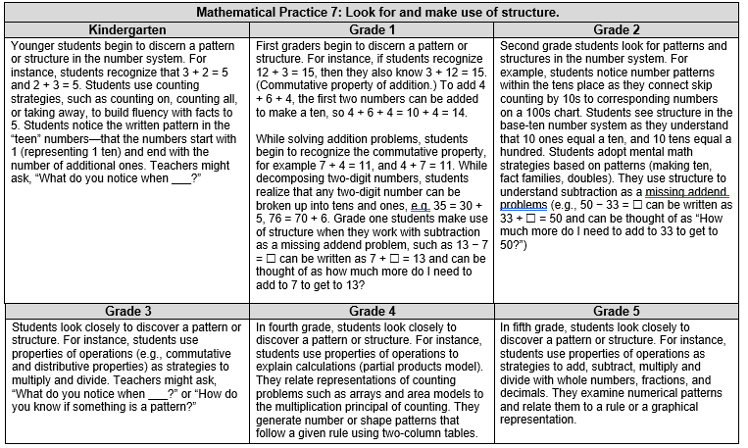
Mathematical practice 7: look for and make use of structure.

Slide 33
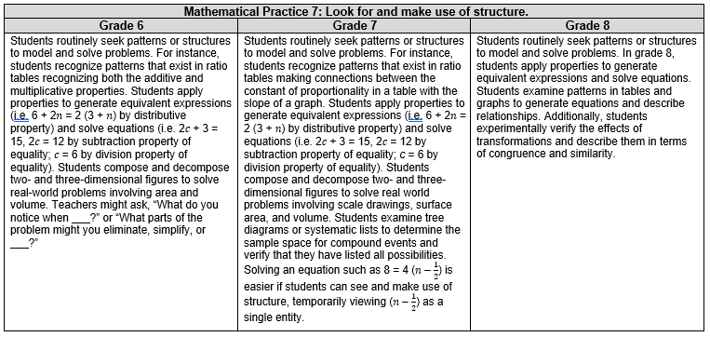
MP 7 look for and make use of structure.

Slide 34
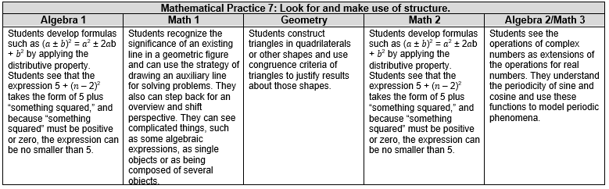
MP 7 look for and make use of structure Algebra 1-2

Slide 35
Discussion Debrief
Discussion Debrief Question #1: What do you think Math Practice 7: Look for and Make Use Of Structure means or looks like at your grade level/course?
Discussion Debrief Question #2: How does your school or district support students’ progression with their usage of structure across grade levels and/or courses?

Slide 36
Resources

Slide 37
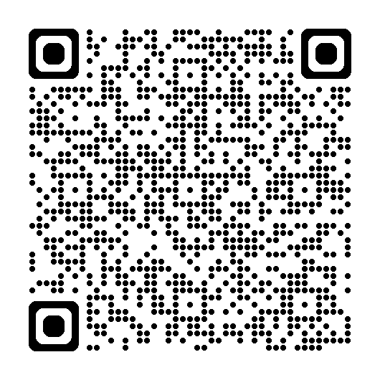
NCTM “Look Fors”
Seeing structure and generalizing | 7. Look for and make use of structure | Look for patterns or structure, recognizing that quantities can be represented in different ways Recognize the significance in concepts and models and use the patters or structure for solving related problems View complicated quantities both as single object or compositions of several objects and use operations to make sense of problems Comments: | Engage students in discussions emphasizing relationships between particular topics within a content domain or across content domains Recognize that they quantitative relationships modeled by operations and their properties remain important regardless of operational focus of a lesson Provide activities in which students demonstrate their flexibility in representing mathematics in a number of ways, e.g., 76=(7x10)+6; discussing types of quadrilaterals, etc. Comments:
 | 8. Look for and express regularity in repeated reasoning | Notice repeated calculations and look for general methods and shortcuts Continually evaluate the reasonableness of intermediate results (comparing estimates), while attending to details, and make generalizations based on findings Comments: | Engage students in discussion related to repeated reasoning that may occur in a problem’s solution Draw attention to the prerequisite steps necessary to consider when solving a problem Urge students to continually evaluate the reasonableness of their results Comments:
Notes:
The next couple slides show rubrics that students and teachers can use to access their ability to use MP 7.
This one is an NCTM rubric for Students and Teachers.
https://www.google.com/search?q=nctm+math+practice+look+fors&rlz=1C1GCEU_enUS820US820&oq=NCTM+math&aqs=chrome.1.69i57j35i39j0i20i263j0l2j69i60l3.3630j0j4&sourceid=chrome&ie=UTF-8

Slide 38
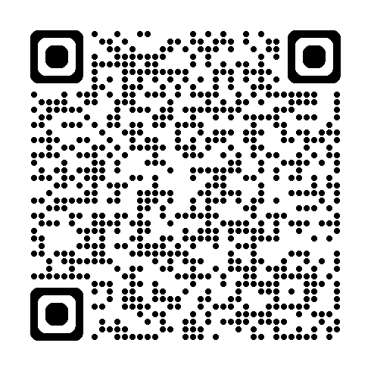
Implementing Standards for MP 7
Practice | Needs Improvement | Emerging (teacher does thinking) | Proficient (teacher mostly models) | Exemplary (students take ownership)
Look for and make use of structure. | Task: Requires students to automatically apply an algorithm to a task without evaluating its appropriateness. Teacher: Does note recognize students for developing efficient approaches to the task. Requires students to apply the same algorithm to a task although there may be other approaches. | Task: Requires students to analyze a task before automatically applying an algorithm. Teacher: Identifies individual students’ efficient approaches but does not expand understanding to the rest of the class. Demonstrates the same algorithm to all related tasks although there may be other more effective approaches. | Task: Requires students to analyze a task and identify more than one approach to the problem. Teacher: Facilitates all students in developing reasonable and efficient ways to accurately perform basic operations. Continuously questions students about the reasonableness of their intermediate results. | Task: Requires students to identify the most efficient solution to the task. Teacher: Prompts students to identify mathematical structure of the task in order to identify the most effective solution path. Encourages students to justify their choice of algorithm or solution path.

Slide 39
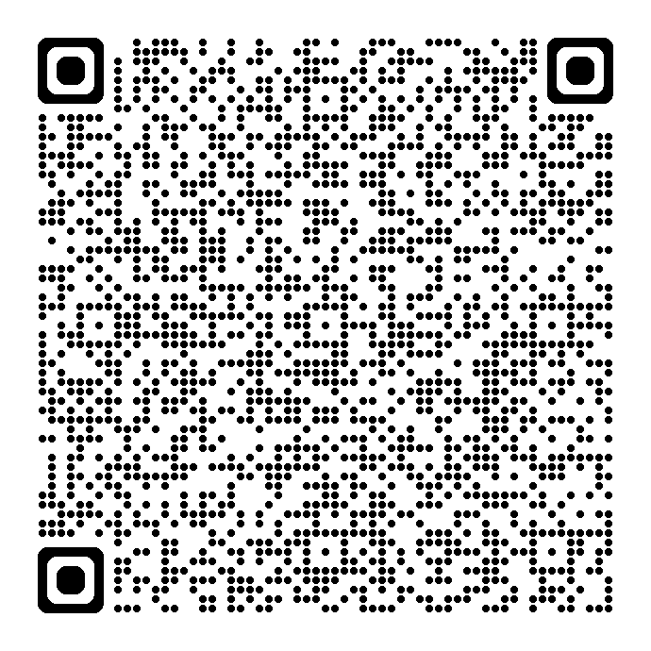
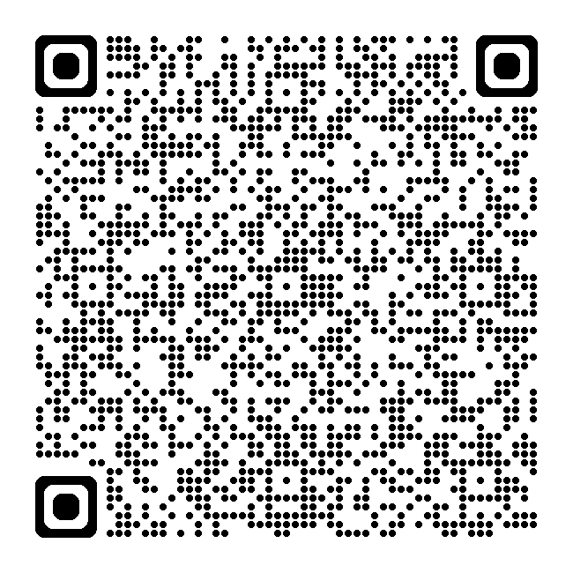
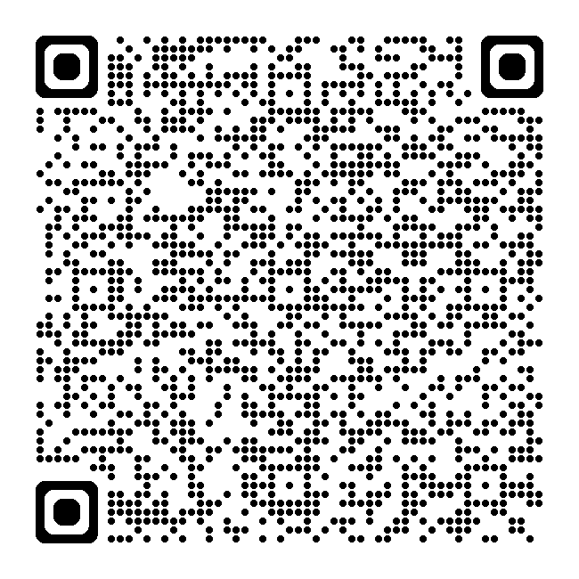
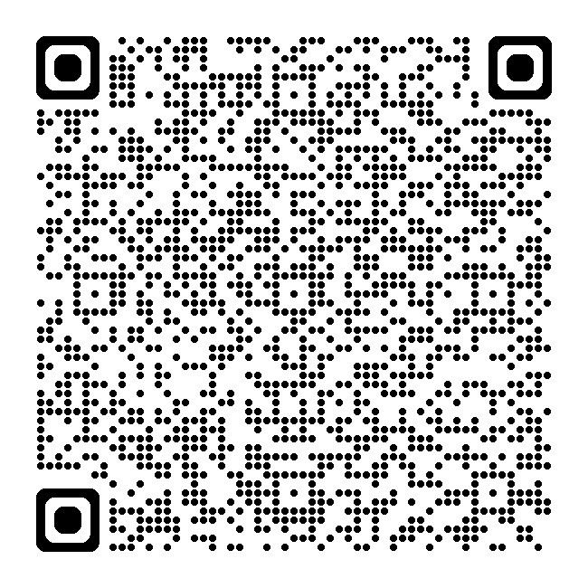
RESOURCE LINKS
Standards for Mathematical Practice
Kindergarten - Grade 5
Grades 6-8
High School
Notes:
Standards for MP: https://education.ohio.gov/getattachment/Topics/Learning-in-Ohio/Mathematics/Model-Curricula-in-Mathematics/Standards-for-Mathematical-Practice/Standards-for-Mathematical-Practice.pdf.aspx

Slide 40
Rubric
MP | Needs Improvement | Emerging | Proficient | Exemplary
MP 7 Look for and Make Use of Structure. | Applies an algorithm or method without evaluating their choice; has difficulty using an efficient or appropriate approach. | Uses only one appropriate method or algorithm for a problem even though there may be more efficient approaches. | Analyzes a task and finds more than one method or algorithm to a problem; takes efficiency into consideration. | Uses the most efficient method, algorithm, or solution path for a task based on mathematical structure.
 | Has difficulty articulating why they chose an algorithm or solution path. | Analyzes a task before automatically applying an algorithm or solution path; explains why they choose an algorithm or solution path. | Analyzes a task before automatically applying an algorithm or solution path; articulates and justifies their choice of algorithm or solution path. | Analyzes the task before automatically applying an algorithm or solution path; articulates and justifies choice of algorithm or solution path, defends their choice, and questions others’ choices.
 | Has difficulty recognizing that quantities can be represented in different ways. | Looks for patterns or structures, recognizing that quantities can be represented in different ways; recognizes equivalent forms, but may not be able to choose the best form to use. | Recognizes the significance in concepts and models and use the patterns or structure within a problem to solve related problems; changes structure(s) to an appropriate equivalent form(s) to solve a problem; interprets, models, and connects multiple representations. | Steps back and shifts perspectives based on a problem’s structure; identifies similarities between different mathematical forms and uses patterns from known situations to solve nonroutine problems; chooses an equivalent structure based on efficiency or its power to communicate solution.
 | Struggles or forgets to analyze the reasonableness of intermediate results. | Recognizes when intermediate results do not make sense. | Analyzes reasonableness of intermediate results and if results don’t make sense, determines why they don’t. | Analyzes reasonableness of intermediate results and changes course to a more effective or efficient process.
 | Has difficulty viewing simple quantities both as single objects and as composition of several objects. | Views simple quantities both as single objects or as a composition of several objects and uses operations to make sense of a problem. | View complicated quantities both as single objects or composition(s) of several objects and uses operations to make sense of a problem. | Views and analyses complicated quantities both as single objects or composition(s) of several objects and uses operations flexibly to make sense of a problem.
Notes:
Another teachers’ rubric to evaluate students’ ability to use SMP 7. This rubric can be edited to become the tool for the students to assess their MP 7 skills.

Slide 41
References
Boston, M., Dillon, F., Smith, M., & Miller, S. (2017). Taking Action Implementing Effective Mathematics Teaching Practices, Grades 9-12. Reston, VA: The National Council of Teachers of Mathematics
Graham, K., Cuoco, A., & Zimmermann, G., (2010). Focus on High School Mathematics: Reasoning and Sense Making. Reston, VA: The National Council of Teachers of Mathematics
Illustrative Mathematics. (2014, May 6). Standards for Mathematical Practice: Commentary and Elaborations for 6–8. Tucson, AZ.
Koestler, C., Felton-Koestler, M. D., Bieda, K., & Otten, S. (2013). Connecting the NCTM process standards and the CCSSM practices. Reston, VA: The National Council of Teachers of Mathematics.
O'Connell, S., & SanGiovanni, J. (2013). Putting the practices into action: Implementing the common core standards for mathematical practice, K-8. Portsmouth, NH: Heinemann.

Slide 42
Resource Links
Ohio Department of Education Documents
Standards for Mathematical Practice
Kindergarten - Grade 5
Grades 6-8
High School
University of Arizona Progressions
Standards for Mathematical Practice: Commentary and Elaborations for K-5
Standards for Mathematical Practice: Commentary and Elaborations for 6-8
Other National Resources
Inside Mathematics
Illustrative Mathematics
Robert Kaplinsky: Math CCSS Math Practices Readable

Slide 43
Other National Resource Links
Implementing Standards for Mathematical Practices from Louisiana Believes
Implementing the Mathematical Practice Standards
Math Argumentation Rubric (Draft)
Mathematical Practice Standards by Charles A. Dana Center
Ohio Learning Standards
Standards for Mathematical Practice Rubric
The Power of Making Mistakes in Learning Math”
What Isn’t Mathematical Modeling?

Slide 44
Mathematics Questions?
Email
Mathematics@education.ohio.gov

Slide 45
questions

Slide 46
DEW

