Slide 1
Ohio Department of Education and Workforce

Slide 2

MATH PRACTICE 8: LOOK FOR AND EXPRESS REGULARITY IN REPEATED REASONING

Slide 3
WELCOME

Slide 4
OHIO DEPARTMENT OF EDUCATION AND WORKFORCE PRIORITIES
Literacy
Learning Acceleration
Workforce Readiness
Student Wellness
Notes:
The math plan looks to connect. To department priorities in the following areas:
Literacy Achievement: Building a foundation for lifelong success by ensuring every student is reading at or above grade level.
Learning Acceleration: Empowering each learner to reach their full potential through individualized, evidence-based support.
Student Wellness: Fostering safe and supportive environments that engage students and enable them to thrive.
Workforce Readiness: Preparing students for the future fully equipped with the skills needed to take the next steps in their career journeys.
Our strongest connection to the Department’s priorities is around learning acceleration. In mathematics, we want every student to be able to accelerate their learning. This means they can access the proactive, research-. And evidence-based, and individualized support they need to succeed. To achieve this priority, all students must have the opportunity to engage in grade-level core instruction regardless of ability, which requires replacing remediation (the practice of teaching below grade-level content) with the just-in-time intervention that allows students to complete unfinished learning and access grade-level instruction (or above).

Slide 5
SESSION NORMS
Listen
Listen with the intent to understand. Ask questions!
Focus
Focus on how this applies to your daily work.
Imagine the possibilities!
Create
Create a safe place to air confusion and raise questions.
Support
Support ideas with evidence. Bring your vast experience to the table. Support participation of all.
Notes:
Welcome everyone. We want to take a moment to ground us in our Session Norms.
We want to Listen with the intent to understand. Ask question!
We want to Focus on how this applies to your daily work. Imagine the possibilities!
We want to Create a safe place to air confusion and raise questions.
We went to Support ideas with evidence. Bring your vast experience to the table. Encourage everyone’s participation. Part of Supporting others is to make sure we are providing space for all in group to share. In addition, we have noticed a few participants have invited an AI presence to curate notes for them during the session. While we appreciate the use of productivity tools, unfortunately, MS TEAMS does not know how to deal with these “non-human” participants and this is affecting breakout rooms, so going forward, we will not be admitting AI participants into our community meetings each month. If there are questions or concerns, please contact one of the Dept team on this session. Thank you!

Slide 6
PURPOSE:
Connect
Ohio’s Mathematics Vision from Ohio’s Plan for K-12 Mathematics to the Mathematical Practices.
Explore
MP 8: Look for and Express Regularity in Repeated Reasoning through grade band-aligned instructional tasks.
Identify
Resources to support instruction aligned to Math Practice 8: Look for and Express Regularity in Repeated Reasoning.
Utilize
Resources to help recognize and collect evidence of MP 8: Look for and Express Regularity in Repeated Reasoning in the classroom.

Slide 7
AGENDA
What: | Why: | How:
Welcome and Introductions 5-10 minutes | To establish the session norms and outline the focus of the session | Facilitator presentation
Ohio’s Plan for K-12 Mathematics 5 minutes | To learn about Ohio’s Vision for Mathematics as outlined in Ohio’s Plan for K-12 Mathematics | Facilitator presentation
Resource Exploration and Discussions 45-60 minutes | Explore various Ohio resources aligned to MP 8: Look for and Express Regularity in Repeated Reasoning and identify connections to Ohio’s Mathematics Vision. | Breakout Rooms and Whole Group Discussion
Closing 5 minutes | Address lingering questions and provide session feedback | Department contact information

Slide 8
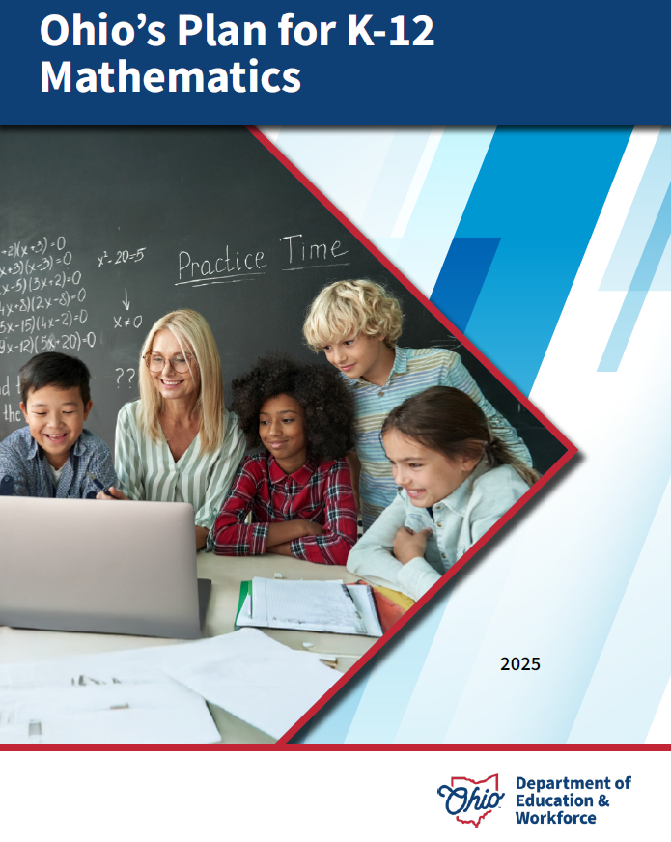
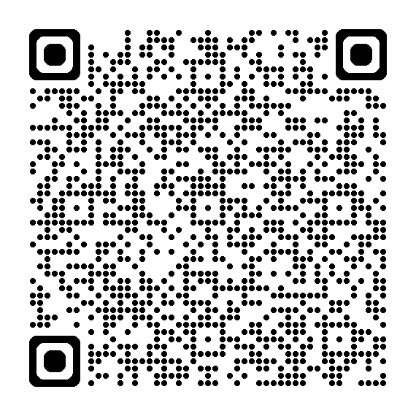
OHIO’S PLAN FOR
K-12 MATHEMATICS
education.ohio.gov/math

Slide 9
STRUCTURE OF OHIO’S PLAN
Why?
What?
How?
Section 1: Why a Comprehensive Mathematics Plan is Needed
Section 2: Ohio’s Mathematics Vision
Section 4: Strategies and Activities
Section 3: Ohio’s Theory of Action
Notes:
This session will connect best with Section 2: Ohio’s Mathematics Vision, which is outlined in Ohio’s Plan for K-12 Mathematics.

Slide 10
SECTION 2:
OHIO’S MATHEMATICS VISION
The Importance of Mathematics
A Shift Toward Rigor
Ohio’s Vision for Mathematics Instruction
Notes:
This section defines mathematics and sets the vision
Outlines that across the state, all students must have access to rigorous instruction that advances their growth and confidence in mathematics.
Section 2 sets the foundation and expectations for mathematics instruction, focusing grounded in the effective math teaching practices and student practices.

Slide 11
OHIO’S MATHEMATICS VISION
Ohio’s vision is to empower students with the confidence and ability to apply mathematical concepts, procedures, and reasoning, enabling students to thrive in a variety of contexts, life experiences, and career pathways.
Notes:
Improving mathematics outcomes for all Ohio students — across districts and grade levels and with special attention to those who are furthest behind — requires a thoughtful, multi-pronged strategy. Ohio’s Plan for K-12 Mathematics leverages multiple strands of activity and investment into a single, coherent theory of action. This theory builds upon existing math-related policies and initiatives in Ohio and proposes additional strategies to cultivate rigorous, high-quality mathematics instruction in every classroom and for all students. Ohio’s theory of action combines five interdependent strands of action. It is important to emphasize that these five strands of work are not sequential but should interact with and support one another in service of improved student learning.

Slide 12
THE IMPORTANCE OF MATHEMATICS
The Department defines mathematics as the human activity of reasoning and problem-solving with numbers, quantities, patterns, and shapes.
Notes:
The Department defines mathematics as the human activity of reasoning and problem-solving with numbers, quantities, patterns, and shapes.
Mathematics is a powerful tool for understanding the world, communication, critical thinking, and solving real-world problems. The Department recognizes that students’ mastery of mathematics ― as outlined in Ohio’s Learning Standards ― is an increasingly important factor in accessing a full range of career pathways and college options (including two-year, four-year, and technical programs). High school graduates who have a robust understanding of mathematics principles and concepts and who can apply those ideas to their work are in high demand by employers across a growing number of fields.
Mathematics is valuable in other aspects of life as well. Mathematics empowers users to understand and critique the world in all its facets (such as economic, ecological, social, political, historical, and more), make sense of the world around them, and participate as informed members of a democratic society. Mathematics is also a practical tool needed for many aspects of adult daily life, such as budgeting, scheduling time, and home repair. Lastly, mathematics, like other modes of creative expression, can be a way to experience joy, wonder, and beauty.

Slide 13
A SHIFT TOWARD RIGOR
Learning acceleration
Just-in-time interventions
Access
Notes:
It is not enough for some students to participate in a rigorous math curriculum. To ensure a full array of college and career opportunities for every graduate, all Ohio students must have opportunities to develop and advance their conceptual understanding, procedural skills and fluency, and application of mathematics. That requires a shared commitment to the following principles in all Ohio mathematics classrooms:
Learning acceleration: Every student accelerates their learning in math and has access to the proactive, evidence-based, and individualized support they need to succeed. All students must have the opportunity to engage in grade-level core instruction regardless of ability, which requires replacing remediation (the practice of teaching below grade-level content) with the just-in-time intervention that allows students to complete unfinished learning and access grade-level instruction (or above).
(Note: This term is not equivalent to grade-level or course acceleration, which occurs when advanced learners move ahead an entire grade level in one or more subject areas.)
Just-in-time intervention: Current learning data is used to identify gaps that would prevent students from accessing grade-level instruction, plan scaffolds to provide that access, and then remove those scaffolds as soon as they are no longer needed.
Access: Providing learning “access” means removing or accommodating any barriers that would prevent a student from successfully and equitably engaging with the grade-level curriculum. Ohio commits to providing equitable access to a grade-level (or above) curriculum for learners of all backgrounds and abilities.

Slide 14
OHIO’S VISION FOR MATHEMATICS INSTRUCTION
Recommended Instructional Focus
Standards for Mathematical Practice
Effective Mathematics Teaching Practices
Notes:
The Ohio Learning Standards for mathematics were updated based on a review process led by educators and the Department in 2017. The revised standards define what learners should know and be able to do and guide districts in modifying local curricula, instructional plans, and materials to ensure all students have access to coherent, rigorous, grade-level instruction.
Ohio’s mathematics vision builds on long-accepted research about how students learn mathematics and the instructional practices that cultivate rigor.
Outlined in Ohio’s Vision for Mathematics Instruction, is first and foremost, an alignment to the Standards. In the Math Plan, we identify the recommended instructional focus for Pre-K through High Schools. These major topics or themes are taken from the Ohio Learning Standards and have been around since 2011.
Next, we have encouragement to utilize a more student-centered focus to mathematics learning through the inclusion of the Standards for Mathematical Practice. These outline ways that students can show their understanding of mathematics in every grade level and course.
Last, we highlight the importance of using the evidence-based Effective Mathematics Teaching Practices from the National Council of Teachers of Mathematics or NCTM. These Teaching Practices identify what teachers can do in the delivery of high-quality instruction.

Slide 15

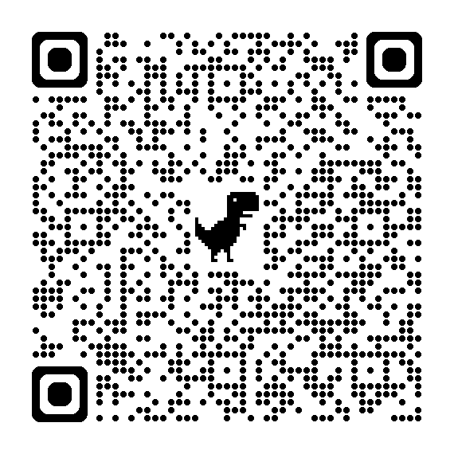
STANDARDS FOR MATHEMATICAL PRACTICE
MP 1: Make sense of problems and persevere in solving them.
MP 2: Reason abstractly and quantitatively. ​​
MP 3: Construct viable arguments and critique the reasoning of others.
MP 4: Model with mathematics.
MP 5: Use appropriate tools strategically.
MP 6: Attend to precision.
MP 7: Look for and make use of structure.
MP 8: Look for and express regularity in repeated reasoning.
Notes:
Links:
Standards for Mathematics Practice: https://education.ohio.gov/Topics/Learning-in-Ohio/Mathematics/Model-Curricula-in-Mathematics/Standards-for-Mathematical-Practice
The eight Standards for Mathematical Practice outlined in Ohio’s Learning Standards for Mathematics describe varieties of expertise that mathematics educators at all grade levels should seek to develop in their students.
These eight practices rest on important “processes and proficiencies” with longstanding importance in mathematics education. This includes the process standards of problem-solving, reasoning, communication, representation, and connections described by the National Council of Teachers of Mathematics and the five strands of mathematical proficiency described by the National Research Council.

Slide 16
What comes to your mind when you think about MP 8: Look for and Express Regularity in Repeated Reasoning?
Notes:
At this time of this session, please use chat feature to write what comes to your mind when you think about Looking for and Expressing Regularity in Repeated Reasoning.

Slide 17
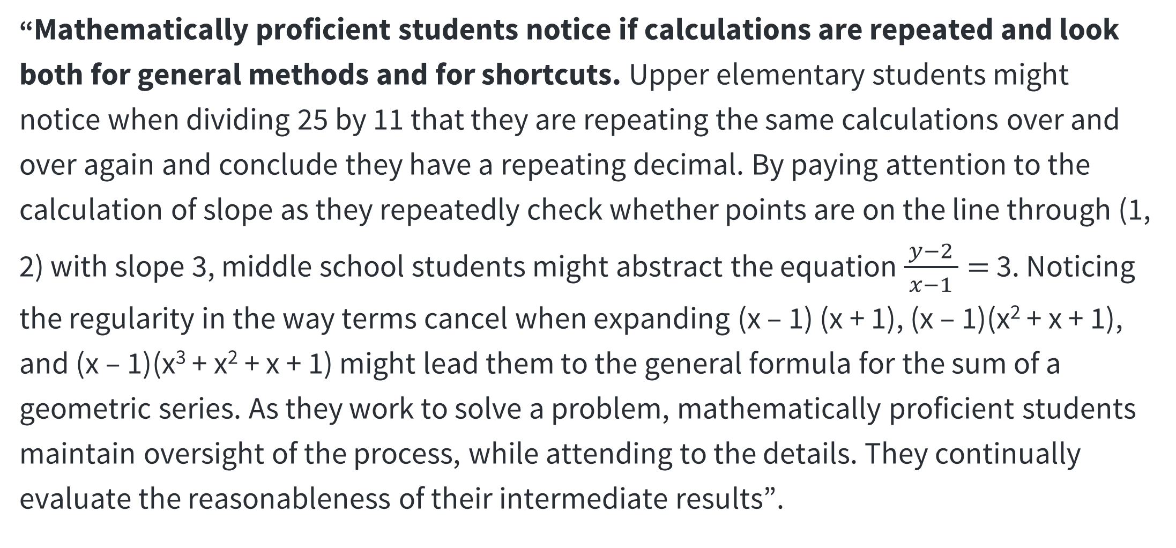
LOOK FOR AND EXPRESS REGULARITY IN REPEATED REASONING
“Mathematically proficient students notice if calculations are repeated and look both for general methods and for shortcuts. Upper elementary students might notice when dividing 25 by 11 that they are repeating the same calculations over and over again and conclude they have a repeating decimal. By paying attention to the calculation of slope as they repeatedly check whether points are on the line through (1, 2) with slope 3, middle school students might abstract the equation $\frac{y−2}{ x−1 }=$ 3. Noticing the regularity in the way terms cancel when expanding (x – 1) (x + 1), (x – 1)(x² + x + 1), and (x – 1)(x³ + x² + x + 1) might lead them to the general formula for the sum of a geometric series. As they work to solve a problem, mathematically proficient students maintain oversight of the process, while attending to the details. They continually evaluate the reasonableness of their intermediate results”.
Notes:
You can see the exact wording of Math Practice 8.

Slide 18
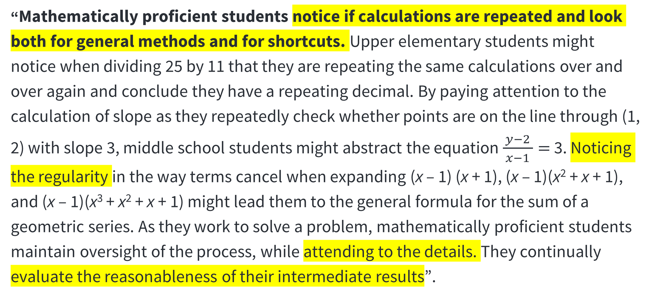
LOOK FOR AND EXPRESS REGULARITY IN REPEATED REASONING CONT’D
“Mathematically proficient students notice if calculations are repeated and look both for general methods and for shortcuts. Upper elementary students might notice when dividing 25 by 11 that they are repeating the same calculations over and over again and conclude they have a repeating decimal. By paying attention to the calculation of slope as they repeatedly check whether points are on the line through (1, 2) with slope 3, middle school students might abstract the equation $\frac{y−2}{ x−1 }=$ 3. Noticing the regularity in the way terms cancel when expanding (x – 1) (x + 1), (x – 1)(x² + x + 1), and (x – 1)(x³ + x² + x + 1) might lead them to the general formula for the sum of a geometric series. As they work to solve a problem, mathematically proficient students maintain oversight of the process, while attending to the details. They continually evaluate the reasonableness of their intermediate results”.
Notes:
In mathematics, it is easy to forget the big picture while working on the details of the problem. For students to understand how a problem can be applied to other problems, they should work on repeating and applying their mathematical reasoning to various situations and problems. If a student can solve one problem the way it was taught, it is important that they can also apply that problem-solving technique to other problems.
When students identify strategies for problem solving, they can use many different skills to determine the answer. For example, they can identify similar patterns to solve problems that are out of their learning comfort zone.

Slide 19
WHY MP 8?
Provides basis for learning math logic
Forms a sense of order
Allows for making educated guesses
Reduces math anxiety
Aids in developing mental math skills
Builds mathematical relationships
Offers insight into the natural world
Notes:
Understanding of patterns and rules:
You can not gain the benefit of patterns if you can not see them, and you can only see them if you understand them. With understanding patterns – and other forms of math – sometimes you need to stick with it for the long term. This is because a major component of solving algebra problems involves data analysis, which is deeply related to the understanding of patterns. Without being able to recognize the appearance of patterns, the ability to be proficient in algebra will be limited
Also, a stress reducer
Much science is based on making a hypothesis, and hypotheses are often based on understanding patterns. Similarly, we make many common assumptions based on recurring patterns.
To recognize patterns, one needs to understand critical thinking and logic, and these are important skills to develop.
For example, relationship patterns found in multiplication, such as the commutative property
While animals and certainly plants are far from thinking beings, they do have certain habits that exist in patterns, and understanding these behavioral patterns provides a clearer understanding of all living things.

Slide 20

MP 8 is about …
Making Connections
Generalizing
Exclusions
Coherence
Repeated Reasoning
Operations
Identifying Shortcuts
Relevance
Notes:
Discovering connection and irrelevance
Discovering coherence and inconsistency
Discovering regularity and exclusions
Discovering generalizations and shortcuts
Discovering similarity and dissimilarity of methods
Applies knowledge fluidly and creatively
Adapts previously mastered definitions and techniques
Reasons by analogy on similar problems
Uses known approaches in novel situations
Go beyond dependency on basic skills
Avoid route memorization
Apply ways of thinking with repeated practice over time
Produce strategies

Slide 21
MP 8: AVENUE OF THINKING
Students | Teachers
Is there a number pattern? | Will the same strategy work in other situations?
Are there a repeated calculations? | How would you prove that…?
Are there more efficient computations strategies using number patterns | How do you notice about…?
Is there a shortcut or the general method? | What is happening in this situation?
Do I consider all the details while focusing on the overall process? | What would happen if…?
Do I continually evaluate the reasonableness of my intermediate results? | Is there a mathematics rule for…?
 | What predictions or generations can this pattern support?
 | What mathematical consistencies do you notice?
Notes:
This slide presents a series of starter questions that teachers can use to help students develop their ability to express repeated reasoning. A theme that cuts across all these questions is that they do not prescribe a strategy to a student, nor do they dictate thinking. Instead, they allow for student discussions and further engagement in sense-making.

Slide 22

MP.7 and MP.8

Slide 23
MP 7 vs. MP 8
MP 7 | MP 8
Focuses on structure in a mathematical object Makes a shift to a big picture or a complex construction Finds a relationship between parts of mathematical situation and simplifies them, if necessary. Reduces the complexity of the expressions Transforms a structure of the model to reveal its phenomena Connects concepts and representations | Recognizes similarity within numbers, objects, operations, and problems Helps find an entry point to an unfamiliar situation Focuses on reasoning, not on object Builds mathematics by abstracting from the concrete examples
Notes:
This is a comparison of two practices that are often used together but they are distinct.

Slide 24
DISCUSSION

Slide 25
KINDERGARTEN-GRADE 2 TASKS
What is the same about the four problems below? What is different?
(A) A student has 7 pieces of candy. He gives 3 pieces to a friend. How many pieces do he still have for himself? | (B) A person with $12 buys an item for $8. How much money does the person have left?
(C) Packet A contains 9 pieces of candy. Packet B contains 5 pieces of candy. How many more pieces does A have than B? | (D) If one job pays $11 and another pays $7, how much more does the first job pay than the second?
Task taken from Connecting the NCTM Process Standards & CCSSM Practices

Slide 26


GRADES 3-5 TASKS
Use mental math to solve the two Number Talk tasks.
Number Talk Task #1
1 ÷ $\frac{1}{2}$
1 ÷ $\frac{1}{3}$
1 ÷ $\frac{1}{4}$
1 ÷ $\frac{1}{5}$
1 ÷ $\frac{1}{6}$
Number Talk Task #2
2 ÷ $\frac{1}{2}$
2 ÷ $\frac{1}{3}$
2 ÷ $\frac{1}{4}$
2 ÷ $\frac{1}{5}$
2 ÷ $\frac{1}{6}$
Discuss your mental math problem-solving strategies for both Number Talk Tasks with colleagues afterward.
Task taken from Implementing the Common Core State Standards through Mathematical Problem Solving by Theresa J. Gurl, Alice F. Artzt, and Alan Sultan.
Notes:
Number Talk Task #1 Answers:
1 ÷ $\frac{1}{2}$ = 2
1 ÷ $\frac{1}{3}$ = 3
1 ÷ $\frac{1}{4}$ = 4
1 ÷ $\frac{1}{5}$ = 5
1 ÷ $\frac{1}{6}$ = 6
Number Talk Task #2 Answers:
2 ÷ $\frac{1}{2}$ = 4
2 ÷ $\frac{1}{3}$ = 6
2 ÷ $\frac{1}{4}$ = 8
2 ÷ $\frac{1}{5}$ = 10
2 ÷ $\frac{1}{6}$ = 12

Slide 27


GRADES 6-8 TASKS
Use mental math to solve the two Number Talk tasks.
Number Talk Task #1
1 ÷ $\frac{1}{2}$
1 ÷ $\frac{2}{3}$
1 ÷ $\frac{3}{4}$
1 ÷ $\frac{4}{5}$
1 ÷ $\frac{5}{6}$
Number Talk Task #2
2 ÷ $\frac{1}{2}$
2 ÷ $\frac{2}{3}$
2 ÷ $\frac{3}{4}$
2 ÷ $\frac{4}{5}$
2 ÷ $\frac{5}{6}$
Discuss your mental math problem-solving strategies for both Number Talk Tasks with colleagues afterward.
Task taken from Implementing the Common Core State Standards through Mathematical Problem Solving by Theresa J. Gurl, Alice F. Artzt, and Alan Sultan.
Notes:
Number Talk Task #1 Answers:
1 ÷ $\frac{1}{2}$ = 2
1 ÷ $\frac{2}{3}$ = 1.5
1 ÷ $\frac{3}{4}$ = 1.3333…
1 ÷ $\frac{4}{5}$ = 1.25
1 ÷ $\frac{5}{6}$ = 1.2
Number Talk Task #2 Answers:
2 ÷ $\frac{1}{2}$ = 4
2 ÷ $\frac{2}{3}$ = 3
2 ÷ $\frac{3}{4}$ = 2.6666…
2 ÷ $\frac{4}{5}$ = 2.5
2 ÷ $\frac{5}{6}$ = 2.4

Slide 28
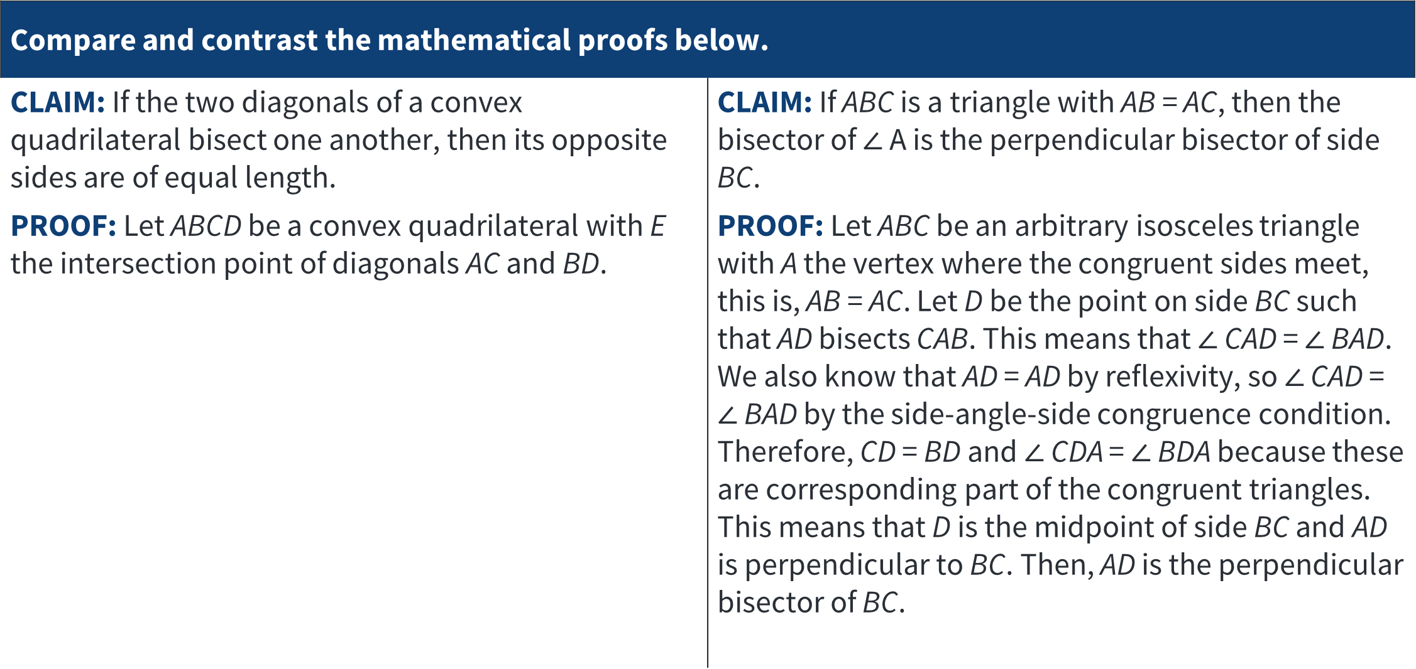
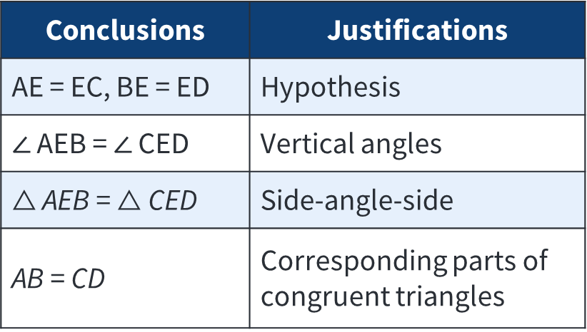
GRADES 9-12 TASKS
Compare and contrast the mathematical proofs below.
CLAIM: If the two diagonals of a convex quadrilateral bisect one another, then its opposite sides are of equal length. PROOF: Let ABCD be a convex quadrilateral with E the intersection point of diagonals AC and BD. | CLAIM: If ABC is a triangle with AB = AC, then the bisector of $∠$ A is the perpendicular bisector of side BC. PROOF: Let ABC be an arbitrary isosceles triangle with A the vertex where the congruent sides meet, this is, AB = AC. Let D be the point on side BC such that AD bisects CAB. This means that $∠$ CAD = $∠$ BAD. We also know that AD = AD by reflexivity, so $∠$ CAD = $∠$ BAD by the side-angle-side congruence condition. Therefore, CD = BD and $∠$ CDA = $∠$ BDA because these are corresponding part of the congruent triangles. This means that D is the midpoint of side BC and AD is perpendicular to BC. Then, AD is the perpendicular bisector of BC.
Conclusions | Justifications
AE = EC, BE = ED | Hypothesis
$∠$ AEB = $∠$ CED | Vertical angles
$△$ AEB = $△$ CED | Side-angle-side
AB = CD | Corresponding parts of congruent triangles
Task taken from Connecting the NCTM Process Standards & CCSSM Practices

Slide 29
DISCUSSION DEBRIEF

Slide 30
BREAKOUT ROOM DISCUSSIONS DEBRIEF
Where in your Breakout Room tasks did you observe opportunities for students to:
Make connections?
Identify shortcuts?
Recognize relevance?
Foster coherence?
Determine exclusions?
Exercise repeated reasoning?
Generalize?
Apply operations?

Slide 31
TASK: REVIEW THE MP PROGRESSION DOCUMENTS.
Discussion question #1:
What do you think Math Practice 8: Look for and Express Regularity in Repeated Reasoning means or looks like at your grade level/course?
Discussion question #2: How does your school or district support students’ progression of repeated reasoning across grade levels and/or courses?

Slide 32
DISCUSSION

Slide 33
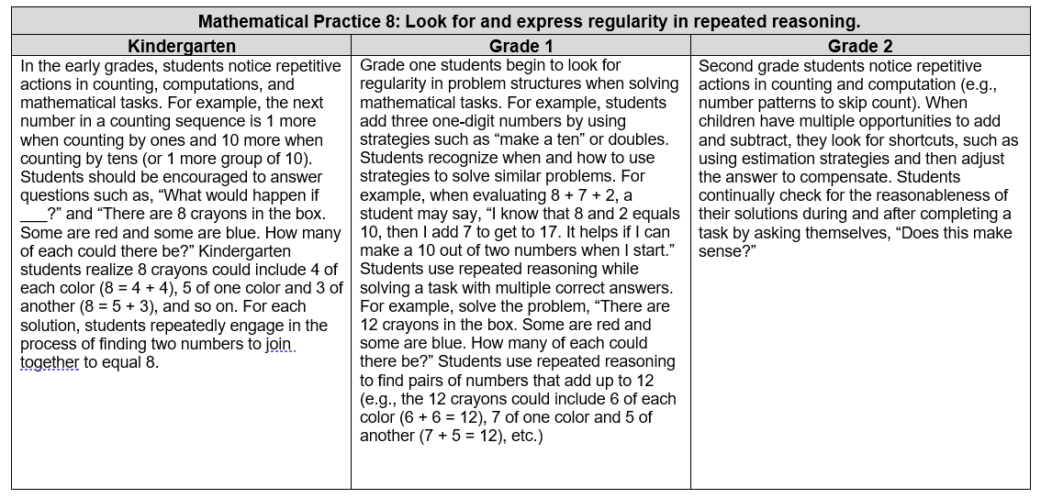
Mathematical Practice 8: Look for and express regularity in repeated reasoning.
Notes:
This slide and the next three slides are Standards for Math Practice 8 Progressions from K to HS.
Not only the Content Standards but Math Practices progress from K to HS.
The link to this document is available in the chat. You will need an access to it while working in the next round of BO rooms.
https://education.ohio.gov/getattachment/Topics/Learning-in-Ohio/Mathematics/Model-Curricula-in-Mathematics/Standards-for-Mathematical-Practice/ohio-standards-for-mathematical-practice-progressions.pdf.aspx?lang=en-US

Slide 34
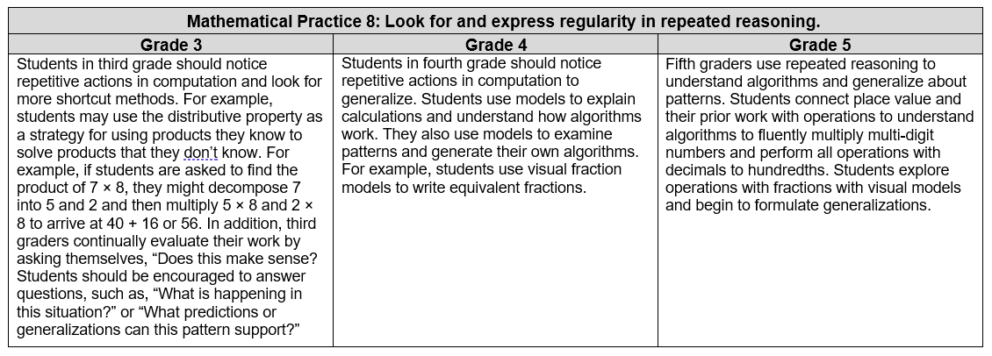
Mathematical Practice 8: Look for and express regularity in repeated reasoning. Cont’d 1

Slide 35
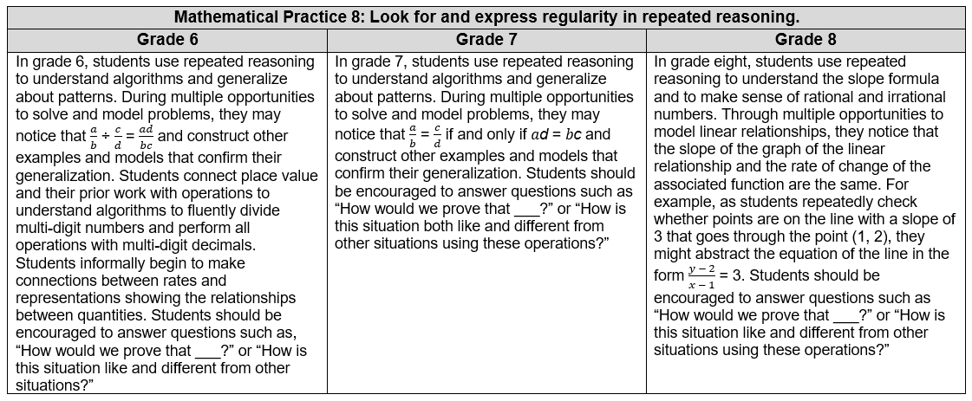
Mathematical Practice 8: Look for and express regularity in repeated reasoning. Cont’d 2

Slide 36
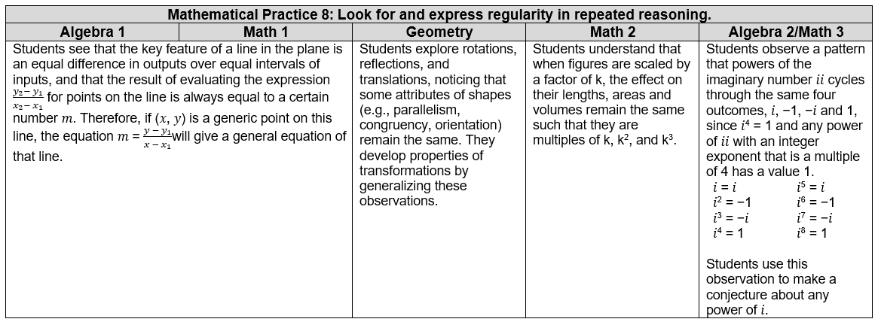
Mathematical Practice 8: Look for and express regularity in repeated reasoning. Cont’d 3

Slide 37
SHARE OUT

Slide 38
RESOURCES

Slide 39
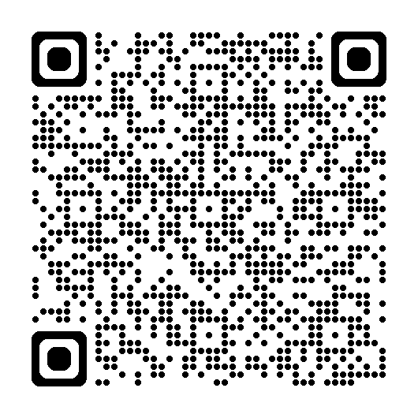
NCTM “Look Fors”
Mathematics |  | Students | Teachers
Seeing structure and generalizing | 7. Look for and make use of structure | Look for patterns or structure, recognizing that quantities can be represented in different ways Recognize the significance in concepts and models and use of the patterns or structure for solving related problems View complicated quantities both as single objects or compositions of several objects and use operations to make sense of problems Comments: | Engage students in discussions emphasizing relationships between particular topics within a content domain or across content domains Recognize that the quantitative relationships modeled by operations and their properties remain important regardless of the operational focus of a lesson Provide activities in which students demonstrate their flexibility in representing mathematics in a number of ways, e.g. 76 = (7x10) + 6; discussing types of quadrilaterals, etc. Comments:
 | 8. Look for and express regularity in repeated reasoning | Notice repeated calculations and look for general methods and shortcuts Continually evaluate the reasonableness of intermediate results (comparing estimates), while attending to details, and make generalizations based on findings Comments: | Engage students in discussion related to repeated reasoning that may occur in a problem’s solution Draw attention to the prerequisite steps necessary to consider when solving a problem Urge students to continually evaluate the reasonableness of their results Comments:

Slide 40
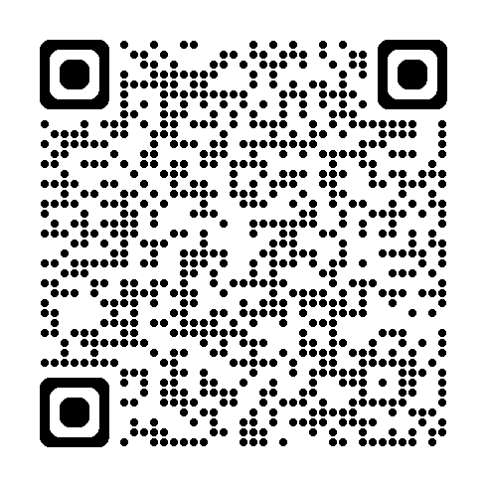
IMPLEMENTING STANDARDS FOR MP 8
Practice | Needs Improvement | Emerging (Teacher does thinking) | Proficient (Teacher does most of the mathematics | Exemplary (Students do most of the mathematics
Look for and express regularity in repeated reasoning. | Does not show evidence of understanding the hierarchy. within concepts Presents or examines task in isolation. | Hides or does not draw connections to prior or future concepts. | Connects concept to prior or future concepts to help students develop an understanding of procedural shortcuts. Demonstrates connections between tasks. | Encourages students to connect task to prior concepts and tasks. Prompts students to generate exploratory questions based on current task. Encourages students to monitor each other’s intermediate results.
Notes:
This is a rubric for the teachers to assess tasks they selected to develop MP.8.
https://cdn.carnegielearning.com/assets/webinar-presentation-files/SMP_Teacher_Rubric_.pdf

Slide 41
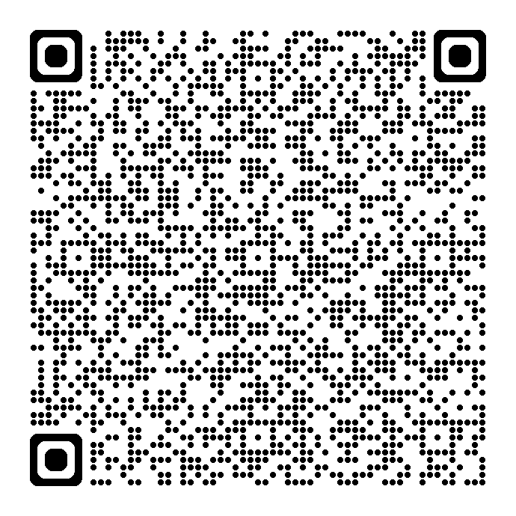
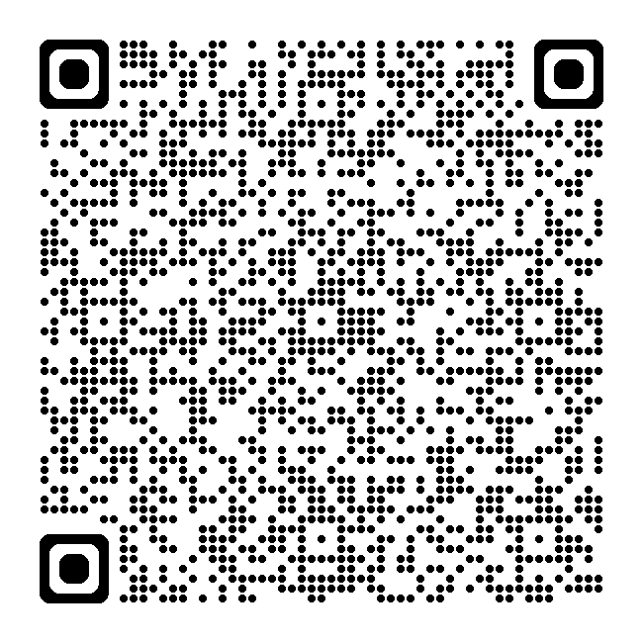
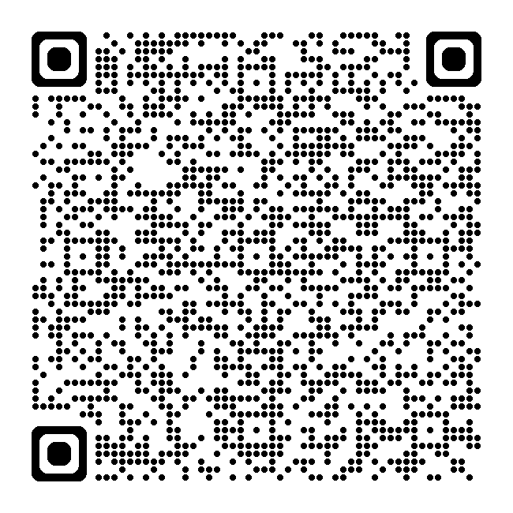
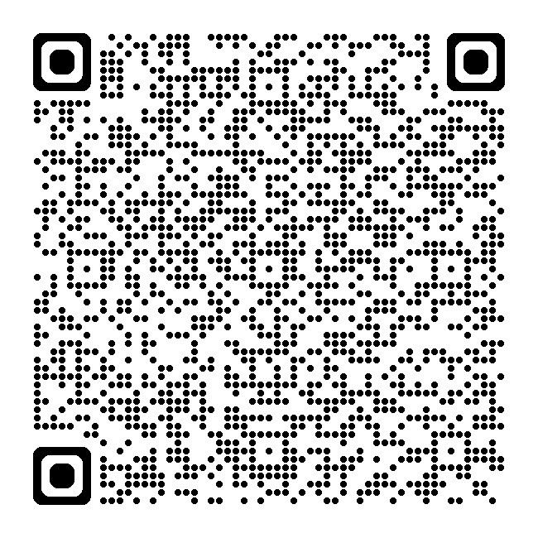
RESOURCE LINKS
Standards for Mathematical Practice
Kindergarten - Grade 5
Grades 6-8
High School
Notes:
Standards for MP: https://education.ohio.gov/getattachment/Topics/Learning-in-Ohio/Mathematics/Model-Curricula-in-Mathematics/Standards-for-Mathematical-Practice/Standards-for-Mathematical-Practice.pdf.aspx

Slide 42
RUBRIC
MP | Needs Improvement | Emerging | Proficient | Exemplary
MP 8: Look for and Express Regularity in Repeated Reasoning. | Examines task in isolation; struggles with understanding the hierarchy within concepts; cannot recognize a known problem within a different context. | Starts to draw connections to prior or future concepts; can complete a similar problem with prompting to get started | Draws connections to prior or future concepts to develop understanding of procedural tasks; can complete a similar problem to get started. | Connects tasks to prior concepts and tasks and evaluates which concepts are most efficient and applies strategies to nonroutine tasks.
 | Struggles with demonstrating a logical progression that leads to pattern recognition. | Demonstrates a logical progression that leads to pattern recognition but applies an incorrect progression for the context. | Demonstrates a logical progression that leads to pattern recognition and a solution based on a pattern of repeated reasoning. | Demonstrates a logical progression that leads to pattern recognition and applies solutions based on repeated reasoning to a new situation including nonroutine tasks.
 | Struggles with noticing general methods or shortcuts or forgets to look for general methods or shortcuts. | Uses memorized shortcuts without understanding its basis on repeated calculations. | Notices repeated calculations and look for general methods and shortcuts based on repeated calculations. | Generalizes processes and applies them to higher-level problem solving implementing short cuts; generates exploratory questions based on the current task; articulates multiple approaches and/or answers to a problem.
 | Struggles to or forgets to monitor intermediate results. | Occasionally monitors intermediate results asking “Why?” when something doesn’t work. | Continually evaluates the reasonableness of intermediate results while attending to the details and make generalizations based on findings. | Continually evaluates the reasonableness of intermediate results while attending to the details and make generalizations based on findings; encourages peers to monitor each other’s intermediate results.
Notes:
This rubric is to help teachers to evaluate students’ ability to use MP.8 or Look for and express regularity in repeated reasoning.
Teachers can rewrite this rubric so that it can become the tool for the students

Slide 43
REFERENCES
Boston, M., Dillon, F., Smith, M., & Miller, S. (2017). Taking Action: Implementing Effective Mathematics Teaching Practices, Grades 9-12. Reston, VA: The National Council of Teachers of Mathematics
Graham, K., Cuoco, A., & Zimmermann, G., (2010). Focus on High School Mathematics: Reasoning and Sense Making. Reston, VA: The National Council of Teachers of Mathematics
Gurl, Theresa J, et al. Implementing the Common Core State Standards through Mathematical Problem Solving. High School. Reston, Va, NCTM, 2012.
Illustrative Mathematics. (2014, May 6). Standards for Mathematical Practice: Commentary and Elaborations for 6–8. Tucson, AZ.
Koestler, C., Felton-Koestler, M. D., Bieda, K., & Otten, S. (2013). Connecting the NCTM process standards and the CCSSM practices. Reston, VA: The National Council of Teachers of Mathematics.
O'Connell, S., & San Giovanni, J. (2013). Putting the practices into action: Implementing the common core standards for mathematical practice, K-8. Portsmouth, NH: Heinemann.

Slide 44
MATHEMATICS QUESTIONS?
Email
Mathematics@education.ohio.gov

Slide 45
Questions

Slide 46
Ohio Department of Education and Workforce 2

