Slide 2
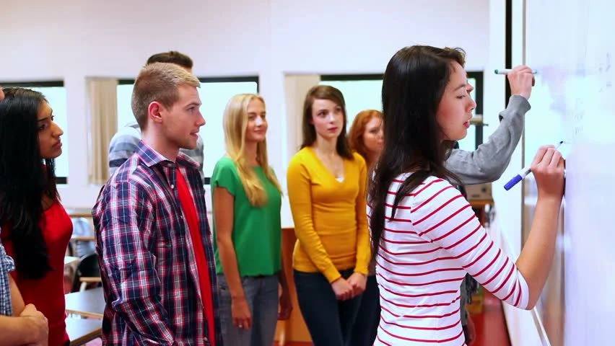
Standards for mathematical practice overview

Slide 3
WELCOME

Slide 4
OHIO DEPARTMENT OF EDUCATION AND WORKFORCE PRIORITIES
Literacy
Learning Acceleration
Workforce Readiness
Student Wellness
Notes:
The math plan looks to connect. To department priorities in the following areas:
Literacy Achievement: Building a foundation for lifelong success by ensuring every student is reading at or above grade level.
Learning Acceleration: Empowering each learner to reach their full potential through individualized, evidence-based support.
Student Wellness: Fostering safe and supportive environments that engage students and enable them to thrive.
Workforce Readiness: Preparing students for the future fully equipped with the skills needed to take the next steps in their career journeys.
Our strongest connection to the Department’s priorities is around learning acceleration. In mathematics, we want every student to be able to accelerate their learning. This means they can access the proactive, research-. And evidence-based, and individualized support they need to succeed. To achieve this priority, all students must have the opportunity to engage in grade-level core instruction regardless of ability, which requires replacing remediation (the practice of teaching below grade-level content) with the just-in-time intervention that allows students to complete unfinished learning and access grade-level instruction (or above).

Slide 5
SESSION NORMS
Listen
Listen with the intent to understand. Ask questions!
Focus
Focus on how this applies to your daily work.
Imagine the possibilities!
Create
Create a safe place to air confusion and raise questions.
Support
Support ideas with evidence. Bring your vast experience to the table. Support participation of all.
Notes:
Welcome everyone. We want to take a moment to ground us in our Session Norms.
We want to Listen with the intent to understand. Ask question!
We want to Focus on how this applies to your daily work. Imagine the possibilities!
We want to Create a safe place to air confusion and raise questions.
We went to Support ideas with evidence. Bring your vast experience to the table. Encourage everyone’s participation. Part of Supporting others is to make sure we are providing space for all in group to share. In addition, we have noticed a few participants have invited an AI presence to curate notes for them during the session. While we appreciate the use of productivity tools, unfortunately, MS TEAMS does not know how to deal with these “non-human” participants and this is affecting breakout rooms, so going forward, we will not be admitting AI participants into our community meetings each month. If there are questions or concerns, please contact one of the Dept team on this session. Thank you!

Slide 6
PURPOSE:
Connect
Ohio’s Mathematics Vision from Ohio’s Plan for K-12 Mathematics to the Mathematical Practices.
Explore
MP 8: Look for and Express Regularity in Repeated Reasoning through grade band-aligned instructional tasks.
Identify
Resources to support instruction aligned to Math Practice 8: Look for and Express Regularity in Repeated Reasoning.
Utilize
Resources to help recognize and collect evidence of MP 8: Look for and Express Regularity in Repeated Reasoning in the classroom.

Slide 7
AGENDA
What: | Why: | How:
Welcome and Introductions 5-10 minutes | To establish the session norms and outline the focus of the session | Facilitator presentation
Ohio’s Plan for K-12 Mathematics 5 minutes | To learn about Ohio’s Vision for Mathematics as outlined in Ohio’s Plan for K-12 Mathematics | Facilitator presentation
MPs Overview, Resources, and Discussions 45-60 minutes | Learn about and explore various resources aligned to the MPs. Discover how the MPs connect to Ohio’s Mathematics Vision. | Breakout Rooms and Whole Group Discussion
Closing 5 minutes | Address lingering questions and provide session feedback | Department contact information

Slide 8
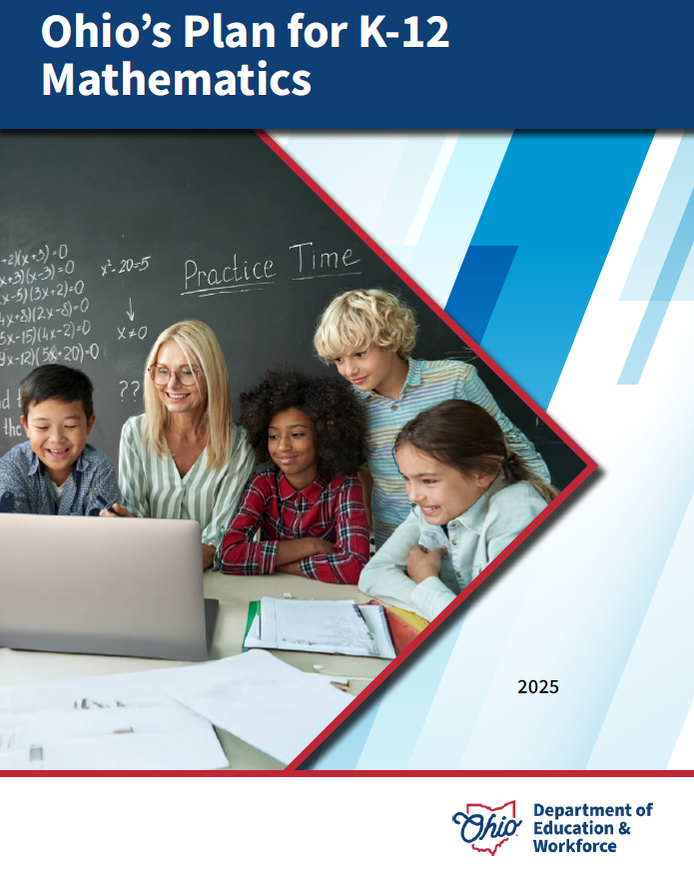
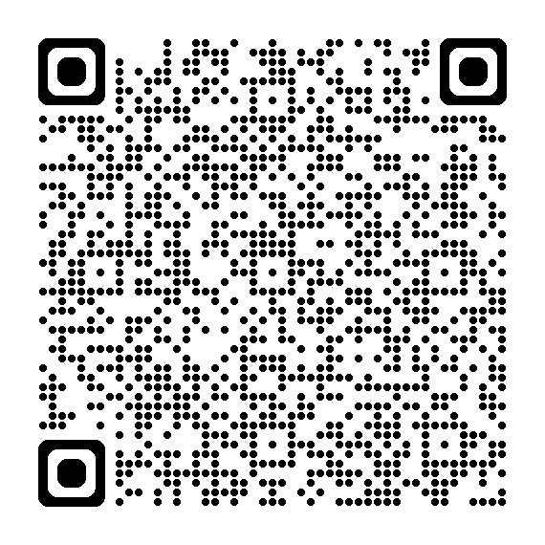
OHIO’S PLAN FOR
K-12 MATHEMATICS
education.ohio.gov/math

Slide 9
STRUCTURE OF OHIO’S PLAN
Why?
What?
How?
Section 1: Why a Comprehensive Mathematics Plan is Needed
Section 2: Ohio’s Mathematics Vision
Section 4: Strategies and Activities
Section 3: Ohio’s Theory of Action
Notes:
This session will connect best with Section 2: Ohio’s Mathematics Vision, which is outlined in Ohio’s Plan for K-12 Mathematics.

Slide 10
SECTION 2:
OHIO’S MATHEMATICS VISION
The Importance of Mathematics
A Shift Toward Rigor
Ohio’s Vision for Mathematics Instruction
Notes:
This section defines mathematics and sets the vision
Outlines that across the state, all students must have access to rigorous instruction that advances their growth and confidence in mathematics.
Section 2 sets the foundation and expectations for mathematics instruction, focusing grounded in the effective math teaching practices and student practices.

Slide 11
OHIO’S MATHEMATICS VISION
Ohio’s vision is to empower students with the confidence and ability to apply mathematical concepts, procedures, and reasoning, enabling students to thrive in a variety of contexts, life experiences, and career pathways.
Notes:
Improving mathematics outcomes for all Ohio students — across districts and grade levels and with special attention to those who are furthest behind — requires a thoughtful, multi-pronged strategy. Ohio’s Plan for K-12 Mathematics leverages multiple strands of activity and investment into a single, coherent theory of action. This theory builds upon existing math-related policies and initiatives in Ohio and proposes additional strategies to cultivate rigorous, high-quality mathematics instruction in every classroom and for all students. Ohio’s theory of action combines five interdependent strands of action. It is important to emphasize that these five strands of work are not sequential but should interact with and support one another in service of improved student learning.

Slide 12
A SHIFT TOWARD RIGOR
Learning acceleration
Just-in-time interventions
Access
Notes:
It is not enough for some students to participate in a rigorous math curriculum. To ensure a full array of college and career opportunities for every graduate, all Ohio students must have opportunities to develop and advance their conceptual understanding, procedural skills and fluency, and application of mathematics. That requires a shared commitment to the following principles in all Ohio mathematics classrooms:
Learning acceleration: Every student accelerates their learning in math and has access to the proactive, evidence-based, and individualized support they need to succeed. All students must have the opportunity to engage in grade-level core instruction regardless of ability, which requires replacing remediation (the practice of teaching below grade-level content) with the just-in-time intervention that allows students to complete unfinished learning and access grade-level instruction (or above).
(Note: This term is not equivalent to grade-level or course acceleration, which occurs when advanced learners move ahead an entire grade level in one or more subject areas.)
Just-in-time intervention: Current learning data is used to identify gaps that would prevent students from accessing grade-level instruction, plan scaffolds to provide that access, and then remove those scaffolds as soon as they are no longer needed.
Access: Providing learning “access” means removing or accommodating any barriers that would prevent a student from successfully and equitably engaging with the grade-level curriculum. Ohio commits to providing equitable access to a grade-level (or above) curriculum for learners of all backgrounds and abilities.

Slide 13
OHIO’S VISION FOR MATHEMATICS INSTRUCTION
Recommended Instructional Focus
Standards for Mathematical Practice
Effective Mathematics Teaching Practices
Notes:
The Ohio Learning Standards for mathematics were updated based on a review process led by educators and the Department in 2017. The revised standards define what learners should know and be able to do and guide districts in modifying local curricula, instructional plans, and materials to ensure all students have access to coherent, rigorous, grade-level instruction.
Ohio’s mathematics vision builds on long-accepted research about how students learn mathematics and the instructional practices that cultivate rigor.
Outlined in Ohio’s Vision for Mathematics Instruction, is first and foremost, an alignment to the Standards. In the Math Plan, we identify the recommended instructional focus for Pre-K through High Schools. These major topics or themes are taken from the Ohio Learning Standards and have been around since 2011.
Next, we have encouragement to utilize a more student-centered focus to mathematics learning through the inclusion of the Standards for Mathematical Practice. These outline ways that students can show their understanding of mathematics in every grade level and course.
Last, we highlight the importance of using the evidence-based Effective Mathematics Teaching Practices from the National Council of Teachers of Mathematics or NCTM. These Teaching Practices identify what teachers can do in the delivery of high-quality instruction.

Slide 14

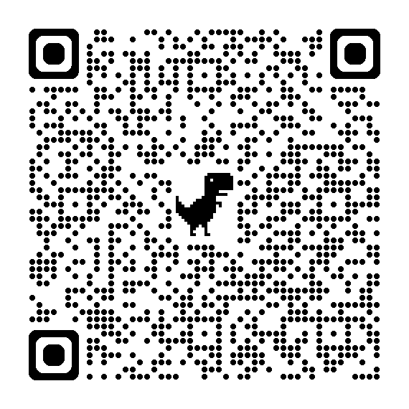
STANDARDS FOR MATHEMATICAL PRACTICE
MP 1: Make sense of problems and persevere in solving them.
MP 2: Reason abstractly and quantitatively. ​​
MP 3: Construct viable arguments and critique the reasoning of others.
MP 4: Model with mathematics.
MP 5: Use appropriate tools strategically.
MP 6: Attend to precision.
MP 7: Look for and make use of structure.
MP 8: Look for and express regularity in repeated reasoning.
Notes:
Links:
Standards for Mathematics Practice: https://education.ohio.gov/Topics/Learning-in-Ohio/Mathematics/Model-Curricula-in-Mathematics/Standards-for-Mathematical-Practice
The eight Standards for Mathematical Practice outlined in Ohio’s Learning Standards for Mathematics describe varieties of expertise that mathematics educators at all grade levels should seek to develop in their students.
These eight practices rest on important “processes and proficiencies” with longstanding importance in mathematics education. This includes the process standards of problem-solving, reasoning, communication, representation, and connections described by the National Council of Teachers of Mathematics and the five strands of mathematical proficiency described by the National Research Council.

Slide 15
What comes to your mind when you think about the mathematical practices?
Notes:
For those in the live session or participating in the PD through the on-demand recording, you can engage in local discussions with your colleagues using this question. If using this recording for virtual PL with a live audience, you can ask the attendees to write their responses in the chat and share them with the group as part of a waterfall chat activity. Be sure to provide ample time for the participants to read through and possibly discuss their responses with each other prior to moving forward. With that in mind, “What comes to your mind when you think about the Standards for Mathematical Practice

Slide 16
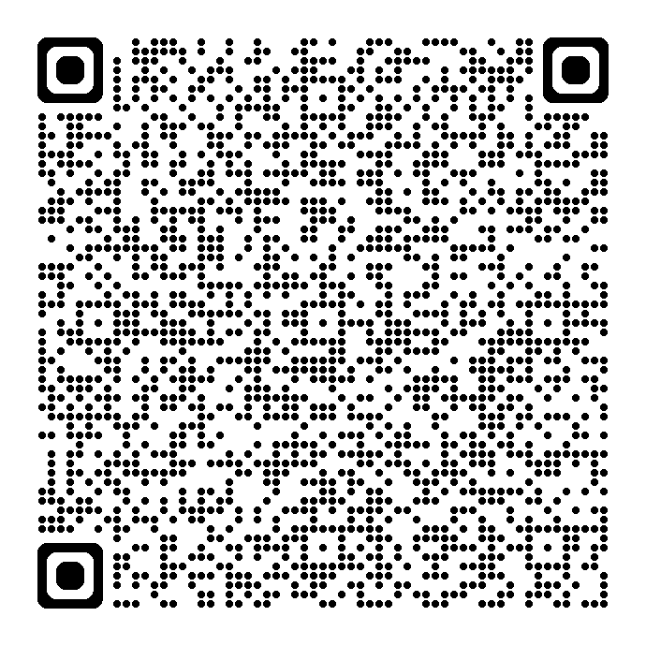
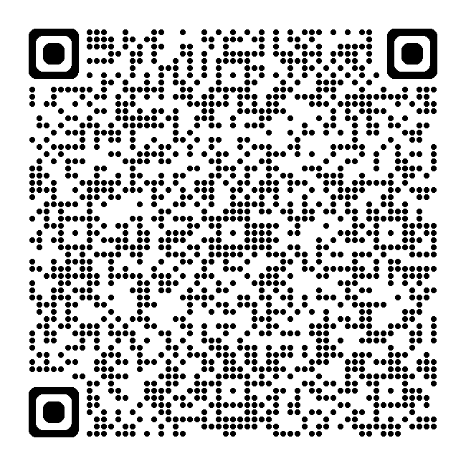
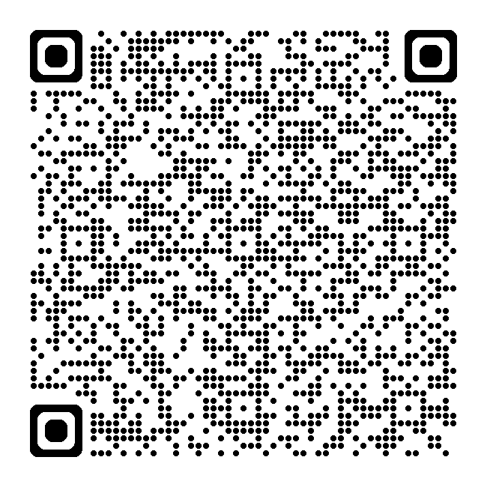
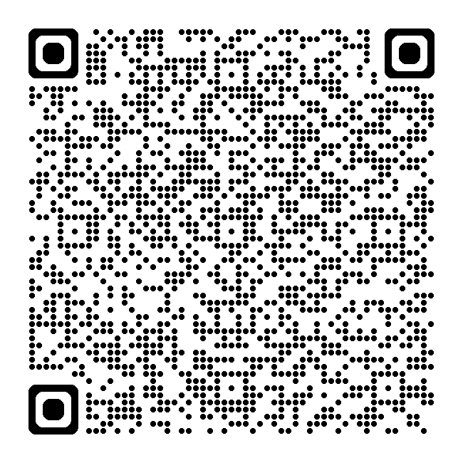
RESOURCE LINKS
Standards for Mathematical Practice
Kindergarten - Grade 5
Grades 6-8
High School
Notes:
Standards for MP: https://education.ohio.gov/getattachment/Topics/Learning-in-Ohio/Mathematics/Model-Curricula-in-Mathematics/Standards-for-Mathematical-Practice/Standards-for-Mathematical-Practice.pdf.aspx

Slide 17
BREAKOUT ROOM 1/DISCUSSION
MP 1: MAKE SENSE OF PROBLEMS AND PERSEVERE IN SOLVING THEM
Standards for Mathematical Practice
Kindergarten - Grade 5
Grades 6-8
High School
Look at the DEW documents on the MPs
What theme(s) do you notice with the MP?
What stands out to you about this MP?
Notes:
MPs: https://education.ohio.gov/getattachment/Topics/Learning-in-Ohio/Mathematics/Model-Curricula-in-Mathematics/Standards-for-Mathematical-Practice/Standards-for-Mathematical-Practice.pdf.aspx

Slide 18
MP 1: Make Sense of Problems & Persevere in Solving Them.
Notes:
The Common Core’s Standards for Mathematical Practice describe how students should demonstrate their mathematical proficiency. These standards “describe varieties of expertise that mathematics educators at all levels should seek to develop in their students” (Standards for Mathematical Practice, 2010). This is achieved by giving expectations for the depth of students’ understanding, the skills students should have, and how students should express what they know. Unfortunately, the MPs are written in a manner that makes them difficult for many educators to understand which makes their implementation difficult.
Each of the eight MPs are described a paragraph that begins with the words “Mathematically proficient students” followed by the specific expertise students should demonstrate. The standards contain 3 to 10 sentences each with individual sentences running as long as 69 words in length. If we were to use the Flesch Reading Ease formula to measure how easy the MPs are read, we would discover that the average a score of approximately 32. Some MPs scores are as low as 17.5 and 15.6 for Standards 2 and 5. These low scores means they are especially difficult to read.
For those who an unfamiliar with the Flesch Reading Ease formula, scores from this formula range from 0 to 100 with scores between 0-29 considered to be very difficult to read. For reference, Time Magazine articles average a score of approximately 55 and the nursery rhyme “Humpty Dumpty” scores a 79.7. For the remainder of this session, we will examine each of the MPs and break them down into simpler language that will help make them easier to understand and later implement in our classrooms.
This is what CCSS-M says about MP 1. It’s very wordy. What does this mean across when looking for evidence at your grade level or course?
Mathematically proficient students start by explaining to themselves the meaning of a problem and looking for entry points to its solution. They analyze givens, constraints, relationships, and goals. They make conjectures about the form and meaning of the solution and plan a solution pathway rather than simply jumping into a solution attempt. They consider analogous problems, and try special cases and simpler forms of the original problem in order to gain insight into its solution. They monitor and evaluate their progress and change course if necessary. Older students might, depending on the context of the problem, transform algebraic expressions or change the viewing window on their graphing calculator to get the information they need. Mathematically proficient students can explain correspondences between equations, verbal descriptions, tables, and graphs or draw diagrams of important features and relationships, graph data, and search for regularity or trends. Younger students might rely on using concrete objects or pictures to help conceptualize and solve a problem. Mathematically proficient students check their answers to problems using a different method, and they continually ask themselves, "Does this make sense?" They can understand the approaches of others to solving complex problems and identify correspondences between different approaches.

Slide 19
MP 1: Make Sense of Problems and Persevere in Solving Them.
Develop operation sense and number sense
Learn to evaluate other’s strategies
Focus on ideas and solution strategies
Identify which problem solving strategy to use
Explain or justify their problem solving strategy
Notes:
In MP 1, students make sense of the problem and use perseverance to solve it. In the early grades this can be as simple as determining the operation and steps needed to solve the one or two-step problem. Meanwhile, at high school, this can be as complex as determining the question you want to ask and why when presented with a mathematical modeling problem. In MP1, students learn to understand their own strategies and evaluate other’s. Anytime they evaluate mathematical arguments where they must justify their own solutions, they gain a different perspective and point of view. Here discussions center on ideas and solution strategies with mathematical understanding rather than traditional answer getting. For example, what did you get for question number 5? In MP 1, the strategies used should be coming from the students rather than being dictated by task. Sometimes, in the standards, the standards themselves may dictate a particular model such as a number line or area model, but they do not necessarily prescribe the strategy students should use such as skip counting, making tens, doubles, etc. With instruction, open-ended or open-middle tasks provide excellent opportunities for students to demonstrate MP1. When using other tasks during instruction, teachers can use focusing questions to help students clarify their ideas and share their strategies.
Focusing questions are those questions that allow students to do the cognitive work of learning by helping to push their thinking forward. Focusing questions encourage students to figure things out for themselves. They are designed to advance student learning by clarifying understanding and thereby areas of misunderstanding. This formative assessment data can be used to immediately inform supports and instruction.

Slide 20
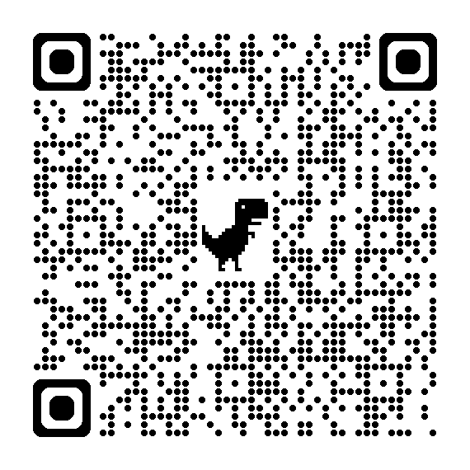
Inside Mathematics Videos for MP 1: Make Sense of Problems and Persevere in Solving Them.
Learning Activity
Watch a video or a group of videos at the grade level(s) you teach or the grade band you work with.
Look for examples of where MP 1 is present in the video(s).
Discuss your observations with a colleague or colleagues.
Inside Mathematics MP 1 Videos
Notes:
https://www.insidemathematics.org/common-core-resources/mathematical-practice-standards/standard-1-make-sense-problems-persevere-solving-them#video-5287
Classroom Observations
Teachers who are developing students’ capacity to “make sense of problems and persevere in solving them” develop ways of framing mathematical challenges that are clear and explicit, and then check in repeatedly with students to help them clarify their thinking and their process. An early childhood teacher might ask her students to work in pairs to evaluate their approach to a problem, telling a partner to describe their process, saying “what [they] did, and what [they] might do next time.” A middle childhood teacher might post a set of different approaches to a solution, asking students to identify “what this mathematician was thinking or trying out” and evaluate the success of the strategy. An early adolescence teacher might have students articulate a specific way of laying out the terrain of a problem and evaluating different starting points for solving. A teacher of adolescents and young adults might frame the task as a real-world design conundrum, inviting students to engage in a “tinkering” process of working toward mathematical proof, changing course as necessary as they develop their thinking. Visit the video excerpts below to view multiple examples of teachers engaging students in sense-making and mathematical perseverance.

Slide 21
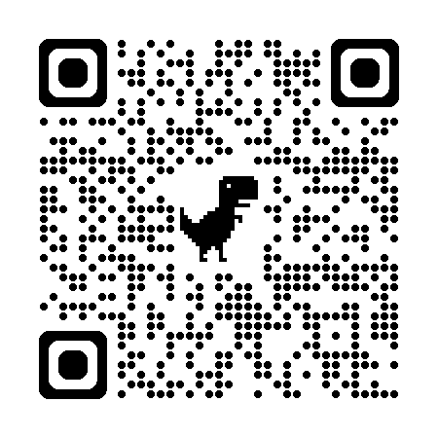
ROBERT KAPLINSKY’S READABLE
Math Practice 1: Make Sense Of Mathematics
Mathematically proficient students begin a problem with a strategy in mind but can also revise it until they get the result they are looking for. They feel comfortable representing their thinking using pictures, numbers, symbols, and/or words and can compare their method to other problem-solving strategies.
Source: https://robertkaplinsky.com/
Notes:
https://robertkaplinsky.com/making-the-ccss-math-practices-readable-mp-1/
Kaplinsky removed the portion of the title that says “and persevere in solving them”. When you read through each of the sentences in the official version of the standard, you will see zero references to perseverance. While it might be an implied part of problem solving, the standard is completely about sense making, not perseverance. This can become problematic when educators see students who are not making sense, but are also not giving up. They believe this demonstrates MP 1. It’s great when students don’t give up, but if the students are not making sense of mathematics, then the students are not demonstrating Math Practice 1.
Kaplinksy decided to delete a large portion of the standard because, while it lists several examples of what sense-making might look like, I feel it just makes it more confusing.

Slide 22
MP | Needs Improvement | Emerging | Proficient | Exemplary
MP 1: Make Sense of Problems and Persevere in Solving Them | Has difficulty working independently or collaboratively; requires continual assistance from teacher or other students. | Works independently and collaboratively with some reliance on the teacher or other students. | Works independently and collaboratively with little reliance on the teacher. | Works independently and leads group in collaboration.
 | Gives up easily; rarely takes initiative to find new information or methodologies to solve a problem. | Gives up occasionally; persists only when comfortable; occasionally takes initiative to find some new information or one methodology to solve a problem. | Generally shows some persistence; may give up when extremely challenged; comfortable seeking new information or exploring one or two methodologies to solve a problem. | Continues working when challenged, regularly taking initiative to find new information; fluid in using multiple methodologies and approaches to solve a problem.
 | Has difficulty getting started on a problem. | Finds an entry point to a problem. | Finds one or two entry points to a problem. | Discovers multiple entry points to problems.
 | Focuses on answers and procedures instead of problem; has difficulty understanding the question of interest being asked; has difficulty analyzing varying aspects of the problem. | Tries to make sense of the problem but may need prompting by classmates or teacher; tries something even if not correct; analyzes some of the aspects of the problem. | Makes sense of the problem; breaks down problems into simpler pieces; articulates the problem into their own words; analyzes information, makes conjectures and plans a solution pathway. | Makes sense and breaks down problems, synthesizing the results when presenting solutions; connects known mathematical ideas and procedures to real-world situations; makes conjectures and plans a solution pathway based on analysis.
 | Struggles or forgets to monitor or evaluate progress; Forgets to check their work or evaluate his or her answer to see if it makes sense. | Occasionally monitors and evaluates the progress; may check and revise work by plugging numbers in; may forget to check for reasonableness. | Regularly monitors and evaluates the progress; checks work and determines reasonableness of solution within context and makes necessary modifications. | Monitors and evaluates the progress, changing course as necessary; checks reasonableness; defends and justifies solution by comparing solution paths.
 | Does not answer the question of interest. | Partially answers the question of interest. | Thoroughly answers the question of interest. | Thoroughly answers the question and poses new question(s); generalizes.

Slide 23
BREAKOUT ROOM 2 /DISCUSSION
MP 2: Reason Abstractly And Quantitatively.
Standards for Mathematical Practice
Kindergarten - Grade 5
Grades 6-8
High School
Look at the DEW documents on the MPs
What theme(s) do you notice with the MP?
What stands out to you about this MP?
Notes:
MPs: https://education.ohio.gov/getattachment/Topics/Learning-in-Ohio/Mathematics/Model-Curricula-in-Mathematics/Standards-for-Mathematical-Practice/Standards-for-Mathematical-Practice.pdf.aspx

Slide 24
MP 2: Reason Abstractly & Quantitatively.
Notes:
This is what CCSS-M says about MP2. As mentioned earlier, it’s readability score is 17.5 out of 100. That scores means this is the second most difficult MP to read according to the Reading Ease formula. Now, let’s break down what this MP means and what evidence to look for at your grade level or course.
Mathematically proficient students make sense of quantities and their relationships in problem situations. They bring two complementary abilities to bear on problems involving quantitative relationships: the ability to decontextualize—to abstract a given situation and represent it symbolically and manipulate the representing symbols as if they have a life of their own, without necessarily attending to their referents—and the ability to contextualize, to pause as needed during the manipulation process in order to probe into the referents for the symbols involved. Quantitative reasoning entails habits of creating a coherent representation of the problem at hand; considering the units involved; attending to the meaning of quantities, not just how to compute them; and knowing and flexibly using different properties of operations and objects.

Slide 25
MP 2: Reason Abstractly and Quantitatively.
Contextualized and decontextualized problems
Connecting mathematical symbols and operations to real-world contexts
Move back and forth between problem situations and symbolic notations
Notes:
MP 2 is about connecting the mathematical symbols and operations to real-world contextual applications. Here students contextualize and de-contextualize problems. They move back and forth between problem situations and symbolic notations. As students are developing an understand of MP 2, they may be representing a problem verbally, numerically, graphically (i.e. visual or pictoral), or symbolically. In early grades, this can be a simple as subitizing a group of objects in a collection and recording the total numerically. In later grades, proficient students are able to manipulate the represented symbols without having to constantly refer back to the original problem or context.

Slide 26
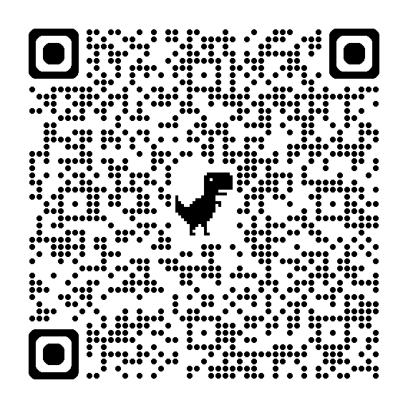
INSIDE MATHEMATICS VIDEOS FOR MP 2: REASON ABSTRACTLY & QUANTITATIVELY
Learning Activity
Watch a video or a group of videos at the grade level(s) you teach or the grade band you work with.
Look for examples of where MP 2 is present in the video(s).
Discuss your observations with a colleague or colleagues.
Inside Mathematics MP 2 Videos
Notes:
https://www.insidemathematics.org/common-core-resources/mathematical-practice-standards/standard-2-reason-abstractly-quantitatively
Classroom Observations
Teachers who are developing students’ capacity to "reason abstractly and quantitatively" help their learners understand the relationships between problem scenarios and mathematical representation, as well as how the symbols represent strategies for solution. A middle childhood teacher might ask her students to reflect on what each number in a fraction represents as parts of a whole. A different middle childhood teacher might ask his students to discuss different sample operational strategies for a patterning problem, evaluating which is the most efficient and accurate means of finding a solution. See the video excerpts to observe teachers engaging their students in abstract and quantitative reasoning.

Slide 27
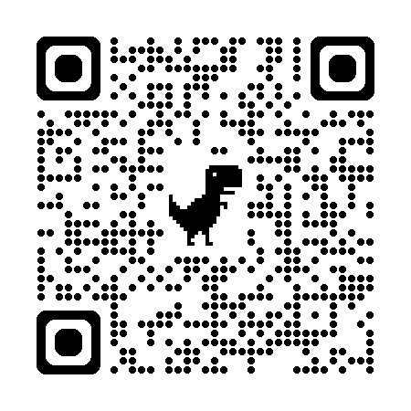
ROBERT KAPLINSKY’S READABLE
Math Practice 2: Add or Remove Context to Solve Problems
Mathematically proficient students understand what the numbers, symbols, pictures, words, etc. in their work represent. They feel comfortable switching back and forth between a problem’s context and its representation and use the form that best fits the situation.
Source: https://robertkaplinsky.com/
Notes:
https://robertkaplinsky.com/making-the-ccss-math-practices-readable-mp-2/
The two most important words in the official version of Math Practice 2 are certainly “contextualize” and “decontextualize.” They are even italicized. The basic idea is that students should be able to fluidly move back and forth between the context and the abstraction. I considered also using contexualize and decontextualize but ultimately decided that they were not friendly enough words. I had a hard time finding student friendly substitute words and eventually ended up with “add or remove context.”
Note that the entire original standard is only three sentences long with one sentence being 69 words long and another having three semi colons. I don’t think I’ve ever written an understandable sentence that is 60+ words long or has 3 semicolons.
I considered adding this third sentence: “They do not respond to the question ‘Where did that 46 come from?’ with ‘I don’t know, I got it with my calculator.’ This allows them to notice when a calculation does or doesn’t make sense.” I didn’t because it violated my guiding principle of “perfection is attained not when there is nothing more to add, but when there is nothing more to remove.”

Slide 28
MP | Needs Improvement | Emerging | Proficient | Exemplary
MP 2: Reason Abstractly and Quantitatively. | Does not understand that quantities have meaning. | Understands that quantities having meaning, but not able to see all the relationships between quantities. | Attends to the meaning of quantities and the relationships between quantities, rather than simply computing them. | Attends to the meaning of quantities and the relationships between quantities, rather than simply computing them; generalizes their relationships to new situations.
 | Ignores units. | Considers the units involved but does not understand how they relate to the problem; may use units as labels. | Pays attention to units and uses them appropriately. | Analyzes the use of symbols, variables and units accurately, consistently and appropriately.
 | Uses memorized procedures and algorithms incorrectly; cannot represent a situation symbolically. | Uses memorized procedures and algorithms but is not able to explain underlying concepts; can represent and manipulate simple situations symbolically. | Sees connections between procedures or algorithms and contextual meaning but has difficulty articulating them; can represent and manipulate routine situations symbolically. | Articulates connections between procedures or algorithms and contextual meaning; can take a situation and flexibly represent it symbolically and then manipulate the symbols (decontextualize).
 | Does not see a connection between the symbolic representation and the context. | Sees a connection between the symbolic representation and the context but has difficulty articulating it. | Takes a symbolic situation and relates it to the context (contextualize). | Takes a symbolic situation and relates it to the context and other similar contexts.
 | Does not use representations when approaching a problem. | Uses some representations to represent the problem. | Creates a coherent representation of the problem. | Creates, interprets, models, and connects multiple representations coherently.
 | Does not finish calculations or interpret solutions. | Finishes calculations but does not interpret solutions. | Interprets solutions appropriately. | Looks beyond solutions to make predictions, generalizations, and decisions.

Slide 29
Breakout Room 3/Discussion
MP 3: Construct viable arguments and critique the reasoning of others.
Standards for Mathematical Practice
Kindergarten - Grade 5
Grades 6-8
High School
Look at the DEW documents on the MPs
What theme(s) do you notice with the MP?
What stands out to you about this MP?
Notes:
MPs: https://education.ohio.gov/getattachment/Topics/Learning-in-Ohio/Mathematics/Model-Curricula-in-Mathematics/Standards-for-Mathematical-Practice/Standards-for-Mathematical-Practice.pdf.aspx

Slide 30
MP 3: Construct Viable Arguments & Critique the Reasoning of Others.
Notes:
MP. 3
Mathematically proficient students understand and use stated assumptions, definitions, and previously established results in constructing arguments. They make conjectures and build a logical progression of statements to explore the truth of their conjectures. They are able to analyze situations by breaking them into cases, and can recognize and use counterexamples. They justify their conclusions, communicate them to others, and respond to the arguments of others. They reason inductively about data, making plausible arguments that take into account the context from which the data arose. Mathematically proficient students are also able to compare the effectiveness of two plausible arguments, distinguish correct logic or reasoning from that which is flawed, and—if there is a flaw in an argument—explain what it is. Elementary students can construct arguments using concrete referents such as objects, drawings, diagrams, and actions. Such arguments can make sense and be correct, even though they are not generalized or made formal until later grades. Later, students learn to determine domains to which an argument applies. Students at all grades can listen or read the arguments of others, decide whether they make sense, and ask useful questions to clarify or improve the arguments.

Slide 31
MP 3: Construct Viable Arguments and Critique the Reasoning Of Others.
Understand the implications of the conjecture or claim
Recognize and understand the method used
Infer why the reasons or statements are adequately supported for the conjecture or claim
Describe ideas using both formal and informal mathematical language
Notes:
Students must be able to to understand how to evaluate math arguments. Proficiency requires students to 1.) Understand the implications of the conjecture or claim 2.) Recognize and understand the method used and 3.) Infer why the reason or statement are adequately supported for the conjecture or claim. With instruction, it’s better to use arguments generated by students. However, if a common misconception or big mathematical idea does not present itself during class discussion or group work, it’s OK to use an example from another class. Teachers may find it helpful to ask students to identify examples and counterexamples to test whether student generalizations are true. Teachers can ask simple open-ended questions, like “does that work every time?”, “how do you know?”, or “who can find a counterexample?” to provide higher cognitive complexity to support peer examination each other’s mathematical thinking. Discussions should always focus on the evaluations of ideas (not people). An important part of learning to communicate about mathematics is to use language of mathematics to express ideas precisely. This MP provides a purpose behind learning the proper mathematical terms, so students can use that language in their discussions. Describing ideas accurately helps students interpret the meaning of terms in other’s arguments.

Slide 32
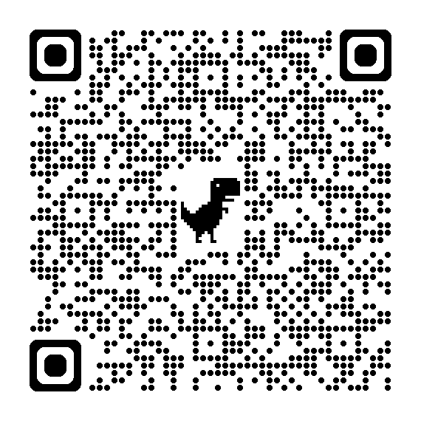
Inside Mathematics Videos for MP 3: Construct Viable Arguments & Critique the Reasoning of Others
Learning Activity
Watch a video or a group of videos at the grade level(s) you teach or the grade band you work with.
Look for examples of where MP 3 is present in the video(s).
Discuss your observations with a colleague or colleagues.
Inside Mathematics MP 3 Videos
Notes:
https://www.insidemathematics.org/common-core-resources/mathematical-practice-standards/standard-3-construct-viable-arguments-critique-reasoning-others
Classroom Observations
Teachers who are developing students’ capacity to "construct viable arguments and critique the reasoning of others" require their students to engage in active mathematical discourse. This might involve having students explain and discuss their thinking processes aloud, or signaling agreement/disagreement with a hand signal. A middle childhood teacher might post multiple approaches to a problem and ask students to identify plausible rationales for each approach, as well as any mistakes made by the mathematician. An early adolescence teacher might post a chart showing a cost-analysis comparison of multiple DVD rental plans and ask his students to formulate and defend a way of showing when each plan becomes most economical. A teacher of adolescents and young adults might actively engage her students in extended conjecture about conditions for proof in the construction of quadrilaterals, testing their assumptions and questioning their approaches. View the videos to see multiple examples of teachers engaging students in formulating, critiquing, and defending arguments of mathematical reasoning.

Slide 33
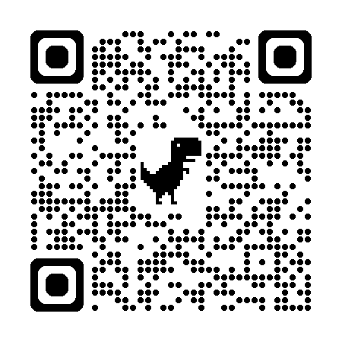
ROBERT KAPLINSKY’S READABLE
Math Practice 3: Explain and Defend Your Reasoning
Mathematically proficient students can convince others that their reasoning is correct. This includes convincing others who have not solved the problem as well as those who have solved it but reached different conclusions.
Source: https://robertkaplinsky.com/
Notes:
https://robertkaplinsky.com/making-the-ccss-math-practices-readable-mp-3/
This standard rewrite was heavily influenced by this Levels of Convincing blog post.
I cut out a large amount of the standard’s text, mostly consisting of examples of what this might look like. I don’t disagree with the examples, but I am trying to follow my guiding principle of “perfection is attained not when there is nothing more to add, but when there is nothing more to remove.” I believe that what is left is the essence of the standard.
I was unsure if it sufficiently addressed the portion about “critique[ing] the reasoning of others” but felt that it was implied by “convincing others… who have solved it but reached different conclusions.”

Slide 34
MP | Needs Improvement | Emerging | Proficient | Exemplary
MP 3: Construct Viable Arguments and Critique the Reasoning of Others | Struggles or forgets to offer any explanation. | Explains reasoning, but does not use mathematical language; attempts to use an object, graph, chart, etc. | Explains and defends reasonings using mathematical language; explains each step and the reasoning behind it using objects, graphs, charts, etc. | Articulates and defends reasoning using concise mathematical language using objects, graphs, charts, etc.
 | Forgets to look for errors; arguments are based on opinion. | Identifies some errors; uses some arguments and logic, but arguments may have holes. | Analyzes a problem for errors and misconceptions; uses logical mathematical arguments to support and justify solutions. | Analyzes a problem for misconceptions and errors in logic, computation, and methodologies; uses logical arguments and justifies conclusions; uses definitions and previously established results in constructing arguments.
 | Struggles or forgets to defend or give rationale for the choices they made. | Defends their own choices, but concludes which plan is best without solid support, or concludes a single plan is best rather than looking at the conditions under which each plan is best. | Defends their own choices; concludes their choice is best by looking at the conditions of each plan. | Defends their own choices; concludes their choice is best by looking at the conditions of each plan and gives evidence to support their choices.
 | Struggles or forgets to seek understanding of classmates’ solutions. | Asks for clarification of classmates’ solutions. | Questions classmates’ solutions and asks “Why?” | Asks classmates probing questions to clarify and improve their arguments.
 | Struggles or forgets to list assumptions or logical conjectures. | Lists assumptions and logical conjectures but may not be able to clearly differentiate between them. | Differentiates between assumptions and logical conjectures. | Makes, recognizes and challenges assumptions and logical conjectures by providing evidence; evaluates peer arguments; able to compare the effectiveness of two plausible arguments.

Slide 35
BREAKOUT ROOM 4/DISCUSSION
MP 4: Model with mathematics.
Standards for Mathematical Practice
Kindergarten - Grade 5
Grades 6-8
High School
Look at the DEW documents on the MPs
What theme(s) do you notice with the MP?
What stands out to you about this MP?
Notes:
MPs: https://education.ohio.gov/getattachment/Topics/Learning-in-Ohio/Mathematics/Model-Curricula-in-Mathematics/Standards-for-Mathematical-Practice/Standards-for-Mathematical-Practice.pdf.aspx

Slide 36
MP 4: Model With Mathematics.
Notes:
MP.4: Mathematically proficient students can apply the mathematics they know to solve problems arising in everyday life, society, and the workplace. In early grades, this might be as simple as writing an addition equation to describe a situation. In middle grades, a student might apply proportional reasoning to plan a school event or analyze a problem in the community. By high school, a student might use geometry to solve a design problem or use a function to describe how one quantity of interest depends on another. Mathematically proficient students who can apply what they know are comfortable making assumptions and approximations to simplify a complicated situation, realizing that these may need revision later. They are able to identify important quantities in a practical situation and map their relationships using such tools as diagrams, two-way tables, graphs, flowcharts and formulas. They can analyze those relationships mathematically to draw conclusions. They routinely interpret their mathematical results in the context of the situation and reflect on whether the results make sense, possibly improving the model if it has not served its purpose.

Slide 37
MP 4: Model With Mathematics.
Uses models to clarify math concepts and simplify problems
Models may include:
        Acting out the situations
        Physical or virtual manipulatives
        Drawings or diagrams
        Written equations
        Graphic representations (e.g. tables, graphs, charts, etc.)
Notes:
MP 4 focuses on using models to clarify math concepts and simplify problems. When we ask students to create math models, we challenge them to represent their mathematical understanding. This can be done by acting out the situations, using manipulatives, drawing diagrams, creating equations, or creating graphic representations (e.g. tables, graphs, charts, etc.). Creating models challenges students to represent their math understanding. In K-5 you see evidence of this practice frequently demonstrated through actions, objects, drawings, number lines, words, and numbers. Then in Grades 6 and above this evidence expands to include more charts, tables, and graphs to represent mathematical understanding and ideas.

Slide 38
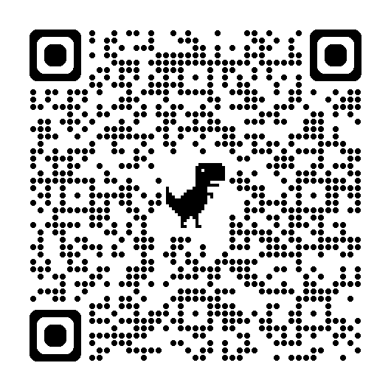
Inside Mathematics Videos for MP 4: Model With Mathematics
Learning Activity
Watch a video or a group of videos at the grade level(s) you teach or the grade band you work with.
Look for examples of where MP 4 is present in the video(s).
Discuss your observations with a colleague or colleagues.
Inside Mathematics MP 4 Videos
Notes:
https://www.insidemathematics.org/common-core-resources/mathematical-practice-standards/standard-4-model-mathematics
Classroom Observations
Teachers who are developing students’ capacity to "model with mathematics" move explicitly between real-world scenarios and mathematical representations of those scenarios. A middle childhood teacher might pose a scenario of candy boxes containing multiple flavors to help students identify proportions and ratios of flavors and ingredients. An early adolescence teacher might represent a comparison of different DVD rental plans using a table, asking the students whether or not the table helps directly compare the plans or whether elements of the comparison are omitted. A teacher of adolescents and young adults might pose a "kite factory" scenario, in which advanced students are asked to determine the conditions for always creating a particular shape of kite given the dimensions of the diagonals and the angle of intersection. See the video excerpts to observe multiple examples of teachers engaging students in mathematical modeling.

Slide 39
ROBERT KAPLINSKY’S READABLE
Math Practice 4: Ask Questions About the World
Mathematically proficient students ask and answer questions about the world. They begin with a question in mind, determine what information is needed to answer it, and get the information. Next, they use that information to create a mathematical representation to answer the question. Then, they verify whether their representation works or needs improvement. If necessary, they repeat this process, adjusting both what information they use and how they use it until they sufficiently answer the question.
Source: https://robertkaplinsky.com/
Notes:
https://robertkaplinsky.com/making-the-ccss-math-practices-readable-mp-4/
When re-writing this Practice, Robert Kaplinsky found this to be the hardest of the 8 to revise. For this reason, he made it the longest worded Practice in his readable series. It was very hard for me to stick to my guiding principle of “perfection is attained not when there is nothing more to add, but when there is nothing more to remove.” For example, I wanted to add examples of what math modeling could look like, but didn’t.
I went back and forth about whether to include “about the world” in the first sentence. On the one hand, it doesn’t necessarily have to be about the world. On the other hand, if I don’t add it, then it sounds like anytime you use math to answer questions, it is math modeling.
As much as I believe in the importance of mathematical modeling, I believe that it is absolutely essential to take the word “model” out of the title if we want people to understand it. I know that will seem blasphemous to some people, but my goal is to make a version that educators, parents, and students can all understand. If we include the word model, it will continue to be misunderstood. So, while this standard is still about mathematical modeling, I chose not to call it that.

Slide 40
MP | Needs Improvement | Emerging | Proficient | Exemplary
MP 4: Model with Mathematics. | Forgets that attempting to make a simpler problem is a viable strategy. | Attempts to make a simpler problem; struggles to or forgets to identify assumptions. | Uses and identifies assumptions and approximations to make a simpler problem. | Uses and identifies, assumptions and approximations to make a simpler problem; explains how assumptions and/or approximations affect their solution.
 | Struggles or forgets to make a model or chooses an inappropriate model. | Uses a model to describe patterns or trends; it may be incomplete or partial model; explains the appropriateness of their model. | Identifies important quantities and maps their relationships using tools such as diagrams, two-way tables, graphs, flowcharts, and/or formulas, etc.; uses their model to describe patterns or trends; evaluates and explains appropriateness of their model. | Creates a model based upon important quantities; evaluates and explains the appropriateness of their model including variables and procedures; reflects on their model and makes any necessary revisions.
 | Struggles or forgets to identify variables. | Can correctly identify some, but not all, of the variables. | Identifies and justifies choice of variables in the problem; identifies extraneous or missing information. | Identifies and justifies choice of all variables in the problem; identifies extraneous information; seeks out missing information.
 | Struggles or forgets to compute results correctly; has difficulty interpreting their results. | Computes results correctly, but interprets their results, incorrectly, or interprets their results but computes incorrectly. | Computes and interprets results correctly and reports findings using a mixture of representations. | Computes and interprets results and justifies the reasonableness of their results and procedures within the task’s context.
 | Struggles or forgets to check work. | Checks some calculations. | Checks calculations and checks to see if an answer makes sense within the context of a situation. | Checks to see if an answer makes sense within the context of a situation and changes a model when necessary.

Slide 41
BREAKOUT ROOM 5/DISCUSSION
MP 5: Use Appropriate Tools Strategically.
Standards for Mathematical Practice
Kindergarten - Grade 5
Grades 6-8
High School
Look at the DEW documents on the MPs
What theme(s) do you notice with the MP?
What stands out to you about this MP?
Notes:
MPs: https://education.ohio.gov/getattachment/Topics/Learning-in-Ohio/Mathematics/Model-Curricula-in-Mathematics/Standards-for-Mathematical-Practice/Standards-for-Mathematical-Practice.pdf.aspx

Slide 42
MP 5: Use Appropriate Tools Strategically.
Notes:
This is what CCSS-M says about MP5. As mentioned earlier, it’s readability score is 15.6 out of 100. That scores means it is the most difficult MP to read according to the Reading Ease formula. Now, let’s break down what this MP means and what evidence to look for at your grade level or course.
Mathematically proficient students consider the available tools when solving a mathematical problem. These tools might include pencil and paper, concrete models, a ruler, a protractor, a calculator, a spreadsheet, a computer algebra system, a statistical package, or dynamic geometry software. Proficient students are sufficiently familiar with tools appropriate for their grade or course to make sound decisions about when each of these tools might be helpful, recognizing both the insight to be gained and their limitations. For example, mathematically proficient high school students analyze graphs of functions and solutions generated using a graphing calculator. They detect possible errors by strategically using estimation and other mathematical knowledge. When making mathematical models, they know that technology can enable them to visualize the results of varying assumptions, explore consequences, and compare predictions with data. Mathematically proficient students at various grade levels are able to identify relevant external mathematical resources, such as digital content located on a website, and use them to pose or solve problems. They are able to use technological tools to explore and deepen their understanding of concepts.

Slide 43
MP 5: Use Appropriate Tools Strategically.
Consider and use tools as a way to understand, represent, and solve problems
Tools refers to language, materials, and symbols that help students record and communicate their solution method(s)
Common tools may include:
    Pencils/paper
    Physical or virtual manipulatives
    Pictures or drawings
    Calculators
    Etc.
Notes:
In MP 5, students must consider and use tools as a way to understand, represent, and solve problems. Students learn to use tools to construct and make sense of concepts for themselves; not just watch others demonstrate using the tools. The phrases mathematical tools refers to language, materials, symbols that help students record and communicate their solution method. Tools help shape the way students think about and understand certain math concepts. Teachers must expose students to various tools from physical manipulatives to software so students can use the tools to support their learning and deepen understanding. In elementary, students should be encouraged to develop and use tools that make sense to them. Often these tools will be those tools that directly model the task at hand. Typical tools for these tasks may include pencils/paper, physical manipulatives, fingers, pictures, drawings, or calculators. In middle and high school, students progress to using more abstract models and representations. Middle and high school may continue to use concrete models. They expand their use of tools to include more sophisticated tools such as dynamic graphing software or or other advanced technologies. .

Slide 44
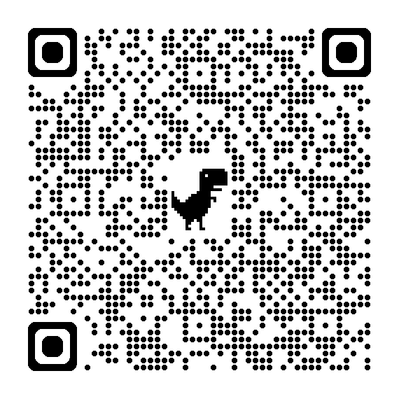
Inside Mathematics Videos for MP 5: Use Appropriate Tools Strategically
Learning Activity
Watch a video or a group of videos at the grade level(s) you teach or the grade band you work with.
Look for examples of where MP 5 is present in the video(s).
Discuss your observations with a colleague or colleagues.
Inside Mathematics MP 5 Videos
Notes:
https://www.insidemathematics.org/common-core-resources/mathematical-practice-standards/standard-5-use-appropriate-tools-strategically
Classroom Observations
Teachers who are developing students' capacity to "use appropriate tools strategically" make clear to students why the use of manipulatives, rulers, compasses, protractors, and other tools will aid their problem-solving processes. A middle childhood teacher might have their students select different color tiles to show repetition in a patterning task. A teacher of adolescents and young adults might have established norms for accessing tools during the students' group "tinkering processes," allowing students to use paper strips, brass fasteners, and protractors to create and test quadrilateral "kite" models. See the video excerpts to observe multiple examples of these teachers.

Slide 45
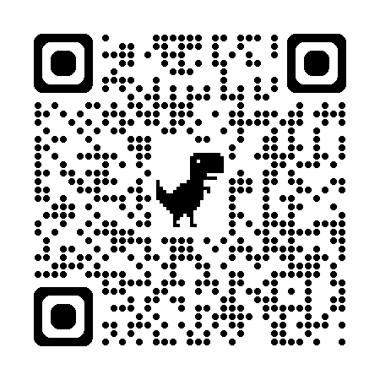
ROBERT KAPLINSKY’S READABLE
Math Practice 5: Use Tools to Make Sense of Mathematics
Mathematically proficient students use tools when they are helpful with making sense of mathematics. This includes physical tools (such as rulers, calculators, and manipulatives), virtual tools (such as graphing software and spreadsheets), or self-created tools (such as tables to organize data or estimation to see if an answer is reasonable).
Source: https://robertkaplinsky.com/
Notes:
https://robertkaplinsky.com/making-the-ccss-math-practices-readable-mp-5/
Most of this standard is a list of examples of what this might look like. While this is helpful, to Robert Kaplinsky, it felt like it was so wordy that important nuggets such as “they detect possible errors by strategically using estimation” get lost.

Slide 46
MP | Needs Improvement | Emerging | Proficient | Exemplary
MP 5: Use appropriate tools strategically. | Needs teacher or classmate to instruct them on which tool to choose. | Selects an appropriate tool but is unsure how to use the tool to complete the task. Able to use the tool with some assistance. | Makes sound decisions about the use of specific tools; chooses and uses tools including technology independently to complete tasks. | Makes sound decisions about multiple tools including technology flexibly to complete tasks finding appropriate alternatives when typical tools are not available.
 | Struggles or forgets to consider whether or tool is effective or has limitations. | Evaluates some of the effectiveness or limitations of a tool. | Thoroughly evaluates effectiveness or limitations of a tool. | Evaluates effectiveness or limitation or limitations of a tool and leverages that knowledge when analyzing a solution to a problem.
 | Has difficulty using tools including technology correctly or efficiently; has difficulty using tools appropriately in exploration of concepts | Uses tools including technology correctly but inefficiently; uses tools appropriately to explore understanding of concepts but struggles to reach conclusions. | Uses tools including technology correctly, efficiently, and strategically; uses technological tools appropriately to explore understanding of concepts and is able to reach conclusions. | Uses tools including technology correctly, efficiently, and strategically; uses technological tools to deepen understanding of concepts, visualize the results of assumptions, explore consequences, and compare predictions with data.
 | Struggles or forgets to consider when a solution provided by technology does not make sense. | Realizes when a solution provided by technology does not make sense. | Evaluates the results produced by technology to detect possibly errors by strategically using estimation and other mathematical knowledge. | Evaluates the results produced by technology to detect possibly errors, adjusting the tool, revising solutions or choosing other technological platforms when necessary.

Slide 47
Breakout Room 6/Discussion
MP 6: Attend to precision.
Standards for Mathematical Practice
Kindergarten - Grade 5
Grades 6-8
High School
Look at the DEW documents on the MPs
What theme(s) do you notice with the MP?
What stands out to you about this MP?
Notes:
MPs: https://education.ohio.gov/getattachment/Topics/Learning-in-Ohio/Mathematics/Model-Curricula-in-Mathematics/Standards-for-Mathematical-Practice/Standards-for-Mathematical-Practice.pdf.aspx

Slide 48
MP 6: Attend to Precision.
Notes:
Mathematically proficient students try to communicate precisely to others. They try to use clear definitions in discussion with others and in their own reasoning. They state the meaning of the symbols they choose, including using the equal sign consistently and appropriately. They are careful about specifying units of measure, and labeling axes to clarify the correspondence with quantities in a problem. They calculate accurately and efficiently, express numerical answers with a degree of precision appropriate for the problem context. In the elementary grades, students give carefully formulated explanations to each other. By the time they reach high school they have learned to examine claims and make explicit use of definitions.

Slide 49
MP 6: Attend to Precision.
Precision includes both a precision of language and number
Examples of precision may include:
        Presenting understandable work
        Explaining or summarizing another’s thinking
        Asking coherent questions
        Defining the variables in an equation or expression
        Providing proper labels for a graph, chart, or table
        Using the appropriate units with quantities
        Using the equal sign correctly
Notes:
In MP 6, we see an emphasis on precision. The word precision includes both a precision of language and number. Evidence of precision can be students presenting their work in a way that can be understood, explaining or summarizing another’s thinking, or by asking coherent questions. The intended interpretation of this practice is not for teachers to increase vocabulary assignments or require recall of precise mathematical terms and definitions. Instead, the precision associated with this practice can be demonstrated by defining the variables in an equation or expression, providing proper labels for a graph, chart, or table, using the appropriate unit when expressing quantities, or using the equal sign correctly (i.e. 2 + 5 = 7 + 3 = 10 is not a correct use of the equal sign). By the end of high school, students should be able to write well-constructed math arguments using formal vocabulary.

Slide 50
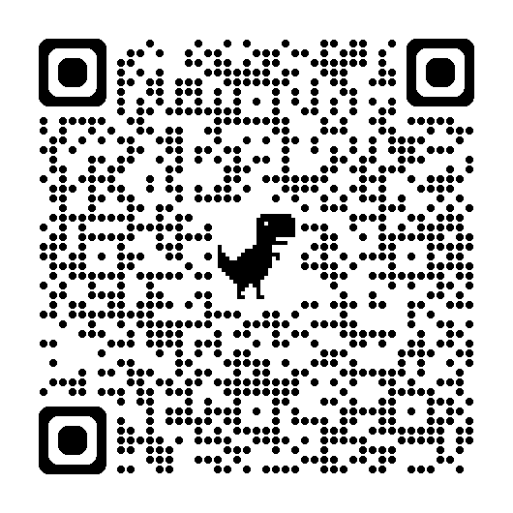
Inside Mathematics Videos for MP 6: Attend to Precision
Learning Activity
Watch a video or a group of videos at the grade level(s) you teach or the grade band you work with.
Look for examples of where MP 6 is present in the video(s).
Discuss your observations with a colleague or colleagues.
Inside Mathematics MP 6 Videos
Notes:
https://www.insidemathematics.org/common-core-resources/mathematical-practice-standards/standard-6-attend-precision
Classroom Observations
Teachers who are developing students’ capacity to "attend to precision" focus on clarity and accuracy of process and outcome in problem solving. A middle childhood teacher might engage his students in a "number talk" in which students use an in/out table and a plotted graph to "guess [the teacher’s] number." An early adolescence teacher might distribute cards with different symbol strings to his students, asking them to mingle in groups and categorize their symbol strings, explaining and defending their groupings. A teacher of adolescents and young adults might continually probe her students to defend whether their requirements for a particular quadrilateral will always be the case, or whether there are some flaws in their group’s thinking that they need to refine and correct. See the videos to observe multiple examples of teachers engaging students in attending to precision.

Slide 51
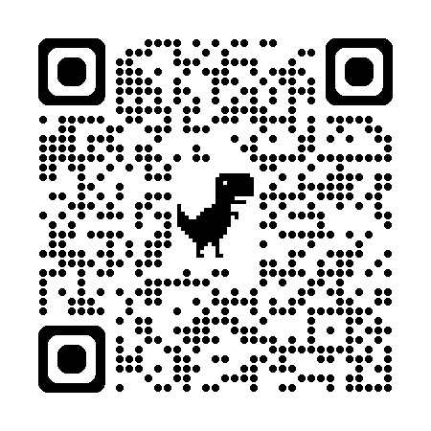
ROBERT KAPLINSKY’S READABLE
Math Practice 6: Communicate Precisely
Mathematically proficient students communicate precisely with others. This includes using proper definitions, defining their variables, specifying their units, and labeling axes.
Source: https://robertkaplinsky.com/
Notes:
https://robertkaplinsky.com/making-the-ccss-math-practices-readable-mp-6/
Robert Kaplinsky went with the language of “Communicate precisely” because the phrasing “attend to precision” is not particularly common in the United States, and people often think this standard is more about calculating than communicating. Lastly, he removed the words “try to” in the first sentence because that felt unnecessary.

Slide 52
MP | Needs Improvement | Emerging | Proficient | Exemplary
MP.6 Attend to Precision. | Struggles or forgets to address the question completely or directly; gives incomplete or wrong responses. | Makes an incomplete attempt to answer the question; struggles or forgets to formulate further responses when necessary. | Answers the question of interest thoroughly and precisely; provides carefully formulated explanations; revises responses when necessary. | Answers the question of interest thoroughly and precisely; provides carefully formulated explanations; identifies when others are not addressing the question completely.
 | Has difficulty communicating; struggles to decipher appropriate depth of communication needed, e.g., goes off on tangents or does not provide relevant information. | Communicates with vague or incorrect terminology. | Communicates clearly with a good grasp of the mathematical terminology. uses mathematical vocabulary carefully. | Communicates clearly and concisely, examining claims and making explicit use of mathematical definitions.
 | Calculates inaccurately; forgets to specify the meaning of symbols and units and to provide labels. | Calculates accurately but not precisely, occasionally specifying the meaning of symbols and units and providing labels. | Calculates accurately and efficiently, expressing numerical answers with a degree of precision; states the meaning of symbols, specifying units of measure and providing accurate labels. | Calculates accurately and efficiently and uses proper precision in procedures; states the meaning of symbols, carefully specifying units of measure and providing accurate labels.
 | Forgets to determine the necessary level of precision. | Determines a level of precision; may not be the best choice. | Determines the necessary level of precision; distinguishes between exact and approximate answers and determines which is more useful depending on the context. | Determines the necessary level of precision noting error or uncertainty; distinguishes between exact and approximate answers and determines which is more useful depending on the context.

Slide 53
BREAKOUT ROOM 7/DISCUSSION
MP 7: Look for and Make Use of Structure.
Standards for Mathematical Practice
Kindergarten - Grade 5
Grades 6-8
High School
Look at the DEW documents on the MPs
What theme(s) do you notice with the MP?
What stands out to you about this MP?
Notes:
MPs: https://education.ohio.gov/getattachment/Topics/Learning-in-Ohio/Mathematics/Model-Curricula-in-Mathematics/Standards-for-Mathematical-Practice/Standards-for-Mathematical-Practice.pdf.aspx

Slide 54
MP 7: Look For and Make Use of Structure.
Notes:
Mathematically proficient students look closely to discern a pattern or structure. Young students, for example, might notice that three and seven more is the same amount as seven and three more, or they may sort a collection of shapes according to how many sides the shapes have. Later, students will see 7 × 8 equals the well-remembered
7 × 5 + 7 × 3, in preparation for learning about the distributive property. In the expression $x^{2}$ + 9 $x$ + 14, older students can see the 14 as 2 × 7 and the 9 as 2 + 7. They recognize the significance of an existing line in a geometric figure and can use the strategy of drawing an auxiliary line for solving problems. They also can step back for an overview and shift perspective. They can see complicated things, such as some algebraic expressions, as single objects or as being composed of several objects. For example, they can see 5 - 3${(x − y)}^{\text{2}}$ as 5 minus a positive number times a square and use that to realize that its value cannot be more than 5 for any real numbers $x$ and $y$.

Slide 55
MP 7: Look For and Make Use of Structure.
Look for connections between the conceptual and abstract levels
Create and use representations to organize, record, and communicate math ideas
Make ideas available for deeper reflection and allow for explicit connections
Demonstrate flexibility with numbers
Understand or recognize patterns and functions
Notes:
MP 7 emphasizes the importance of structure. Structure is a common root of patterns and generalizations. In this MP, we look for connections between the conceptual and abstract levels.This type of recognition helps students discover new math knowledge. Being able to “see structure” often means stepping back or shifting perspective. Students can demonstrate an understanding of MP 7 by creating and using representations to organize, record, and communicate math ideas. Demonstrating an understanding of structure helps make ideas available for deeper reflection and allows for explicit connections back to the math. Evidence of MP 7 can be see whenever students demonstrate a flexibility with numbers, and when they understand or recognize patterns and functions.

Slide 56
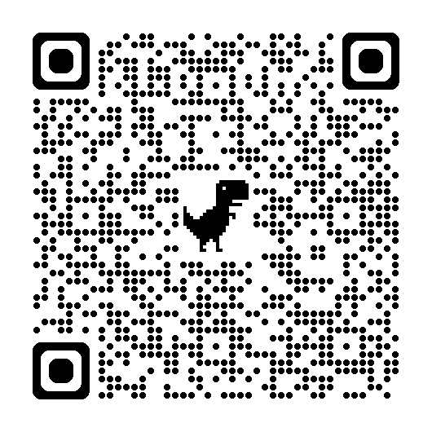
Inside Mathematics Videos For
MP 7: Look For and Make Use of Structure
Learning Activity
Watch a video or a group of videos at the grade level(s) you teach or the grade band you work with.
Look for examples of where MP 7 is present in the video(s).
Discuss your observations with a colleague or colleagues.
Inside Mathematics MP 7 Videos
Notes:
https://www.insidemathematics.org/common-core-resources/mathematical-practice-standards/standard-7-look-make-use-structure
Classroom Observations
Teachers who are developing students’ capacity to "look for and make use of structure" help learners identify and evaluate efficient strategies for solutions. An early childhood teacher might help students identify why using "counting on" is preferable to counting each addend by one, or why multiplication or division can be preferable to repeated addition or subtraction. A middle childhood teacher might help his students discern patterns in a function table to "guess my rule." A teacher of adolescents and young adults might focus on exploring geometric processes through patterns and proof. See the video excerpts to observe multiple examples of teachers engaging students in identifying and making use of mathematical structure.

Slide 57
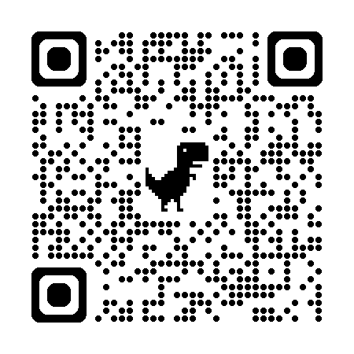
ROBERT KAPLINSKY’S READABLE
Math Practice 7: Simplifying Problems by Using Their Structure
Mathematically proficient students use patterns and structure to strategically transform complicated problems into one or more simpler problems. For example, a student may think of 99 + 46 as 100 + 45 or find the area of a complicated shape by breaking it into multiple simpler shapes.
Source: https://robertkaplinsky.com/
Notes:
https://robertkaplinsky.com/making-the-ccss-math-practices-readable-mp-7/
If necessary, you can consider leaving this standard as just the first sentence. Ultimately, Robert Kaplinsky decided to use a pair of examples to illustrate the full meaning of the Mathematical Practice.
You can also consider adding even more examples, like the original standard, in conversations where less formal language or jargon will be helpful to your audience. In this example, Robert Kaplinksy felt that it would break my guiding principle of “perfection is attained not when there is nothing more to add, but when there is nothing more to remove.”
In writing the readable language for the Practice, Kaplinsky struggled with the revised name for this standard. He could just as easily have used words like “breaking,” “transforming,” or “manipulating”.

Slide 58
MP | Needs Improvement | Emerging | Proficient | Exemplary
MP 7: Look for and Make Use of Structure. | Applies an algorithm or method without evaluating their choice; has difficulty using an efficient or appropriate approach. | Uses only one appropriate method or algorithm for a problem even though there may be more efficient approaches. | Analyzes a task and finds more than one method or algorithm to a problem; takes efficiency into consideration. | Uses the most efficient method, algorithm, or solution path for a task based on mathematical structure.
 | Has difficulty articulating why they chose an algorithm or solution path. | Analyzes a task before automatically applying an algorithm or solution path; explains why they choose an algorithm or solution path. | Analyzes a task before automatically applying an algorithm or solution path; articulates and justifies their choice of algorithm or solution path. | Analyzes the task before automatically applying an algorithm or solution path; articulates and justifies choice of algorithm or solution path, defends their choice, and questions others’ choices.
 | Has difficulty recognizing that quantities can be represented in different ways. | Looks for patterns or structures, recognizing that quantities can be represented in different ways; recognizes equivalent forms, but may not be able to choose the best form to use. | Recognizes the significance in concepts and models and use the patterns or structure within a problem to solve related problems; changes structure(s) to an appropriate equivalent form(s) to solve a problem; interprets, models, and connects multiple representations. | Steps back and shifts perspectives based on a problem’s structure; identifies similarities between different mathematical forms and uses patterns from known situations to solve nonroutine problems; chooses an equivalent structure based on efficiency or its power to communicate solution.
 | Struggles or forgets to analyze the reasonableness of intermediate results. | Recognizes when intermediate results do not make sense. | Analyzes reasonableness of intermediate results and if results don’t make sense, determines why they don’t. | Analyzes reasonableness of intermediate results and changes course to a more effective or efficient process.
 | Has difficulty viewing simple quantities both as single objects and as composition of several objects. | Views simple quantities both as single objects or as a composition of several objects and uses operations to make sense of a problem. | View complicated quantities both as single objects or composition(s) of several objects and uses operations to make sense of a problem. | Views and analyses complicated quantities both as single objects or composition(s) of several objects and uses operations flexibly to make sense of a problem.

Slide 59
BREAKOUT ROOM 8/DISCUSSION
MP 8: Look For and Express Regularity in Repeated Reasoning.
Standards for Mathematical Practice
Kindergarten - Grade 5
Grades 6-8
High School
Look at the DEW documents on the MPs
What theme(s) do you notice with the MP?
What stands out to you about this MP?
Notes:
MPs: https://education.ohio.gov/getattachment/Topics/Learning-in-Ohio/Mathematics/Model-Curricula-in-Mathematics/Standards-for-Mathematical-Practice/Standards-for-Mathematical-Practice.pdf.aspx

Slide 60
MP 8: Look For and Express Regularity in Repeated Reasoning.
Notes:
Mathematically proficient students notice if calculations are repeated, and look both for general methods and for shortcuts. Upper elementary students might notice when dividing 25 by 11 that they are repeating the same calculations over and over again, and conclude they have a repeating decimal. By paying attention to the calculation of slope as they repeatedly check whether points are on the line through (1, 2) with slope 3, middle school students might abstract the equation $\frac{\text{(}\text{y} \text{− }\text{2}\text{)}}{\text{(}x\text{ − }\text{1}\text{)}}$ = 3. Noticing the regularity in the way terms cancel when expanding ($x$ - 1)($x$ + 1), ($x$ - 1)($x^{2}$ + $x$ + 1), and ($x$ - 1)($x^{3}$ + $x^{2}$ $x$ + 1) might lead them to the general formula for the sum of a geometric series. As they work to solve a problem, mathematically proficient students maintain oversight of the process while attending to the details. They continually evaluate the reasonableness of their intermediate results.

Slide 61
MP 8: Look For and Express Regularity in Repeated Reasoning.
Looks for patterns
Consider generalities, limitations, and make connections across past & present reasonings
Engages students in active sense-making
Encourages discovery and expression of identified generalizations
Notes:
MP 8 includes the type of thinking students engage with as they work through procedures. Students should look for patterns, consider generalities, limitations, and make connections across past & present reasonings. MP 8 is about engaging students in active sense making. Here we focus on making students aware of the potential for generalizations. This practice encourages discovery and expression of identified generalizations. There is a disposition for seeking patterns that hinges on students recognition of something that makes sense. Once students are looking for regularity in their work. It’s important for teachers to find ways for students to express those regularities.

Slide 62
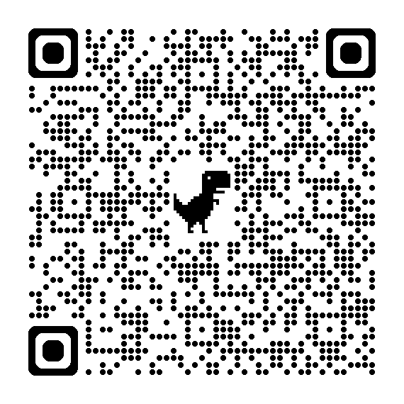
Inside Mathematics Videos For
MP 8: Look For and Express Regularity in Repeated Reasoning
Learning Activity
Watch a video or a group of videos at the grade level(s) you teach or the grade band you work with.
Look for examples of where MP 8 is present in the video(s).
Discuss your observations with a colleague or colleagues.
Inside Mathematics MP 8 Videos
Notes:
https://www.insidemathematics.org/common-core-resources/mathematical-practice-standards/standard-7-look-make-use-structure
Classroom Observations
Integrating Standard Eight into classroom practice is not only a matter of planning lessons that occasion students to look for general methods and shortcuts. It also requires teachers to attend to and listen closely to their students’ noticing's and “a-ha moments,” and to follow those a-ha moments so that they generalize to the classroom as a whole. The video clips included here are intended to show, as a composite, how teachers create the conditions for students to look for and express regularity in repeated reasoning and follow and elaborate on students’ thinking when they begin to make these connections.

Slide 63
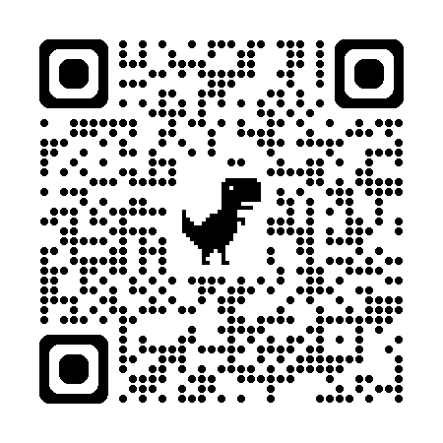
ROBERT KAPLINSKY’S READABLE
Math Practice 8: Simplify Problems by Noticing Patterns
Mathematically proficient students notice patterns and use them to simplify problems. For example, a student may notice repeated addition and multiply instead or may create a function to represent a repeated operation.
Source: https://robertkaplinsky.com/
Notes:
https://robertkaplinsky.com/making-the-ccss-math-practices-readable-mp-8/
The readable language in this practice is intentionally mirrored after some of the language from Math Practice 7. A reason for this is that many people, including Robert Kaplinsky, see Math Practices 7 and 8 as two sides of the same coin. Math Practice 7 is about breaking things apart, and Math Practice 8 is about putting them together.

Slide 64
MP | Needs Improvement | Emerging | Proficient | Exemplary
MP 8: Look for and Express Regularity in Repeated Reasoning. | Examines task in isolation; struggles with understanding the hierarchy within concepts; cannot recognize a known problem within a different context. | Starts to draw connections to prior or future concepts; can complete a similar problem with prompting to get started | Draws connections to prior or future concepts to develop understanding of procedural tasks; can complete a similar problem to get started. | Connects tasks to prior concepts and tasks and evaluates which concepts are most efficient and applies strategies to nonroutine tasks.
 | Struggles with demonstrating a logical progression that leads to pattern recognition. | Demonstrates a logical progression that leads to pattern recognition but applies an incorrect progression for the context. | Demonstrates a logical progression that leads to pattern recognition and a solution based on a pattern of repeated reasoning. | Demonstrates a logical progression that leads to pattern recognition and applies solutions based on repeated reasoning to a new situation including nonroutine tasks.
 | Struggles with noticing general methods or shortcuts or forgets to look for general methods or shortcuts. | Uses memorized shortcuts without understanding its basis on repeated calculations. | Notices repeated calculations and look for general methods and shortcuts based on repeated calculations. | Generalizes processes and applies them to higher-level problem solving implementing short cuts; generates exploratory questions based on the current task; articulates multiple approaches and/or answers to a problem.
 | Struggles to or forgets to monitor intermediate results. | Occasionally monitors intermediate results asking “Why?” when something doesn’t work. | Continually evaluates the reasonableness of intermediate results while attending to the details and make generalizations based on findings. | Continually evaluates the reasonableness of intermediate results while attending to the details and make generalizations based on findings; encourages peers to monitor each other’s intermediate results.

Slide 65
RESOURCE LINKS
Ohio Department of Education and Workforce Documents
Standards for Mathematical Practice
Kindergarten - Grade 5
Grades 6-8
High School
University of Arizona Progressions
Standards for Mathematical Practice: Commentary and Elaborations for K-5
Standards for Mathematical Practice: Commentary and Elaborations for 6-8
Other National Resources
Inside Mathematics
Illustrative Mathematics
Robert Kaplinsky: Math CCSS Math Practices Readable
Notes:
Ohio Department of Education and Workforce Documents
Standards for Mathematical Practice
Kindergarten - Grade 5
Grades 6-8
High School
Arizona Progressions
Standards for Mathematical Practice: Commentary and Elaborations for K-5
Standards for Mathematical Practice: Commentary and Elaborations for 6-8
National Resources
Inside Mathematics
Illustrative Mathematics

Slide 66
REFERENCES:
Illustrative Mathematics. (2014, February 12). Standards for Mathematical Practice: Commentary and Elaborations for K–5. Tucson, AZ.
Illustrative Mathematics. (2014, May 6). Standards for Mathematical Practice: Commentary and Elaborations for 6–8. Tucson, AZ.
Koestler, C., Felton-Koestler, M. D., Bieda, K., & Otten, S. (2013). Connecting the NCTM process standards and the CCSSM practices. Reston, VA: The National Council of Teachers of Mathematics.
O'Connell, S., & SanGiovanni, J. (2013). Putting the practices into action: Implementing the common core standards for mathematical practice, K-8. Portsmouth, NH: Heinemann.

Slide 67
MATHEMATICS QUESTIONS?
Email
Mathematics@education.ohio.gov

