Slide 1
MP 2: Reason Abstractly and Quantitatively
Brian Bickley ∙ March 8, 2022

Slide 2
Welcome

Slide 4
Virtual Meeting Norms
Be respectful.
Recognize that everyone has expertise.
Assume positive intent.
Seek clarification in language and ideas.
Share experiences.
Use the chat feature when you have a question.
Mute your microphone when not speaking.

Slide 5
Each Child Our Future
Notes:
As many of you already know, the Department has the Ohio Strategic Plan which is often referred to as “Each Child, Our Future”.

Slide 6
Each Child Our Future
Our Vision
In Ohio, each child is challenged to discover and learn, prepared to pursue
a fulfilling post-high school path and empowered to become a resilient,
lifelong learner who contributes to society.
Notes:
The vision of the strategic plan is that in Ohio, each child is challenged to discover and learn, prepared to pursue a fulfilling post-high school path and empowered to become a resilient, lifelong learner who contributes to society. One of the main foci of the high school math pathways is help make sure high school students are better prepared to pursue a post-high school fulfilling path. One of the ways this vision ties into the presentation today and the Standards for Mathematical Practices in general, is that no matter the grade level or the high school course, we want all students to be prepared to be diverse problem-solvers and strong communicators.

Slide 7
Math Practices
Make sense of problems and persevere in solving them.
Reason abstractly and quantitatively.
Construct viable arguments and critique the reasoning of others.
Model with mathematics.
Use appropriate tools strategically.
Attend to precision.
Look for and make use of structure.
Look for and express regularity in repeated reasoning.
Notes:
One of the ways the vision in Each Child, Our Future ties into the presentation today is through the Standards for Mathematical Practices in general. No matter the grade level or the high school course, we want all students to be prepared to be diverse problem-solvers and strong communicators. As you look at the Standards for Mathematical Practice as a whole, you will see those as themes that cut across all 8 practices. Today, in this session, we are going to focus on Math Practice 2: Reason Abstractly and Quantitatively.

Slide 8
What comes to your mind when you think about MP 2: Reason Abstractly and Quantitatively?
Click here to go JamBoard Activity
Notes:
For those in the live session or participating in the PD through the on-demand recording, we are going to start with a JamBoard activity. If you are watching this session as a recording on-demand, rather than using the JamBoard, you can pause the video temporarily to engage in discussion with your colleagues about “what comes to mind when you think about Math Practice 2: Reason Abstractly and Quantitatively”?
Link: https://jamboard.google.com/d/1d8Wgqn2UbRQD84WX9ibRNIWxqVx4YcVHS6-qO9qO314/edit?usp=sharing

Slide 9
Share Out

Slide 10
Looking at Tasks That Promote MP 2
Notes:
In a moment, we are going to go into a series of break-out rooms. Attendees in the live session will want to select the break-out room for the grade band that best aligns with where you work most. If you are a curriculum director, coach, ESC staff, higher ed, or serve in another educational role those spans multiple grade levels, simply select which breakout room is best for you.
Meanwhile, for those viewing this session recording on-demand, in a moment you will want to pause the video so you and your colleagues can view and discuss the tasks at your grade band. You are even welcome to discuss the tasks across multiple grade bands if you want to look at MP 2 along a multi-grade progression to see how it evolves through the years.
As you discuss the tasks share with each other:
What do you notice?
What do you wonder?
What commonalities are evident across the tasks?
What are the differences across the tasks?
Where in the task are their opportunities for students to show their understanding of MP 2?
As a teacher, how would you highlight this with your instruction?
These questions are listed in the notes of the PPT slides in case any on-demand audience members want to post them for their discussions with colleagues locally.

Slide 11
Breakout Rooms
Click link to view Google Slides 2-11
Notes:
Break out room slide
http://bit.ly/VPDSMP6

Slide 12
Grades K-2 Problems For MP 2
A squirrel has 7 acorns. He shares some acorns with his squirrel friend. How many acorns do both squirrels now have?
If I have 26 Skittles® and Marie has 40, how many more do I need to have as many as Marie?
Miguel had 6 pretzels. He ate 4. How many does he have left?
Notes:
Mathematically proficient students at the elementary grades make sense of quantities and their relationships in problem situations. They can contextualize quantities and operations by using images or stories. They interpret symbols as having meaning, not just as directions to carry out a procedure. Even as they manipulate the symbols, they can pause as needed to access the meaning of the numbers, the units, and the operations that the symbols represent. Mathematically proficient students know and flexibly use different properties of operations, numbers, and geometric objects.
Mathematically proficient students can contextualize an abstract problem by placing it in a context they then use to make sense of the mathematical ideas. For example, when a student sees the expression 40 − 26, she might visualize this problem by thinking, if I have 26 Skittles and Marie has 40, how many more do I need to have as many as Marie? Then, in that context, she thinks, 4 more will get me to a total of 30, and then 10 more will get me to 40, so the answer is 14. In this example, the student uses a context to think through a strategy for solving the problem, using the relationship between addition and subtraction and decomposing and recomposing the quantities. She then uses what she did in the context to identify the solution of the original abstract problem.
Mathematically proficient students can also make sense of a contextual problem and express the actions or events that are described in the problem using numbers and symbols. If they work with the symbols to solve the problem, they can then interpret their solution in terms of the context. For example, to find the area of the floor of a rectangular room that measures 5 m. by 6 m., a student might represent the problem as an equation, solve it mentally, and record the problem and solution as 5 × 6 = 60. He has decontextualized the problem. When he states at the end that the area of the room is 60 square meters, he has contextualized the answer in order to solve the original problem. Problems like this that begin with a context and are then represented with mathematical objects or symbols are also examples of modeling with mathematics (MP.4).

Slide 13
Grades K-2 Problems For MP 2
There are 3 little dogs and 4 big dogs at the park. How many total dogs are at the park?
Jasmine has 10 pennies in her pocket. One penny fell out. How many pennies are left in Jasmine’s pocket?
Draw a picture or write a story to show 6  4 = 10.

Slide 14
Grades K-2 Problems For MP 2
Destiny played four basketball games. She scored:
21 points in the first game,
14 points in the second game,
24 points in the third game, and
11 points in the fourth game.
How many points did Destiny score in the four games combined?
Notes:
Where in the task are their opportunities for students to show their understanding of MP 2?
As a teacher, how would you highlight this with your instruction?

Slide 15
Grades 3-5 Problems For MP 2
There are 8 cupcakes on the plate. Three of them were chocolate and the rest were vanilla. What fraction of the cupcakes were vanilla?
Andrea plays video games for 90-minutes each day for seven days. How many hours did she spend playing video games?
There are 120 students, and 5 chaperones are going on a field trip. Each bus holds 35 people. How many buses are needed for the field trip?

Slide 16
Grades 3-5 Problems For MP 2
There are 6 soccer teams in a league. Each soccer team has 11 players. How many total players are in the soccer league?
Alejandro ate $\frac{1}{2}$ a pizza. Bianca ate $\frac{1}{3}$ of the same pizza. How much pizza did they eat?

Slide 17
Grades K-5 Problems For MP 2
Find the area of the floor of a rectangular room that measures 5 meters by 6 meters.
In the barnyard is an assortment of chickens and pigs. Counting heads, I get 13; counting legs I get 46. How many pigs and chickens are there?
Marcus bakes 24 cookies. He places them equally into 3 bags. How many bags does Marcus need?
Emani bakes a cake. She cuts the cake into equal pieces and shares a piece with each of her 5 friends. How much of the whole cake does each person receive?

Slide 18
Grades 6-8 Problems For MP 2
In the barnyard is an assortment of chickens and pigs. Counting heads, I get 13; counting legs I get 46. How many pigs and chickens are there?
Solve the equation and write a word problem that goes with 5 × 1.5 = n.
The four members of a bowling team scored 120, 136, 128, and 162 in a game. What is the team’s mean score?
Notes:
Mathematically proficient students at the elementary grades make sense of quantities and their relationships in problem situations. They can contextualize quantities and operations by using images or stories. They interpret symbols as having meaning, not just as directions to carry out a procedure. Even as they manipulate the symbols, they can pause as needed to access the meaning of the numbers, the units, and the operations that the symbols represent. Mathematically proficient students know and flexibly use different properties of operations, numbers, and geometric objects.
Mathematically proficient students can contextualize an abstract problem by placing it in a context they then use to make sense of the mathematical ideas. For example, when a student sees the expression 40 − 26, she might visualize this problem by thinking, if I have 26 Skittles and Marie has 40, how many more do I need to have as many as Marie? Then, in that context, she thinks, 4 more will get me to a total of 30, and then 10 more will get me to 40, so the answer is 14. In this example, the student uses a context to think through a strategy for solving the problem, using the relationship between addition and subtraction and decomposing and recomposing the quantities. She then uses what she did in the context to identify the solution of the original abstract problem.
Mathematically proficient students can also make sense of a contextual problem and express the actions or events that are described in the problem using numbers and symbols. If they work with the symbols to solve the problem, they can then interpret their solution in terms of the context. For example, to find the area of the floor of a rectangular room that measures 5 m. by 6 m., a student might represent the problem as an equation, solve it mentally, and record the problem and solution as 5 × 6 = 60. He has decontextualized the problem. When he states at the end that the area of the room is 60 square meters, he has contextualized the answer in order to solve the original problem. Problems like this that begin with a context and are then represented with mathematical objects or symbols are also examples of modeling with mathematics (MP.4).

Slide 19
Grades 6-8 Problems For MP 2
In the barnyard is an assortment of chickens and pigs. Counting heads, I get 13; counting legs I get 46. How many pigs and chickens are there?
Solve the equation and write a word problem that goes with 5 × 1.5 = n.
The four members of a bowling team scored 120, 136, 128, and 162 in a game. What is the team’s mean score?
Solve the following: |3x – 7| > 14

Slide 20
High School Problems for MP 2
There are g gallons of paint available to paint a house. After n gallons have been used , then in terms of g and n, what percent of the paint has not been used?
Two cities n miles apart are located s inches apart on a certain map that is drawn to scale. In terms of n and s, what is the distance, in inches, on the map between two cities that are (n + 1) miles apart?

Slide 21
High School Problems for MP 2
For a quadratic function f(x) = ax 2 + bx + c, determine whether it is possible that f(1) = f(2) = f(3).
Determine all the quadratic functions f(x) = ax 2 + bx + c that satisfy the relationship f(f(1)) = f(f(2)) = f(f(3)).
Task taken from mathpractices.edc.org

Slide 22
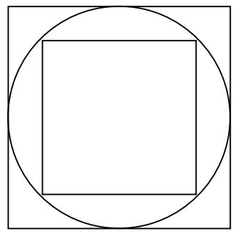
High School Problems for MP 2
This diagram shows a circle with one square inside and one square outside. The circle has radius r inches.
Write down the side of the large square in terms of r. _________ inches
Find the side of the small square in terms of r. _________ inches.
What is the ratio of the areas of the two squares?
Draw a second circle inscribed inside the small square. Find the ratio of the areas of the two circles.

Slide 23
Breakout Room
Discussion Share Out
Break out room slide
Break out 10-20 min.
Notes:
Where in the task are their opportunities for students to show their understanding of MP 2?
As a teacher, how would you highlight this with your instruction?

Slide 24
MP 2: Reason abstractly & quantitatively.
Mathematically proficient students make sense of quantities and their relationships in problem situations. They bring two complementary abilities to bear on problems involving quantitative relationships: the ability to decontextualize—to abstract a given situation and represent it symbolically and manipulate the representing symbols as if they have a life of their own, without necessarily attending to their referents—and the ability to contextualize, to pause as needed during the manipulation process in order to probe into the referents for the symbols involved. Quantitative reasoning entails habits of creating a coherent representation of the problem at hand; considering the units involved; attending to the meaning of quantities, not just how to compute them; and knowing and flexibly using different properties of operations and objects.
Notes:
The Ohio’s Learning Standards for Mathematical Practice (K-12) describe how students should demonstrate their mathematical proficiency. These standards “describe varieties of expertise that mathematics educators at all levels should seek to develop in their students” (Standards for Mathematical Practice, 2010). This is achieved by giving expectations for the depth of students’ understanding, the skills students should have, and how students should express what they know. Unfortunately, the MPs are written in a manner that makes them difficult for many educators to understand which makes their implementation difficult.
Each of the eight MPs are described a paragraph that begins with the words “Mathematically proficient students” followed by the specific expertise students should demonstrate. The standards contain 3 to 10 sentences each with individual sentences running as long as 69 words in length. If we were to use the Flesch Reading Ease formula to measure how easy the MPs are read, we would discover that the average a score of approximately 32. Some MPs scores are as low as 17.5 and 15.6 for Standards 2 and 5. These low scores means they are especially difficult to read.
For those who an unfamiliar with the Flesch Reading Ease formula, scores from this formula range from 0 to 100 with scores between 0-29 considered to be very difficult to read. For reference, Time Magazine articles average a score of approximately 55 and the nursery rhyme “Humpty Dumpty” scores a 79.7. For the rest of this session, we are going to look at each of the MPs and break them down in simpler language that will help make them easier to understand and later implement in our classrooms.
This is what CCSS-M says about MP 2. It’s very wordy. As mentioned earlier, it’s readability score is 17.5 out of 100. That scores means this is the second most difficult MP to read according to the Reading Ease formula. Now, let’s break down what this MP means and what evidence to look for at your grade level or course. What does this mean across when looking for evidence at your grade level or course?

Slide 25
Exploring Resources for MP 2
Notes:
For those of you watching the recording on-demand, in a moment we are going to be looking at a series of resources for Progression documents focused exclusively on MP 2. After you have had time to view the progressions, discuss with your colleagues what do you think Math Practice 2: Reason Abstractly and Quantitatively means or looks like at your grade level/course?
As with before, the discussion question is listed in the notes of the PPT slides in case any on-demand audience members want to post it for their discussions with colleagues locally.

Slide 26
MP 2 Progression: Reason abstractly and quantitatively.
Click link to Google Slides 13-16
Notes:
Google Slides: https://docs.google.com/presentation/d/1Tjj56z0IkBgyCuTyfCQUDdhQrPEtySZyueNCqI703hk/edit?usp=sharing

Slide 27
Breakout Rooms
Task: Review the MP progression documents.
Discussion question: What do you think Math Practice 2: Reason Abstractly and Quantitatively means or looks like at your grade level/course?
Notes:
Break out room slide
Discussion question: What do you think of when MP 2?
Break out time approx. 10-20 min. depending on the number of people

Slide 31
Notes:
Split the progression as Grades 6-A1 & Grade 8 – Geo

Slide 33
Resource Links
Standards for Mathematical Practice
Kindergarten - Grade 5
Grades 6-8
High School
Notes:
Standards for MP: https://education.ohio.gov/getattachment/Topics/Learning-in-Ohio/Mathematics/Model-Curricula-in-Mathematics/Standards-for-Mathematical-Practice/Standards-for-Mathematical-Practice.pdf.aspx

Slide 34
Breakout Room Discussion Share Out
Notes:
Dan

Slide 35
What does MP 2: Reason Abstractly and Quantitatively Look Like at My Grade Band?
Notes:
Now that you have had an opportunity to discuss what you think MP 2 looks like at your grade level and/or grade band, we are going to look at what some of the national resources on the Math Practices say.

Slide 36
MP 2: Reason abstractly and quantitatively.
Contextualized and decontextualized problems.
Connecting mathematical symbols and operations to real-world contexts.
Move back and forth between problem situations and symbolic notations.
Notes:
Contextualize & Decontextualize Problems: K-2 teachers will see evidence of this whenever students encounter addition and subtraction situations like change, addend, bigger, start, or smaller unknown problems in Table 1. Basically, the last two columns. Teachers in 3-5 can observe evidence of MP 2 with multiplication and division situations like group size and number of groups unknown problems

Slide 37
What does MP 2 look like at K-5?
Make sense of quantities and their relationships in problem situations.
Contextualize quantities and operations by using images or stories.
Contextualize an abstract problem by placing it in a context they then use to make sense of the mathematical ideas.
Notes:
Mathematically proficient students at the elementary grades make sense of quantities and their relationships in problem situations. K-2 teachers will see evidence of this whenever students encounter addition and subtraction situations like change, addend, bigger, start, or smaller unknown problems in Table 1. Basically, the last two columns. Teachers in 3-5 can observe evidence of MP 2 with multiplication and division situations like group size and number of groups unknown problems.
Mathematically proficient students can contextualize an abstract problem by placing it in a context they then use to make sense of the mathematical ideas. For example, when a student sees the expression 40 − 26, she might visualize this problem by thinking, if I have 26 marbles and Marie has 40, how many more do I need to have as many as Marie? Then, in that context, she thinks, 4 more will get me to a total of 30, and then 10 more will get me to 40, so the answer is 14. In this example, the student uses a context to think through a strategy for solving the problem, using the relationship between addition and subtraction and decomposing and recomposing the quantities. She then uses what she did in the context to identify the solution of the original abstract problem.
Mathematically proficient students can also make sense of a contextual problem and express the actions or events that are described in the problem using numbers and symbols. If they work with the symbols to solve the problem, they can then interpret their solution in terms of the context. For example, to find the area of the floor of a rectangular room that measures 10 m. by 12 m., a student might represent the problem as an equation, solve it mentally, and record the problem and solution as 10 × 12 = 120. He has decontextualized the problem. When he states at the end that the area of the room is 120 square meters, he has contextualized the answer in order to solve the original problem. Problems like this that begin with a context and are then represented with mathematical objects or symbols are also examples of modeling with mathematics (MP.4).

Slide 38
What does MP 2 look like at K-5?
Interpret symbols as having meaning, not just as directions to carry out a procedure.
Know and flexibly use:
different properties of operations,
numbers, and
geometric objects
Notes:
They interpret symbols as having meaning, not just as directions to carry out a procedure. Even as they manipulate the symbols, they can pause as needed to access the meaning of the numbers, the units, and the operations that the symbols represent. Mathematically proficient students know and flexibly use different properties of operations, numbers, and geometric objects.

Slide 39
What does MP 2 look like at Grades 6-8?
Make sense of quantities and relationships in problem situations.
Applying ratio reasoning to convert measurement units and proportional relationships to solve percent problems.
Representing problem situations using symbols and then manipulate those symbols in search of a solution.
Notes:
Mathematically proficient students make sense of quantities and relationships in problem situations. For example, they can apply ratio reasoning to convert measurement units and proportional relationships to solve percent problems.
They represent problem situations using symbols and then manipulate those symbols in search of a solution. They can, for example, solve problems involving unit rates by representing the situations in equation form.

Slide 40
What does MP 2 look like at Grades 6-8?
Solving problems involving unit rates by representing the situations in equation form.
Ability to pause as needed during the manipulation process to double-check or apply referents for the symbols involved.
Can look back at symbol referents and the applicable units of measure to clarify or inform solution steps.
Notes:
Mathematically proficient students also pause as needed during the manipulation process to double-check or apply referents for the symbols involved. In the process, they can look back at symbol referents and the applicable units of measure to clarify or inform solution steps.

Slide 41
What does MP 2 look like at Grades 6-8?
Flexibly using different properties of operations and objects.
Using properties of operations to generate equivalent expressions and use the number line to understand multiplication and division of rational numbers.
Notes:
Quantitative reasoning also entails knowing and flexibly using different properties of operations and objects. For example, in middle school, students use properties of operations to generate equivalent expressions and use the number line to understand multiplication and division of rational numbers.

Slide 42
Robert Kaplinsky’s Readable Version
Math Practice 2: Add or remove context to solve problems.
Mathematically proficient students understand what the numbers, symbols, pictures, words, etc. in their work represent. They feel comfortable switching back and forth between a problem’s context and its representation and use the form that best fits the situation.
Notes:
The two most important words in the official version of Math Practice 2 are certainly “contextualize” and “decontextualize.” They are even italicized. The basic idea is that students should be able to fluidly move back and forth between the context and the abstraction. I considered also using contextualize and decontextualize but ultimately decided that they were not friendly enough words. I had a hard time finding student friendly substitute words and eventually ended up with “add or remove context.”
Note that the entire original standard is only three sentences long with one sentence being 69 words long and another having three semi colons. I don’t think I’ve ever written an understandable sentence that is 60+ words long or has 3 semicolons.
In Robert Kaplinsky’s re-worded version, there was some consideration to adding a third sentence that read: “They do not respond to the question ‘Where did that 46 come from?’ with ‘I don’t know, I got it with my calculator.’ This allows them to notice when a calculation does or doesn’t make sense.” I didn’t because it violated my guiding principle of “perfection is attained not when there is nothing more to add, but when there is nothing more to remove.”

Slide 43
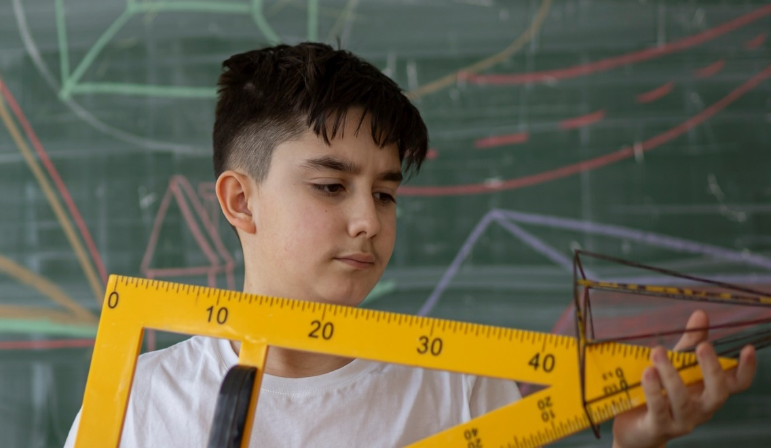
ODE Math Practice Rubric

Slide 44
MP | Needs Improvement | Emerging | Proficient | Exemplary
MP.2 Reason Abstractly and Quantitatively. | Does not understand that quantities have meaning. | Understands that quantities having meaning, but not able to see all the relationships between quantities. | Attends to the meaning of quantities and the relationships between quantities, rather than simply computing them. | Attends to the meaning of quantities and the relationships between quantities, rather than simply computing them; generalizes their relationships to new situations.
 | Ignores units. | Considers the units involved but does not understand how they relate to the problem; may use units as labels. | Pays attention to units and uses them appropriately. | Analyzes the use of symbols, variables and units accurately, consistently and appropriately.
 | Uses memorized procedures and algorithms incorrectly; cannot represent a situation symbolically. | Uses memorized procedures and algorithms but is not able to explain underlying concepts; can represent and manipulate simple situations symbolically. | Sees connections between procedures or algorithms and contextual meaning but has difficulty articulating them; can represent and manipulate routine situations symbolically. | Articulates connections between procedures or algorithms and contextual meaning; can take a situation and flexibly represent it symbolically and then manipulate the symbols (decontextualize).
 | Does not see a connection between the symbolic representation and the context. | Sees a connection between the symbolic representation and the context but has difficulty articulating it. | Takes a symbolic situation and relates it to the context (contextualize). | Takes a symbolic situation and relates it to the context and other similar contexts.
 | Does not use representations when approaching a problem. | Uses some representations to represent the problem. | Creates a coherent representation of the problem. | Creates, interprets, models, and connects multiple representations coherently.
 | Does not finish calculations or interpret solutions. | Finishes calculations but does not interpret solutions. | Interprets solutions appropriately. | Looks beyond solutions to make predictions, generalizations, and decisions.

Slide 45
NCTM 8 Effective Teaching Practices

Slide 46
Effective Teaching Practices
Establish mathematics goals to focus learning. Effective teaching of mathematics establishes clear goals for the mathematics that students are learning, situates goals within learning progressions, and uses the goals to guide instructional decisions.
Implement tasks that promote reasoning and problem solving. Effective teaching of mathematics engages students in solving and discussing tasks that promote mathematical reasoning and problem solving and allow multiple entry points and varied solution strategies.
Use and connect mathematical representations. Effective teaching of mathematics engages students in making connections among mathematical representations to deepen understanding of mathematics concepts and procedures and as tools for problem solving.
Facilitate meaningful mathematical discourse. Effective teaching of mathematics facilitates discourse among students to build shared understanding of mathematical ideas by analyzing and comparing student approaches and arguments.

Slide 47
Effective Teaching Practices
Pose purposeful questions. Effective teaching of mathematics uses purposeful questions to assess and advance students’ reasoning and sense making about important mathematical ideas and relationships.
Build procedural fluency from conceptual understanding. Effective teaching of mathematics builds fluency with procedures on a foundation of conceptual understanding so that students, over time, become skillful in using procedures flexibly as they solve contextual and mathematical problems.
Support productive struggle in learning mathematics. Effective teaching of mathematics consistently provides students, individually and collectively, with opportunities and supports to engage in productive struggle as they grapple with mathematical ideas and relationships.
Elicit and use evidence of student thinking. Effective teaching of mathematics uses evidence of student thinking to assess progress toward mathematical understanding and to adjust instruction continually in ways that support and extend learning.

Slide 48
Questions?

Slide 49
Mathematics Questions?
Name | Email
Brian Bickley | Brian.Bickley@education.ohio.gov
Anna Cannelongo | Anna.Cannelongo@education.ohio.gov
Annika Moore | Annika.Moore@education.ohio.gov
Yelena Palayeva | Yelena.Palayeva@education.ohio.gov

Slide 50
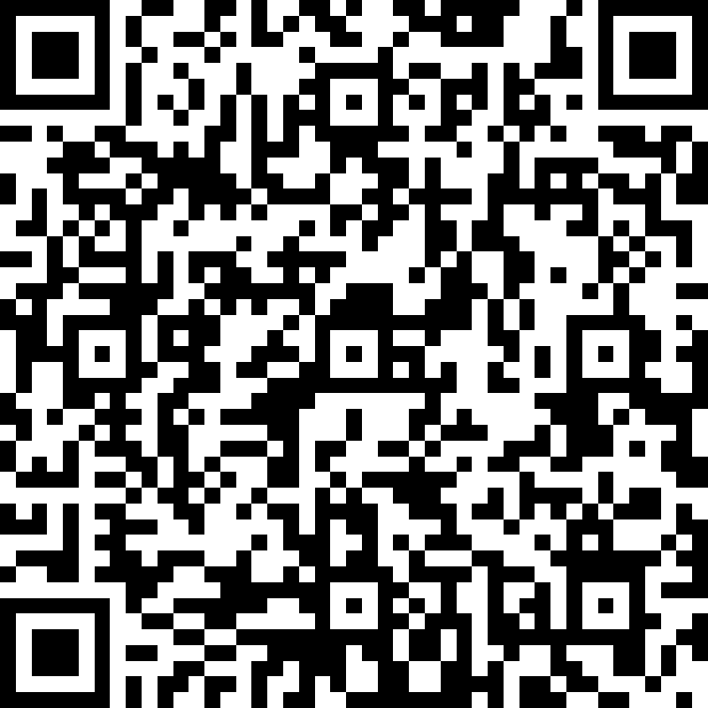
Exit Ticket Survey
https://forms.office.com/g/7u2yYV6qGx
Notes:
https://forms.office.com/g/7u2yYV6qGx

Slide 51
Resource Links
Ohio Department of Education Documents
Standards for Mathematical Practice
Kindergarten - Grade 5
Grades 6-8
High School
University of Arizona Progressions
Standards for Mathematical Practice: Commentary and Elaborations for K-5
Standards for Mathematical Practice: Commentary and Elaborations for 6-8
Other National Resources
Inside Mathematics
Illustrative Mathematics
Robert Kaplinsky: Math CCSS Math Practices Readable

Slide 52
References
Illustrative Mathematics. (2014, February 12). Standards for Mathematical Practice: Commentary and
Elaborations for K–5. Tucson, AZ.
Illustrative Mathematics. (2014, May 6). Standards for Mathematical Practice: Commentary and Elaborations
for 6–8. Tucson, AZ.
Koestler, C., Felton-Koestler, M. D., Bieda, K., & Otten, S. (2013). Connecting the NCTM process standards
and the CCSSM practices. Reston, VA: The National Council of Teachers of Mathematics.
O'Connell, S., & SanGiovanni, J. (2013). Putting the practices into action: Implementing the common core
standards for mathematical practice, K-8. Portsmouth, NH: Heinemann.

Slide 53
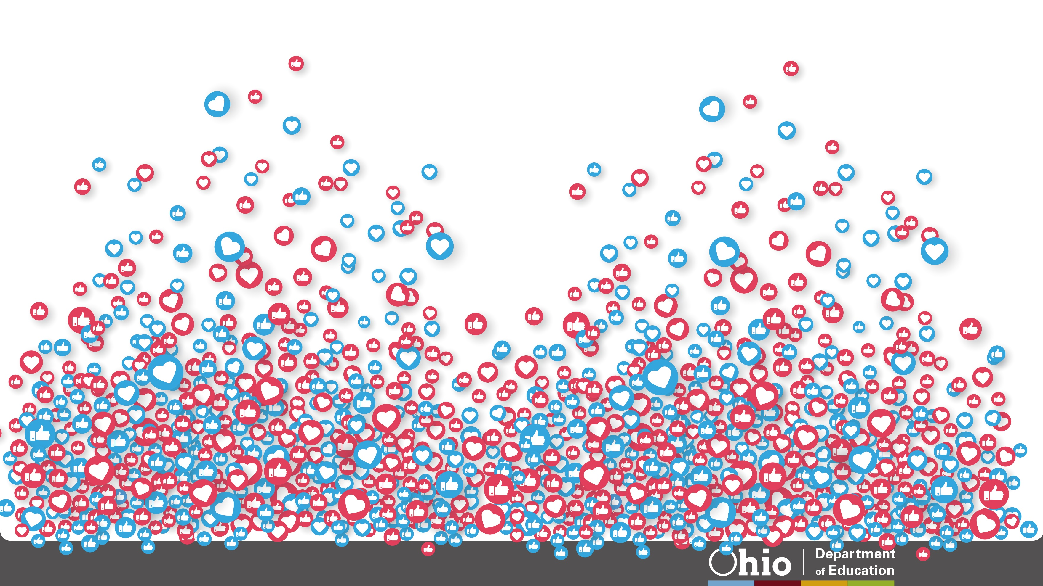
@OHEducation

