Slide 1
SMP.4 Model with Mathematics
Fall 2022

Slide 2
Note:
Rename yourself by grade band
K-2
3-5
6-8
HS

Slide 3

Welcome

Slide 4


Slide 5
Virtual Meeting Norms
Be respectful.
Recognize that everyone has expertise.
Assume positive intent.
Seek clarification in language and ideas.
Share experiences.
Use the chat feature when you have a question.
Mute your microphone when not speaking.

Slide 6

Each Child Our Future
Our Vision
In Ohio, each child is challenged to discover and learn, prepared to pursue
a fulfilling post-high school path and empowered to become a resilient,
lifelong learner who contributes to society.

Slide 7
Math Practices
Make sense of problems and persevere in solving them.
Reason abstractly and quantitatively.
Construct viable arguments and critique the reasoning of others.
Model with mathematics.
Use appropriate tools strategically.
Attend to precision.
Look for and make use of structure.
Look for and express regularity in repeated reasoning.

Slide 8
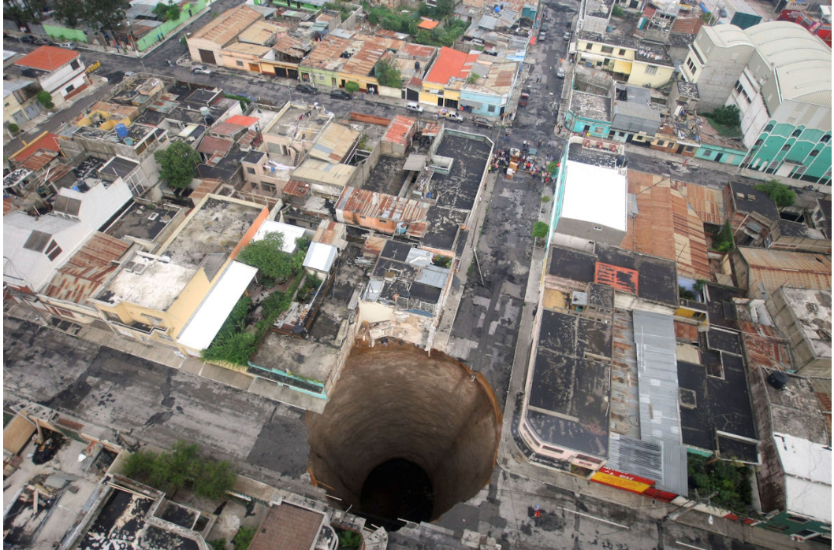
Act 1: A Guatemalan Sinkhole
What do you notice?
What do you wonder?
Notes:
In 2010, an enormous sinkhole (pictured below) suddenly appeared in the middle of a Guatemalan neighborhood and swallowed a three-story building above it.
Anticipated Questions:
How much material will they need to fill the sinkhole?--volume
How much will it cost to fill the sinkhole in?
What events cause sink holes?
Why did it happen here instead of somewhere else?
What’s the land compositions causes sinkholes?
https://robertkaplinsky.com/work/sink-hole/

Slide 9
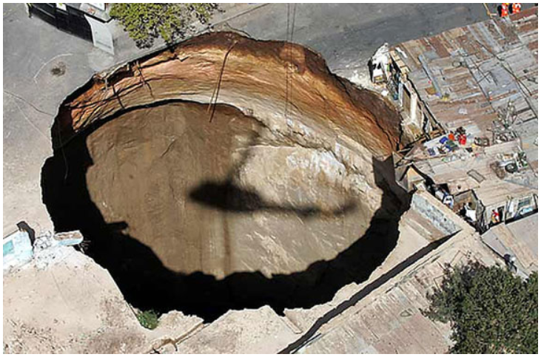
Act 2: Estimate
What do you know?
What information do we need?
What is a guess that is too high?
What is a guess that is too low?
What’s your best guess?
Notes:
In 2010, an enormous sinkhole (pictured below) suddenly appeared in the middle of a Guatemalan neighborhood and swallowed a three-story building above it.
https://robertkaplinsky.com/work/sink-hole/

Slide 10
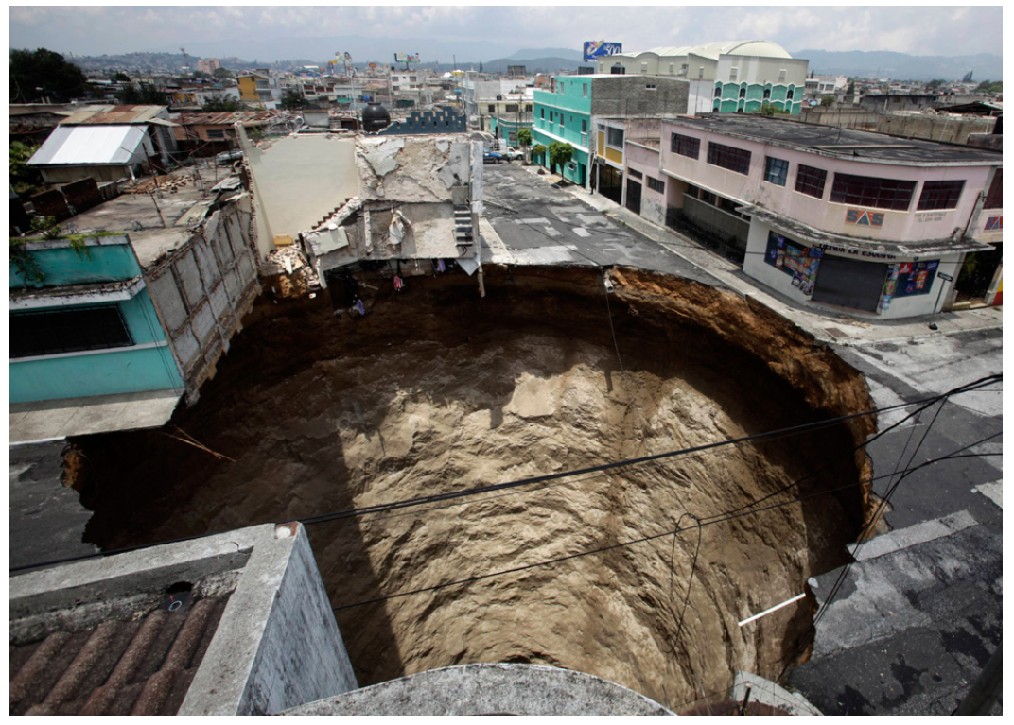
Act 2: Create a Mathematical Model to Describe the Situation
Diameter of sinkhole: 20m (about 66 ft)
Depth of sinkhole: 30m (about 100 ft)
Notes:
In 2010, an enormous sinkhole (pictured below) suddenly appeared in the middle of a Guatemalan neighborhood and swallowed a three-story building above it.
Make an estimate that is too high! That is too low! And a more reasonable estimate.
https://robertkaplinsky.com/work/sink-hole/

Slide 11
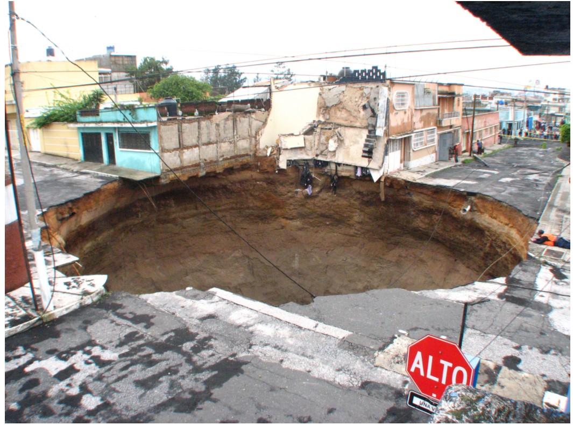
Act 3: Reveal
Notes:
V= 342,119.44 ft^3 or V=108,900pi ft^3
Calculate in Meters
https://robertkaplinsky.com/work/sink-hole/

Slide 12
Act 3: Next Steps
Could you revise your model to make it better?
What new questions do you have?
Notes:
In 2010, an enormous sinkhole (pictured below) suddenly appeared in the middle of a Guatemalan neighborhood and swallowed a three-story building above it.
What events cause sink holes?
Why did it happen here instead of somewhere else?
What’s the land compositions causes sinkholes?
https://robertkaplinsky.com/work/sink-hole/

Slide 13
3-Act Task
Act 1: Pose the Problem.
A hook
Brainstorm Q&A
Act 2: The Model
Make an estimate
Act 3: The Resolution and Sequel.
The solution and reflection.
Next Steps-revise or elaborate
Develop a mathematical model

Slide 14
What is Mathematical Modeling?
Mathematical modeling is a process that uses mathematics to represent, analyze, make predictions or otherwise provide insight into real-world phenomena.
-GAIMME
In the Standards, modeling means using mathematics or statistics to describe (i.e., model) a real-world situation and deduce additional information about the situation by mathematical or statistical computation and analysis
-AZ Progression
Purpose: To understand reality
-AZ Progressions

Slide 15
Model vs Modeling
Mathematical Model | Mathematical Modeling Process
A tool that uses mathematics to represent a real-world situation to facilitate quantification, analyses, predictions, and gaining insight. There may be multiple mathematical models for any given scenario with varying degrees of complexity The type of model depends on the available resources and knowledge of the person creating it. | The creation of such a tool and often requires significant creativity and brainstorming, but not necessarily complicated mathematics. The process itself includes determining what the output of the model is (what is being quantified?) and identifying what variables may impact that quantity. Assumptions must be made to determine relationships between the input and output of the model. Validating the model to assess how well it performs at making a prediction or measurement and the consideration of refinements.
Notes:
Mathematical models—
a tool that uses mathematics to represent a real-world situation to facilitate quantification, analyses, predictions, and gaining insight.
multiple mathematical models for any given scenario with varying degrees of complexity
depends on the available resources and knowledge of the person creating it.
Mathematical Modeling Process—
From GAIMME

Slide 16
Some Types of Mathematical Models
Equations
Graphs
Diagrams
Geometric Illustrations
Tables
Spreadsheets
Simulations
Experiments

Slide 17

Breakout Rooms
Notes:
https://docs.google.com/presentation/d/1i3e-IEGzYXJFhyOll3nTyH_6j6MxIBi49tGrmJ_Zz7M/edit#slide=id.ga80333bd55_0_119

Slide 18
Traditional Mathematics Class | Modeling-Focused Class
Skill-driven with concepts applied | Concept-driven with skills applied
Practice and then apply | Apply and then practice
Context removed, solve problem, insert context | Problem cannot be solved without context
Behaviorist approach | Inquiry-based
Teacher-centered | Student-centered
Individual-centered | Team-centered
Communication optional | Communication essential
Objects of study are abstract | Objects of study are data
For specific, high-level STEM careers | For all careers, and essential for good citizenship and personal finance decisions

Slide 19

A Variety of Graphics, but
Similar Processes…

Slide 20
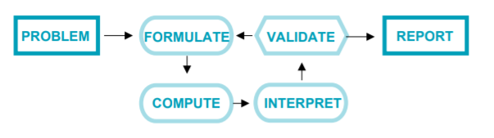
Ohio Learning Standards

Slide 21
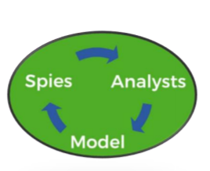
Spies, Analysts, Model by Robert Kaplinsky
Step 1: Spies–What information do I need and how do I acquire it?
Step 2: Analysts–Take the information and work with it to figure out how to use it
Step 3: Model–Use the model and verify that it works

Slide 22
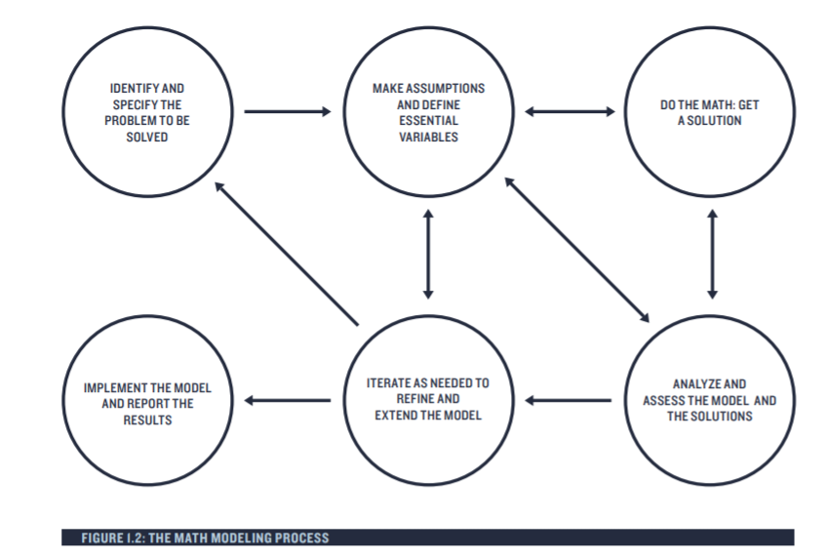
GAIMME

Slide 23
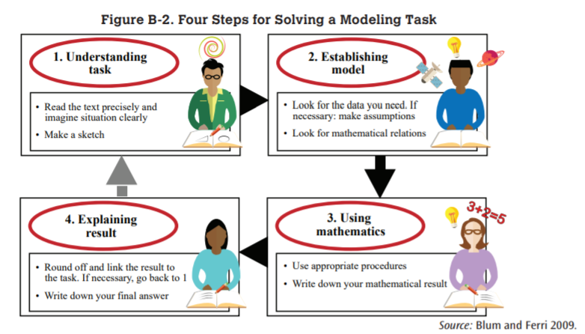
Blum and Ferri

Slide 24
Mathematical Modeling Is NOT…
Telling students “I do this; now you do the same.”
Using a graph, equation, or function and calling it modeling. True modeling is a process.
Starting with a real-world situation and solving a math problem. Modeling returns students to a real-world situation and uses mathematics to inform their understanding of the world (See MP.2)
Using manipulatives to represent mathematical concepts; this might instead be referred to as “using concrete representations.”
Beginning with mathematics and then moving to the real world. Modeling begins with real-world situations and represents them with mathematics.

Slide 25
Mathematical Modeling Is NOT…
Starting with a real-world situation and solving a math problem. Modeling returns students to a real-world situation and uses mathematics to inform their understanding of the world (See MP.2)
Beginning with mathematics and then moving to the real world. Modeling begins with real-world situations and represents them with mathematics.
It is not beginning with a contrived real world situation; it is starting with a situation that is as close to how students would actually encounter it as possible.

Slide 26
Role of Teacher
Provide appropriate, engaging tasks
Understanding of content to ask assessing and advancing questions
Encourage collaboration with peers and promote an environment that supports growth
Understanding of content to support individual student perspectives

Slide 27
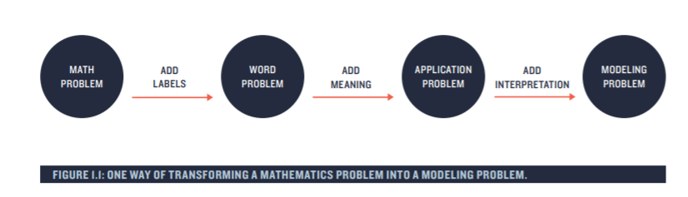
Transforming a Mathematical Problem into a Modeling Problem
+
choices
Notes:
It is important to see that adding labels, such as “pretzels,” is not sufficient. Perhaps less obvious but equally important, adding context and meaning, such as jobs and wages or lapse rates and drones, is also not sufficient. A modeling problem must also provide room for students to interpret the problem and have choices in the solution process. T

Slide 28
Breakout Rooms
Notes:
https://docs.google.com/presentation/d/1i3e-IEGzYXJFhyOll3nTyH_6j6MxIBi49tGrmJ_Zz7M/edit#slide=id.ga80333bd55_0_119

Slide 29
Breakout Reflection Questions
If you can remove a problem’s context and still solve it, is it a modeling problem?
How can you launch a problem that is open ended and messy?
Did the modeling problem address the mathematical content you want to teach?

Slide 30
Check your Answers
Guidelines for Assessment & Instruction in Mathematical Modeling Education (GAIMME) Report
Grades K-8: See pages 141-143
High School: See pages 55-57, 180-191

Slide 31
Things to Anticipate
What kinds of questions will the students need to ask as they try to define and answer the problem?
What information might they seek and from whence will they seek it?
Which discussions should happen in small groups and which with the whole class?
What decisions will students need to make and what information will they need to make them?

Slide 32
Things to Anticipate
What mathematical approaches might they take?
Will there be pieces of information to introduce later if students need steering in a particular direction?
How can I nudge my students without depriving them of the opportunity to develop concepts and discover relationships among them?
How many days should students work on this problem? How long each day?

Slide 33
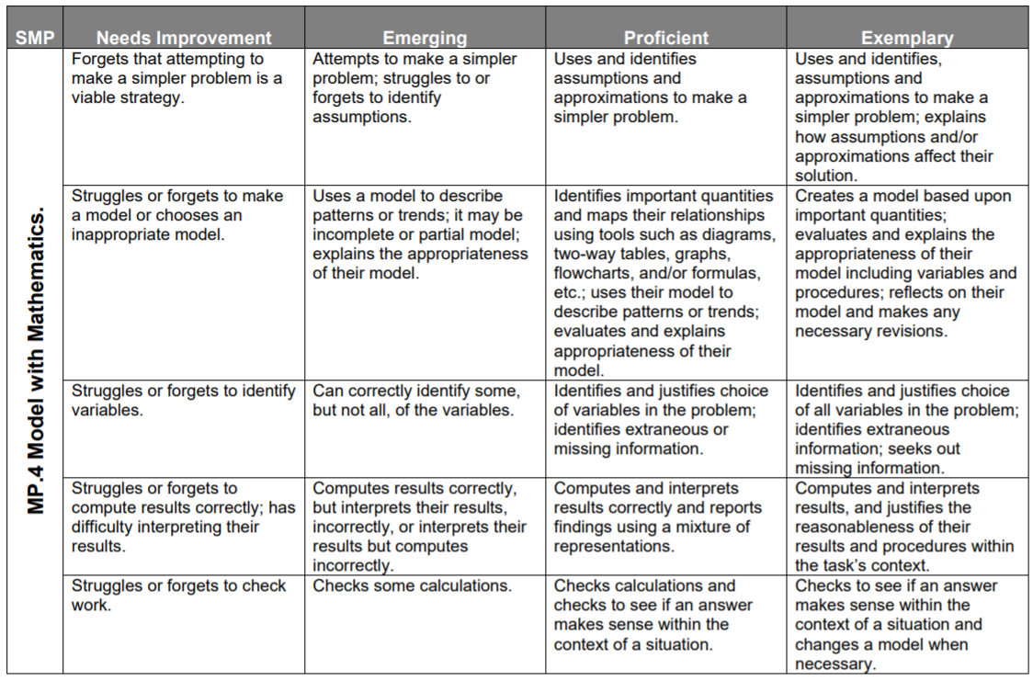
Student Rubric

Slide 34
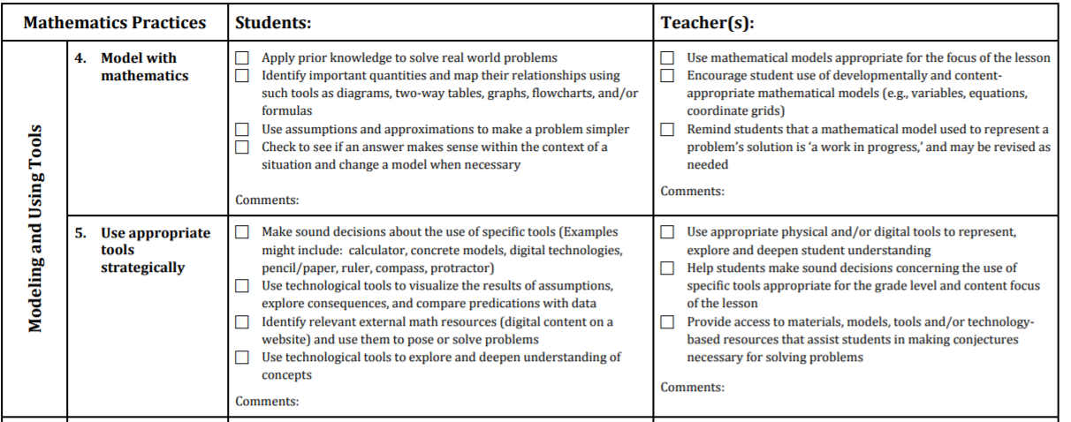
NCTM Modeling “Look Fors”
Notes:
https://education.ohio.gov/getattachment/Topics/Learning-in-Ohio/Mathematics/Model-Curricula-in-Mathematics/Standards-for-Mathematical-Practice/Math-Practices-Rubric.pdf.aspx?lang=en-US

Slide 35
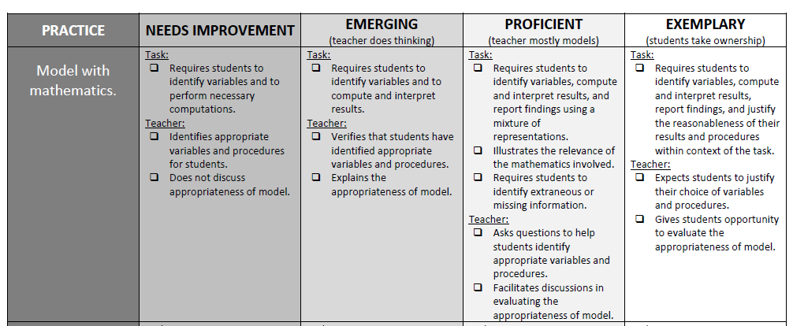

Another Rubric

Slide 36
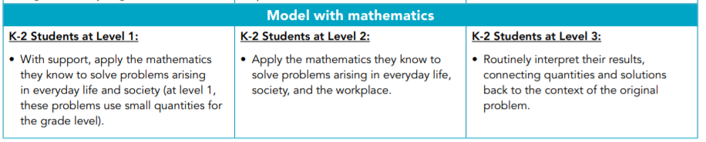
CCSSO’s Performance Level Descriptors at K-2

Slide 37
GAIMME Report Rubrics
Guidelines for Assessment & Instruction in Mathematical Modeling Education (GAIMME) Report
See pages 192-205

Slide 38
Breakout Rooms
Notes:
https://docs.google.com/presentation/d/1i3e-IEGzYXJFhyOll3nTyH_6j6MxIBi49tGrmJ_Zz7M/edit#slide=id.ga80333bd55_0_119

Slide 39
Tips
Modeling (like real life) is open-ended and messy.
When students are modeling, they must be making genuine choices.
Start big, start small, just start.
Assessment should focus on the process, not the product.
Modeling does not happen in isolation.

Slide 40
References
Conrad Wolfram on Computational Thinking
Engaging in Mathematical Practice Look Fors
Guidelines for Assessment & Instruction in Mathematical Modeling Education (GAIMME)
Mathematical Modeling of the Mathematics Framework for California Public Schools: Kindergraten through Grade 12
MPRES Toolkit for Teachers Conceptual Change – Using Mathematics & Computational Thinking

Slide 41
References
Ohio Learning Standards
Robert Kaplinsky
  Beware of Fake Math Modeling Problems
  Do You Need Better Spies of Analysts?
  Sink Hole
  What Isn’t Modeling?
Using Mathematics and Computational Thinking

Slide 42
Mathematics Questions?
Name | Email
Brian Bickley | Brian.Bickley@education.ohio.gov
Anna Cannelongo | Anna.Cannelongo@education.ohio.gov
Annika Moore | Annika.Moore@education.ohio.gov
Yelena Palayeva | Yelena.Palayeva@education.ohio.gov

Slide 43





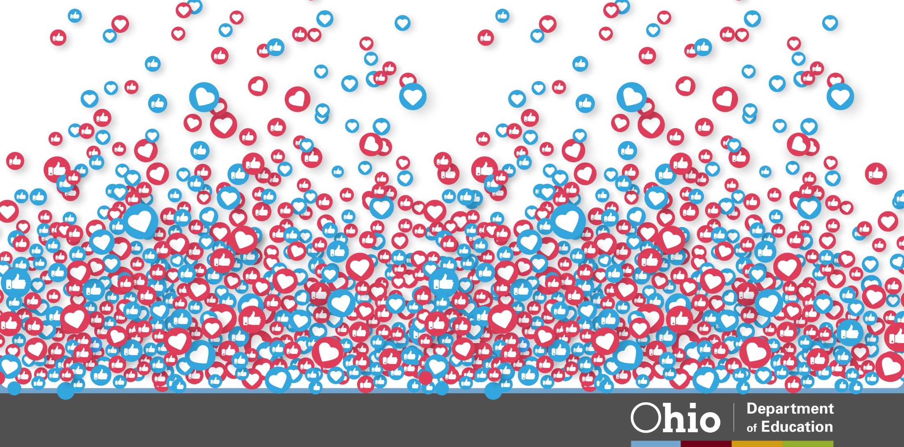
@OHEducation

Slide 44
Practices vs GAIMME Model
Science Practices | GAIMME
Asking Questions and Defining Problems | Identify and specify the problem to be solved. Make assumptions and identify variables.
Developing and Using Models | Analyze and assess the model and the solutions.
Planning and Carrying Out Investigations | Do the math.
Analyzing and Interpreting Data | Analyze and assess the model and the solutions.
Using Mathematics and Computational Thinking | Do the math.
Constructing Explanations and Designing Solutions | Analyze and assess the model and the solutions.
Engaging in Argument from Evidence | Analyze and assess the model and the solutions.
Obtaining, Evaluating, and Communicating Information | Report the results.

Slide 45
Modeling as a vehicle
Modeling as content

Slide 46
https://ccl.northwestern.edu/2017/WilkFenw2017_PP.pdf

