Slide 3
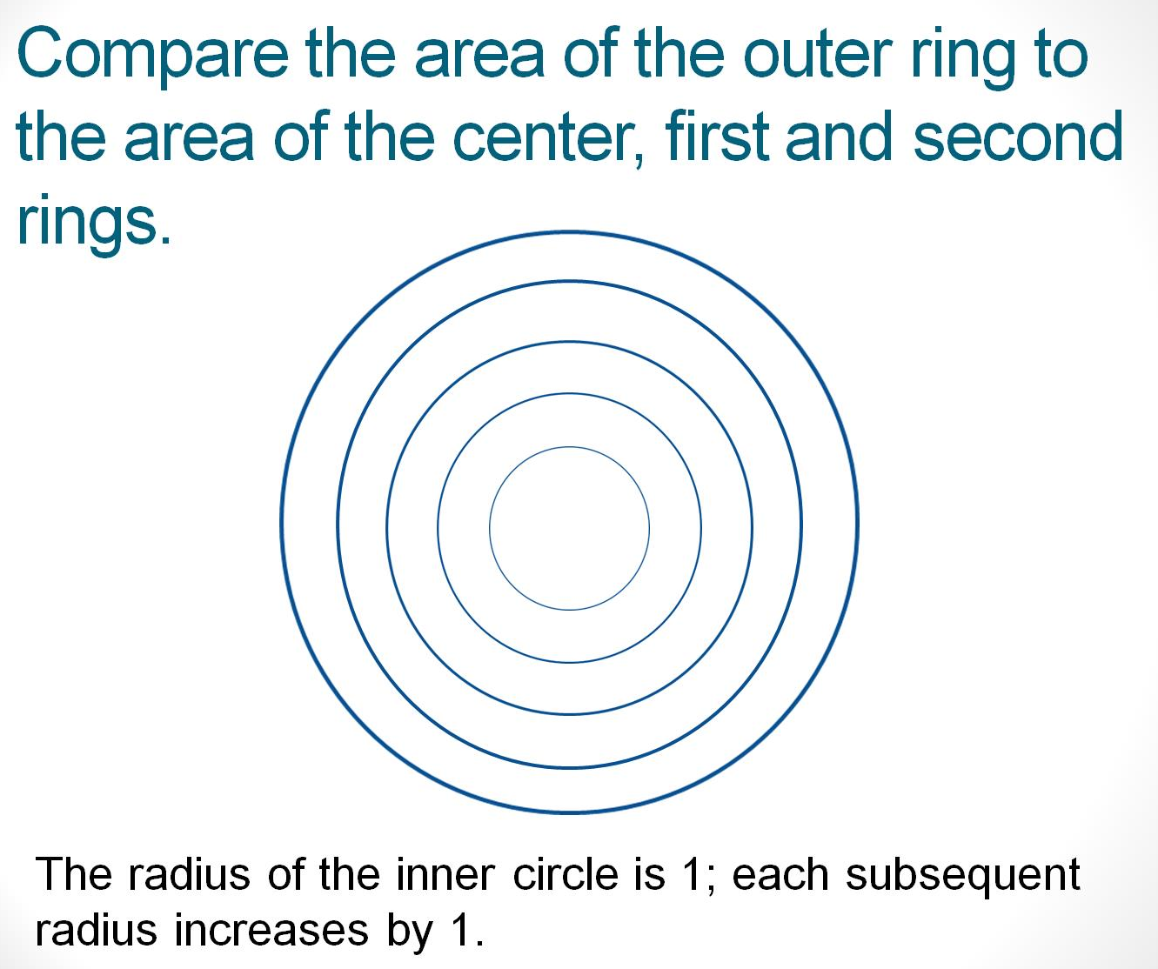
Compare the area of the outer ring to the area of the center, first and second rings.

Slide 4
Problem Solving: Solve mathematical and contextual problems
Building Mathematical Understanding
Using Strategies
Developing Efficient and Effective Skills and Procedures
Fluency
Problem Solving:
Apply mathematics in mathematical and real-world situations
Notes:
Common shift 1: Build a deep understanding of mathematics and apply this thinking
A major shift in mathematics instruction lies within the way mathematics is learned and mathematical thinking is developed.
The Common Core is designed to allow time for the building of deep understanding of mathematical concepts. Students who understand how and why numbers do what they do are able to solve problems using multiple strategies, utilize shortcuts, recall facts, skills and procedures and apply their thinking in novel situations.
The Common Core establishes a progression of learning through the standards that moves through three stages starting with building mathematical understanding, evolving into using strategies, ending with developing efficient and effective skills and procedures with the ultimate goal of fluency. In the early grades, these stages are typically spread over three years. By seventh grade, the time frame begins to shorten, with the completion of the progression occurring within a single grade or course.
In each grade or course, the starting and ending stage varies by concept. It is important for teachers to be aware of the stage of the learning for the concepts, and skill and procedures within the grade or course they are teaching.
It is an expectation that all students, in all grades and courses, should experience problem solving as a means of introducing each of these stages and as a means of trying out their newly acquired mathematical thinking in unfamiliar mathematical and relevant real-world situations.

Slide 5
Cognitive Demand
Memorize Facts, Definitions, Formulas | Perform Procedures | Demonstrate Understanding of Mathematical Ideas | Conjecture, Analyze, Generalize, Prove | Solve Non-Routine Problems / Make Connections
Recite basic mathematical facts Recall mathematics terms and definitions Recall formulas and computational procedures | Use numbers to count, order, denote Do computational procedures or algorithms Follow procedures/instructions Solve equations, formulas, or routine word problems Organize or display data Read or produce graphs and tables Execute geometric constructions | Communicate mathematical ideas Use representations to model mathematical ideas Explain findings and results from data analysis strategies Develop/explain relationships between concepts Show or explain relationships between models, diagrams, and/or other representations | Determine the truth of a mathematical pattern or proposition Write formal or informal proofs Recognize, generate or create patterns Find a mathematical rule to generate a pattern or number sequence Make and investigate mathematical conjectures Identify faulty arguments or misrepresentations of data Reason inductively or deductively | Apply and adapt a variety of appropriate strategies to solve non-routine problems Apply mathematics in contexts outside of mathematics Apply to real-world situations Synthesize content and ideas from several sources
Start Here
Move Outward

Slide 6
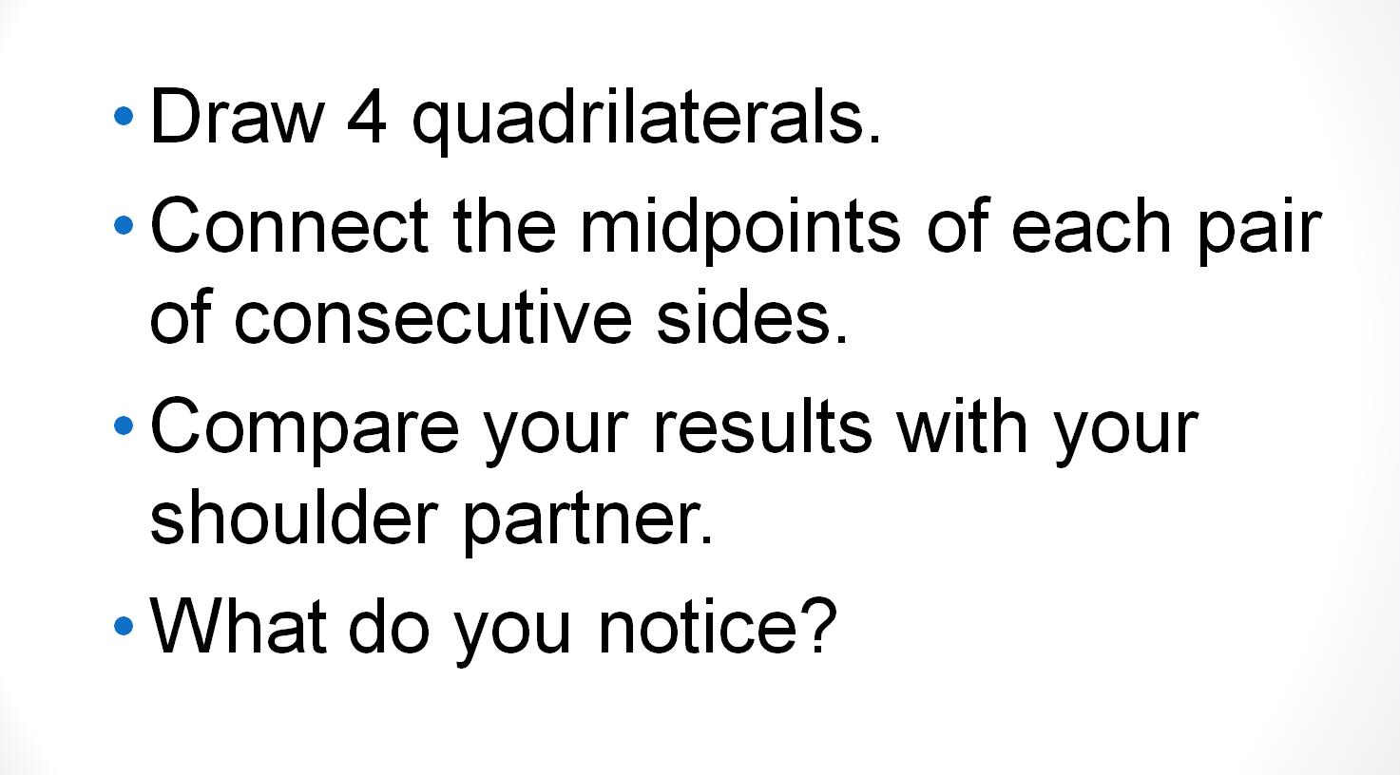
Quadrilaterals

Slide 7
Good Questions = Open Questions
Work Backward
Identify a topic
Think of a closed question
Make up a question that includes or addresses the answer

Slide 8
Good Questions = Open Questions
Work Backward
Percents
True or false? 40% > 3/5
Choose a fraction and a percent.
Which is greater? Prove it!

Slide 9
Good Questions = Open Questions
Adapt a Standard Question
Identify a topic
Think of a standard question
Adapt to make a good question

Slide 10
Good Questions = Open Questions
Adapt a Standard Question
Expressions
Substitute and solve
k=4 ini 2k + 62
When k=4 an expression is equal to 10.
What could the expression be?

Slide 11
Good Questions = Open Questions
Generalization
Identify a key relationship or procedure within a topic
Students solve several examples
Students generalize the steps followed

Slide 12
Good Questions = Open Questions
Generalization
Number of zeroes in a product
Placement of decimal in product
Equivalent fractions
Algorithms
Division of fractions

Slide 13
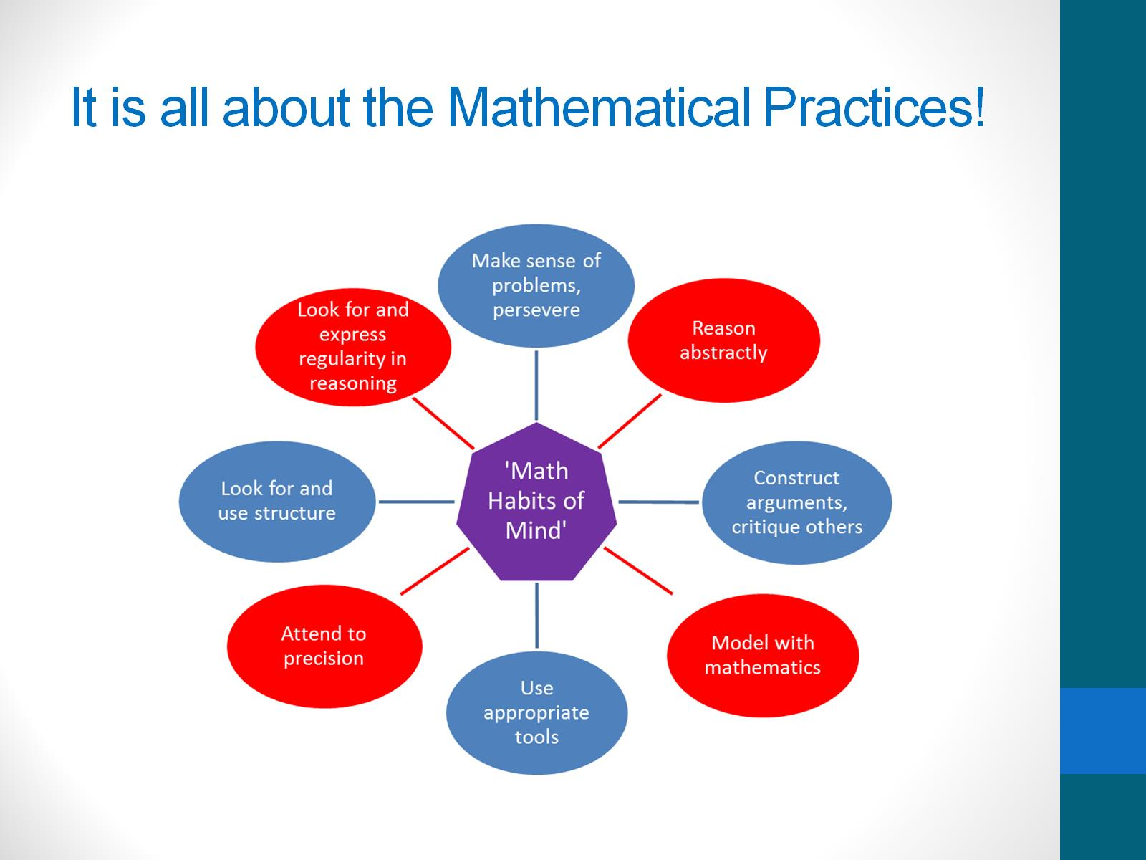
It’s All About the Mathematical Practices!

Slide 14
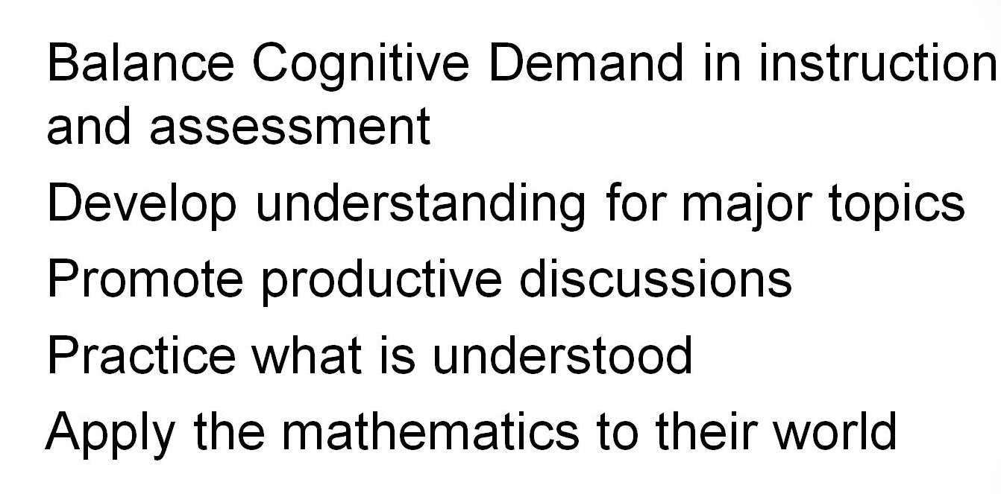
RaMP ^{up} the Reasoning

Slide 15
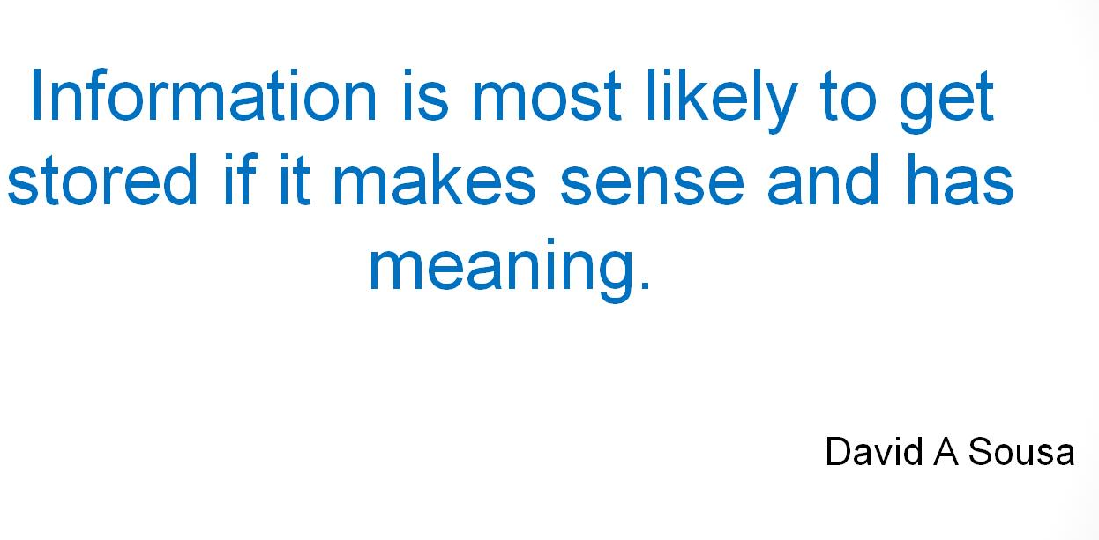

Slide 16
Contact Information
ANNIKA MOORE
(P) 614-728-2373
annika.moore@education.ohio.gov
BRIAN BICKLEY
(P) 614-644-6814
brian.bickley@education.ohio.gov
YELENA PALAYEVA
(P) 614-387-7561
yelena.palayeva@education.ohio.gov
Notes:
2:00 – 2:50 in Room 204
A Question & Answer Session with ODE Staff

