Slide 1
Best Practices in K-12 Mathematics for Gifted Learners Using Ohio’s K-8 Learning Progressions
November 15th, 2021

Slide 2
Today’s Presenter: Megan Vermillion
Education Program Specialist for Gifted Services
Bachelor's Degree in Early Childhood Education and Special Education from Capital University
Master's Degree in Curriculum and Instruction with a focus in Gifted Education from Cleveland State University
5 years teaching experience as a Gifted Intervention Specialist and General Education teacher

Slide 3
Today’s Discussion
Lifting Instruction Using Progressions
Interactive Planning Options
Differentiation Tools

Slide 4
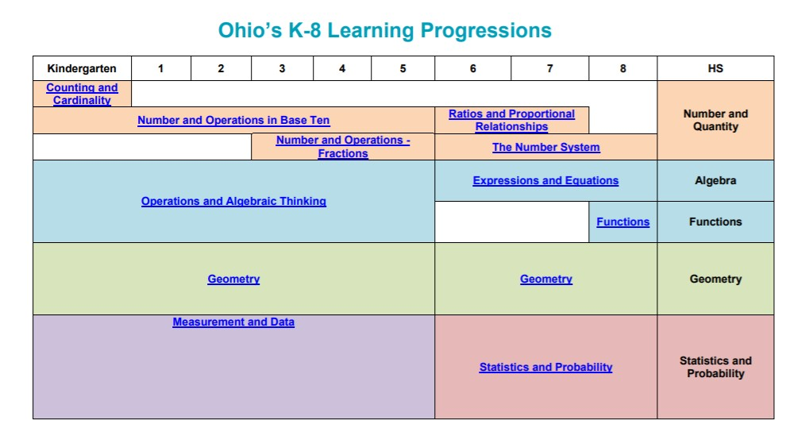
click here

Slide 5
Notes:
How to use the progressions:
The coloring on the Ohio’s K-5 Learning Progressions identifies standards along a multi-year topic or theme. For example, in K-5 the coloring:
Red = Addition and Subtraction
Blue = Multiplication and Division
Black = Number/Place Value
Brown = Geometry
Green = Fractions
Meanwhile, the Ohio’s K-8 Learning Progressions coloring identifies changes to the standards as part of the 2016-2017 revisions.
Red = changes in language
Purple = Footnotes from the 2011 Standards that were added directly into the 2017 Standards
Black = no change made to the standard as part of the 2016-2017 revisions
Multi-grade groups of teachers
Example 1: Select a domain within the standards, beginning at the lowest grade of the domain, then identify the main concepts at that grade. Follow each concept progressing through the grades by identifying how the concept changes and increases in rigor and understanding for the student. Additionally, identify new concepts introduced in subsequent grades and follow them through the years.
Example 2: Building on example one, begin to identify the connections among the learning progressions. For instance, how is Measurement and Data connected (used to develop the essential understandings) to other topics in grades 6-8? How is Measurement and Data used in the service of learning other concepts and skills in kindergarten through grade 5?
Example 3: Use the learning progressions to identify where concepts and skills have moved. Some concepts and skills have moved to earlier grades, other to later grades.
Grade level or individual teachers
Example 4: In partnership with regular classroom formative assessment, teachers can use the learning progression to assist in identifying where students are in the progression. Then they can develop supports to accelerate the students in an effort to bring their understandings and skills to the appropriate level or to go deeper into the content. Note that going deeper does not imply going to the next level in the progression, rather building stronger understandings of the content or making connections to other concepts or skills.
Example 5: It is important to make connections among the standards; between standards within a domain; between standards within a cluster; and between clusters across domains. Also use the Mathematics – K-8 Critical Areas of Focus to make further connections.

Slide 6
Ohio's Learning Standards
Basic font sizes
Click here
Sequences and timelines
Numbers
Notes:
Layout of standards
Supporting documents that teachers can access

Slide 7
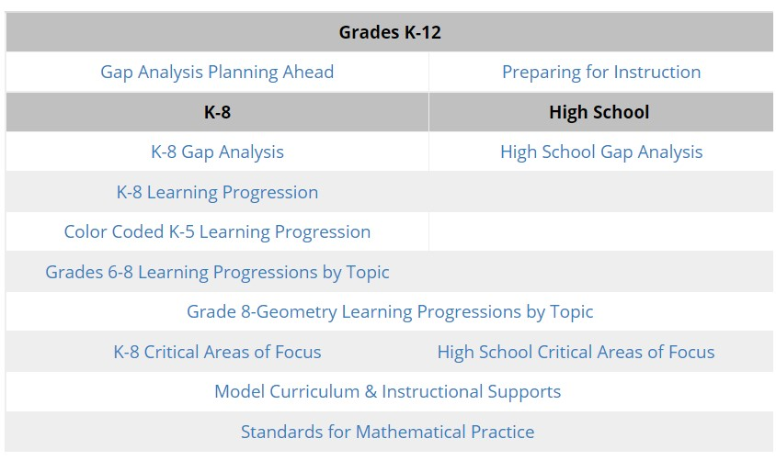
Department Website- Grades K-12
Basic font sizes
Bullet points, lines and shapes
Numbers

Slide 8
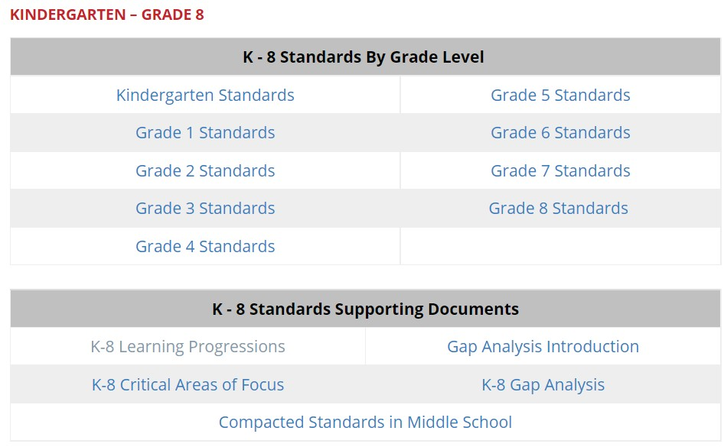
Department Website- Grades K-8
Basic font sizes
Bullet points, lines and shapes
Numbers

Slide 9
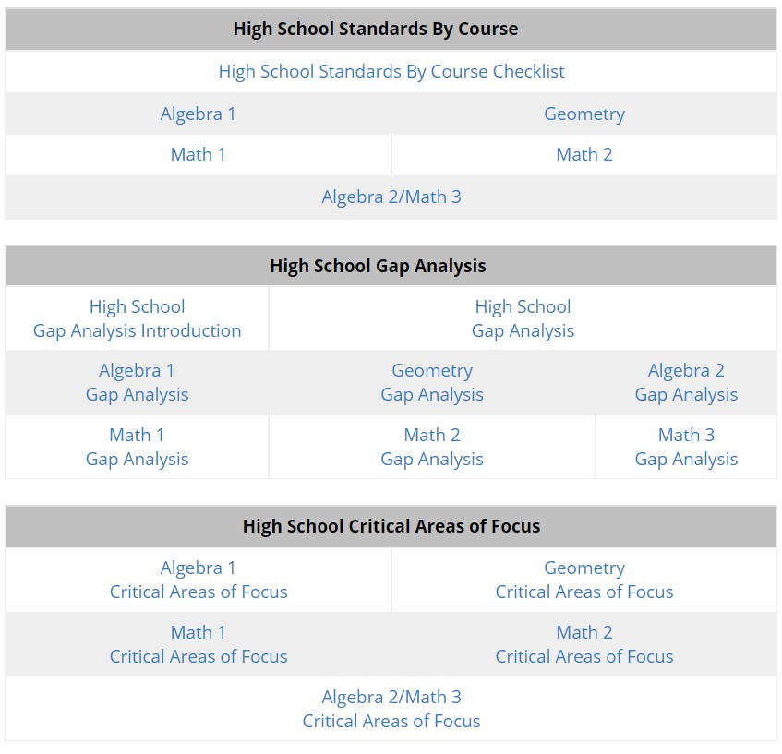
Department Website- High School
Basic font sizes
Bullet points, lines and shapes
Numbers
Notes:
Helpful for instructional coaches or coordinators

Slide 10
Why Differentiate?
Thinking through a gifted lens
Students learn best when curriculum is in Zone of Proximal Development
To make materials accessible for all
English Language Learners, Twice Exceptional Students
Students learn best with curriculum is relevant and interesting to them

Slide 11
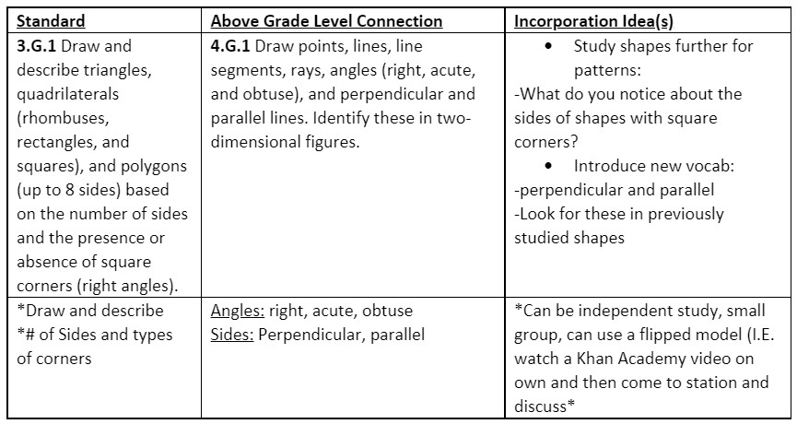
Interactive Activity Example
Basic font sizes
Bullet points, lines and shapes
Numbers

Slide 12
Interactive Task #1
Click here
Open your grade level standard document.
Open your appropriate learning progression.
Choose a standard to examine.
Assume you have a student who has shown mastery of this standard.
HOW COULD YOU INCORPORATE AN ABOVE GRADE LEVEL CONCEPT INTO THEIR LEARNING?
Notes:
If you teach multiple grade levels, choose one
Open your appropriate learning progression. (High School- Open your course document and focus on the standards and "critical area of focus")
Link in chat:
http://education.ohio.gov/Topics/Learning-in-Ohio/Mathematics/Ohio-s-Learning-Standards-in-Mathematics
Some of you may have helpful documents in your curriculum materials- feel free to use those as well!

Slide 13
Three Ways to Plan Differentiation
Content
Process
Product
Notes:
Content- Changes the information they are learning
Process- Changes how they are learning
Product- Changes how they show what they learned

Slide 14
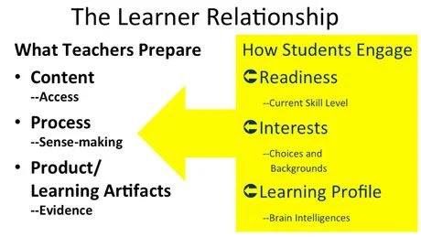
Student and Teacher Roles
Does every student need this content?
Will it be newly learned information? Review?
Where does it fit into the continuum?
Are there different ways I can make this content accessible based on student learning preference? Readiness?
How will students show mastery?
Does the evidence need to look the same for everyone?
Notes:
Source: https://www.edutopia.org/blog/differentiated-instruction-ways-to-plan-john-mccarthy

Slide 15
Interactive Task #2
Look at an upcoming lesson or topic
How could you differentiate the content of this lesson?
How could you differentiate the process of this lesson?
How could you differentiate the product of this lesson?

Slide 16
Depth and Complexity
Notes:
The eight Depth elements are:
Language of the Discipline
Details
Patterns
Unanswered Questions
Rules
Trends
Ethics
Big Idea
The three Complexity elements are:
Across Disciplines
Multiple Perspectives
Change over Time
Source: https://www.giftedguru.com/why-i-love-depth-and-complexity/

Slide 17
Language of the Discipline
What words are associated with this content?
What vocabulary do you need to know to work with this content?
What are the phrases, signs, symbols, abbreviations, or figures of speech you need to understand to work effectively in this content?
Notes:
Source: http://envisiongifted.com/depth-and-complexity-math/
Questions from Gifted Guru

Slide 18
Notes:
Source: http://envisiongifted.com/depth-and-complexity-math/

Slide 19
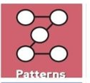
Notes:
Source: http://envisiongifted.com/depth-and-complexity-math/

Slide 20
Notes:
Source: http://envisiongifted.com/depth-and-complexity-math/

Slide 21
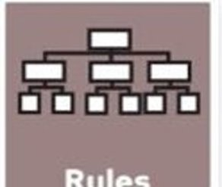
Notes:
Source: http://envisiongifted.com/depth-and-complexity-math/

Slide 22
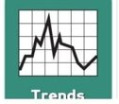
Notes:
Source: http://envisiongifted.com/depth-and-complexity-math/

Slide 23
Notes:
Source: http://envisiongifted.com/depth-and-complexity-math/

Slide 25
Missing Complexity Examples
Across Disciplines
Changes Over Time
Notes:
Across Disciplines:
Project-Based Learning- Pair with ELA, Science, Social Studies, etc.
Changes Over Time:
Data, Students understanding of the topic (from year to year, unit to unit, etc.)… Example: (When students begin subtraction, they are constantly told "you can't subtract 8 from 6", etc. Then they learn that negative numbers exist and their understanding changes

Slide 26
Interactive Task #3
Look at an upcoming lesson or topic
Choose one or two of the Depth and Complexity Icons
How could you add in that level of depth and complexity to this lesson?

Slide 27
Toolbox Takeaways
Set up easy access to important guidance documents
Bookmark in browser
Print and create a binder or display in room
Choose one differentiation strategy to focus on or incorporate into an upcoming lesson
Content, Process, Product
Depth and Complexity
Set up systems that make this differentiation easier on you:
Choice Menu Boards
Stations
Student-guided
Notes:
Set up easy access to important guidance documents
Bookmark in browser
Print and create a binder or display in room
Choose one differentiation strategy to focus on or incorporate into an upcoming lesson

Slide 28
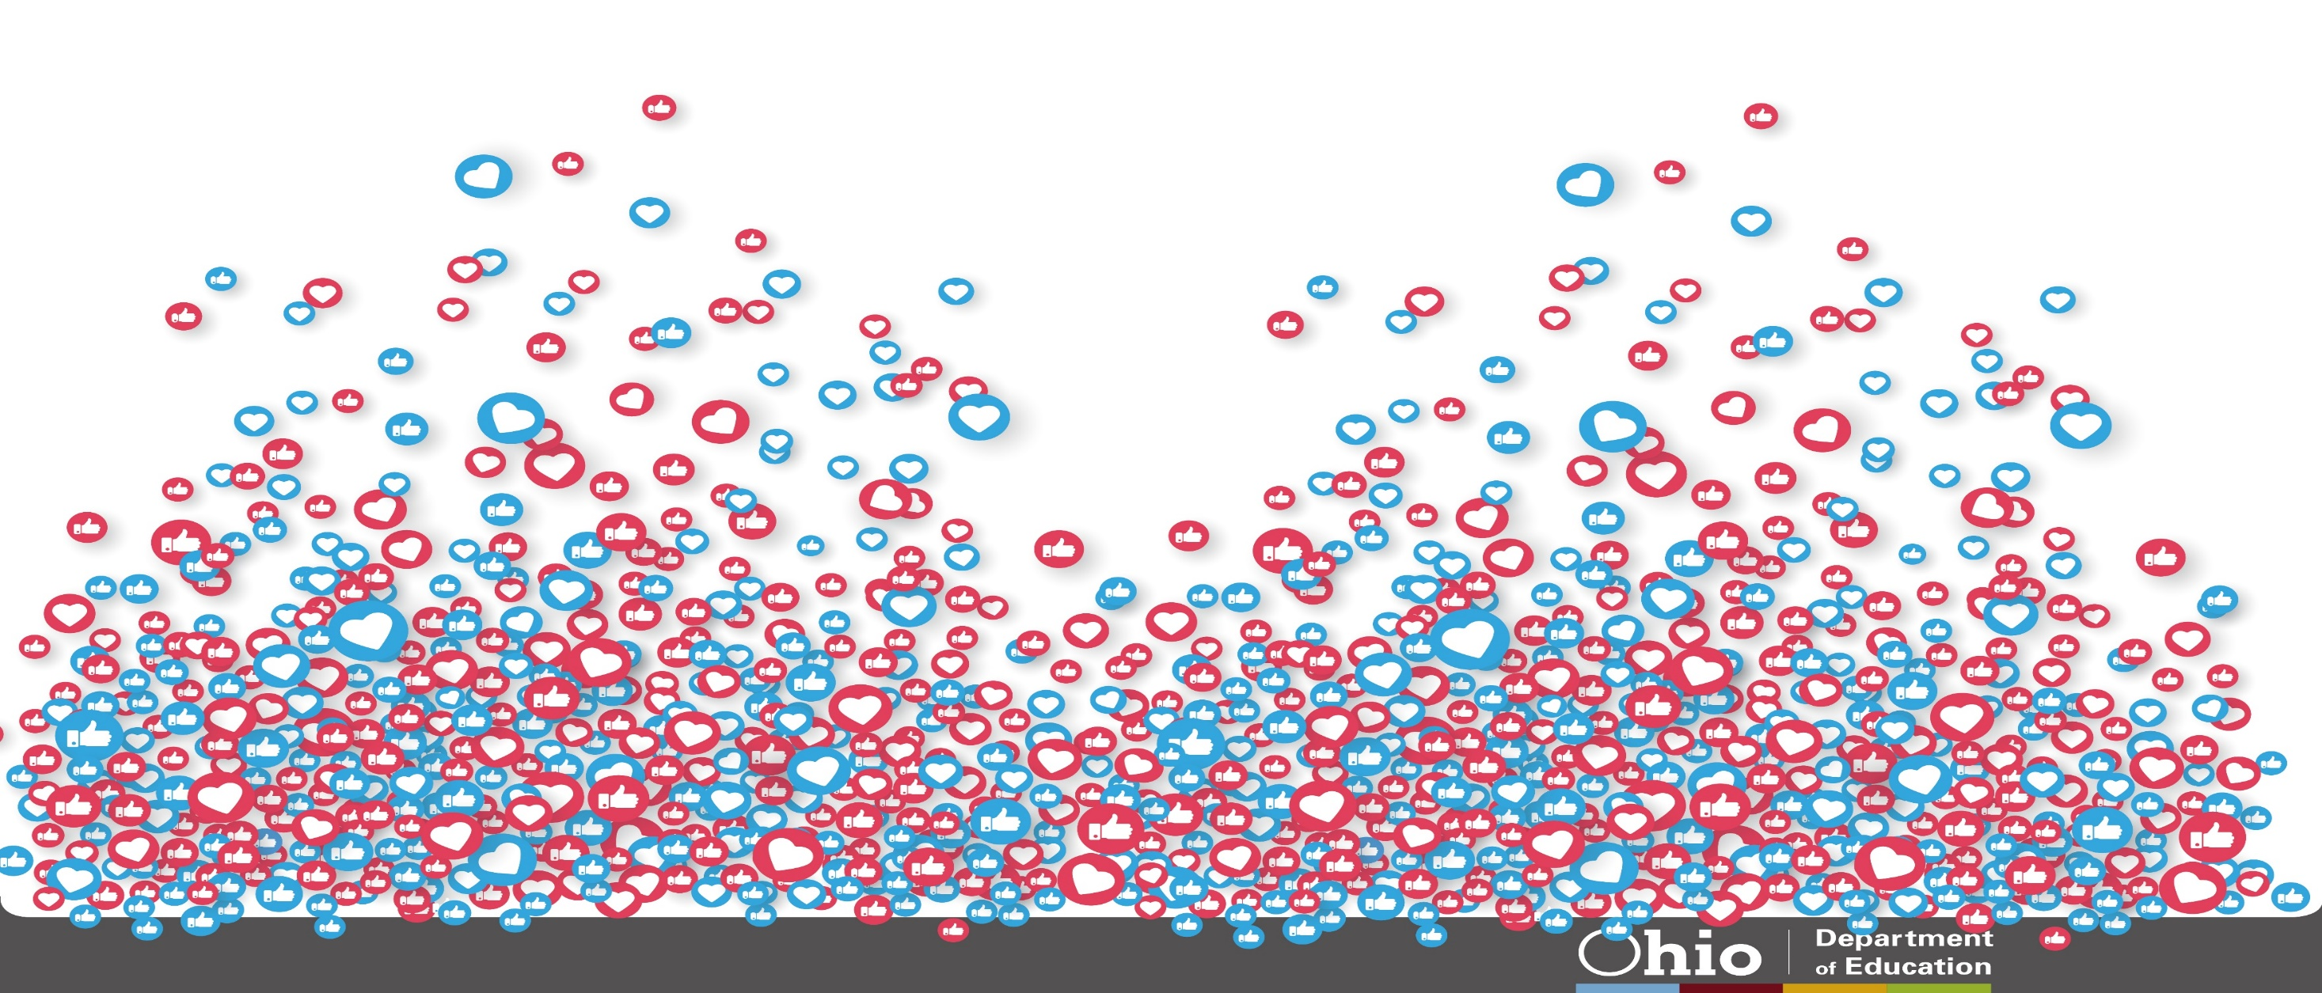
@OHEducation
gifted@education.ohio.gov
Megan.vermillion@education.ohio.gov

Slide 29
Share your learning community with us!
#MyOhioClassroom
Celebrate educators!
#OhioLovesTeachers

