Slide 1
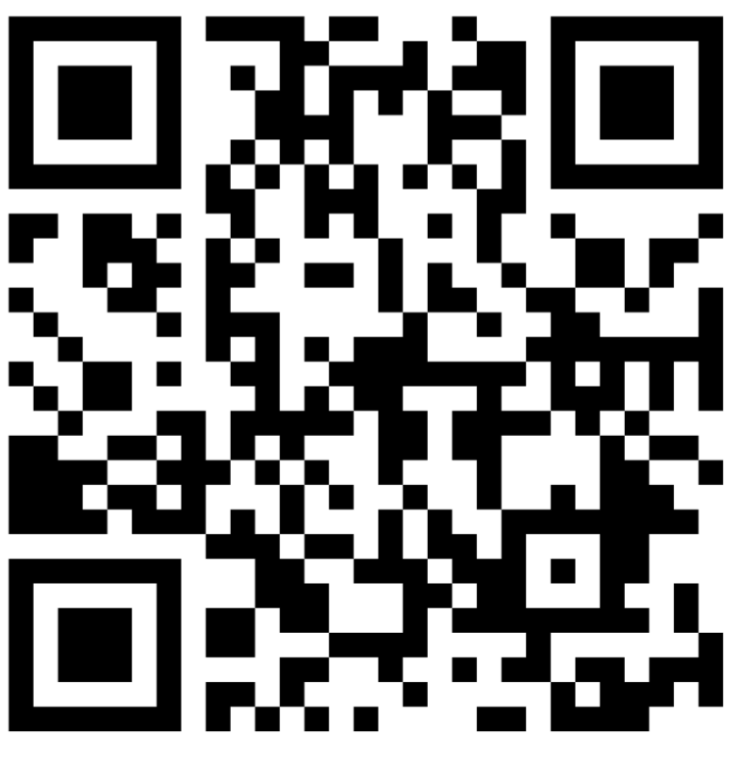
4. Middle School, High School and Higher Education Math Faculty Discussion
Facilitated by
Peggy Kasten, Ohio Math and Science Coalition (OMSC)
Heather Wukelich, Ohio Council of Teachers of Mathematics (OCTM)
Give feedback on our Padlet!
This session will be recorded, so it can be posted on the Department’s website. The recording will begin at the end of this slide.
Notes:
Note: Yelena will introduce and press record. Annika will support.
Padlet Link: https://padlet.com/annacannelongo/k1iiu6ny9gzvlg8c

Slide 2
Session Hosts
Peggy Kasten
Heather Wukelich
Annika Moore
Executive Director
Instructional Specialist
Mathematics Consultant
President

Slide 3
High School
Mathematics Pathways Symposium
Higher Education and
6-12 Math Faculty Discussion

Slide 4
Agenda for our Discussion:
Five Questions
NOT Focused on Specifics of Equivalent Course Options
Importance of Toolkits

Slide 5
Intentions of Algebra II or its Equivalent

Slide 6
Important Tools & Resources
Definition of Rigor
Ohio’s Learning Standards
Critical Areas of Focus
High Quality Instructional Materials
SAT & ACT Alignments
Student Decision Tree

Slide 7
Rigor
“Students use mathematical language to communicate effectively and to describe their work with clarity and precision. Students demonstrate how, when, and why their procedure works and why it is appropriate. Students can answer the question, ‘How do we know?’”

Slide 8
Rigorous courses are… | Rigorous courses are not…
Defined by complexity, which is a measure of the thinking, action, or knowledge that is needed to complete the task | Characterized by difficulty, which is a measure of effort required to complete a task
Measured in depth of understanding | Measured by the amount of work
Opportunities for precision in reasoning, language, definitions, and notation that are sufficient to appropriate age/course | Based on procedure alone
Determined by students’ process | Measured by assigning difficult problems
Opportunities for students to make decisions in problem solving | Defined only by the resources used

Slide 9
Rigorous courses are… | Rigorous courses are not…
Opportunities to make connections | Taught in isolation
Supportive of the transfer of knowledge to new situations | Repetitive
Driven by students developing efficient explanations of solutions and why they work, providing opportunities for thinking and reasoning about contextual problems and situations | Focused on getting an answer
Defined by what the student does with what you give them | Defined by what you give the student

Slide 10
Important Tools & Resources
Definition of Rigor
High Quality Instructional Materials
SAT & ACT Alignments
Student Decision Tree

Slide 11
Where do we start?
What courses do you currently offer beyond, Algebra, Geometry and Algebra 2?
Is your school already offering an equivalent course that are aligned with (or could be easily tweaked to be aligned with) the Pathway alternatives?

Slide 12
Ohio’s High School Math Pathways
Algebra 2 | Statistics and Probability | Data Science Foundations
Discrete Math / Computer Science | Quantitative Reasoning
Notes:
Math-Pathways Course Descriptions for Students
Let’s check out the resources in the Teacher Toolkit

Slide 14
How do we guide students?
Student Decision Tree
ACT and SAT Alignments

Slide 15
Planning for 2022-2023
What is the status of the development of the 22-23 master schedule in your school?
Is it possible to make well-thought out adjustments to the curriculum, or would it be better to start planning now (scheduling, materials, PD for teachers..) and target 23-24 as the launch year?

Slide 16
Consider Applying to Pilot a Course
November - Applications will be available
December - Application Deadline
January - Schools will be notified
Modeling & Reasoning Course
Data Science Foundations Course
Discrete Math/Computer Science

Slide 17
Flexibility with the Pathways
Consider the courses you currently offer your students. Is there flexibility for them to move from one track to another?
What can we do to ensure that students truly have choice and flexibility in their mathematics courses?

Slide 18
What resources beyond those listed on the toolkit page would you consider essential to effective implementation of a “new” equivalent course at your school?

Slide 19
What implications for implementation of these new equivalent course(s) have for higher education curriculum?
Is there a need for professional development for higher education mathematics faculty?
Is this an opportunity for collaboration for HS and higher ed?

Slide 20
Thank you!

