Slide 1
Algebra 2 Course Updates
High School Math Pathways Symposium
Nov. 9-10, 2021
Notes:
Presenter: Margie Introduces

Slide 2
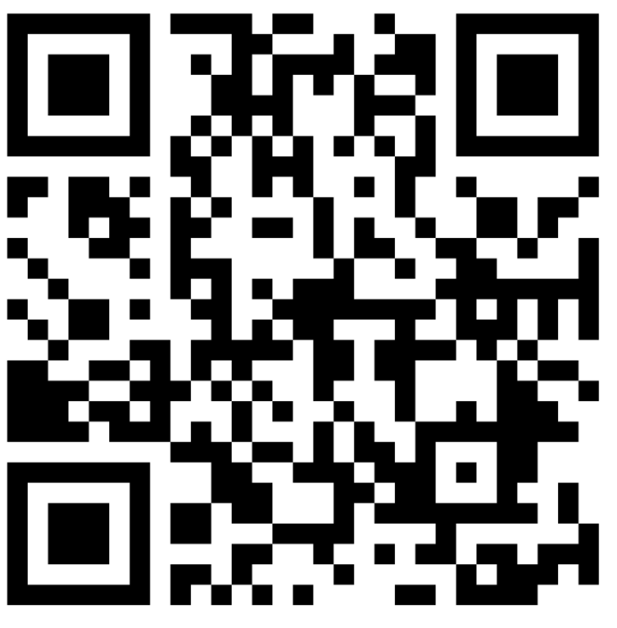
5. Algebra 2 Course Updates
Facilitated by
Margie Coleman, Kings Local Schools
Steve Hiner, Columbus City Schools
Scott Reveal, Cincinnati Public Schools
Lee Wayand, Columbus State Community College
Give feedback on our Padlet!
This session will be recorded, so it can be posted on the Department’s website. The recording will begin at the end of this slide.
Notes:
Note: Yelena will introduce and record. Yelena will offer to move slides.
Padlet Link: https://padlet.com/annacannelongo/k1iiu6ny9gzvlg8c

Slide 3
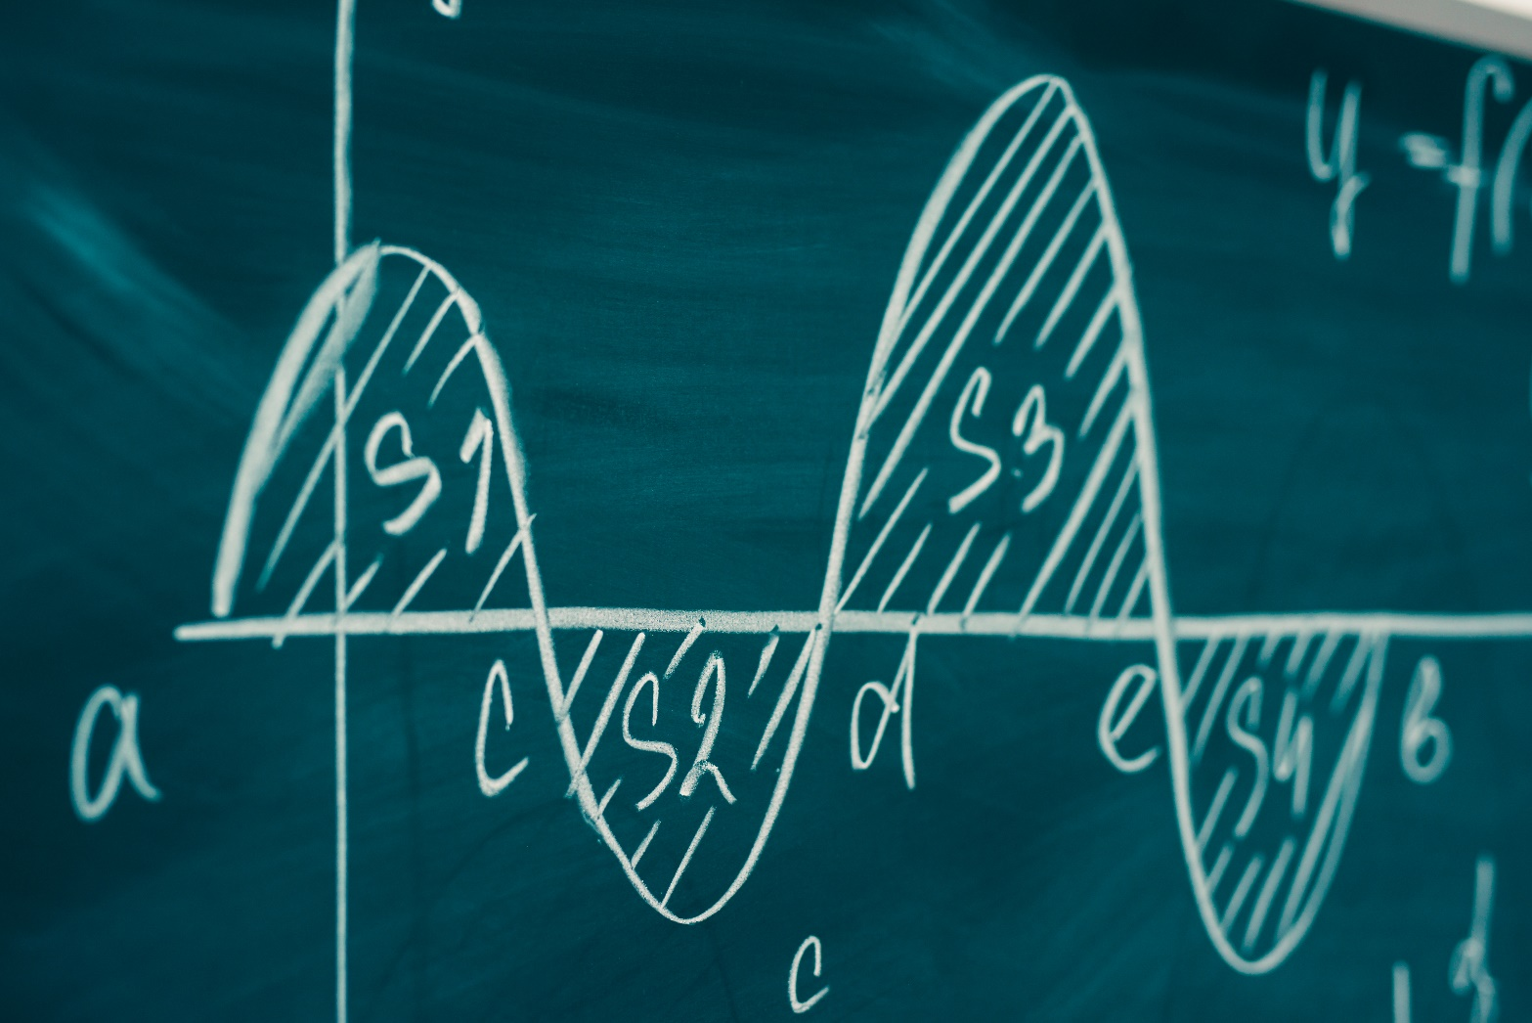
Algebra 2 Refocused
Goal: To get more students to understand and pass Calculus at the collegiate level.
College-level Calculus is just the beginning of mathematics for most STEM students on the Calculus Pathway.
It is no longer Algebra 2 for all!
Notes:
Presenter: Lee

Slide 4
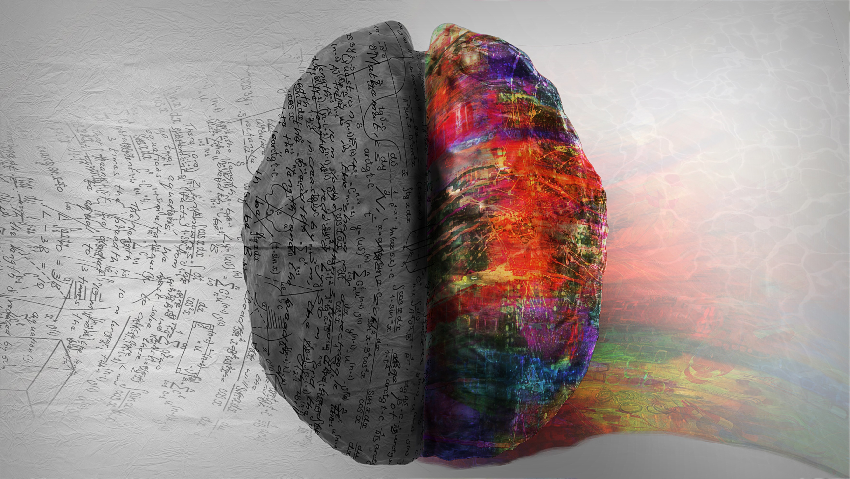
Rigor
“Students use mathematical language to communicate effectively and to describe their work with clarity and precision. Students demonstrate how, when, and why their procedure works and why it is appropriate. Students can answer the question, ‘How do we know?’”
4
Notes:
Presenter: Lee

Slide 5
Rigorous courses are… | Rigorous courses are not…
Defined by complexity, which is a measure of the thinking, action or knowledge that is needed to complete the task | Characterized by difficulty, which is a measure of effort required to complete a task
Measured in depth of understanding | Measured by the amount of work
Opportunities for precision in reasoning, language, definitions and notation that are sufficient to appropriate age/course | Based on procedure alone
Determined by students’ process | Measured by assigning difficult problems
Opportunities for students to make decisions in problem solving | Defined only by the resources used
Notes:
Presenter: Lee

Slide 6
Rigorous courses are… | Rigorous courses are not…
Opportunities to make connections | Taught in isolation
Supportive of the transfer of knowledge to new situations | Repetitive
Driven by students developing efficient explanations of solutions and why they work, providing opportunities for thinking and reasoning about contextual problems and situations | Focused on getting an answer
Defined by what the student does with what you give them | Defined by what you give the student
Notes:
Presenter: Lee

Slide 7

Higher Education Expectations
Algebraic Reasoning
Analytic Reasoning
Communication
Independence
Notes:
Presenter: Lee

Slide 8
Critical Areas of Focus
Communication and Analysis
Modeling with Functions
Extending Algebraic Reasoning
Polynomial and Rational Relationships
Trigonometry of General Triangles
Notes:
Presenter: Scott

Slide 9
Changes to Algebra 2 Standards Course Guidance Document
Number and Quantity
Standards Added
Perform arithmetic operations with complex numbers.
N.CN.3 Find the conjugate of a complex number; use conjugates to find magnitudes and quotients of complex numbers.
Plus (+) Signs Removed
Use complex numbers in polynomial identities and equations.
N.CN.7 Solve quadratic equations with real coefficients that have complex solutions.
N.CN.8 Extend polynomial identities to the complex numbers. For example, rewrite x² + 4 as
(x + 2 𝑖)(x − 2 𝑖).
N.CN.9 Know the Fundamental Theorem of Algebra; show that it is true for quadratic polynomials.
Notes:
Presenter: Scott

Slide 10
Changes to Algebra 2 Standards Course Guidance Document
Algebra
Standards Deleted
Use polynomial identities to solve problems.
A.APR.4 Prove polynomial identities and use them to describe numerical relationships. For example, the polynomial identity (x² + y²)² = (x² − y²)² + (2xy)² can be used to generate Pythagorean triples.
Plus (+) Signs Removed
Rewrite rational expressions.
A.APR.7 Understand that rational expressions form a system analogous to the rational numbers, closed under addition, subtraction, multiplication, and division by a nonzero rational expression; add, subtract, multiply, and divide rational expressions.
Notes:
Presenter: Scott

Slide 11
Changes to Algebra 2 Standards Course Guidance Document
Functions
Standards ADDED
Build a function that models a relationship between two quantities.
F.BF.1 Write a function that describes a relationship between two quantities.★
c. Compose functions. For example, if T(y) is the temperature in the atmosphere as a function of height, and h(t) is the height of a weather balloon as a function of time, then T(h(t)) is the temperature of a cooling body by adding a constant function to a decaying exponential, and relate these functions to the model. (A2, M3).
Standards Deleted
All F.TF Standards
Notes:
Presenter: Margie

Slide 12
Changes to Algebra 2 Standards Course Guidance Document
Functions
Plus (+) Signs Removed
Analyze functions using different representations.
F.IF.7 Graph functions expressed symbolically and indicate key features of the graph, by hand in simple cases and using technology for more complicated cases. Include applications and how key features relate to characteristics of a situation, making selection of a particular type of function model appropriate.★
g. Graph rational functions, identifying zeros and asymptotes when factoring is reasonable, and indicating end behavior. (A2, M3)
h. Graph logarithmic functions, indicating intercepts and end behavior. (A2, M3)
Build new functions from existing functions.
F.BF.4 Find inverse functions.
b. Read values of an inverse function from a graph or a table, given that the function has an inverse. (A2, M3)
c. Verify by composition that one function is the inverse of another. (A2, M3)
d. Find the inverse of a function algebraically, given that the function has an inverse. (A2, M3)
Notes:
Presenter: Margie

Slide 13
Changes to Algebra 2 Standards Course Guidance Document
Geometry
Standards Deleted
Find arc lengths and areas of sectors of circles.
G.C.6 Derive formulas that relate degrees and radians, and convert between the two. (A2, M3)
Notes:
Presenter: Steve

Slide 14
Changes to Algebra 2 Standards Course Guidance Document
Geometry
Plus (+) Signs Removed
Define trigonometric ratios, and solve problems involving right triangles.
G.SRT.8 Solve problems involving right triangles.★
b. Use trigonometric ratios and the Pythagorean Theorem to solve right triangles in applied problems.★ (A2, M3)
Note: Standard G.SRT.10 Part a. is included in this course to be considered for next standards revision.
Apply trigonometry to general triangles.
G.SRT.9 Derive the formula A = ¹/₂ ab sin(C) for the area of a triangle by drawing an auxiliary line from a vertex perpendicular to the opposite side.
G.SRT.10 Explain proofs of the Laws of Sines and Cosines and use the Laws to solve problems.
a. Extend right triangle trigonometry to include obtuse angles.
G.SRT.11 Understand and apply the Law of Sines and the Law of Cosines to find unknown measurements in right and non-right triangles, e.g., surveying problems, resultant forces.
Notes:
Presenter: Steve

Slide 15
Changes to Algebra 2 Standards Course Guidance Document
Statistics and Probability
Standards Deleted
All Statistics and Probability standards except:
Summarize, represent, and interpret data on two categorical and quantitative variables.
S.ID.6 Represent data on two quantitative variables on a scatter plot and describe how the variables
are related.★
Fit a function to the data; use functions fitted to data to solve problems in the context of the data. Use given functions, or choose a function suggested by the context. Emphasize linear, quadratic, and exponential models. (A2, M3)
Informally assess the fit of a function by discussing residuals. (A2, M3)
Notes:
Presenter: Steve

Slide 16
Follow-on Courses
Pre-Calculus at the high school
CCP Trigonometry
Other Algebra 2 equivalency course
Other CCP math course
Possibly AP Statistics
Note: CCP College Algebra is not a beneficial course for most students on the calculus pathway. It would be better for most students on the calculus pathway to take a pre-calculus course at their own high school with the intention of taking an AP Calculus course or Calculus in a postsecondary setting.
Notes:
Presenter: Lee

Slide 17
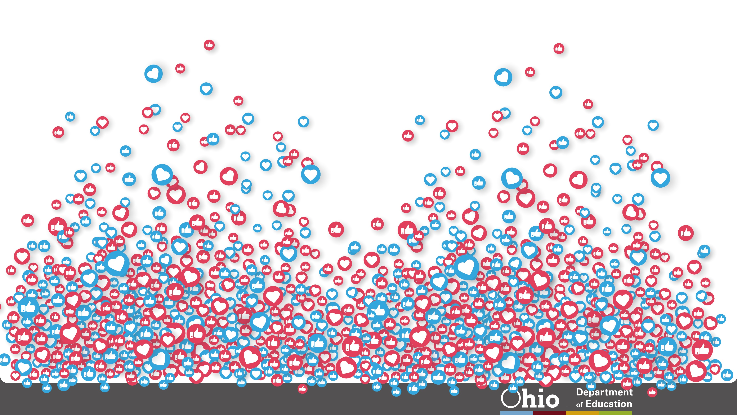





@OHEducation

Slide 18


Share your learning community with us!
#MyOhioClassroom
Celebrate educators!
#OhioLovesTeachers

