Slide 1
Mathematical Modeling and Reasoning: An Advanced Quantitative Reasoning Course
High School Math Pathways Symposium
Nov. 9-10, 2021

Slide 2
What is Quantitative Reasoning?

Slide 3
Definition of QR
“Quantitative reasoning (QR) is the application of basic mathematics skills, such as algebra, to the analysis and interpretation of real-world quantitative information in the context of a discipline or an interdisciplinary problem to draw conclusions that are relevant to students in their daily lives. It is not just mathematics.”
From Susan Elrod, “Quantitative Reasoning: The Next "Across the Curriculum" Movement,” Peer Review, Summer 2014, 16, 3: Retrieved from: https://www.aacu.org/peerreview/2014/summer/elrod

Slide 4
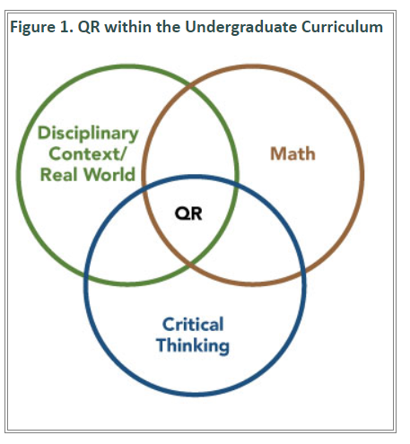
From Susan Elrod, “Quantitative Reasoning: The Next "Across the Curriculum" Movement,” Peer Review, Summer 2014, 16, 3: Retrieved from: https://www.aacu.org/peerreview/2014/summer/elrod
Notes:
https://www.aacu.org/peerreview/2014/summer/elrod

Slide 5
Quantitative Reasoning

Slide 6
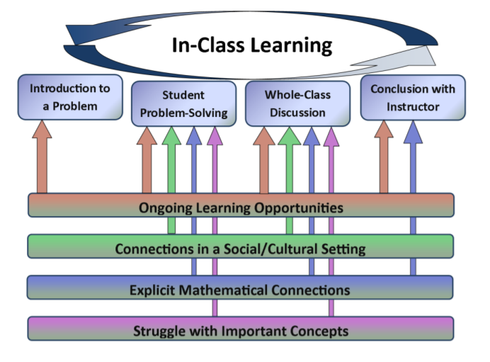
Quantitative Reasoning

Slide 7
Traditional Mathematics Class | Quantitative Reasoning Class
Skill driven with concepts applied | Concept driven with skills applied
Practice and then apply | Apply and then practice
Context removed, solve problem, insert context | Problem cannot be solved without context
Behaviorist approach | Inquiry based
Teacher-centered | Student-centered
Individual-centered | Team-centered
Communication optional | Communication essential
Objects of study are abstract | Objects of study are data
For specific, high-level STEM careers | For all careers, and essential for good citizenship and personal finance decisions

Slide 8
Description of Course
This course is designed to promote reasoning, problem-solving and modeling through thematic units focused on the mathematical practices while reinforcing and extending content in Number and Quantity, Algebra, Functions, Statistics and Probability, and Geometry.

Slide 9
Math Practices
Make sense of problems and persevere in solving them.
Reason abstractly and quantitatively.
Construct viable arguments and critique the reasoning of others.
Model with mathematics.
Use appropriate tools strategically.
Attend to precision.
Look for and make use of structure.
Look for and express regularity in repeated reasoning.

Slide 10
QR Transition Course
with Remediation-Free Goal
College
Math Pathway
Future Career
College Algebra to Calculus
Business
Chemistry
Engineering
High School
Quantitative Reasoning
Communication
Criminal Justice
Fine Arts
Statistics
Nursing
Nutrition
Social Work
Notes:
Target Student: A student who may go to college or take a College Credit Plus course but is not yet academically ready from a mathematical perspective. Note: Although the course most likely will consist of seniors, juniors may take the course.
Description of Course: This course is designed to promote reasoning, problem-solving and modeling through thematic units focused on mathematical practices while reinforcing and extending content in Number and Quantity, Algebra, Functions, Statistics and Probability, and Geometry. It is a yearlong course taught using student-centered pedagogy.
Type/Structure of Course:
A yearlong course Rationale: All students can make sense and demonstrate understanding of mathematics given the opportunity to think deeply about mathematics in context. Given ample time, students can engage in multiple-day activities that provide opportunities to explore and build understanding. Students will engage in rich mathematical discussion, comparing multiple solution strategies and making connections among and between multiple representations.
Focused on quantitative reasoning, problem-solving and modeling Rationale: Quantitative reasoning and modeling involve the application of mathematics to real-world situations with careful attention to the choice of units and contextual challenges. Problem-solving requires analyzing an unfamiliar situation and devising a solution strategy. Problem-solving and modeling mathematics together provide opportunities for students to experience success with mathematics not merely improve their self-perception. These habits and skills promote perseverance and cut across disciplines, thus providing a gateway into successful postsecondary education and a variety of careers.
Taught using student-centered pedagogy Rationale: It is essential to create a student-centered learning environment in order to allow students to develop habits and skills in quantitative reasoning, problem-solving and modeling.

Slide 11
Follow-on Courses
CCP Quantitative Reasoning
AP Statistics
CCP Introductory Statistics
CCP Technical Mathematics I
CCP Mathematics in Elementary Education I
CCP Introduction to Data Science
Algebra 2
Another Math Pathways Course

Slide 12
Equity
For purposes of equity, the rigor of this course must be maintained! This is a more relevant pathway with a different type of pedagogy, not a “less than” pathway.

Slide 13
Rigor
“Students use mathematical language to communicate effectively and to describe their work with clarity and precision. Students demonstrate how, when, and why their procedure works and why it is appropriate. Students can answer the question, ‘How do we know?’”

Slide 14
Rigorous courses are… | Rigorous courses are not…
Defined by complexity, which is a measure of the thinking, action, or knowledge that is needed to complete the task | Characterized by difficulty, which is a measure of effort required to complete a task
Measured in depth of understanding | Measured by the amount of work
Opportunities for precision in reasoning, language, definitions, and notation that are sufficient to appropriate age/course | Based on procedure alone
Determined by students’ process | Measured by assigning difficult problems
Opportunities for students to make decisions in problem solving | Defined only by the resources used

Slide 15
Rigorous courses are… | Rigorous courses are not…
Opportunities to make connections | Taught in isolation
Supportive of the transfer of knowledge to new situations | Repetitive
Driven by students developing efficient explanations of solutions and why they work, providing opportunities for thinking and reasoning about contextual problems and situations | Focused on getting an answer
Defined by what the student does with what you give them | Defined by what you give the student

Slide 16
Themes
Number and Quantity
Functions, Part 1
Functions, Part 2
Geometry
Statistics
Probability
Applications

Slide 17
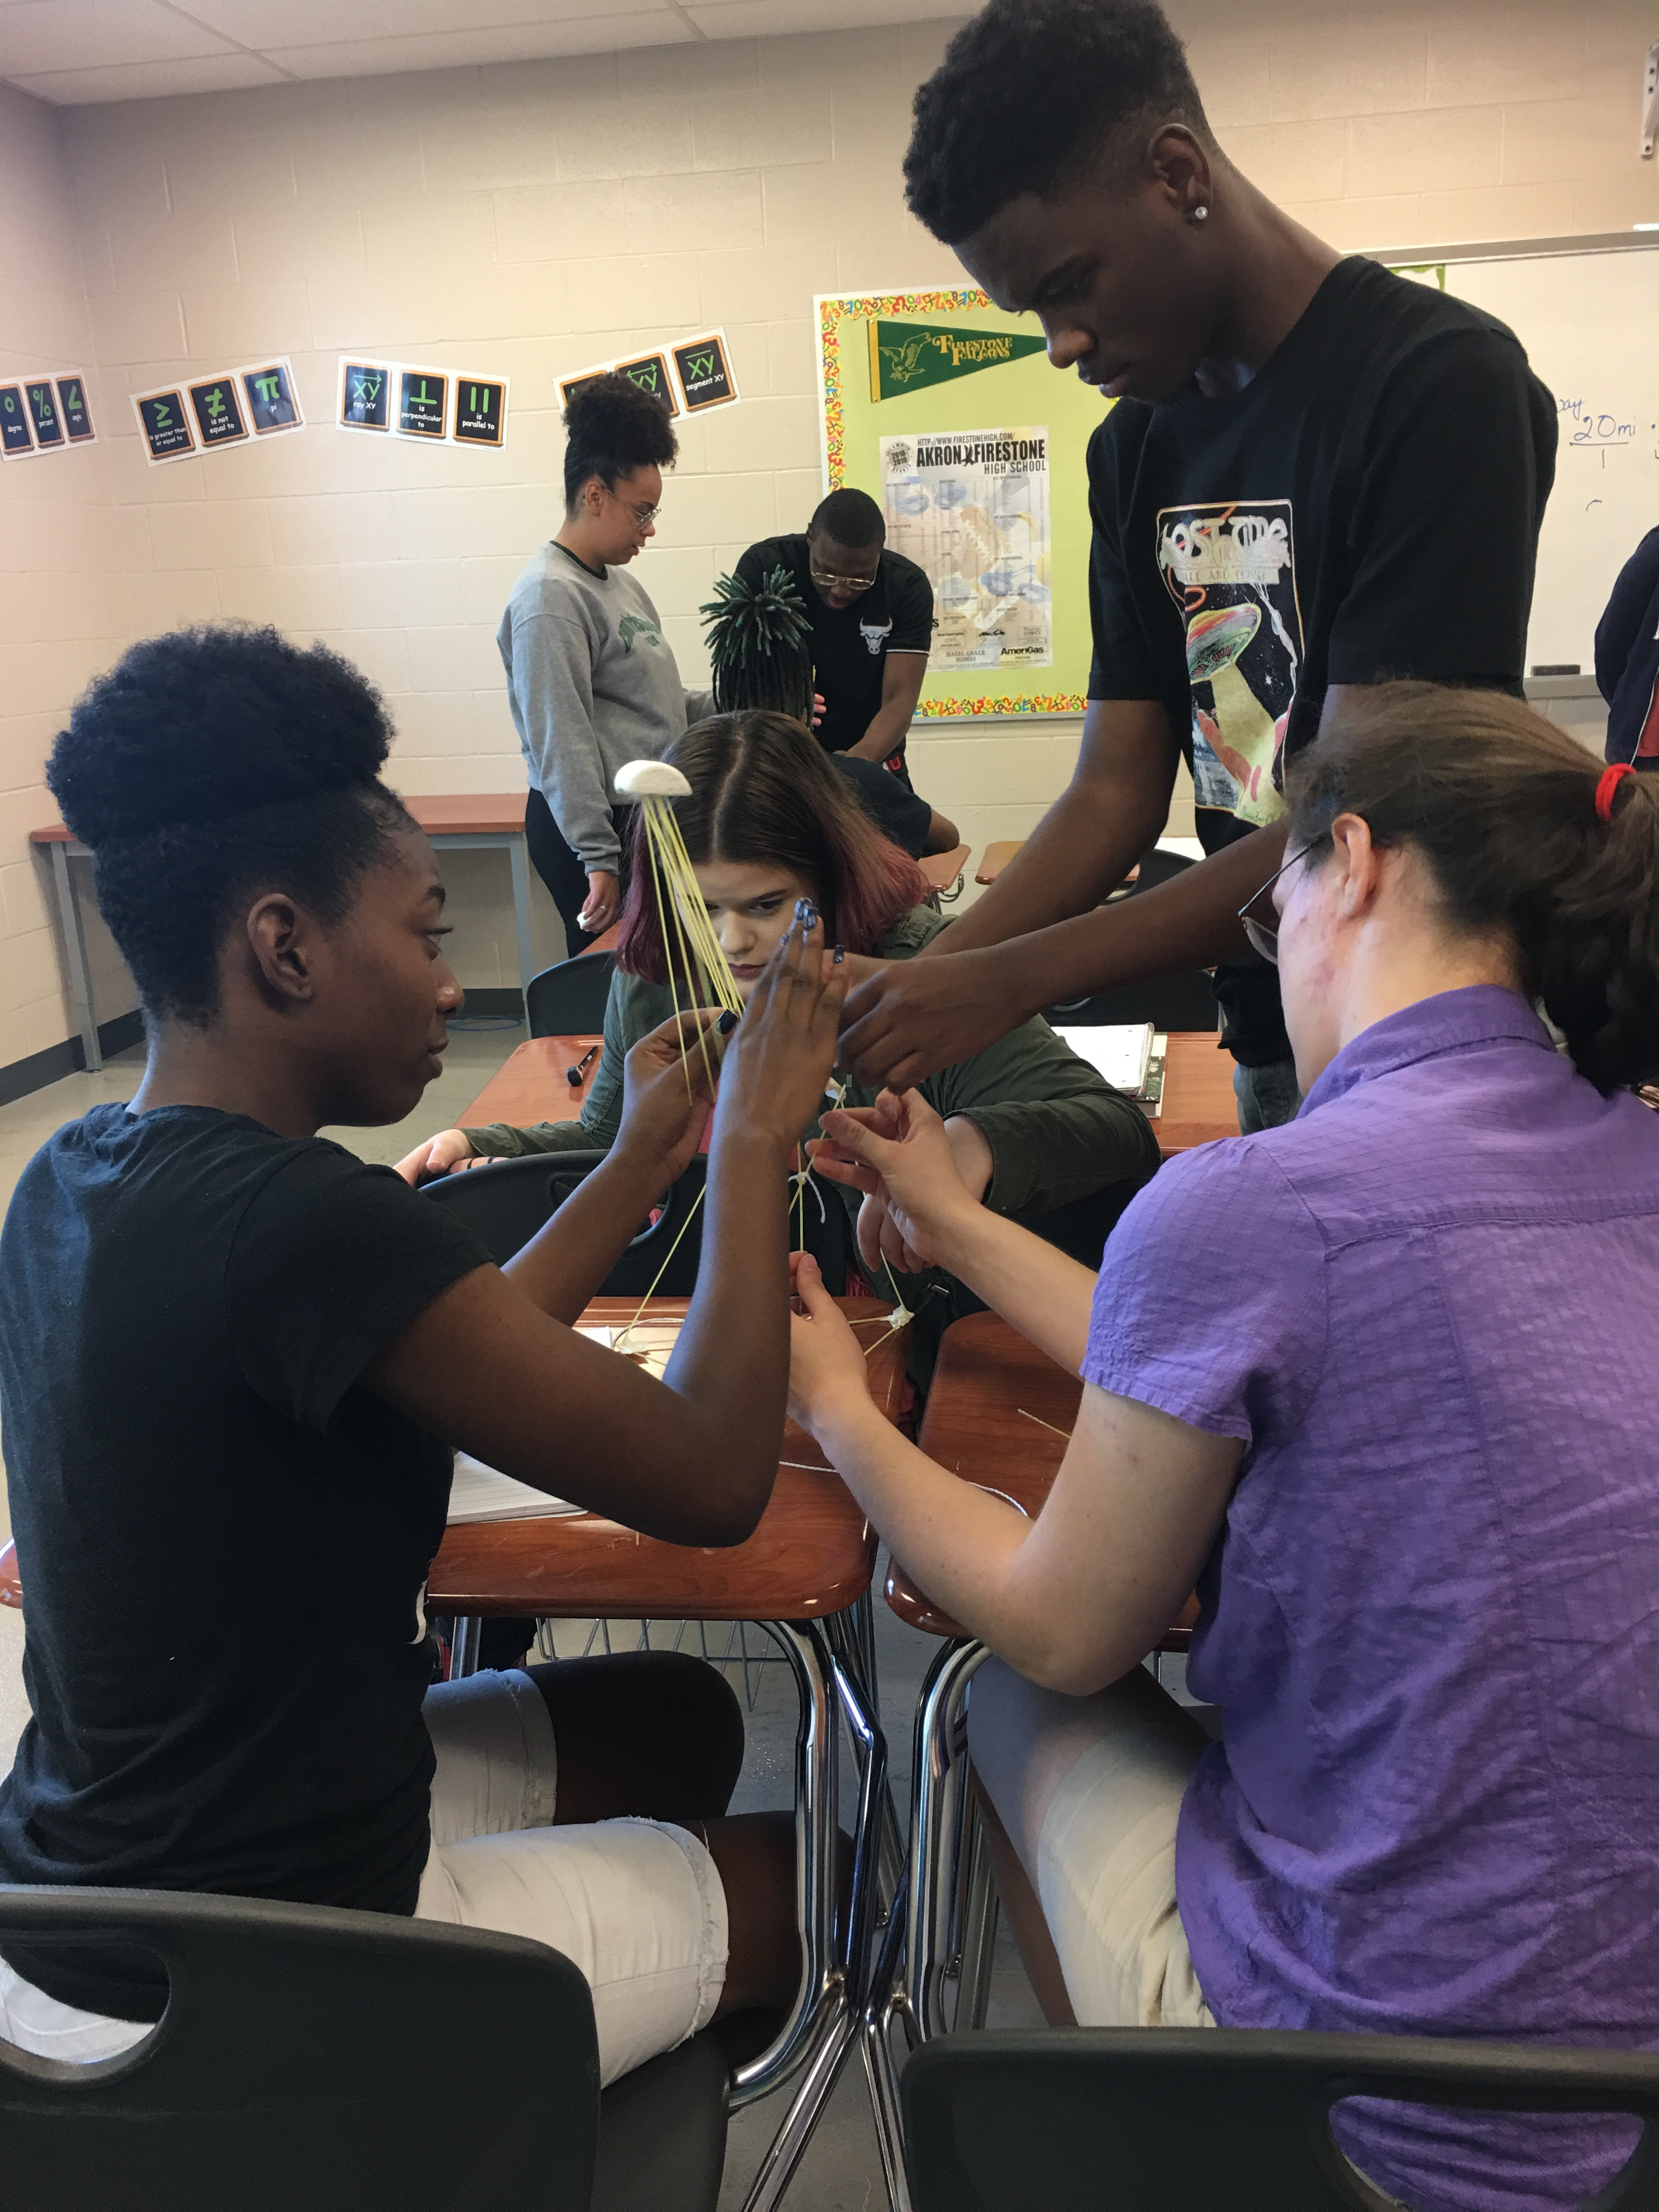
Theme 0
Growth Mindset
Launching Lessons
Mindsets
Math Practices
Routines
Convincing, defending, proof

Slide 18
Overview of Numbers and Quantity
Farm Swap
Remodeling the Classroom
Gears
Driving for Gas
Planning a Road Trip
Credit Cards
1
2
3
4
5
6

Slide 19
Functions-Part 1
Ramps
Bungee Drop
Follow the Bouncing Ball
One Good Bounce
Hopping Through Optimization
Which Amusement Park?
Buying a Car
7
8
9
10
11
12
13

Slide 20
Functions-Part 2
Catapult Project
Modeling Cancer Cells
Buying a House
Skid Mark Trial
Big Fish Story
14
15
16
17
18

Slide 21
Overview of Geometry
Design Logo
Working with Triangles
Designing a Mini-gold course
Unraveling the Unit Circle
19
20
21
22

Slide 22
Overview of Statistics
Misusing Statistics
Flinging Frogs
M&Ms Sampling Distributions
What Does Normal Distribution Sound Like?
Colors Challenge
Double-Stuf Oreos
24
25
26
27
28
29

Slide 23
Overview of Probability
Taste Test Challenge
Random Babies
Thinking about False Positives
Carnival Games
30
31
32
33

Slide 24
Applications
Inflation and Consumer Price Index
Public Policy
34
35

Slide 25
Advanced Quantitative Reasoning Standards

Slide 26
Act Blueprint
Reporting Category | Reporting Subcategory | # of Items | % of Test
Integrating Essential Skills (topics learned before 8th grade using higher complexity) |  | 24-26 | 40-43%
Preparing for Higher Mathematics |  | 34-36 | 57-60%
 | Number & Quantity | 4-6 | 7-10%
 | Algebra | 7-9 | 12-15%
 | Functions | 7-9 | 12-15%
 | Geometry | 7-9 | 12-15%
 | Statistics and Probability | 5-7 | 8-10%
Modeling |  | >16 | >27%
Total |  | 60 | 100%
As our group did an analysis, most ACT standards in the 28-32 range are below A2.
Notes:
https://www.act.org/content/act/en/products-and-services/the-act/test-preparation/description-of-math-test.html

Slide 27
Students said…
“This is the first time⎯
…math isn’t my problem class.”
…I understand.”
…math makes sense.”
…I like math.”

Slide 28
A student said…
“I have been able to use my debate skills and have had a better improvement in my chemistry grade because of learning the same problems in this class.”

Slide 29
Another teacher said…
“What’s DY* doing at the board? He’s actually doing work for you! He always sleeps in my class. Any class that makes DY* work must be good, so I need to be in this class.”

Slide 30
Pilot Teacher said…
“The class is more rigorous and engaging and thought-provoking than my pre-calculus class.”

Slide 31
Pilot Teacher said…
“Although I always knew this was the way I was supposed to teach, I didn’t realize that it would make such a huge difference. My students are now excited and eager to try new things and remembering things that they try.”

Slide 32
Pilot Teacher said…
“My kids can read the problem or task now, know what questions they want to answer and know what information they need to find and are able to work independently.”

Slide 33
Student Voices

Slide 34
Teacher Voices

Slide 35
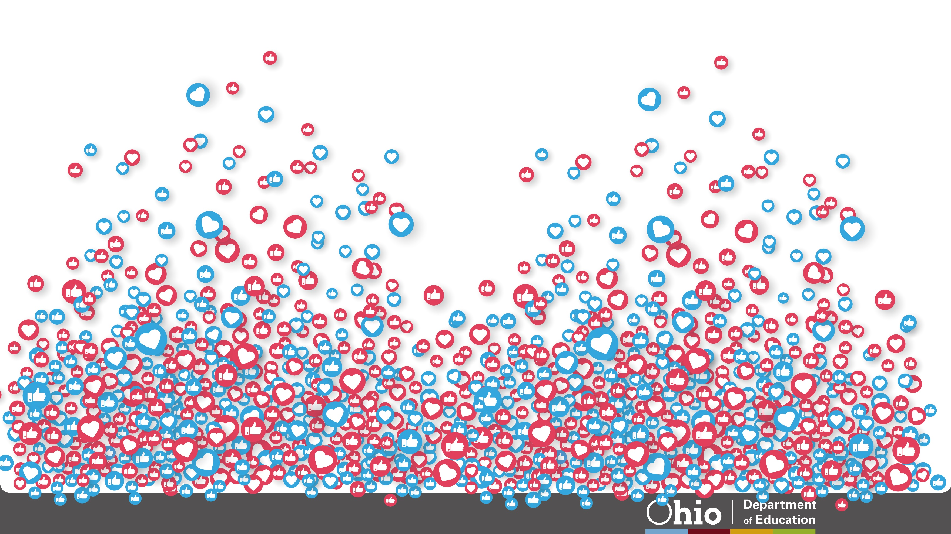
35
@OHEducation

Slide 36
Share your learning community with us!
#MyOhioClassroom
Celebrate educators!
#OhioLovesTeachers

