Slide 1
Math Pathways Symposium
Discrete Math/
Computer Science
Nov. 0

Slide 2
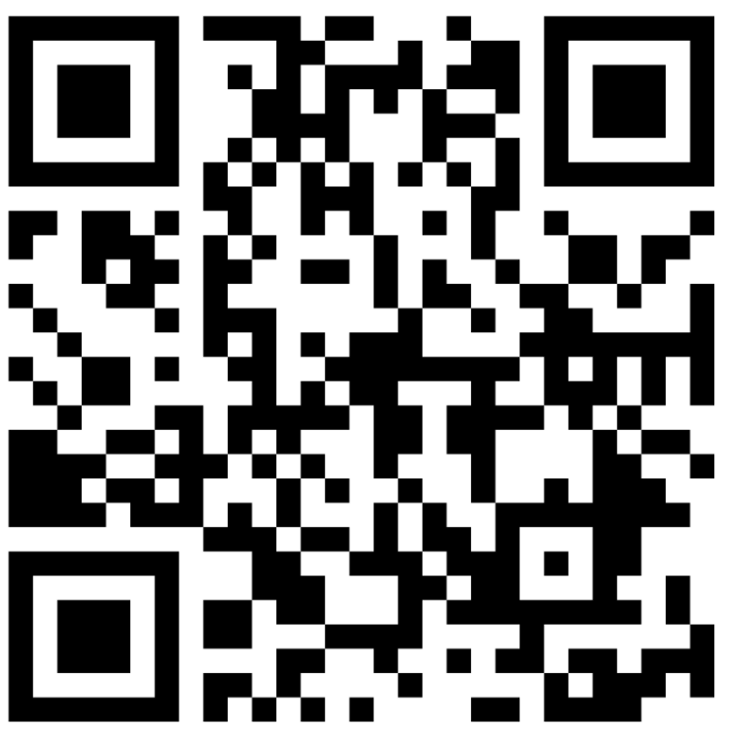
3. Discrete Math/Computer Science
Facilitated by
Chris Orban, The Ohio State University
Carol Van Fossen, Metro Early College High School
John Wiseman, Education Program Specialist at the Ohio Department of Education
Give feedback on our Padlet!
This session will be recorded, so it can be posted on the Department’s website. The recording will begin at the end of this slide.
Notes:
Note: John W. will introduce and record. John will move his slides and Chris will move his.
Padlet Link: https://padlet.com/annacannelongo/k1iiu6ny9gzvlg8c

Slide 3
Virtual Meeting Norms
Be respectful.
Recognize that everyone has expertise.
Assume positive intent.
Seek clarification in language and ideas.
Share experiences.
Use the chat feature when you have a question.
Mute your microphone when not speaking.
Notes:
Sherry: Go over meeting norms

Slide 5
Rigor
“Students use mathematical language to communicate effectively and to describe their work with clarity and precision. Students demonstrate how, when, and why their procedure works and why it is appropriate. Students can answer the question, ‘How do we know?’”
Notes:
This slide shows the definition for rigor as it applies to the math pathways. This definition was written by the Math Pathways Architects, the group that worked on the overarching design for the pathway courses.

Slide 6
STEM Post-Secondary Pathways
Calculus Based STEM Careers
Non-Calculus Based STEM Careers
Notes:
Although many careers in computer science do not require advanced mathematics, many jobs and post-secondary computer science majors do require knowledge of advanced mathematics. A student interested in a computer science career may need additional math content to succeed in advanced computer science.
This course can help student’s make a decision about their future coursework and possibly even eventually which career they choose.
In a later slide we will discuss possible follow-on courses that students could take after the discrete math/cs course.

Slide 7
What is Discrete Math?
The study of mathematical structures that are countable or otherwise distinct and separable (discrete compared to continuous structures). It is the language of computer science.
Integrating Computer Science and Discrete Math will−
Allow math teachers to teach computer science, therefore giving more students access to computer science concepts
Keep students engaged in mathematics so they can continue to advance in their mathematical reasoning and thinking.
Notes:
This slide includes the definition for the Discrete Math.

Slide 8
Course Description
Acquiring foundational knowledge in Discrete Mathematics and basic programming skills are the primary objectives and outcomes of the Discrete Math/Computer Science course. It uses mathematical reasoning and computational thinking in the context of JavaScript and unplugged activities to learn concepts of Discrete Mathematics.
Ohio’s Learning Standards related to Mathematics and Computer Science are taught along with the data demands of good citizenship in the 21st century. These habits and skills cut across disciplines and other languages, promote perseverance and provide a gateway to successful postsecondary education and a variety of careers. This course satisfies the credit requirement for Algebra 2 or equivalent.
Notes:
This is the course description for DM/CS

Slide 9
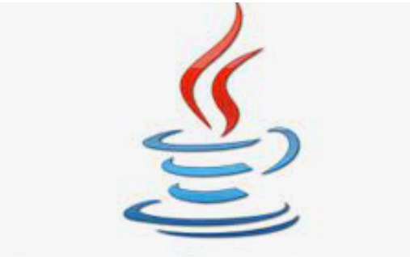
JavaScript
Rationale: The [JavaScript] syntax (although different than Java) more closely aligns to AP Computer Science A which uses Java, so it should be an easier transition for students and AP Computer Science teachers than some other languages.
Notes:
Early on

Slide 10
Course Overview
Unit | Descriptions
1 | Games
2 | Counting/Combinatorics
3 | Probability
4 | Connectivity
5 | Iteration and Recursion
6 | Cryptography

Slide 11
Follow-on Courses
Students could follow-on with the following courses.
Algebra 2 course
AP Computer Science A
AP Computer Science Principles
CCP Discrete Mathematics
CCP Quantitative Reasoning
CCP Data Science
Other Algebra 2 equivalency course
Note: Students who want to pursue a degree in a computer science field that requires calculus should take Algebra 2 and AP Computer Science A in tandem as follow-on courses.

Slide 12
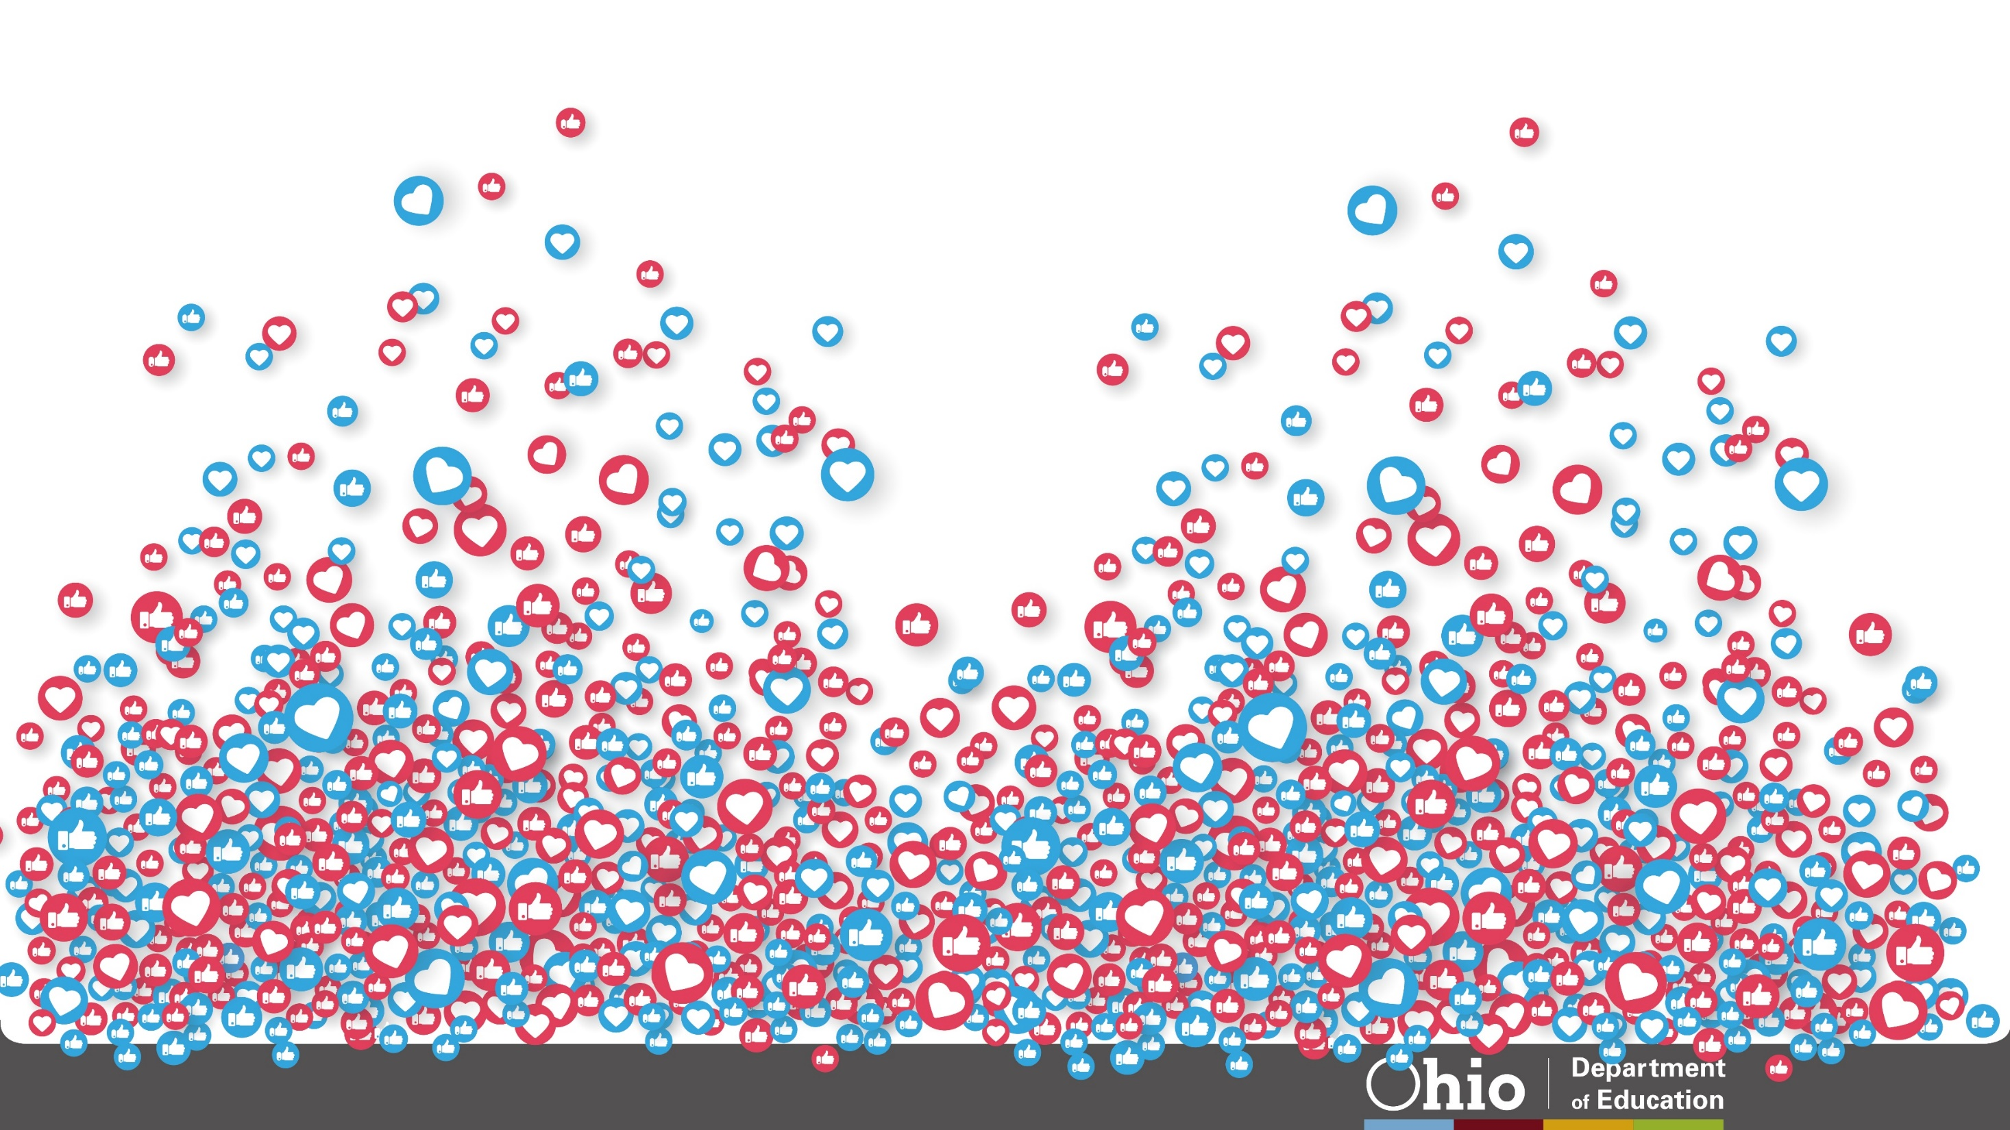
@OHEducation
Notes:
Questions?

Slide 13
Share your learning community with us!
#MyOhioClassroom
Celebrate educators!
#OhioLovesTeachers

