Slide 1
Data Science Foundations
High School Math Pathways Symposium
Nov. 9-10, 2021
Notes:
Presenter: Lauren

Slide 2
What is Data Science?
Data scientists find patterns in sets of information that provide insights about the past, the present and the future.
Notes:
Presenter: Lauren

Slide 3
Data Science
Quantitative Reasoning
Computer Science
Statistics & Probability
Data science is the intersection of the fields of quantitative reasoning, statistics, and computer science with a heavy focus on the creative problem-solving aspect.
Data Science
Notes:
Presenter: Lauren

Slide 4
Why is Data Science important?
Notes:
Presenter: Lauren

Slide 5
Postsecondary Pathways
Bachelor’s or above (requires Calculus) | Bachelor’s or above (requires non-Calculus) | Associate’s degree | Certificate/Bootcamps
Business Intelligence Analysts Data Science Information Science Marketing Software Developers | Any Arts or Humanities degree that requires Quantitative Reasoning Applied Business (AAB) Applied Marketing (AAB) Computer Programmers Criminal Justice (Applied degree) Database Administrators Journalism Market Research Analysts and Marketing Specialists Management Analysts Project Managers Public Relations/Advertising Others | Any Arts or Humanities degree that requires Quantitative Reasoning Computer Network Support Specialists Web Developers | Data Analytics Data Science
Students who are interested in Calc-based careers also need to take Algebra 2.
Notes:
Presenter: Lauren

Slide 6
Target Students
Data Science Foundations is beneficial for students who need a third or fourth credit in mathematics and are not intending to pursue a career that requires calculus. It is appropriate for students with limited or no prior programming, statistics and data analytics knowledge. This course is ideal for absolute beginners who want to acquire a basic working knowledge of data science. Data Science Foundations is designed to be a hands-on course that promotes reasoning using the standards for mathematical practice.
The course is especially appropriate for a student who has the following characteristics:
Anticipates a career in behavioral sciences;
Anticipates a career in the emerging fields of computer science, computational data analysis and/or statistics;
Is interested in applied fields of study that use mathematics;
Enjoys exploring engaging, real-world issues involving data;
Desires to become a better-informed citizen;
Plans on pursuing a pathway that does not require calculus; and/or
Plans on pursuing computer technology or STEM fields at a postsecondary institution.
Notes:
Presenter: Sandra

Slide 7
Data Science Standards
Statistics & Probability
Computer Science
Notes:
Presenter: Sandra

Slide 8
Standards Document
https://education.ohio.gov/Topics/Learning-in-Ohio/Mathematics/Resources-for-Mathematics/Math-Pathways/Higher-Ed-Entry-Level-Math-Pathways-Course-Descrip
Notes:
Presenter: Sandra

Slide 9
Overview of Data Science Foundations Course
Communication and Analysis
Data and Visualizations
Distributions, Probability, and Simulations
Data Collection Methods: Traditional and Modern
Predictions and Models
Data and Society
Notes:
Presenter: Sandra

Slide 10
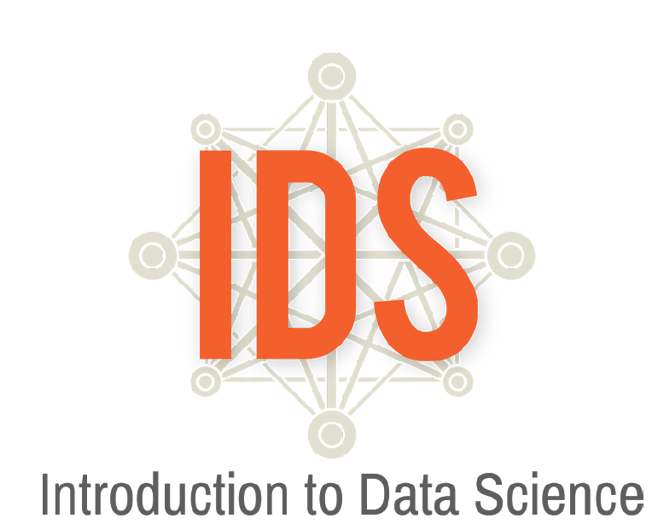
Overview of Data Science Foundations Course
https://www.introdatascience.org/
Notes:
Presenter: Sandra

Slide 11
Overview of Data Science Foundations Course
Technology will be hosted by The University of Cincinnati.
Aligns with emerging postsecondary Introduction to Data Science course
Notes:
Presenter: Sandra

Slide 12
How is Data Science Foundations different than Statistics & Probability?
The big difference between data science and statistics is that where statistics focuses on explaining the data, data science focuses on uncovering insights that help make predictions and decisions.
Notes:
Presenter: Brett
The difference between data science and statistics is that where statistics focuses on explaining the data, data science focuses on using data to make predictions and decisions.

Slide 13
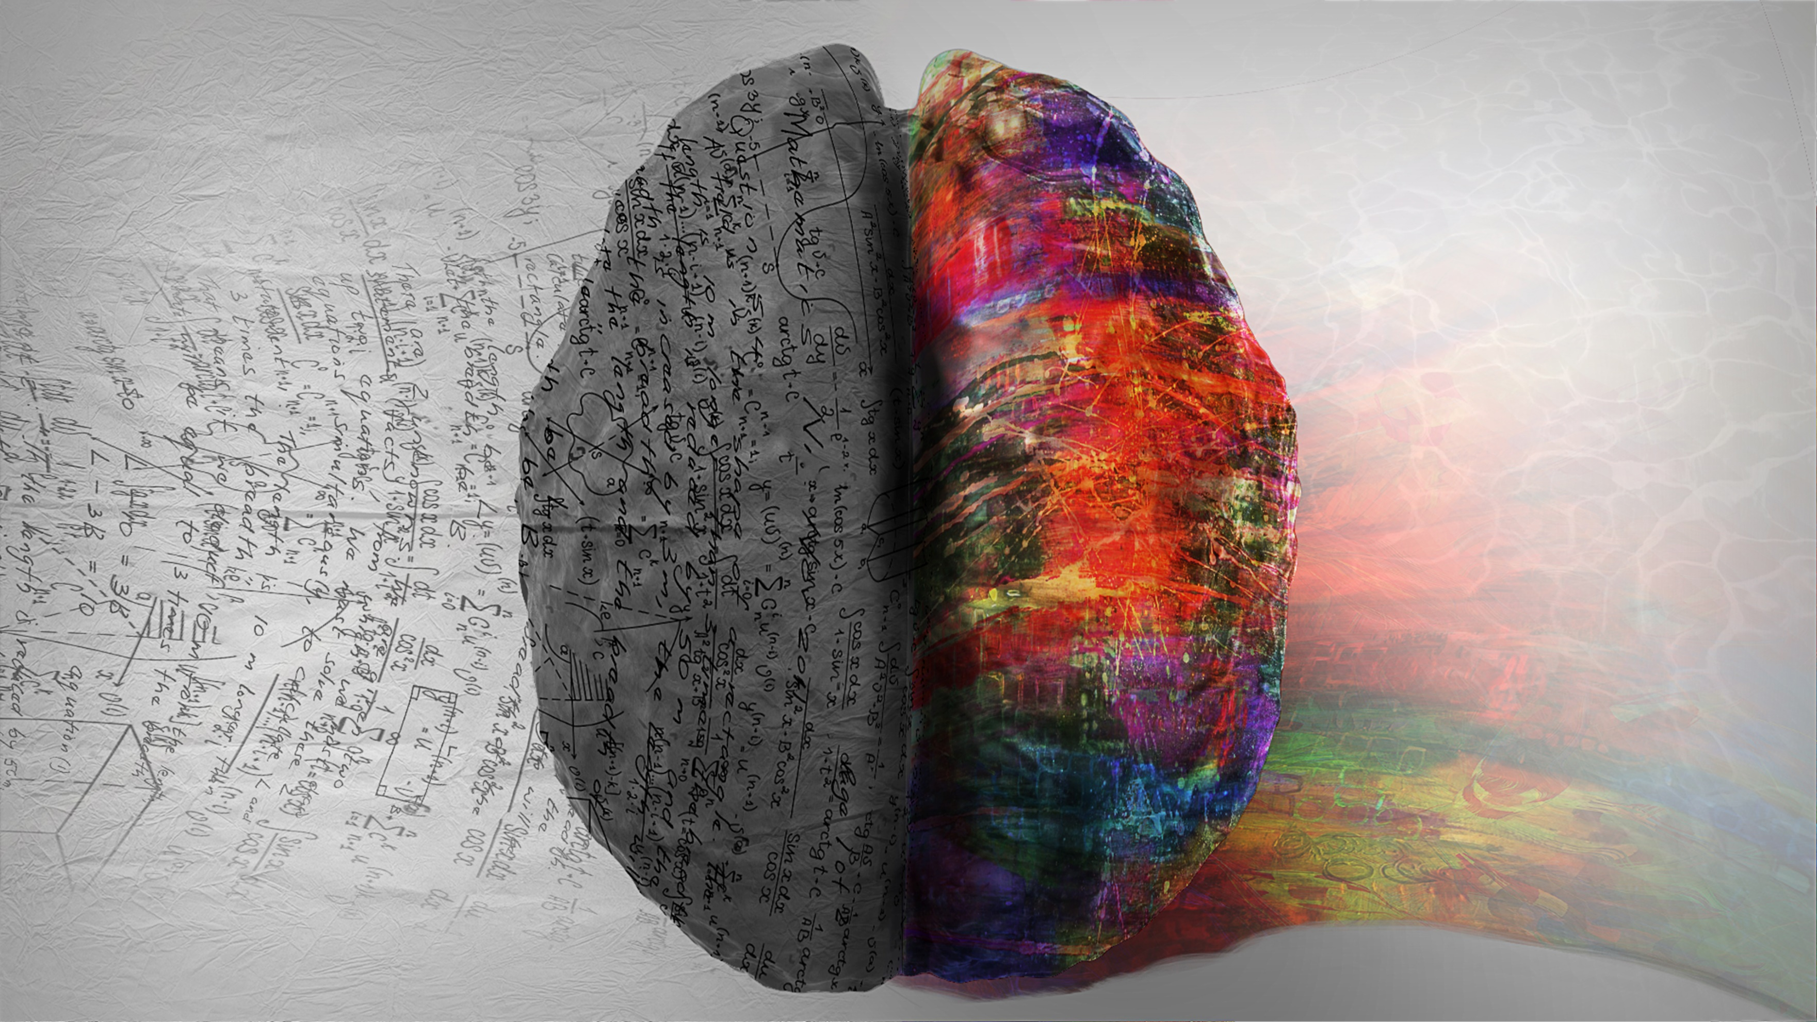
Rigor
“Students use mathematical language to communicate effectively and to describe their work with clarity and precision. Students demonstrate how, when, and why their procedure works and why it is appropriate. Students can answer the question, ‘How do we know?’”
Notes:
Presenter: Brett

Slide 14
Rigorous courses are… | Rigorous courses are not…
Defined by complexity, which is a measure of the thinking, action, or knowledge that is needed to complete the task | Characterized by difficulty, which is a measure of effort required to complete a task
Measured in depth of understanding | Measured by the amount of work
Opportunities for precision in reasoning, language, definitions, and notation that are sufficient to appropriate age/course | Based on procedure alone
Determined by students’ process | Measured by assigning difficult problems
Opportunities for students to make decisions in problem solving | Defined only by the resources used
Notes:
Presenter: Brett

Slide 15
Rigorous courses are… | Rigorous courses are not…
Opportunities to make connections | Taught in isolation
Supportive of the transfer of knowledge to new situations | Repetitive
Driven by students developing efficient explanations of solutions and why they work, providing opportunities for thinking and reasoning about contextual problems and situations | Focused on getting an answer
Defined by what the student does with what you give them | Defined by what you give the student
Notes:
Presenter: Brett

Slide 16
Follow-on Courses
CCP Introduction to Data Science
AP Statistics
CCP Introductory Statistics
CCP Quantitative Reasoning
CCP Mathematics for Elementary Education
AP Computer Science A
Algebra 2
Other Algebra 2 Equivalent Math Pathways course
Other CCP math course
Notes:
Presenter: Brett

Slide 17
Data Science Foundations Pilot
Student-Centered Learning
Collaborative Environment
Curriculum
Differentiation
Notes:
Presenter: Maureen

Slide 18
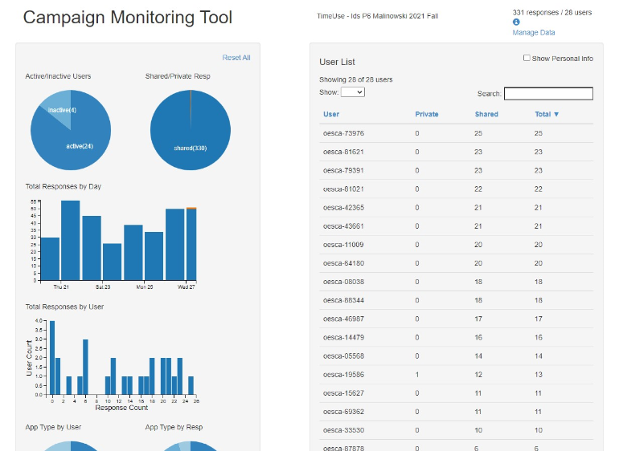
Data Science Foundations Pilot
Campaigns
Food Habits
Time Use
Personality Color
Stress/Chill
Class Campaign
Water Campaign
Notes:
Presenter: Maureen

Slide 19
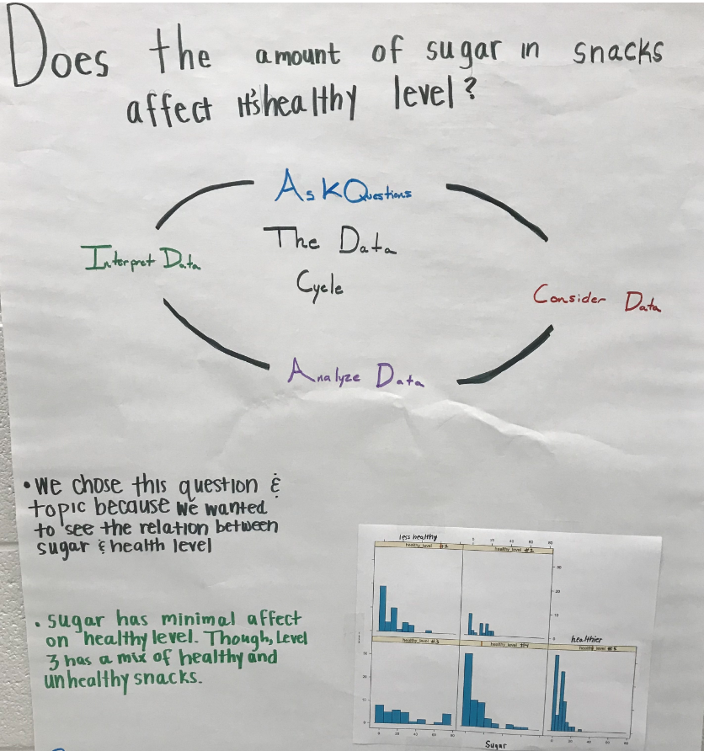
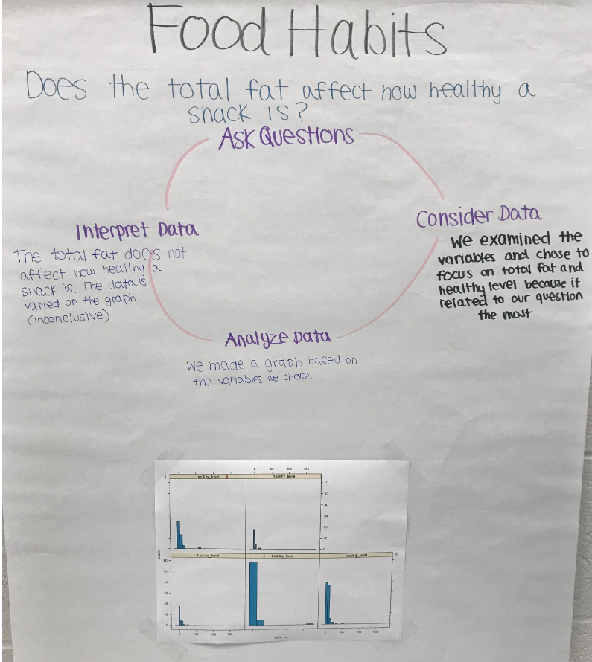
Data Collection Cycle
Notes:
Presenter: Maureen

Slide 20
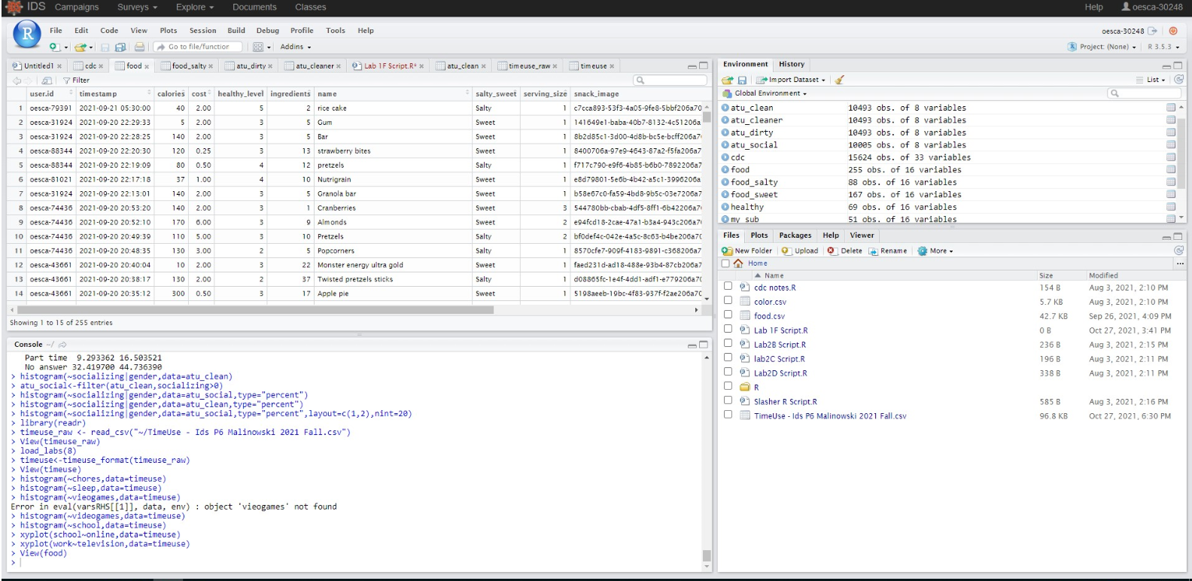
R/RStudio
Notes:
Presenter: Maureen

Slide 21
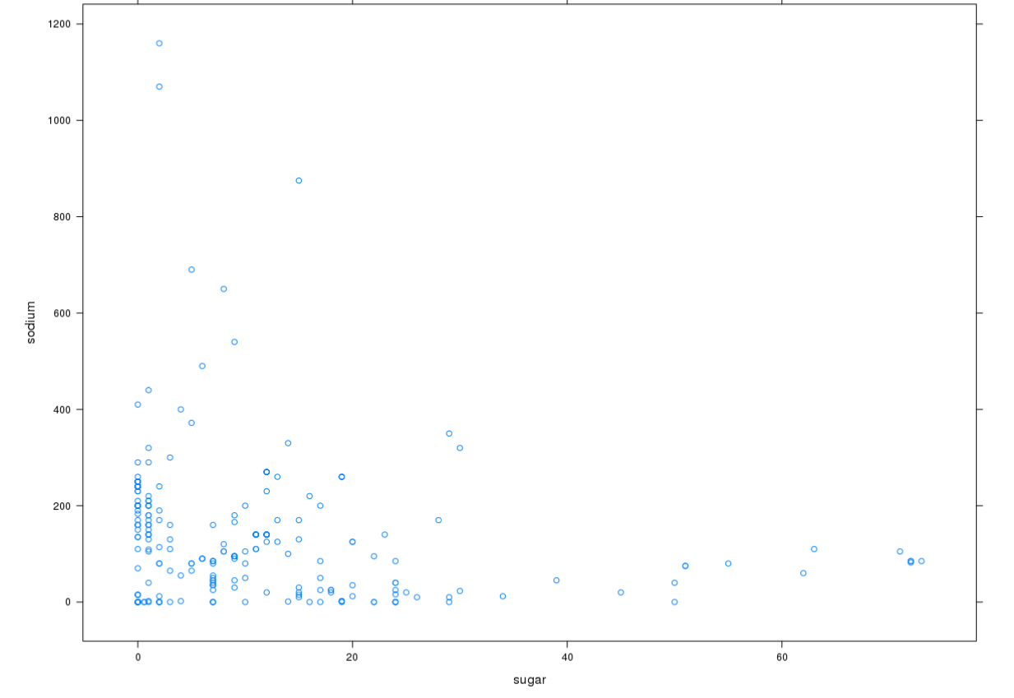
R/RStudio
Notes:
Presenter: Maureen

Slide 22
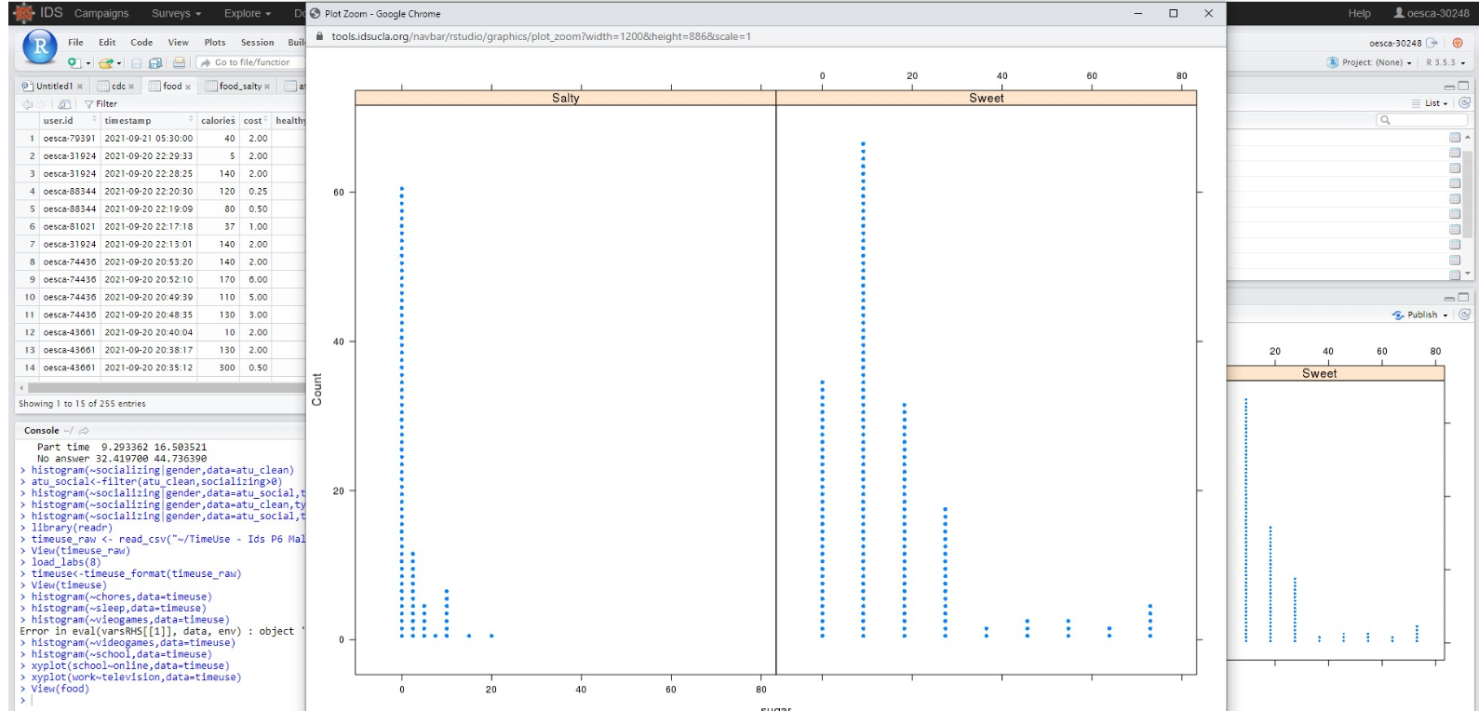
R/RStudio
Notes:
Presenter: Maureen

Slide 23
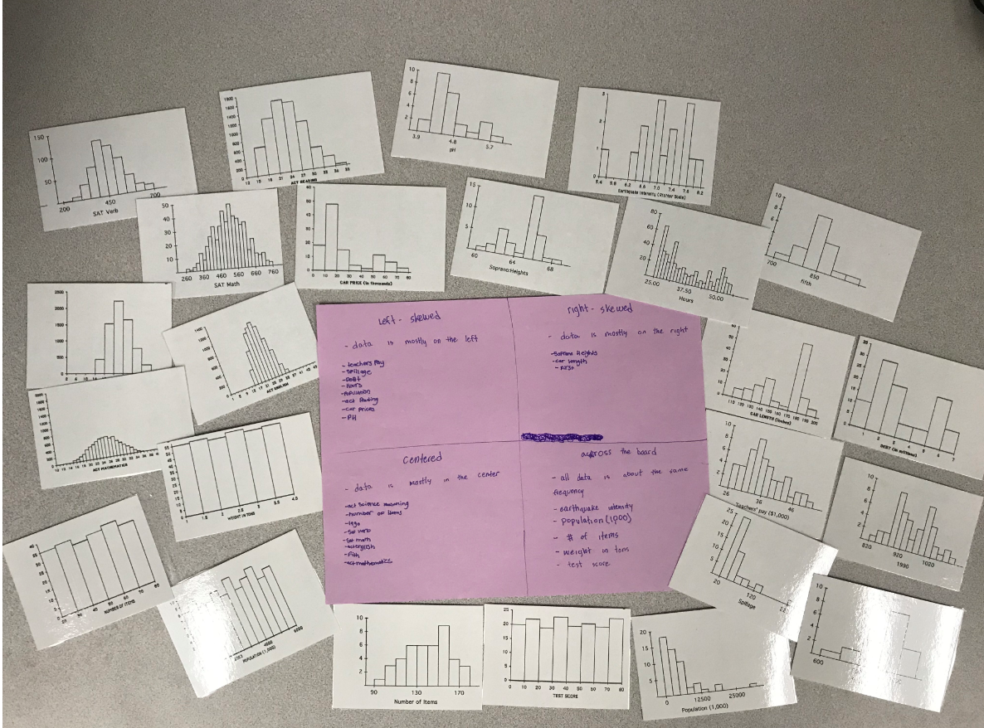
Student Work
Notes:
Presenter: Maureen

Slide 24
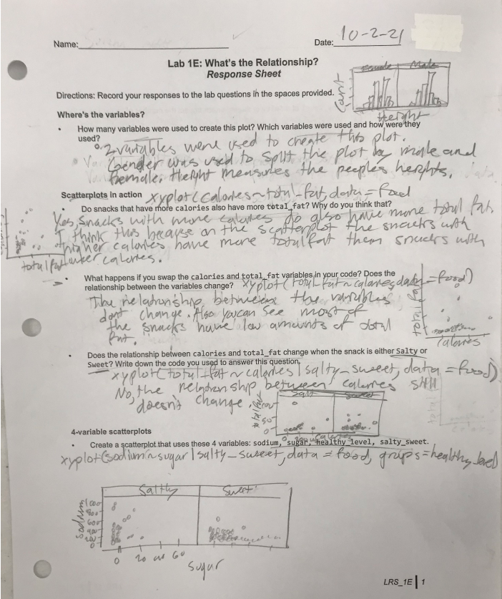
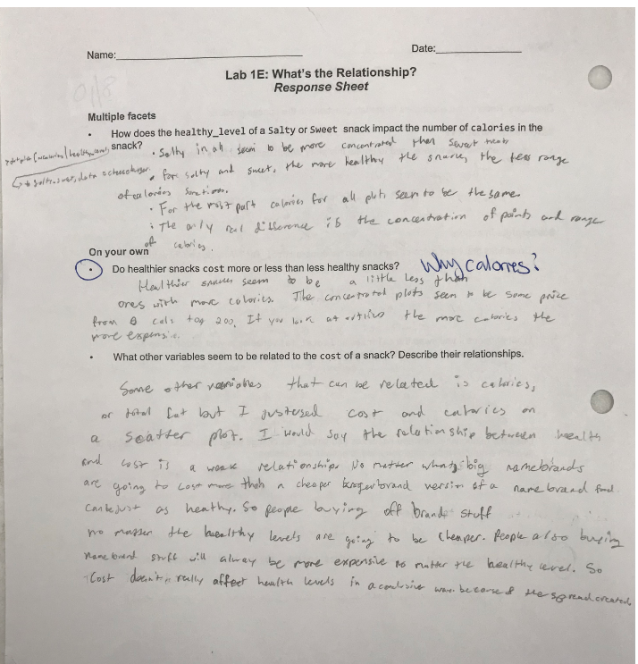
Student Work
Notes:
Presenter: Maureen

Slide 25
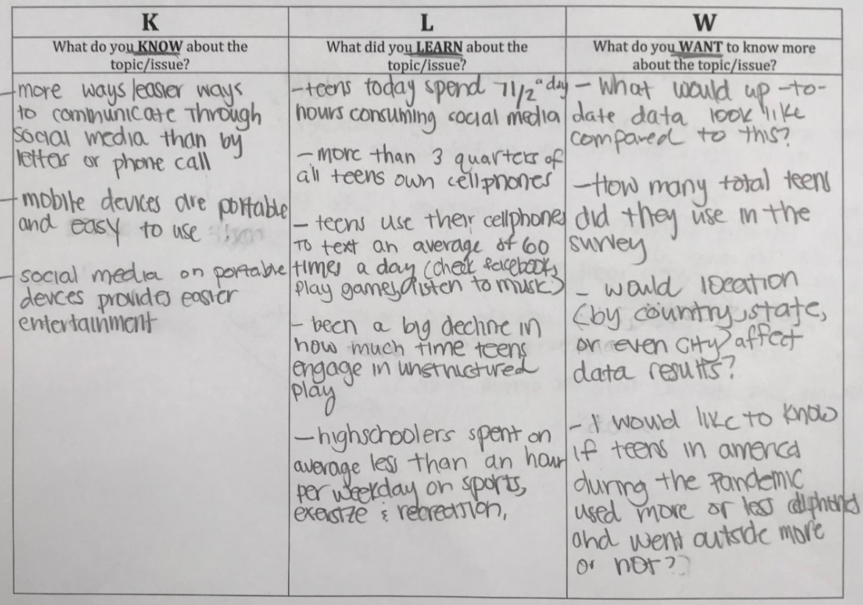
Student Work
Notes:
Presenter: Maureen

Slide 26
Where to Apply for the Data Science Foundations Pilot?
https://education.ohio.gov/Topics/Learning-in-Ohio/Mathematics/Resources-for-Mathematics/Math-Pathways/Data-Science-Foundations
Notes:
Presenter: Maureen

Slide 27
Q & A

Slide 28
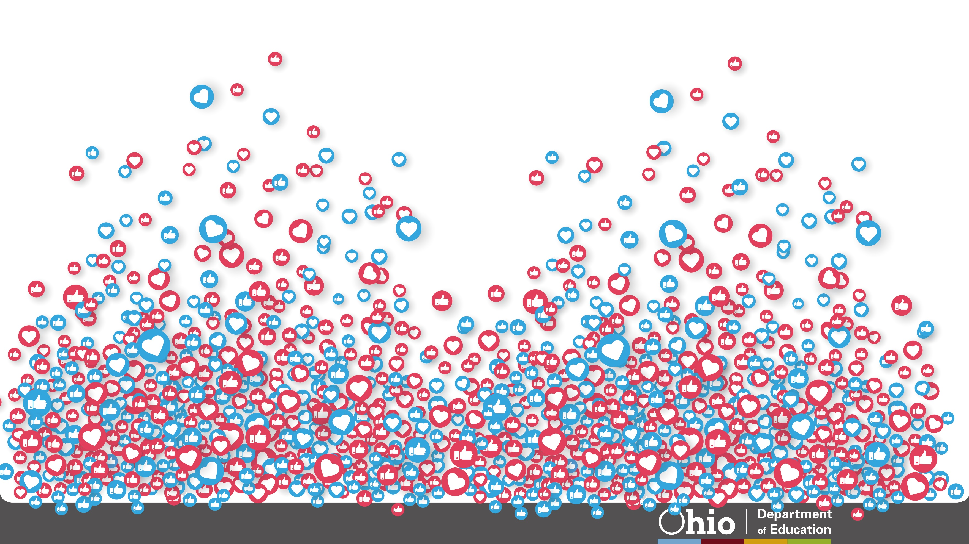
@OHEducation

Slide 29
Share your learning community with us!
#MyOhioClassroom
Celebrate educators!
#OhioLovesTeachers

