Slide 1
School Counselors and Higher Ed Advisors Toolkit Session
ODE Math Symposium: November 9-10, 2021

Slide 2
Advantages of Math Pathways
Expands course options for students in high school that are better connected to their interests and postsecondary plans
Aligns with math courses at the college level
Addresses the state’s need for an educated and credentialed workforce
Ensures exposure to rigorous math experiences outside of the context of Algebra 2
Promotes relevancy of math by delivering hands-on, career-focused lessons
Provides equitable opportunities for all students to succeed
Provides flexibility for movement between pathways

Slide 3
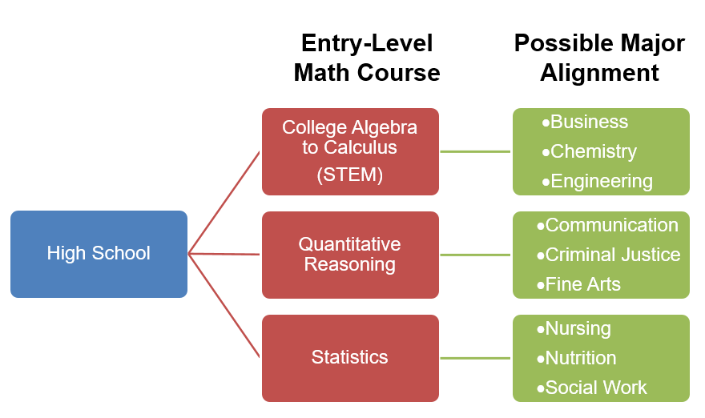
What Role Do School Counselors/Higher Ed Advisors Play?
ADVISING & ACCESS
ADVISING is the intentional career/college planning that will help facilitate students entering and progressing through the math pathway that is best aligned with their goals.
ACCESS is ensuring that students are provided with the opportunities to participate and be successful within the math pathway that is best aligned with their goals.

Slide 4
Toolkit Resources for School Counselors/Higher Ed Advisors
A2E Flowcharts: There is a flowchart showing all possible combinations of offerings from two pathways through five
Math Pathways Course Descriptions for Students: Summary of the 5 math pathways
Entry-Level Math Pathways Course Description for HE: Summary of the various entry-level math courses taught at many colleges/universities
Student Decision Tree: Worksheet that can be used to help guide students in exploring career interests and how those align with the math pathways
Administrator Decision Tree: Can be used to help guide discussion on capacity and need
Pathway Majors/Careers Chart: Chart that maps out the various careers and majors that align with each of the math pathways
Also working on:
CCP Guidance
Graduation Planning/Seals Integration Guide
Video Cartoon for each Pathway
ACT/SAT Alignment & Clarification Documents
Webpage and FAQ on ODE Site

Slide 5
School Counselor/Higher Ed Advisor Considerations for Implementation
Higher Ed Advisors
College admission decisions – how to assess student who does not have Algebra 2
Ensuring diverse offerings of entry-level math options
Developing multiple measures of assessing math aptitude for course placement
Academic preparation and supports to ensure students are prepared for pathways and supported throughout
School Counselors
Ensuring equity and access to courses
Master scheduling and staff capacities
Considerations for family engagement and parent education
Academic preparation and supports to ensure students are prepared for pathways and supported throughout
ACT/SAT preparation and potential impacts
College Credit Plus opportunities and transferability of courses

Slide 6
Questions & Discussion

Slide 7
Shawn Grime Executive Director Ohio School Counselor Association shawngrime@ohioschoolcounselor.org

