Slide 1
High School Math Pathways Trainings with School Counselors and Curriculum Directors
Sept. 2022

Slide 2
Welcome
Notes:
Welcome Slide
* Introduce the meeting facilitators

Slide 3
Notes:
Everything we do in our work at the Department is tied to the Ohio Strategic Plan.
Today we are going to focus on the three principles with an emphasis on equity and Strategy 10: Transform High School/Provide More Paths to Graduation.
Here is a link to where you can find more information: http://education.ohio.gov/Media/Media-Releases/Ohio-Launches-Strategic-Plan-for-Education-Each-C#.W8hwoGhKiUk
The 3 core principles of the strategic plan, shown in a light blue, are: equity, partnerships, and quality schools. These core principles run through all the different initiatives at the Department and the High School Math Pathways are no exception.

Slide 4
Equity
Students choose pathways based on their future aspirations. Students are NOT placed based on perceived preparation levels.
Notes:
Students choose pathways based on their future aspirations. Students are NOT placed based on perceived preparation levels. To help raise awareness on this critical aspect of the Pathways Initiative, the Department has been working with school counselors in particular, the Ohio School Counselors Association, throughout the development process. We are aware school counselors have a tremendous passion for their work and want to do what’s best for their students. As districts prepare to implement the pathways in the 2022-2023 school year, the messaging around equity from school counselors, administrators, and teachers with parents and students will be an important part of the process. Educators at the local levels will be the key to the success of this initiative.

Slide 5
Strategy 10
Ensure high school inspires students to identify paths to future success, and give students multiple ways to demonstrate the knowledge, skills and dispositions necessary for high school graduation and beyond.
Notes:
This initiative also aligns to Strategy 10 of the strategic plan which ensures high school inspires students to identify paths to future success, and give students multiple ways to demonstrate the knowledge, skills and dispositions necessary for high school graduation and beyond.

Slide 6
Problem Statement
Ohio has a diverse student body, where each child has unique postsecondary aspirations.
Diverse career aspirations, one math pathway!
Notes:
Most of the people in attendance today or possibly watching the presentation on recording have participated in a traditional K-8 mathematics experience which likely led to an Algebra 1, Geometry, Algebra 2, Pre-Calculus, Calculus course sequence in high school. Some of you may have veered from that high school sequence at one point or another but that was the pathway for most people. Now, in Ohio as part of the mathematics curriculum requirements for students who enter high school on or after July 1, 2014, all students must earn one credit of Algebra 2 or its equivalent. The problem with this is, Ohio has a very diverse student population where each student has a unique set of post-secondary and/or career aspirations. The problem in recent years is that while our Ohio students have these diverse aspirations, there has one predominant pathway laid out for them to follow. Before, this course sequence had coherence between high school and college with what was going on at the post-secondary level, even though it was at times unmotivating for some students. If any of you have ever taught mathematics at the high school or post-secondary levels, you most likely have been asked by a student, “when am I ever going to use this?”. Sometimes, in those upper-level math courses, you as teachers may have had a tough time trying to explain the relevant career applications of the mathematical content to the student given some of the diverse career interests Ohio students have. Again, in the past, at least this practice was coherent with what was going on in higher education at the time. However, now that higher education has made changes, we have had to begin thinking about ‘what we need to do at K-12 to match what’s currently going on at the higher ed level’.

Slide 7
Math Pathways
ALL Pathways are college preparatory
Notes:
While some of you may have seen this before, the image identifies the four new Algebra 2 equivalent courses based on careers. The only course in the High School Math Pathways wheel diagram that has a pre-requisite is Pre-Calculus. This pathway you will often hear referenced as Calculus based STEM. However, there are some other STEM fields that are not Calculus based, for example, some are more of a Statistics based STEM pathway where students may also need some Data Science. Just so you know, we are already seeing the landscape around this starting to change where not all STEM programs are requiring Calculus.
Students have the option of staying within this wheel for their third and fourth courses of they can go on into a College Credit Plus (CCP) of AP course for their fourth course if they choose. The decision whether to stay on the wheel for both the third and fourth courses or jump to CCP or AP for their fourth course is dependent on the student and what they want to do and how many of the math pathways courses their district offers.
We are sharing with everyone what we are hearing from educators who have shared that they want options other than Algebra 2 that districts can offer their students in addition to Algebra 2. Districts may offer more than one course listed. While districts are encouraged to offer more than one pathway, it is not a mandate nor is it a requirement. The high school math pathways are not required by law. They are not legislated in any way. We are simply trying to present to districts their options and allowing them to use their local control to determine what is best for them. To support districts as they make these decisions locally, we have a series of Administrator Decision Trees in Administrator Toolkits section of our High School Math Pathways Toolkits.
A takeaway we want all of you to have is that ALL PATHWAYS ARE COLLEGE PREPARATORY. Each pathway course leads somewhere. This is valuable to all students even if they may not intend to go to college immediately after high school. For students who may decide they want to enter the workforce after high school. After some time in a career, these students may discover they are passionate about that type of work. They may determine down the road they want to advance in their career and identify one of the ways to do that is by earning a college degree, so they enroll in some type of a degree program later. High school credit in these pathways' courses will give people in this situation a solid foundational math background they can build on with any potential post-secondary work. We were intentional in the design of these pathways to make sure none of them led to academic dead ends.

Slide 8
Course | Description
Data Science | In today’s society, data is all around you. Whether you go online or to the supermarket, data about you is continuously being collected and used to make decisions. Data Science Foundations will teach you how to collect, analyze and make decisions using data. You will build graphical and statistical models to describe and communicate data using your newly acquired computer programming skills. This course is perfect for beginners! Note: The big difference between data science and statistics is that statistics focuses on explaining the data, while data science focuses on uncovering insights that help make predictions and decisions.
Discrete Math | Are you interested in exploring the skills needed for a technology-based field? Then Discrete Math/Computer Science might be for you. This course builds upon concepts in algebra, geometry and probability and shows how these ideas apply to a digital world. Through hands-on computer programming, you will actively engage with discrete math. Discrete math is the study of “counting” problems, examples include the number of unique handshakes in a room full of people, the way viruses spread from contact to contact and the optimum strategies for board games. Discrete math is the language of computer science. This course is perfect for beginners. No prior programming experience is necessary.
Notes:
Here are brief descriptions of each of the Algebra 2 equivalent courses. I will pause here briefly to allow you some time to read through the descriptions. These are written in student friendly language to be used with parents and students whenever discussing the pathways. Versions of these descriptions using teacher friendly language are available in the Toolkits for any mathematics educators who want them.

Slide 9
Course | Description
Statistics and Probability | Data is all around you. Do you want to collect and analyze data and see how it represents the world around you? Do you like to conduct research? Are you interested in health care or economics? Then Statistics and Probability might be for you! The purpose of this course is to introduce the major concepts and tools for collecting, analyzing and drawing conclusions from data. You will be exposed to broad conceptual themes: exploring data, sampling and experimentation, anticipating patterns, statistical inference and probability. Note: The big difference between data science and statistics is that statistics focuses on explaining the data, while data science focuses on using data to make predictions and decisions.
Quantitative Reasoning | Do you like to work and communicate with others? Do you enjoy hands-on activities using real-world contexts? Then Quantitative Reasoning might be for you! Quantitative Reasoning is designed to promote reasoning, problem-solving and modeling through thematic units focused on mathematical practices. The course builds upon previous knowledge and extends that knowledge to new situations to create a deeper understanding. Critical thinking and communicating about mathematics are the primary objectives of the course.

Slide 10
Equivalence
Mathematics units must include one unit of Algebra 2 or the equivalent of Algebra 2.
Notes:
As has already been stated earlier, the law in Ohio still requires all students who enter high school on or after July 1, 2014, to earn a credit of Algebra 2 or its equivalent as one of their curriculum requirements for high school graduation. What we are doing with this initiative is leveraging the word equivalent in the law. What does it mean to be equivalent to Algebra 2? Previously, the Department has had guidance on their webpage about what that means. Unfortunately, that guidance was rather vague and open to interpretation by districts. What we have heard from districts through the years that they want more specificity around what is equivalent to Algebra 2.

Slide 11
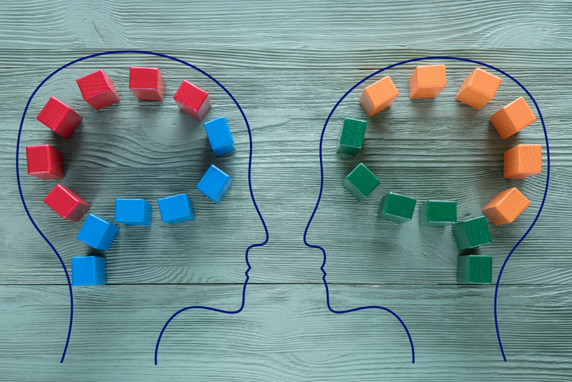
Equivalence
Equivalent thinking and reasoning but NOT equivalent content
Ohio Secondary and Postsecondary Math Faculty have come together to define rigor which is the basis of creating equivalent courses.
Notes:
The Department brought several different groups of stakeholders together to work out what it meant to be equivalent to Algebra 2. Their determination was that equivalent is about equivalent thinking and reasoning rather than equivalent content. Ohio’s Secondary and Post Secondary Math Faculty have come together to define rigor. Their definition of rigor became the basis for creating Algebra 2 equivalent courses. As you go through each of the Algebra 2 equivalent courses you will see the definition that they came up with integrated throughout the course.

Slide 12
Rigor
It has been decided that equivalent refers to the level of rigor and reasoning, not content. There are many branches of mathematics that are equally rigorous but have different content focuses. All equivalent courses should have the same level of rigor and reasoning that are needed to be successful in an entry-level, credit-bearing postsecondary mathematics course.
Ohio has defined rigor as the following:
“Students use mathematical language to communicate effectively and to describe their work with clarity and precision. Students demonstrate how, when, and why their procedure works and why it is appropriate. Students can answer the question, ‘How do we know?’”
Notes:
What was their definition you might ask? It has been decided that equivalent refers to the level of rigor and reasoning, not content. There are many branches of mathematics that are equally rigorous but have different content focuses.
For many of you who may have taken a Statistics and Probability and a College Algebra course you know that the level of rigor in the Statistics course can be equal to the level of rigor in the College Algebra course. While the content of the two course is different, the level of rigor can and often is the equivalent. What we’re doing with this High School Math Pathways Initiative, is recognize these courses are all equally rigorous but different types of courses. Depending on the student’s career trajectory and mathematical interests some of these courses may be more interesting and relevant to students because they will more easily be able to learn about mathematical topics that are interesting to them and contain content that is relevant to their college and career goals.
Each of these high school math pathways are equivalent in rigor and should have the same level of mathematical reasoning that students need to be successful in entry-level credit bearing post-secondary mathematics courses. Credit in each of these high school math pathways courses lead somewhere as it relates to either post-secondary or a career. None of these are terminal courses that lead nowhere.
Ohio has defined rigor as the following:
“Students use mathematical language to communicate effectively and to describe their work with clarity and precision. Students demonstrate how, when and why their procedure works, and why it is appropriate. Students can answer the question, ‘How do we know?’”
This is the definition of rigor that is embedded into each one of the high school mathematics pathways courses. It is the agreed upon definition that our Ohio K-12 and Higher Education Math faculty came up with.

Slide 13
Goals of Initiative
Ohio needs to develop pathways for high school mathematics that provide a seamless transition to a student’s postsecondary aspirations.
To promote equity, any courses that are created should be equally rigorous to the traditional math pathway.
Pathways should be relevant to a student’s future career goals. Not only will relevant courses help a student achieve their goals, but they will also create more buy-in from the students and help develop a positive math identity.
Pathways should also be flexible in case a student changes his or her mind about his or her future plans.
Pathways should be coherent with pathways in higher education to provide students with a seamless transition.
Notes:
Ohio needs to develop pathways for high school mathematics that provide a seamless transition to a student’s postsecondary aspirations. As I go over the goals of the initiative, you will notice that equity runs throughout the pathways.
The goal of this initiative is:
To promote equity, any courses that are created should be equally rigorous to the traditional math pathway.
Pathways should be relevant to a student’s future career goals. Not only will relevant courses help a student achieve their goals, but they will also create more buy-in from the students and help develop a positive math identity. This should help students foster a more positive math identity. We already have a lot of Ohio students that have had a negative math experience. They may even say they, “hate math”. We want to change that by providing more relevance and meaning to the mathematics courses students are taking to help students more easily identify mathematical applications in the real-world.
Pathways should also be flexible in case a student changes his or her mind about his or her future. Everyone recognizes these high school students are still teenagers. Many of them will change their minds along the way. Therefore, we intentionally built on-ramps and off-ramps for students in the event they do change their mind and decide they want to go in a different direction.
Pathways should be coherent with pathways in higher education to provide students with a seamless transition.

Slide 14
Break Out Rooms

Slide 15
Breakout Room Discussion Questions
How will you explain the high school math pathways to students?
What can school counselors and/or curriculum directors do to work with administrators and staff to determine which pathways to offer and capacity?
How can school counselors and/or curriculum directors provide career and thereby course advising for those students who do and do not know what they want to do?
Notes:
How will you explain the high school math pathways to students?
What can school counselors and/or curriculum directors do to work with administrators and staff to determine which pathways to offer and capacity?
How can school counselors and/or curriculum directors provide career and thereby course advising for those students who do and do not know what they want to do?

Slide 16
Breakout Room Discussion Debrief

Slide 17
Breakout Rooms
Notes:
Break out room slide

Slide 18
Breakout Room Discussion Questions
How will school counselors and/or curriculum directors address and advise parents on the high school pathways?
What can school counselors and/or curriculum directors do to address student stereotypes associated with math classes and rigor?
What is your plan to address flexibility within the high school math pathways?
Notes:
How will school counselors and/or curriculum directors address and advise parents on the high school pathways?
What can school counselors and/or curriculum directors do to address student stereotypes associated with math classes and rigor?
What is your plan to address flexibility within the high school math pathways?

Slide 19
Breakout Room Discussion Debrief

Slide 20
Support Materials

Slide 21
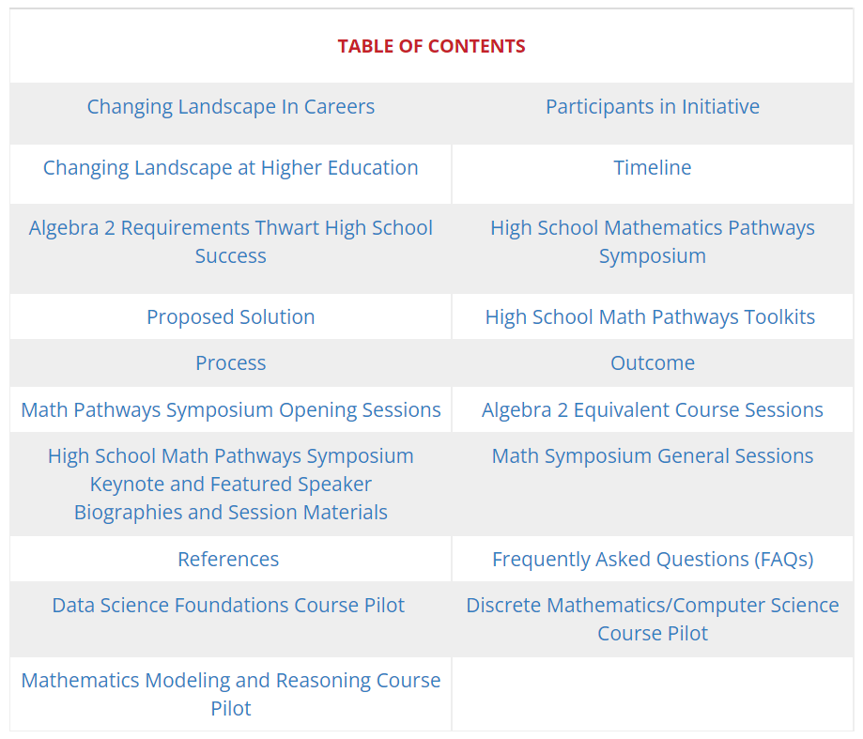
High School Math Pathways Webpage
Notes:
http://education.ohio.gov/math
https://education.ohio.gov/Topics/Learning-in-Ohio/Mathematics/Resources-for-Mathematics/Math-Pathways

Slide 22
High School Math Pathways Webpage
Notes:
http://education.ohio.gov/math
https://education.ohio.gov/Topics/Learning-in-Ohio/Mathematics/Resources-for-Mathematics/Math-Pathways

Slide 23
High School Math Pathways Toolkits
Administrative Decision Tree
Math Pathways Iteration Flowcharts
Course Descriptions
Student Decision Trees
Math Pathways Graphic
Pathways Definition of Rigor
Standards Documents for Pathways Courses
Critical Areas of Focus for Pathways Courses

Slide 24
High School Math Pathways Toolkits
Administrator Decision Tree
Math Pathways Flowchart
Student Decision Trees
Notes:
https://education.ohio.gov/Topics/Learning-in-Ohio/Mathematics/Resources-for-Mathematics/Math-Pathways/Higher-Ed-Entry-Level-Math-Pathways-Course-Descrip
Administrator Decision Tree – Is a planning document to assist with scheduling capacity, teacher capacity, regional needs, student course requests, student interests, and a summary section.
The Math Pathways Flowcharts – These course listings found in the document are not exhaustive list. Instead, they just highlight courses that nicely align with the pathways. Students who earn a Remediation-Free Score in mathematics can take any College Credit Plus (CCP) math course. Additionally, students can take any Advanced Placement (AP) course according to their district guidelines.
Student Decision Trees - The decision trees help identify alignment between majors/careers and high school math pathways courses. The information in these documents is broad and should be used for general guidance only, as alignments may vary by higher education institutions. Districts are encouraged to check with their local community colleges or four-year feeder schools and may need to adjust the documents as necessary. When discussing student’s third unit of mathematics, they may wish to explore one of their new pathway courses such as Statistics & Probability, Data Science Foundations, or Computer Science/Discrete Math. However, if students decide to pursue a major within that pathway that requires Calculus, they should take Algebra 2 for their fourth unit of mathematics.

Slide 25
High School Math Pathways Toolkits
Notes:
Course Descriptions for Students – provides student friendly language to describe each of the math pathways courses for students. This information is useful when students are making the determination which pathways they want to pursue for their third and fourth high school mathematics credits.

Slide 26
Questions?

Slide 27
Mathematics Questions?
Name | Email
Brian Bickley | Brian.Bickley@education.ohio.gov
Annika Moore | Annika.Moore@education.ohio.gov
Yelena Palayeva | Yelena.Palayeva@education.ohio.gov

Slide 28
Graduation Requirements Questions?
gradrequirements@education.ohio.gov

Slide 29
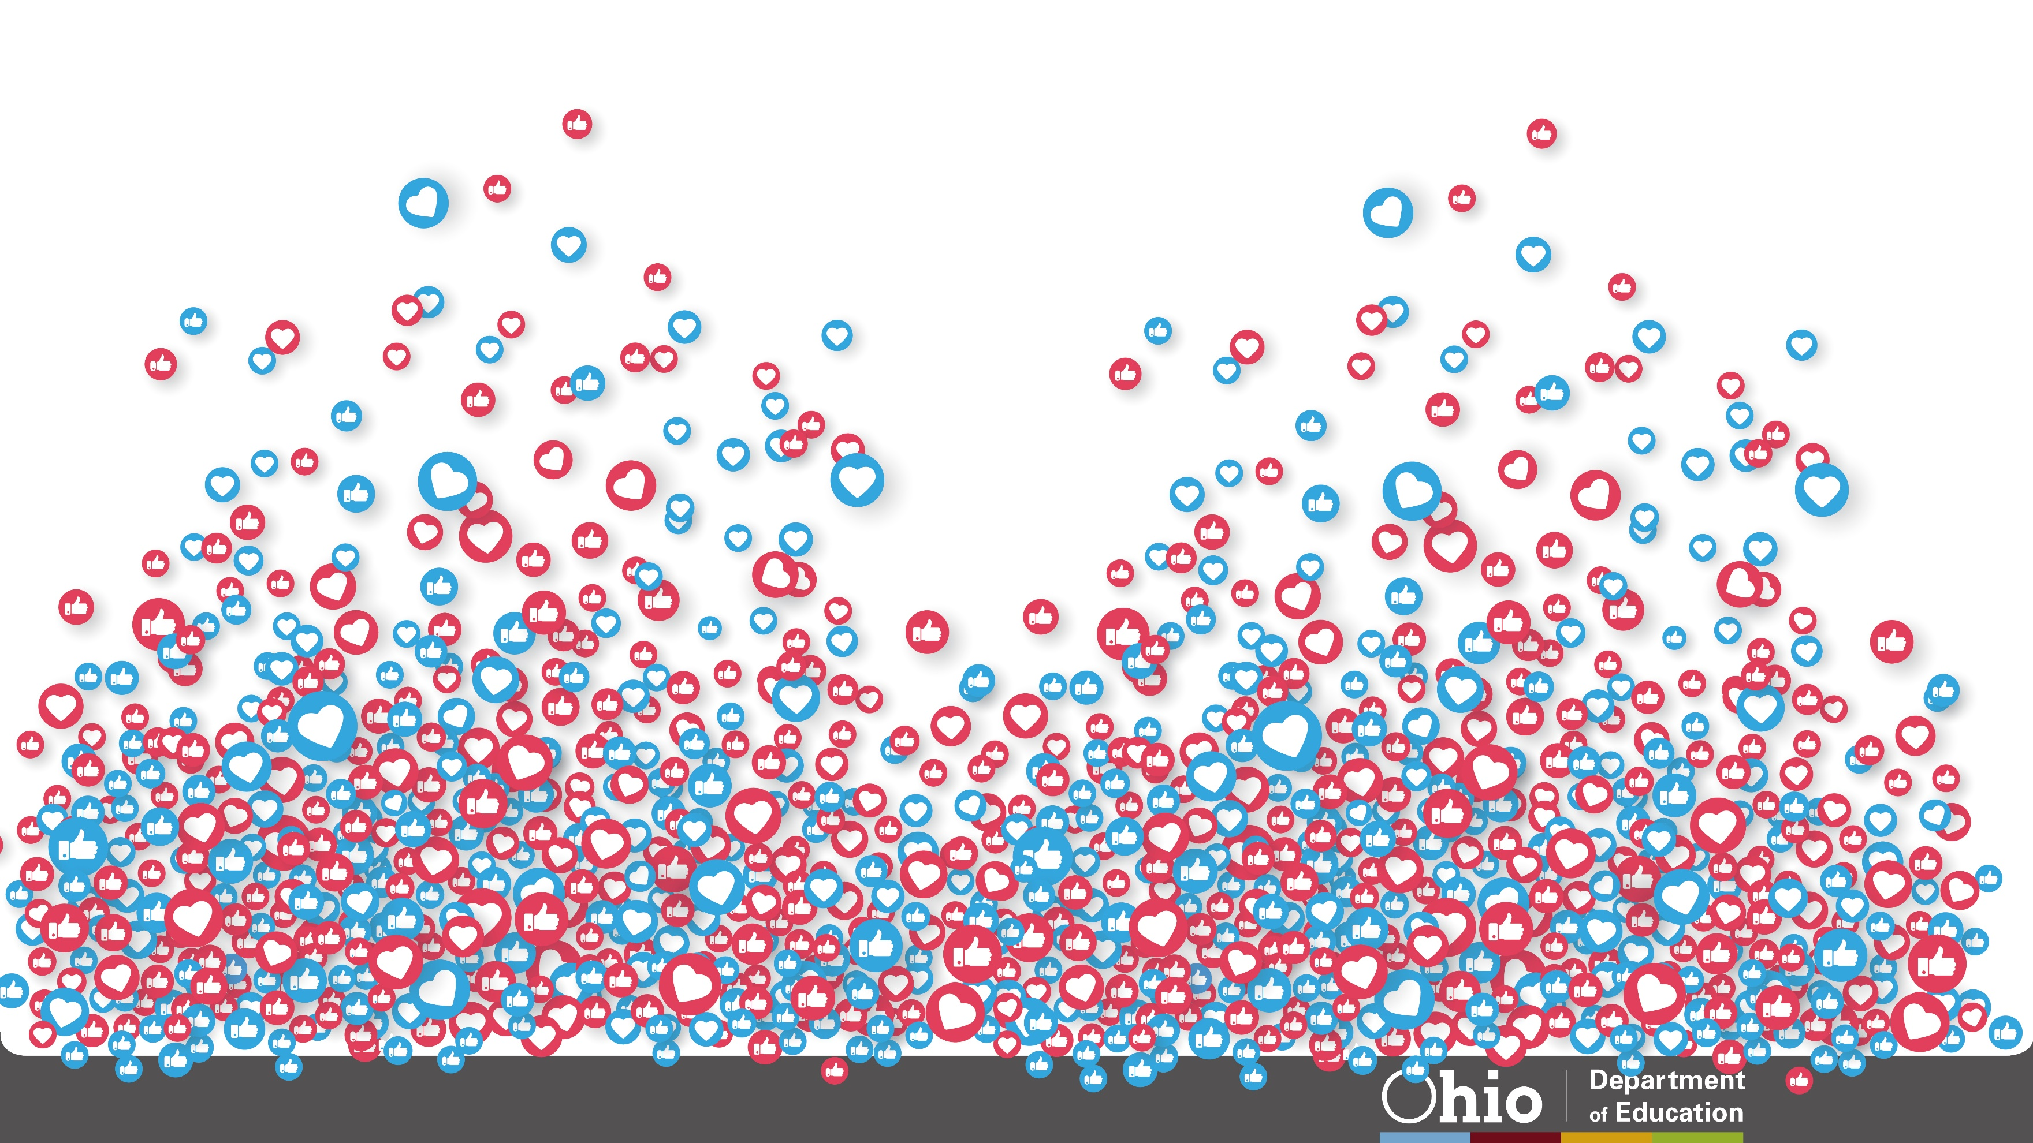
@OHEducation

Slide 30
Share your learning community with us!
#MyOhioClassroom
Celebrate educators!
#OhioLovesTeachers

