Slide 1
Ohio Department of Education and Workforce

Slide 2

High School Math Pathways
School Counselor Training
Brian Bickley
Mathematics Consultant
Office of Academic Success

Slide 3

What is the Why?
Notes:
The Math Pathways Initiative is a bridge between the third and fourth mathematics courses to college and career readiness. The goal of this intitiative is to make sure that all students are receiving a four high school mathematics course sequence that is meaningfully preparing them for their post high school aspirations.

Slide 4


Jobs Landscape
Notes:
Before we get into the specifics about the High School Math Pathways, we will look at the job market, what’s going on in Higher Education, and the high school landscape.

Slide 5
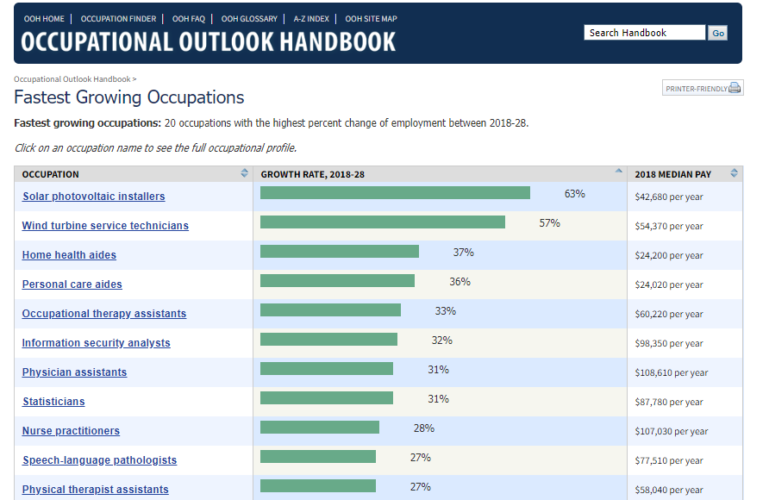
Fastest growing occupations from 2018-2028
2018-2028
Notes:
We are going to start with the occupational outlook at the very beginning of the Pathways work. It is worth noting that this data is prior to the pandemic. Even before the pandemic hit, there was already a noticeable change in the job market taking place. Here we have some data from the U.S. Department of Data showcasing the “Fastest Growing Occupations”. In this slide, want to draw your attention to a couple of career fields. I want you to look at specifically, the ‘Information Security Analysts’ and the ‘Statisticians’ fields. These are not only in demand, but they are also high-paying careers. For example, the median pay of a Statistician in 2018 was over $87,000 per year while the median for an Information Security Analyst at the same time was over $98,000 per year. Both careers have an anticipated growth outlook greater than 30% from 2018-2028.

Slide 6
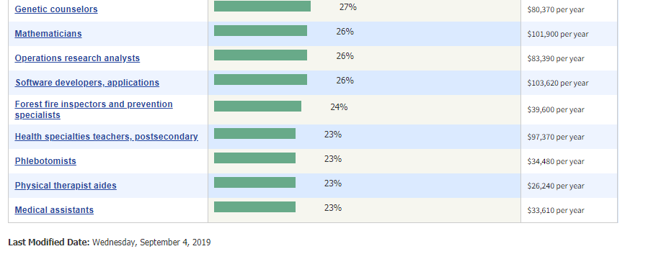
Fastest Growing Occupations from 2018-2028 (continued)
2018-2028 (Cont.)
From U.S. Bureau of Labor Statistics: https://www.bls.gov/ooh/fastest-growing.htm
Notes:
I also want to draw your attention to a couple other fast-growing careers such as “operations research analyst” and “software developers, applications”. I want to highlight these career fields because of their commonality. These are all fast-growing careers that involve math but may not always be the first ones that come to mind when you think about ‘fast growing, in-demand careers or jobs that involve math’. Another commonality among the jobs I just listed is they all involve big data, statistics, and computer science. I wanted to show you this to get you thinking about these possible jobs and careers that are in demand with attractive median salaries that all involve math and may be of interest to high school students when they explore potential career fields.

Slide 7
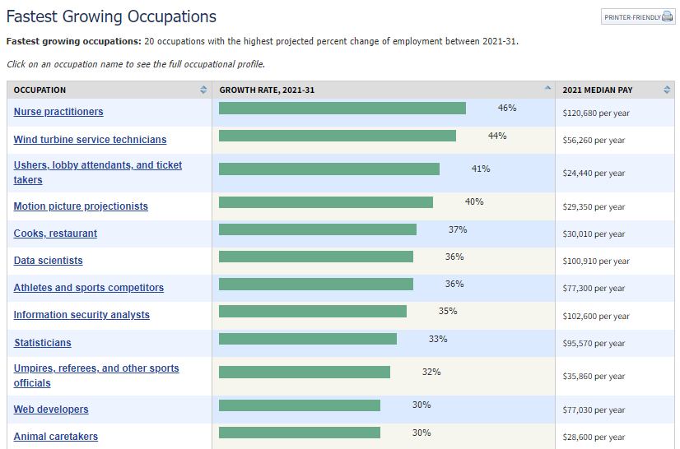
Fastest growing occupations from 2021-2031
2021-2031
From U.S. Bureau of Labor Statistics: https://www.bls.gov/ooh/fastest-growing.htm
Notes:
Statisticians is projected to growth 35% over the next decade. This is up almost 4% from 2018 when the anticipated growth was 31%. Also, the median salary has increased by more than $7,700. Meanwhile, Information Security Analysts, is up another 1% from 2018 with the median income. The median salary for the position has increased by over $4,200 in the last four-years.
I also want to draw your attention to a couple other fast-growing careers such as “operations research analyst” and “software developers, applications”. I want to highlight these career fields because of their commonality. These are all fast-growing careers that involve math but may not always be the first ones that come to mind when you think about ‘fast growing, in-demand careers or jobs that involve math’. Another commonality among the jobs I just listed is they all involve big data, statistics, and computer science. I wanted to show you this to get you thinking about these possible jobs and careers that are in demand with attractive median salaries that all involve math and may be of interest to high school students when they explore potential career fields.

Slide 8
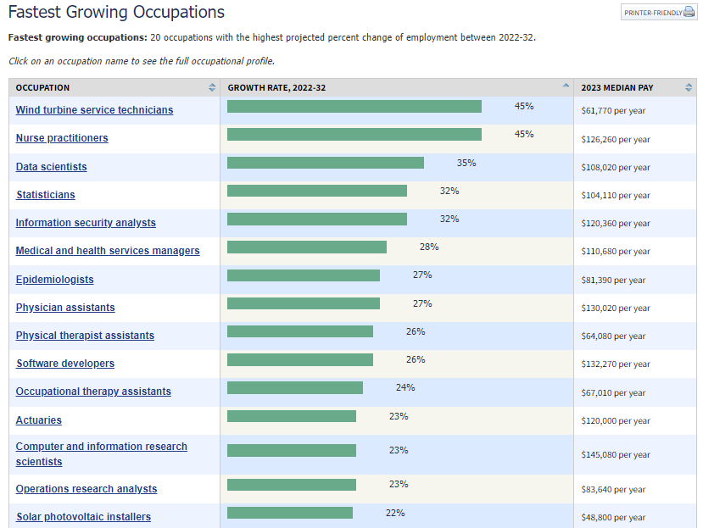
Fastest growing occupations from 2022-2032
2022-2032
(Projections Updated April 2024)
From U.S. Bureau of Labor Statistics: https://www.bls.gov/ooh/fastest-growing.htm
Notes:
*These are updated annually by the U.S. Bureau of Labor Statistics. This shown is the current information on the fastest growing occupations. This 10-year outlook is important when you think about high school students potentially reaching their third or in rare cases fourth high school mathematics as early as their freshman year. This means that the 10-year outlook will encompass the timeline when many of them can be expected to enter the workforce whether that is immediately following high school or after completion of a 2-, 4-, or advanced-degree program.

Slide 9
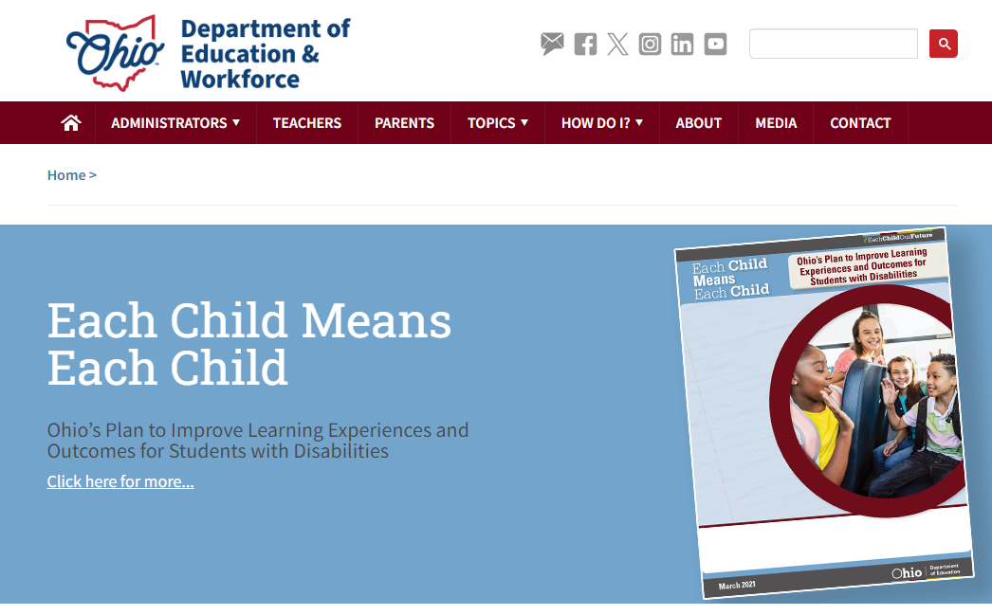
Education.ohio.gov
Search:
High School Math Pathways
Notes:
https://education.ohio.gov/

Slide 10
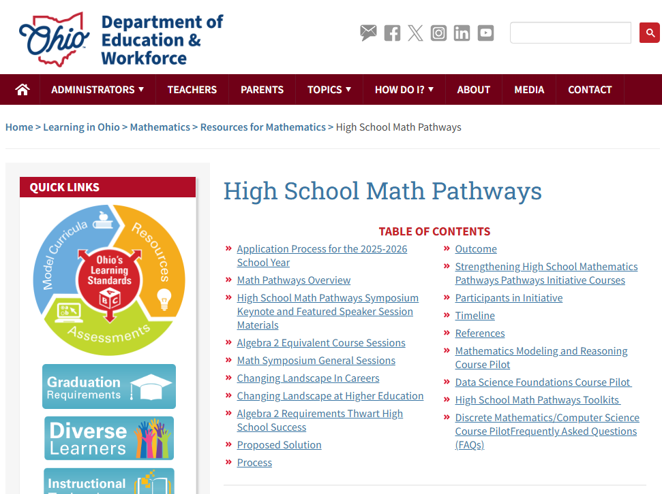
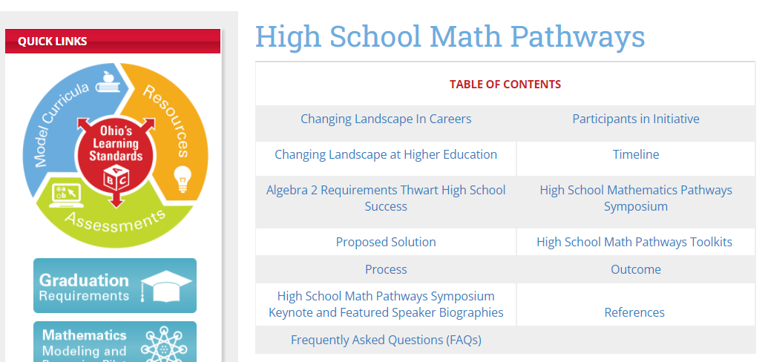
High School Math Pathways Main Page Screen Shot
Notes:
https://education.ohio.gov/Topics/Learning-in-Ohio/Mathematics/Resources-for-Mathematics/Math-Pathways

Slide 11
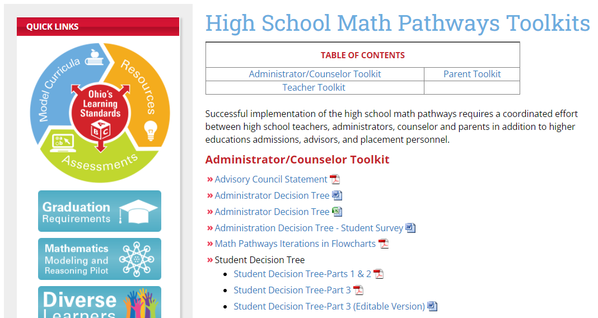
Notes:
https://education.ohio.gov/Topics/Learning-in-Ohio/Mathematics/Resources-for-Mathematics/Math-Pathways/Higher-Ed-Entry-Level-Math-Pathways-Course-Descrip

Slide 12
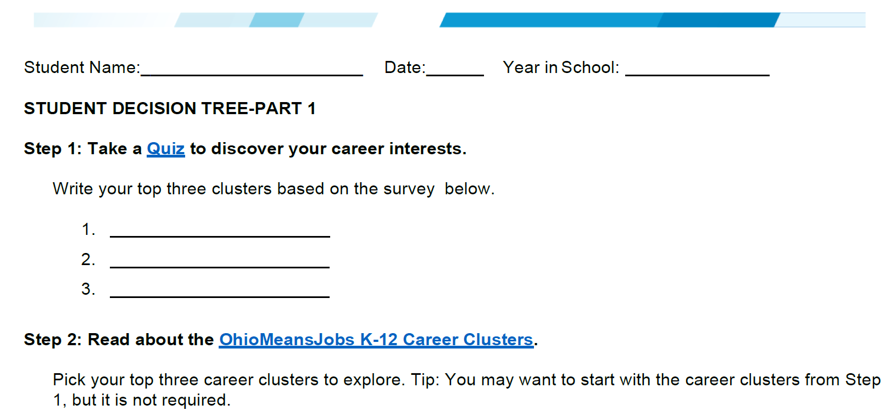
Student Decision Tree Parts 1 & 2
Notes:
https://education.ohio.gov/getattachment/Topics/Learning-in-Ohio/Mathematics/Resources-for-Mathematics/Math-Pathways/Higher-Ed-Entry-Level-Math-Pathways-Course-Descrip/Student-Decision-Tree-Parts-1-and-2.pdf.aspx?lang=en-US

Slide 13

Career Cluster Inventory
Notes:
https://jobseeker.k-12.ohiomeansjobs.monster.com/ExploreIt/DefaultCci.aspx#/welcome

Slide 14
Career Cluster Inventory
1
2
3
Get started
Budget Calculator
Lifestyle Calculator
Notes:
Which career is right for your student? Your student can begin their search here. Not sure what career might be best? Have your student answer the questions in the Career Cluster Inventory. The results will suggest career options that best relate to their interests. The questions should take around 20 minutes to complete. Simply click on the "Get Started" button and they’re on their way to finding the career opportunity that's right for them.
The Budget Calculator allows students to answer a few questions to determine their target salary. Your student(s) can use this target salary to help choose the right occupation for them.
The Lifestyle Calculator allows students to answer a few questions to determine their target salary. Students can use this target salary to help them choose the right occupation for them.

Slide 15
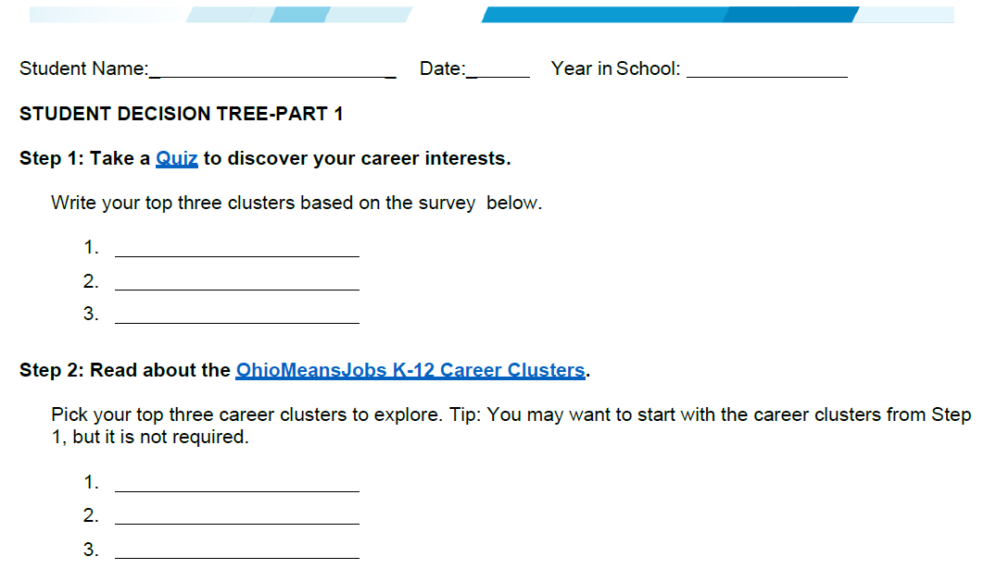
Student Decision Tree Parts 1 & 2
Notes:
Now, going back to the “Student Decision Tree Parts 1 & 2” document for a moment again, we will
https://education.ohio.gov/getattachment/Topics/Learning-in-Ohio/Mathematics/Resources-for-Mathematics/Math-Pathways/Higher-Ed-Entry-Level-Math-Pathways-Course-Descrip/Student-Decision-Tree-Parts-1-and-2.pdf.aspx?lang=en-US

Slide 16

K-12 Career clusters

Slide 17

Ohio Means Jobs K-12 Career Clusters
Notes:
This document provides brief descriptions of career clusters that they can use to help identify one or more career pathway(s) of interest. Career pathways are typical paths by which an individual might reach employment in a certain occupation. While they are by no means the only way to become employed in a given occupation, they offer a general guideline. While these career pathways are organized by their primary industry, it should also be noted that career pathways and occupations can be found across multiple industries.

Slide 18
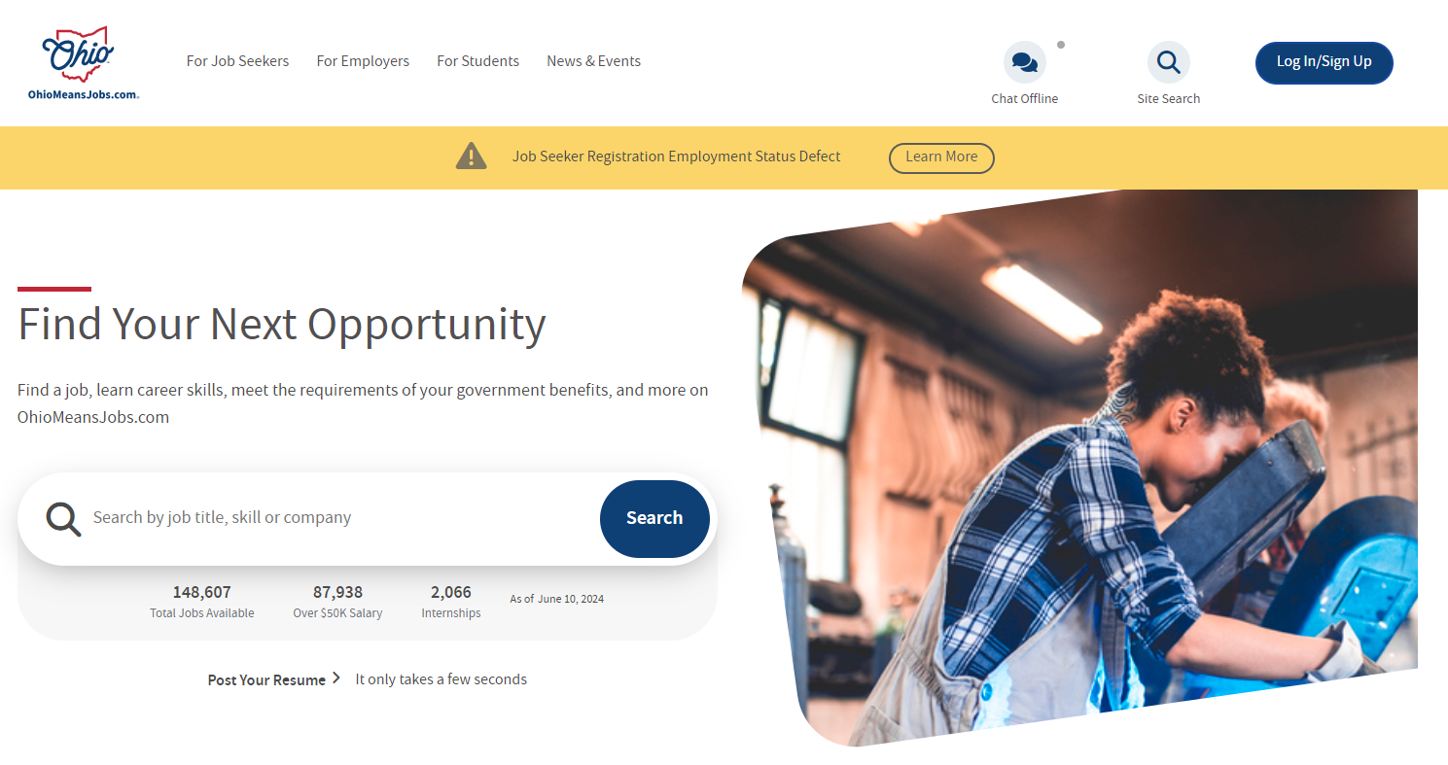
Go to: OhioMeansJobs.Ohio.Gov
Notes:
https://ohiomeansjobs.ohio.gov/

Slide 19
Search: Career Pathway

Slide 20
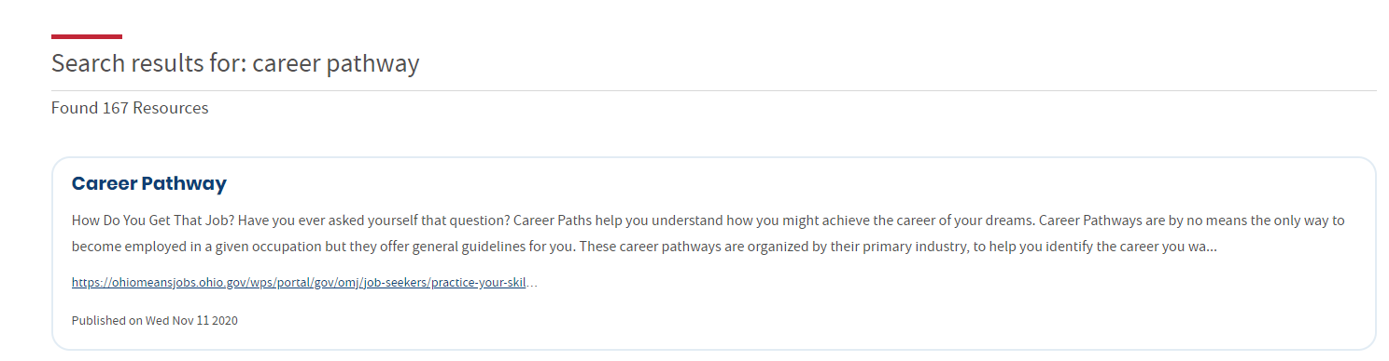
Select: Career Pathway
Notes:
Career Pathway will be the top result of your search. That is the link you will want to click.
https://ohiomeansjobs.ohio.gov/search/?search_query=career+pathway

Slide 21
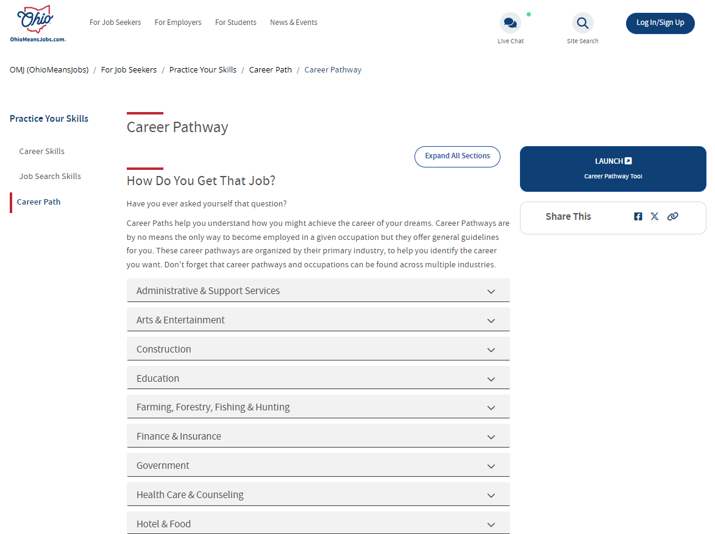
Career Pathways webpage
Click the “Launch Career Pathway Tool”
Notes:
Click on the “Launch Career Pathway Tool” link. You can always return to this page later if you want to explore it more. For now, we are going to focus on the “Career Pathways Tool”.
https://ohiomeansjobs.ohio.gov/job-seekers/practice-your-skills/career-path/career-pathway

Slide 22
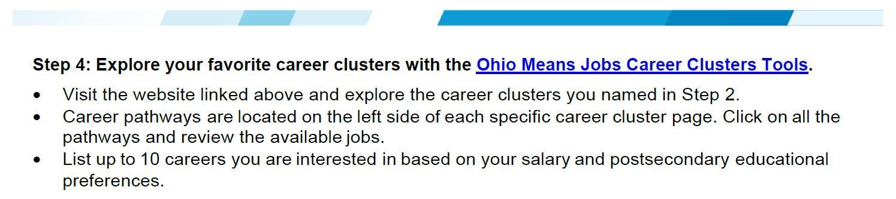
Student Decision Tree Parts 1 & 2
(Page 2)
Notes:
For a shorter pathway to the Career Clusters Tool than the one we just used, you can go to the Student Decision Tree Parts 1 & 2 document on the Math Pathways Toolkit page. In Step 4 of the Student Decision Tree Parts 1 & 2 document, you will see a direct link to the Ohio Means Jobs Career Clusters Tool.
https://jobseeker.k-12.ohiomeansjobs.monster.com/ExploreIt/CareerClusters.aspx
In a moment we are going to visit the “Ohio Means Jobs Career Clusters” website. Once there, I will give you all about 10-12 minutes to explore the career clusters found on the webpage. As you explore, you are encouraged to click on multiple career clusters to review the available jobs for each one.

Slide 23

Ohio Means Jobs Career Clusters
Notes:
Soon, I will give you 5-10 minutes to explore this website. For now, I want to share a little about this resource. Career pathways are typical paths by which an individual might reach employment in a certain occupation. You will notice similarities between the “Career Cluster” found on this webpage and the Career Clusters we looked at just a moment ago. While they are not the only way to become employed in each occupation, they offer a general guideline. While these career pathways are organized by their primary industry, it should also be noted that career pathways and occupations can be found across multiple industries.
Now, take a few moments to explore the career clusters on the webpage. As you explore, I encourage you to click on multiple career clusters.

Slide 24

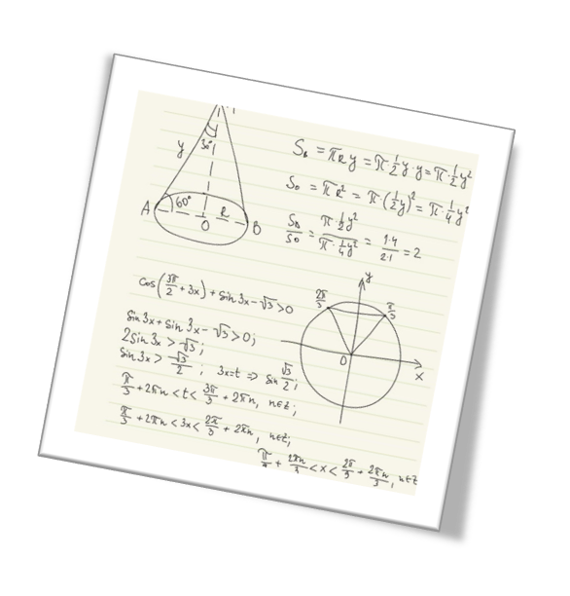

Debrief
Notes:
After looking through the Career Clusters Tool,
What did you notice?
What did you wonder about?
How might you use this Tool with parents and students?

Slide 25

Career Pathways Summary

Slide 26
Go back to: OhioMeansJobs.Ohio.Gov
Notes:
https://ohiomeansjobs.ohio.gov/

Slide 27
Go back to: OhioMeansJobs.Ohio.Gov
Notes:
Go back to ohiomeansjobs.ohio.gov. Once you are back to that main page, you will want to click on the “Log In/Sign Up” link in the upper right-hand corner. If you do not already have an account, you will want to sign-up for one.

Slide 28
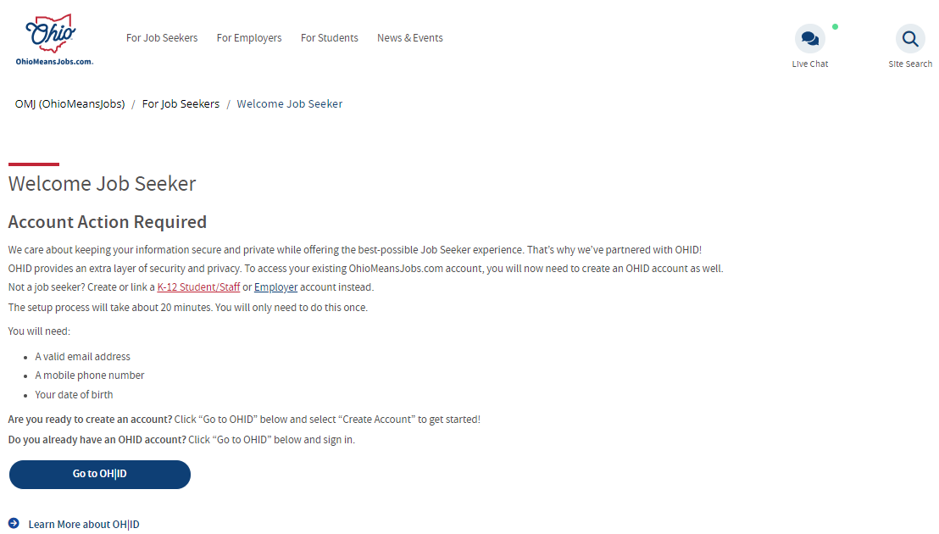
Welcome Job Seeker
Click
Notes:
Click on the K-12 Student/Staff link.

Slide 29
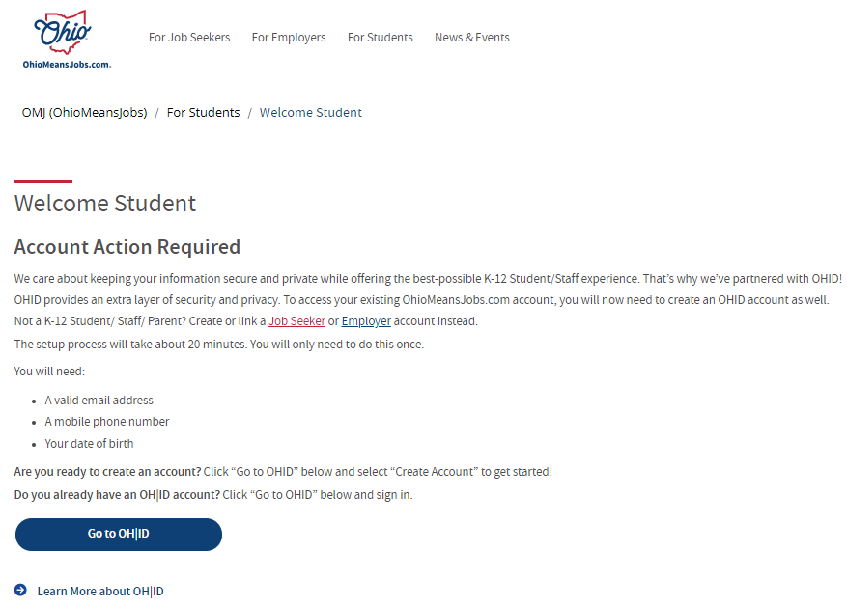
Welcome student
Notes:
https://ohiomeansjobs.ohio.gov/for-students/welcome-student
If you already have an account, you will want to sign in. If you do not have an account, you will want to create one. Through your account you will be able to access any saved Career Pathways you want. Saving the pathways will allow you to more easily view them when you come back without having to retrace all of the same steps. Also, through your account, you can add new career pathways to your account at any time.
If needed, we can pause here for a moment while anyone who needs to creates their own account. When everyone is ready and logged-in, we will proceed.

Slide 30
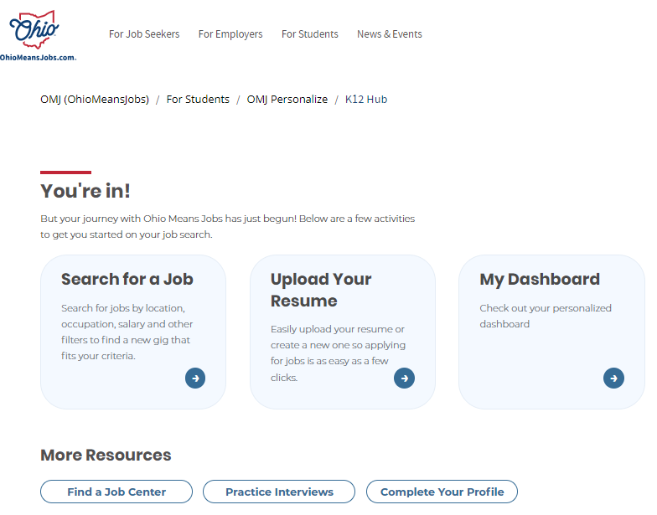
Click on the My Dashboard link
Click on
“My Dashboard”
Notes:
Click on “My Dashboard”.

Slide 31
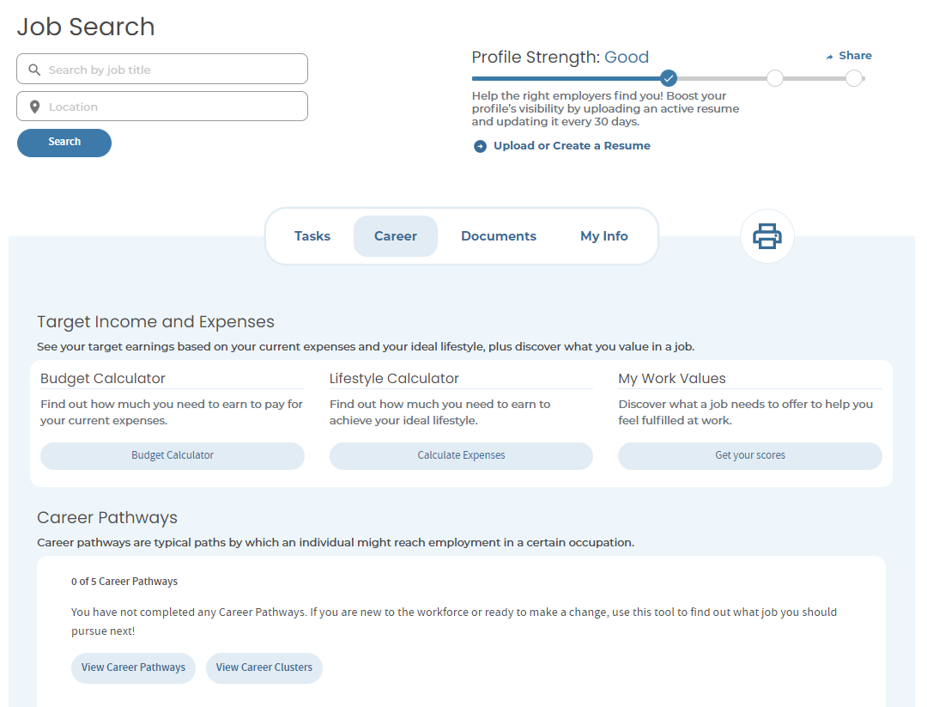
Job Search Screenshot
Notes:
From this screen, you will be able to access the budget calculator and the lifestyle calculator I shared about earlier. Again, the Budget Calculator allows students to answer a few questions to determine their target salary. Your student(s) can use this target salary to help choose the right occupation for them. Meanwhile, the Lifestyle Calculator allows students to answer a few questions to determine their target salary. Students can use this target salary to help them choose the right occupation for them.

Slide 32
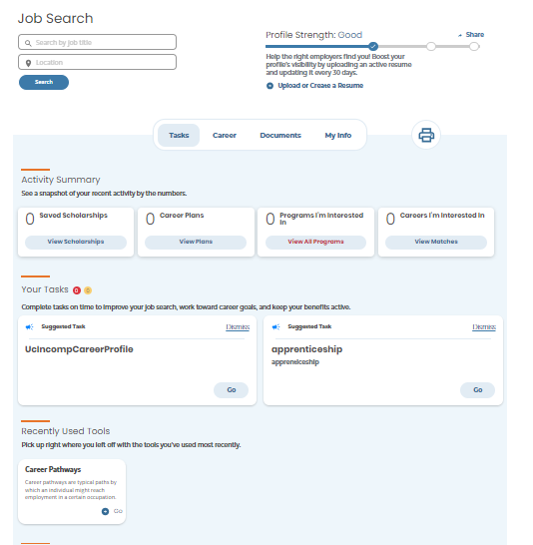
Screenshot of the Job Search webpage
Tasks
Career Pathways
Notes:
Once again, we are going to return to the Job Search main page. Where before we explored the “Careers” tab, this time we are going to explore the “Tasks” tab. Under the “Task” tab, there is a “Career Pathways” section. You will have to scroll down some to find it, but when you do, click on it.

Slide 33
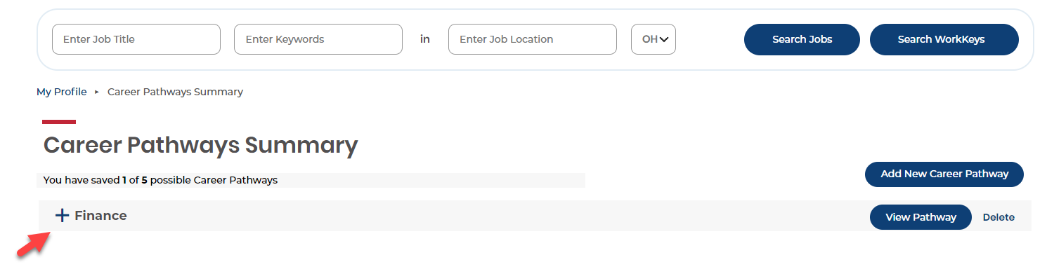
Career Pathways Summary
Notes:
On the “Career Pathways Summary” page, you will likely find a default career of Finance already saved. We are going to use a Career Pathway of Finance to illustrate the benefits of this resource and how it can be used for high school students as they think about their high school graduation plan.

Slide 34
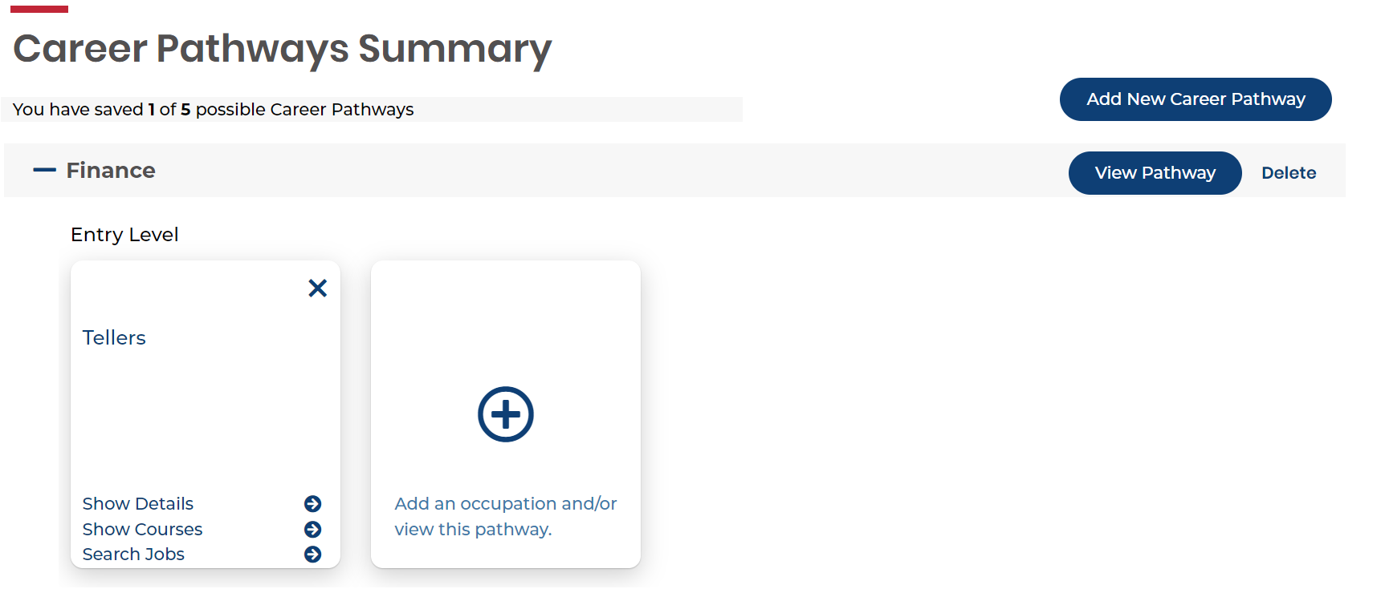
Career Pathway Summary (Continued)
Notes:
Click on the “+” sign to open-up the drop-down menu.

Slide 35
Career pathways summary screenshot
Notes:
In the example provided, we are going to look at a possible career as a “Teller”. On the “Teller” menu, click on “Show Details”.

Slide 36
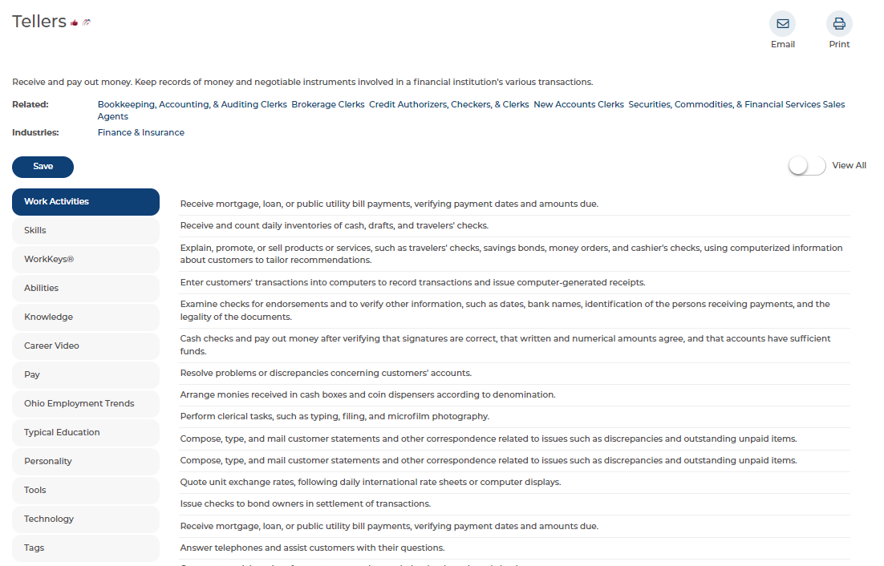
Career as a teller
Name of Career
Notes:
You should be taken to this webpage after clicking the “Show Details” link. In the upper left-hand corner is the name of the career that all of the information on this page will be aligned to. As you can see, the information on this page is specific to “Tellers”. While the webpage contains a tremendous amount of information relevant to a career as a “Teller”, I am going to highlight some sections that are the most useful to you as school counselors.

Slide 37
Typical education for a teller
Level of Education Needed
Notes:
The first topic on this page that we will view is the “Typical Education” link.

Slide 38
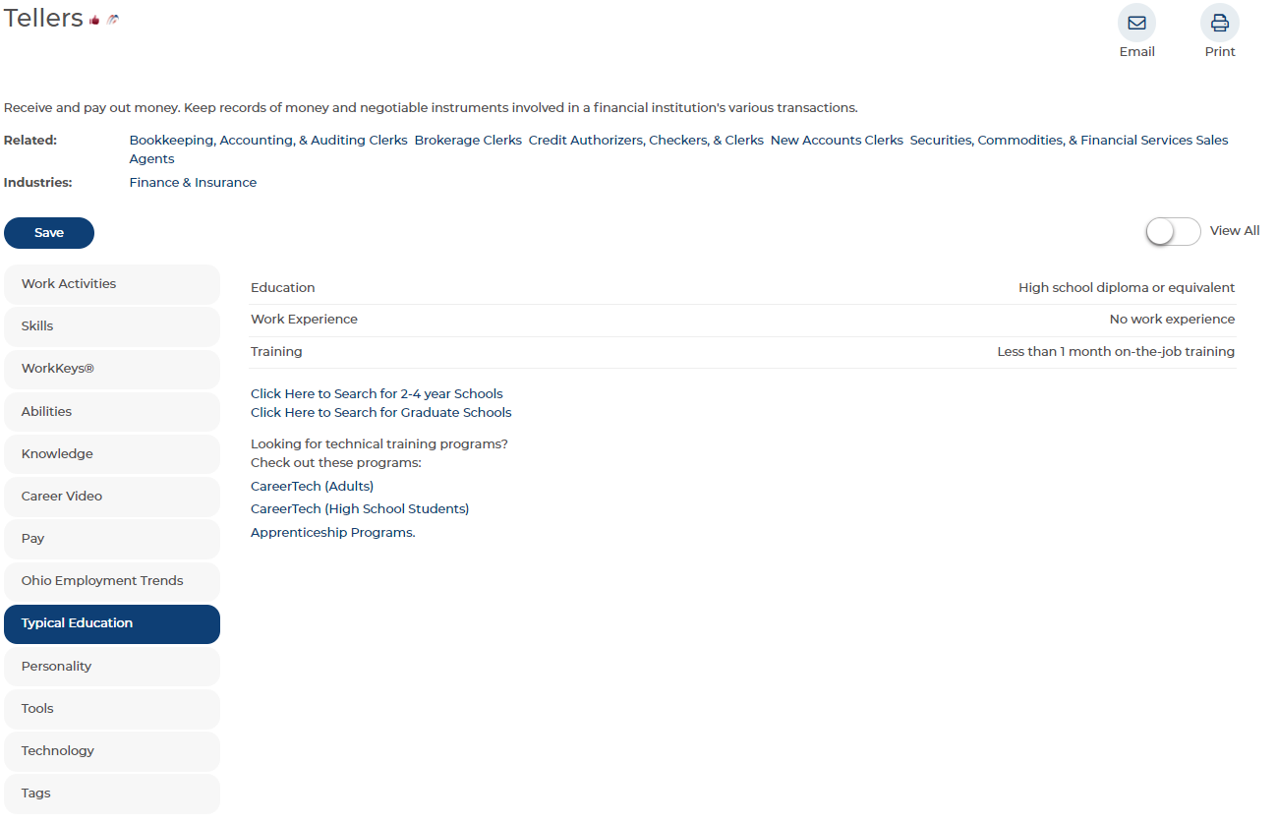
Teller’s Education, Work Experience, and Training
Notes:
“Tellers” need a minimum of a high school diploma or equivalent. Prior work experience as a Teller is not required. Employees working as Tellers will likely receive less than 1-month of on-the-job training when they start.

Slide 39
Ohio employment trends
Projected Openings
Notes:
The second topic we are going to look at are the “Ohio Employment Trends”. Here will see the project number of job openings as a Teller in Ohio.

Slide 40
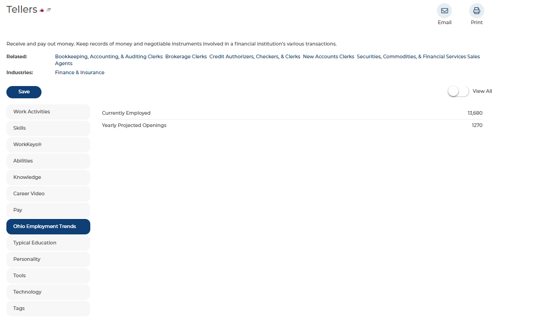
Currently Employed and Yearly Projections for Tellers in Ohio
Currently Employed: 13,680
Yearly Projected Openings: 1,270
Notes:
The Ohio Means Jobs website shows that there are approximately 13,680 Tellers employed in Ohio with a yearly number of projected openings around 1,270. This information is valuable whenever students are exploring possible careers. They need to know how many jobs there are in a particular career and the number of future openings.

Slide 41
Teller’s Annual Salary
Annual Salary
Notes:
Our next topic is the “Pay”.

Slide 42
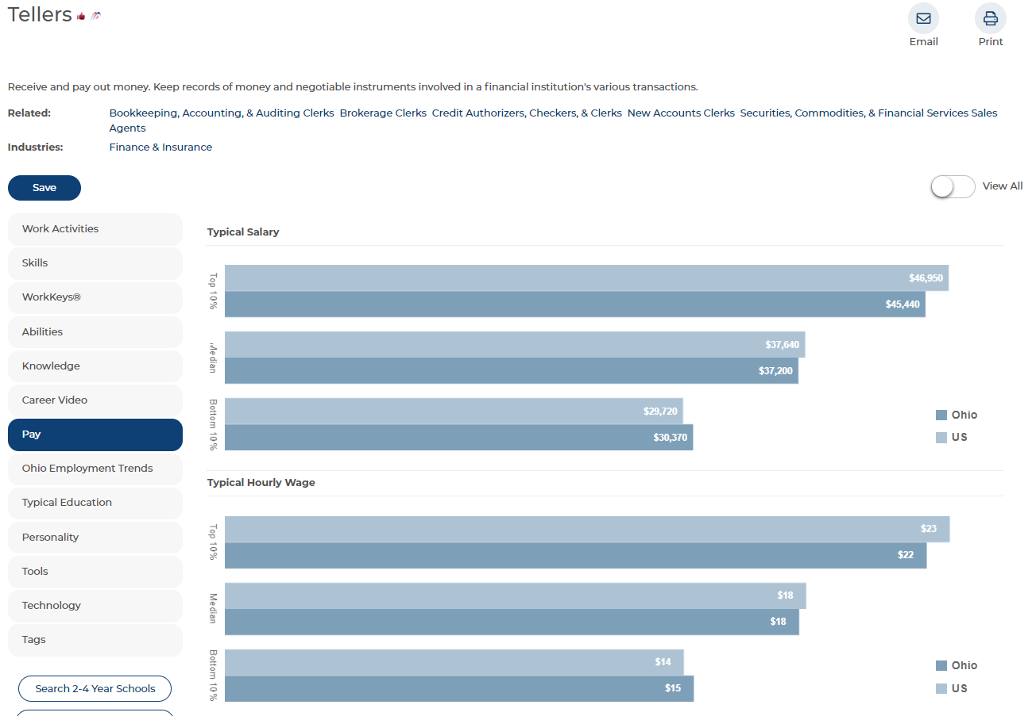
Graphs Showing Salary Data for Teller’s in Ohio
$46,950
$45,440
$37,640
$37,200
$29,720
$30,370
$23
$22
$18
$18
$14
$15
Notes:
The information around the “Pay” as a Teller is shown here. The Top 10% of Tellers in Ohio earn around $45,440. Across Ohio, the median salary of around $37,200. For a career that you can enter with only a high school diploma or equivalent, that can be an attractive salary to a student coming straight out of high school. The range in hourly pay for a Teller in Ohio ranges from around $15-$22 per hour.

Slide 43
Job Search for Career Pathways
Tasks
Career Pathways
Notes:
To show some more materials from the Ohio Means Jobs website, I am going back to that main dashboard page. Just like before, you will want to be under the “Tasks” tab. Once the “Tasks” tab is highlighted, you will get the drop-down options shown on the screen. Again, you will want to click on the “Career Pathways”.

Slide 44
Career Pathways Summary
Notes:
One more time we are going to use a career pathway in Finance for our example.

Slide 45
Career Pathway Summary for Finance
Notes:
Click on the “+” sign to open-up the drop-down menu.

Slide 46
Career Pathways Summary – Show Courses
Notes:
The last time we were on this webpage we clicked on “Show Details”. This time, we are going to click on “Show Courses”.

Slide 47
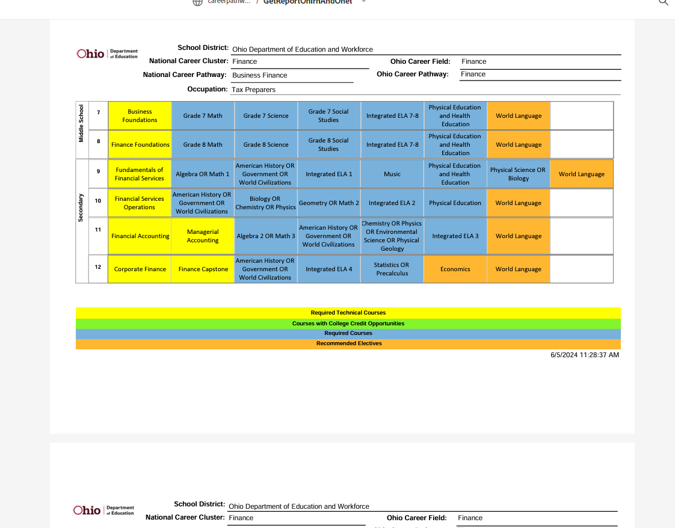
Potential Courses
Notes:
Here is a screenshot for a career as a “Tax Preparer”. The document provides a list of required and recommended courses. Included in the document are suggestions for when these courses can be taken in middle and high school. Information in this document can be helpful for students as they develop and implement their graduation plans. The document helps guide thinking about the possible courses your student may need with a suggestion on when during middle or high school they may want to be taking these courses as they prepare for their career. Depending on your district schedule, this list of course recommendations may need to be modified. Also, if you have students who may be looking at pursuing Career-Technical Education (CTE), CCP, IB, or AP courses these course recommendations will need to be modified accordingly. Lastly, when thinking about students in the graduating classes of 2026 and beyond, they will need to earn a ½ credit of Financial Literacy as part of their curriculum requirements. Therefore, Financial Literacy will need to be included somewhere in the graduation plan for each student.
Looking at the blue-colored squares, you will notice this career requires courses like Algebra 1 (or Math 1), Geometry (or Math 2), Algebra 2 (or Math 3), and Statistics or Pre-Calculus.

Slide 48
Job Search – Careers
Click on
“Careers”
Notes:
Click on the “Careers” tab.

Slide 49
Job Search – Career Pathways
Notes:
Underneath the Budget Calculator and the Lifestyle Calculator, you will find the Career Pathways section. Click on the “View Career Pathways” link.

Slide 50
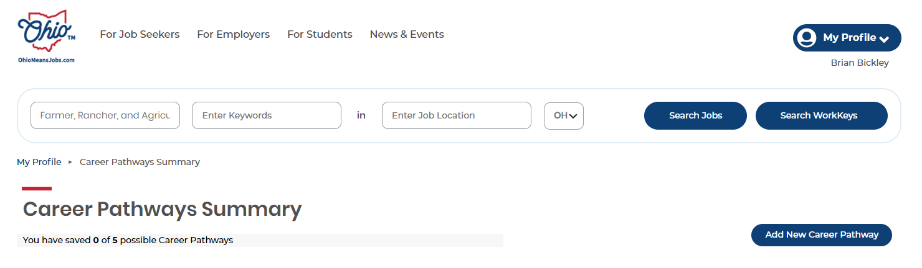
Search a Career Pathway
Notes:
You can use this tool to search any career pathway you choose. In the example shown on the screen, I searched for a career as a “Farmer, Rancher, and Agricultural Manager”.

Slide 51
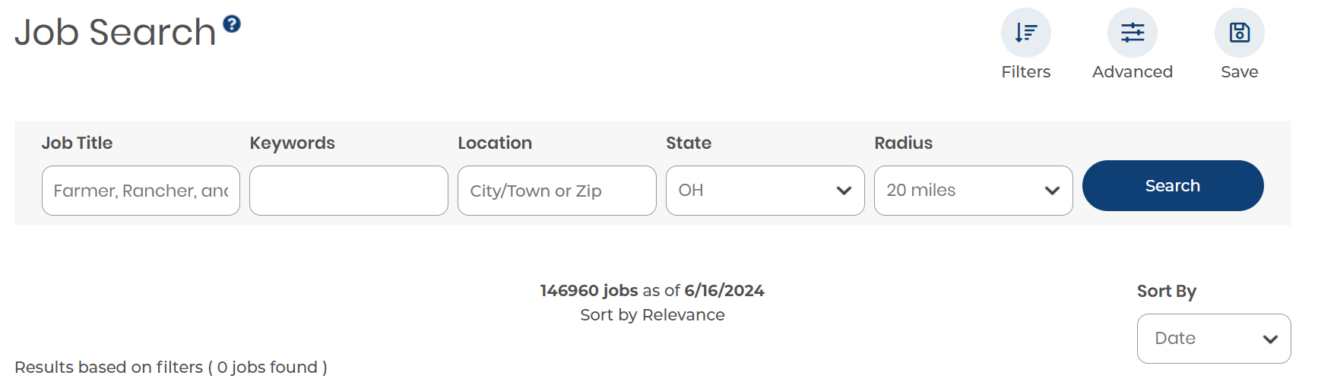
Search a Career Pathway
Notes:
My search identified that as of June 16, 2024, there were 146,960 jobs available in Ohio along this career pathway. To narrow down these results into a more manageable grouping, I will need to add some filters such as the city or town that I want to live in and a radius for how far I am willing to daily commute to and from work from work. From here, the search will identify job openings that meet those criteria that students could apply for. Since the results of these searches are regularly updated by the Department of Jobs and Family Services I will not show a screenshot of the results, because every few weeks those results will change depending on the career field and location being searched.

Slide 52
Job Search – career Clusters
Notes:
If we were to return to the Job Search page and this time if you were to click on the “View Career Clusters” link, it would take you to the Ohio Means Jobs Career Clusters page which we have already explored. The reason this is being pointed out is to acknowledge that the Jobs Search page serves as another entry point to the Ohio Means Jobs Career Clusters webpage.

Slide 53
Ohio Means Jobs Career Clusters
Notes:
We are pointing this out to acknowledge that the Jobs Search page serves as another entry point to the Ohio Means Jobs Career Clusters webpage. Since the information on the Ohio Means Jobs Career Clusters page is so valuable to students as they think about their career readiness we felt it was important to identify the many different ways that users can get to this information.

Slide 54
Questions to Consider
Think about the types of careers your student may be interested in.
Look at the pay/salary ranges.
Identify the most applicable mathematics courses.
Does this career require calculus?
Does this career require a college degree?
  If so, is it a 2-year? 4-year degree? Or an advanced degree?
Notes:
Now, take 10-minutes to explore the website based on what you think your student(s) will be or already is interested in. As you explore, you will want to pay attention to the information provided by the website. On the screen is an example from the
Before you select a Career Cluster below to begin exploring:
Think about the types of careers your student may be interested in?
Look at the pay/salary ranges.
Identify the mathematics courses that are most applicable.
Does this career require calculus?
Does this career require a college degree?
If so, is it a 2-year? 4-year degree? Or advanced degree?
I will put these questions for you in the chat and on the screen while you explore the website.

Slide 55

Debrief
Notes:
What questions do you have so far?

Slide 56
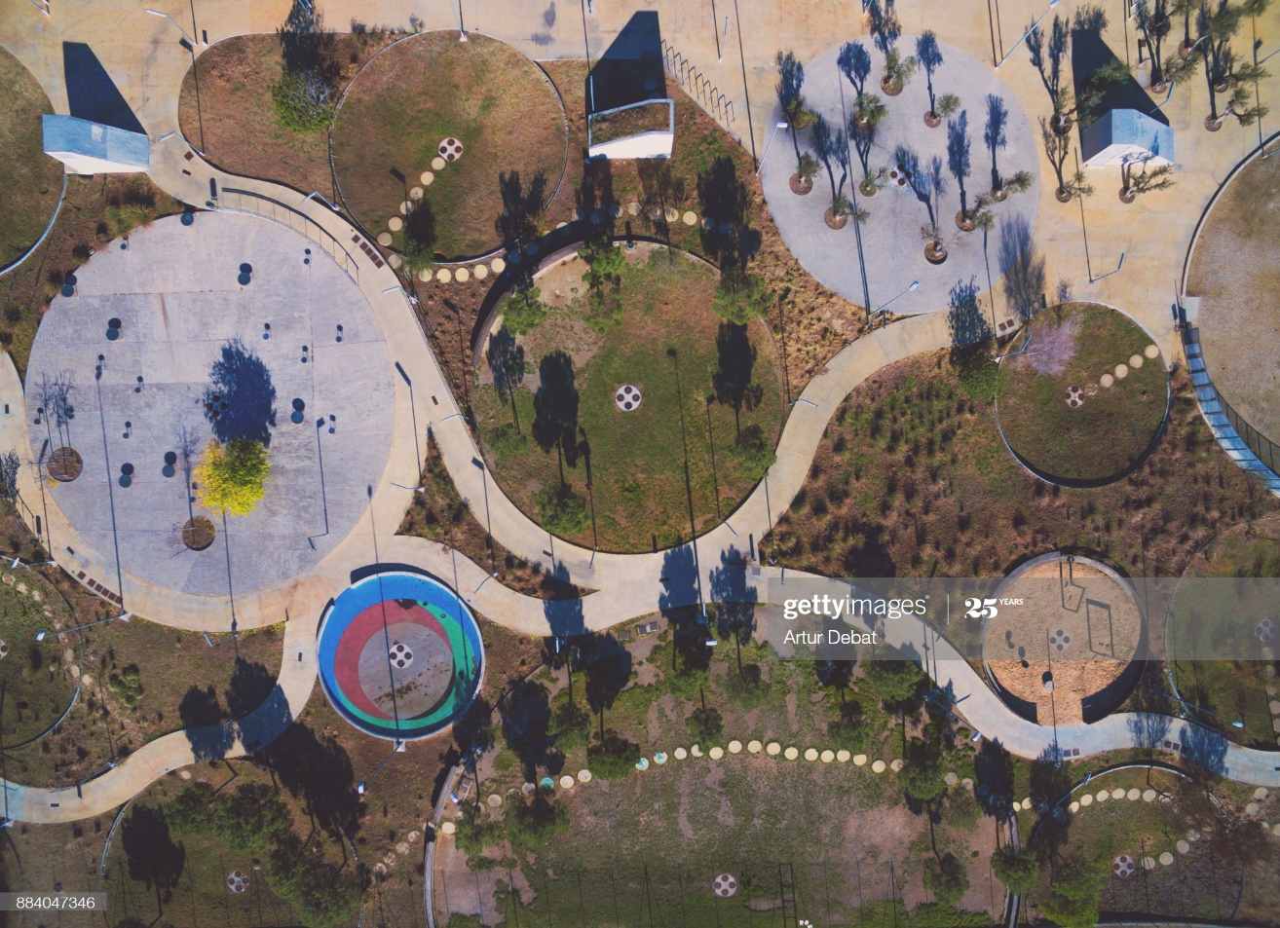
Student Decision Tree Part 3
Notes:
Following all of the information and resources that we just discussed, we are going to return to the Student Decision Trees that are found on the DEW website. Earlier in this session, we used Student Decision Trees 1 & 2 to get us onto the Ohio Means Jobs website.
This time we are going to return to the Student Decision Trees to look at Part 3. This decision tree shows alignment between majors/careers and high school math pathways courses. The information is broad and should be used for general guidance only, as alignments may vary by higher education institutions. Please check your local community colleges or four-year feeder schools and adjust the chart as necessary.
For their third unit of mathematics, students may wish to explore one of their new pathway courses such as Statistics & Probability, Data Science Foundations, or Computer Science/Discrete Math. However, if students decide to pursue a major within that pathway that requires Calculus, they should take Algebra 2 for their fourth unit of mathematics.
https://education.ohio.gov/cmsctx/pv/ID-10131609/culture/en-US/wg/42667fc7-e562-46e3-9bbe-51ce0c96a19d/h/266823795fdf0360c76653ce3f49e829c6027767adda7473b1e9a8d2bbcc6ef9/-/getattachment/Topics/Learning-in-Ohio/Mathematics/Resources-for-Mathematics/Math-Pathways/Higher-Ed-Entry-Level-Math-Pathways-Course-Descrip/Student-Decision-Tree-part3.pdf.aspx?lang=en-US&uh=76a179e7a8938c1abd9dd754991ed33e92b96fed09a2a985a450a6ecefd0d8c2

Slide 57
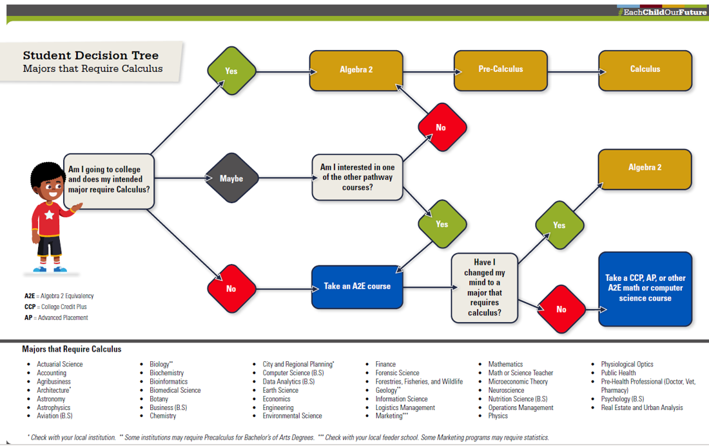
Student decision tree
Notes:
In Student Decision Tree 3, there is this graphic that parents and students can use when deciding which courses to choose. A major decision in which mathematics courses a student takes is whether their college degree program or career field requires calculus. It is worth noting that while many careers require calculus, many do not. The graphic provides a starting list of common in-demand careers that will require calculus. Students that will be entering into a calculus pathway are encouraged to take Algebra 2 (or Math 3) as one of their four high school mathematics courses. Meanwhile, students that will not be entering into a calculus pathway are encouraged to take an Algebra 2 equivalent course such as Advanced Computer Science, Advanced Quantitative Reasoning, Data Science, Discrete Mathematics, or Statistics and Probability. I do want to acknowledge that a student who may choose initially to not take Algebra 2 (or Math 3) can always take Algebra 2 (or Math 3) later. Also, they can double-up on high school mathematics courses in a school year. For example, a student can take Advanced Quantitative Reasoning as their third high school mathematics credit. The following school year they can take both Algebra 2 (or Math 3) and Statistics and Probability.

Slide 58
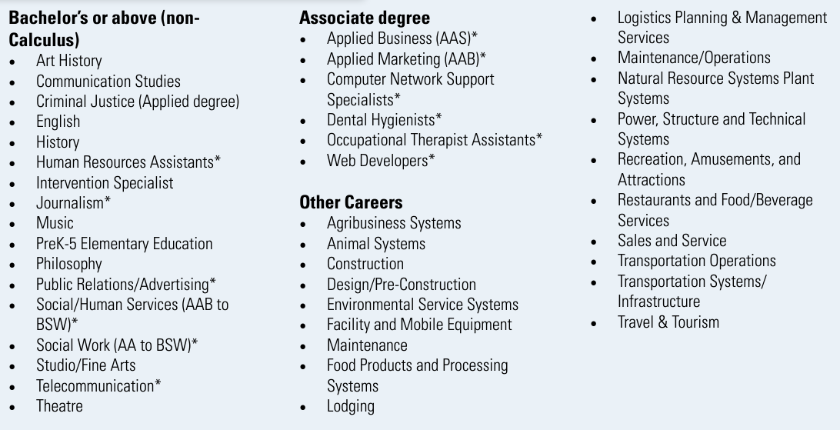
Career applications for Advanced quantitative reasoning
Notes:
Included in the Student Decision Tree 3 recourse are lists of careers that each Algebra 2 equivalent course content will be helpful for. On the screen is a list of those careers that an Advanced Quantitative Reasoning course would be helpful for.

Slide 59
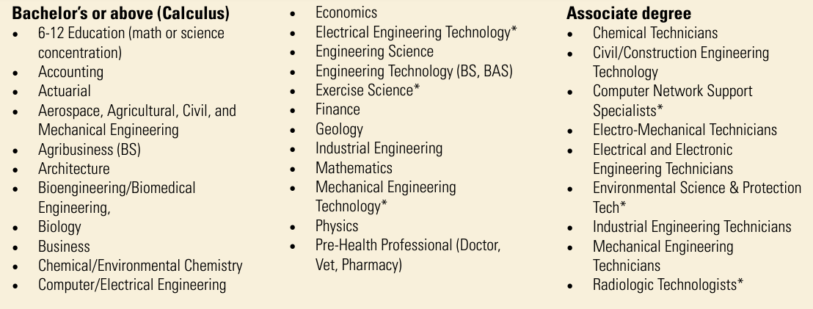
Career applications for algebra 2/math 3
Notes:
Here is the list for Algebra 2/Math 3.

Slide 60
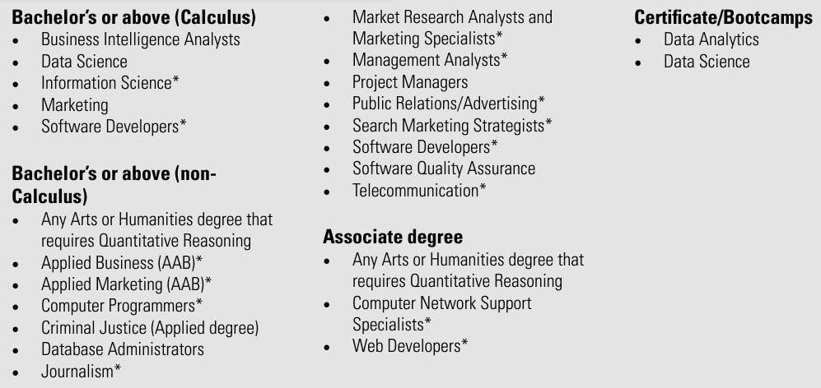
Career applications for data science
Notes:
Here we have a list for Data Science.

Slide 61
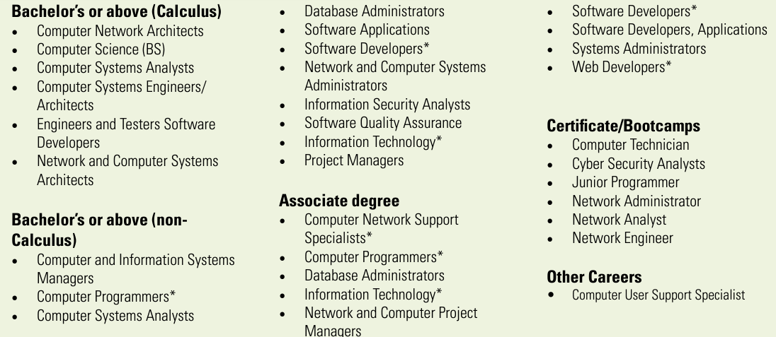
Career applications for discrete mathematics
Notes:
A list for Discrete Mathematics.

Slide 62
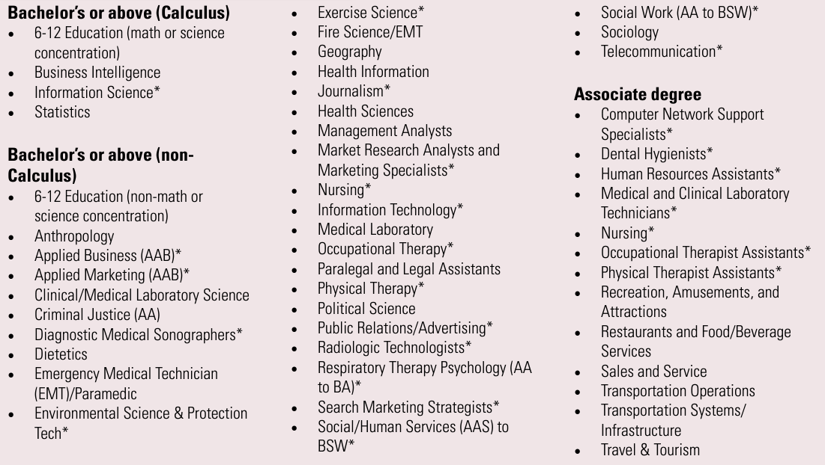
Career applications for statistics & probability
Notes:
And finally, Statistics and Probability.

Slide 63

Connecting the High School Math Pathways to College Credit Plus (CCP) and the Ohio Guaranteed Transfer Pathways
Notes:
WHAT ARE THE OHIO GUARANTEED TRANSFER PATHWAYS?
The Ohio Guaranteed Transfer Pathways are designed by Higher Education to provide a clearer path to degree completion for students pursuing associate degrees at Ohio’s public community colleges with plans to transfer to Ohio public universities to complete their bachelor’s degrees. The Ohio Guaranteed Transfer Pathways also constitute agreements between public community colleges and universities confirming that community college courses meet major preparation requirements and will be counted and applied toward the bachelor’s degree. Students still must meet all university program admission requirements. Because the Ohio Guaranteed Transfer Pathways align college majors to entry-level math courses, these also are useful for school counselors when advising students about which courses to take in high school, including those students who are planning to enter directly into four-year institutions directly after graduation. Students can search transferable courses by major, academic cluster or even institution. More information can be found on the Ohio’s Transfer to Degree Guarantee webpage.

Slide 64
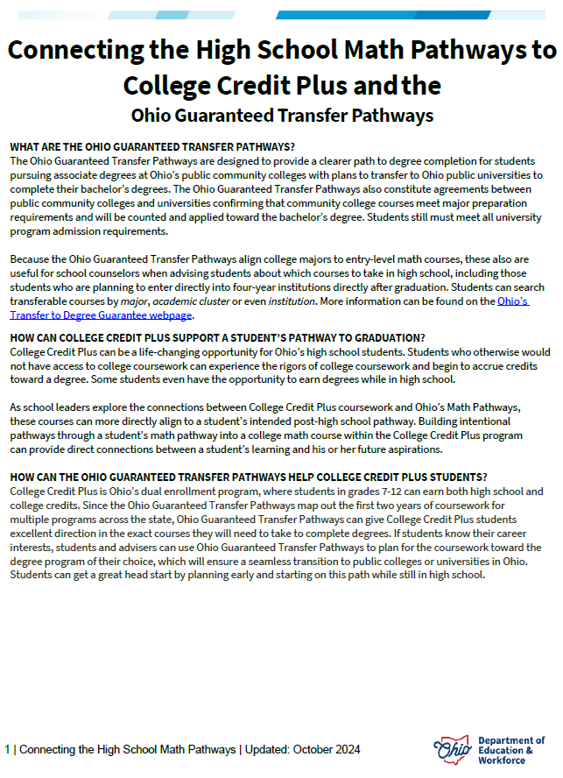
Connecting the High school math pathways to CCP and the Ohio Guaranteed transfer pathways
WHAT ARE THE OHIO GUARANTEED TRANSFER PATHWAYS?
HOW CAN COLLEGE CREDIT PLUS SUPPORT A STUDENT’S PATHWAY TO GRADUATION?
HOW CAN THE OHIO GUARANTEED TRANSFER PATHWAYS HELP COLLEGE CREDIT PLUS STUDENTS?
WHAT ARE APPROPRIATE COLLEGE CREDIT PLUS MATH COURSES FOR STUDENTS TO TAKE BASED ON THE ALGEBRA 2 EQUIVALENCY COURSE?
Notes:
https://education.ohio.gov/cmsctx/pv/ID-10131609/culture/en-US/wg/42667fc7-e562-46e3-9bbe-51ce0c96a19d/h/266823795fdf0360c76653ce3f49e829c6027767adda7473b1e9a8d2bbcc6ef9/-/getattachment/Topics/Learning-in-Ohio/Mathematics/Resources-for-Mathematics/Math-Pathways/Higher-Ed-Entry-Level-Math-Pathways-Course-Descrip/Connecting-the-Math-Pathways-to-CCP-and-OGTP-GW-LH_LS.pdf.aspx?lang=en-US&uh=4c353f6ab289d648e27bd18940c0d5892ae4e229f4e92a45e3315dc168307aba
In this document you will find answers to the following questions. (read the slide from here)

Slide 65

Algebra 2-Equivalent Courses and the ACT/SAT
Notes:
https://education.ohio.gov/getattachment/Topics/Learning-in-Ohio/Mathematics/Resources-for-Mathematics/Math-Pathways/Higher-Ed-Entry-Level-Math-Pathways-Course-Descrip/Math-Pathways-and-ACT-SAT.pdf.aspx?lang=en-US

Slide 66
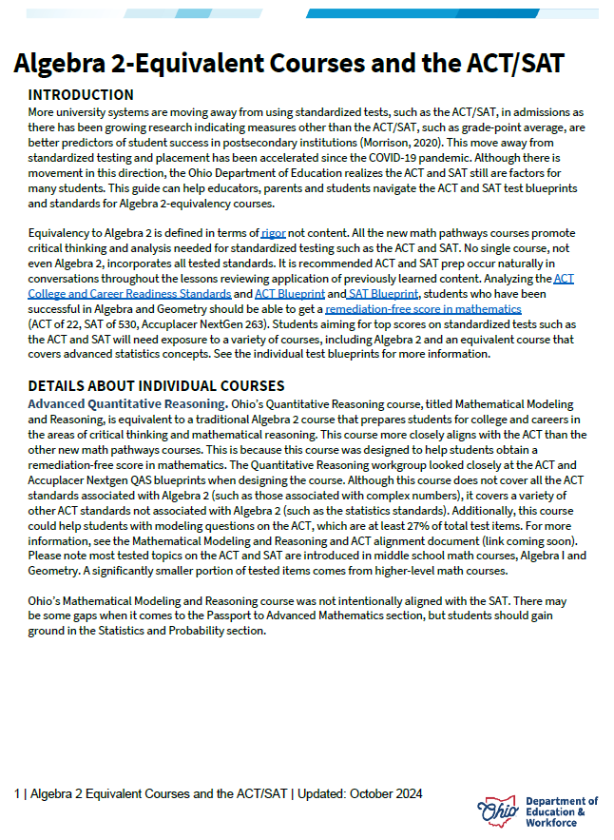
Algebra 2-Equivalent Courses and the ACT/SAT
Notes:
https://education.ohio.gov/getattachment/Topics/Learning-in-Ohio/Mathematics/Resources-for-Mathematics/Math-Pathways/Higher-Ed-Entry-Level-Math-Pathways-Course-Descrip/Math-Pathways-and-ACT-SAT.pdf.aspx?lang=en-US
More university systems are moving away from using standardized tests, such as the ACT/SAT, in admissions as there has been growing research indicating measures other than the ACT/SAT, such as grade-point average, are better predictors of student success in postsecondary institutions (Morrison, 2020). This move away from standardized testing and placement has been accelerated since the COVID-19 pandemic. Although there is movement in this direction, the Ohio Department of Education realizes the ACT and SAT still are factors for many students. This guide can help educators, parents and students navigate the ACT and SAT test blueprints and standards for Algebra 2-equivalency courses.
Equivalency to Algebra 2 is defined in terms of rigor not content. All the new math pathways courses promote critical thinking and analysis needed for standardized testing such as the ACT and SAT. No single course, not even Algebra 2, incorporates all tested standards. It is recommended ACT and SAT prep occur naturally in conversations throughout the lessons reviewing application of previously learned content. Analyzing the ACT College and Career Readiness Standards and ACT Blueprint and SAT Blueprint, students who have been successful in Algebra and Geometry should be able to get a remediation-free score in mathematics (ACT of 22, SAT of 530, Accuplacer NextGen 263). Students aiming for top scores on standardized tests such as the ACT and SAT will need exposure to a variety of courses, including Algebra 2 and an equivalent course that covers advanced statistics concepts. See the individual test blueprints for more information.

Slide 67
Contact Information
Name | Phone | Email
Annika Moore | 614-728-2373 | Annika.Moore@education.ohio.gov
Brian Bickley | 614-644-6814 | Brian.Bickley@education.ohio.gov
Yelena Palayeva | 614-387-7561 | Yelena.Palayeva@education.ohio.gov

Slide 68
Computer Science Questions?
John Wiseman
John.Wiseman@education.ohio.gov
And
Janelle Horton
Janelle.Horton@education.ohio.gov

Slide 69
Questions?

Slide 70
Questions?

Slide 71
Ohio The Heart of It All.

Slide 72
Ohio Department of Education and Workforce

