Slide 1
Honors Algebra 2 & Physics (HAPS)
Mr. Robert Engels
& Ms. Angela Sanor
St. Vincent-St. Mary High School

Slide 2
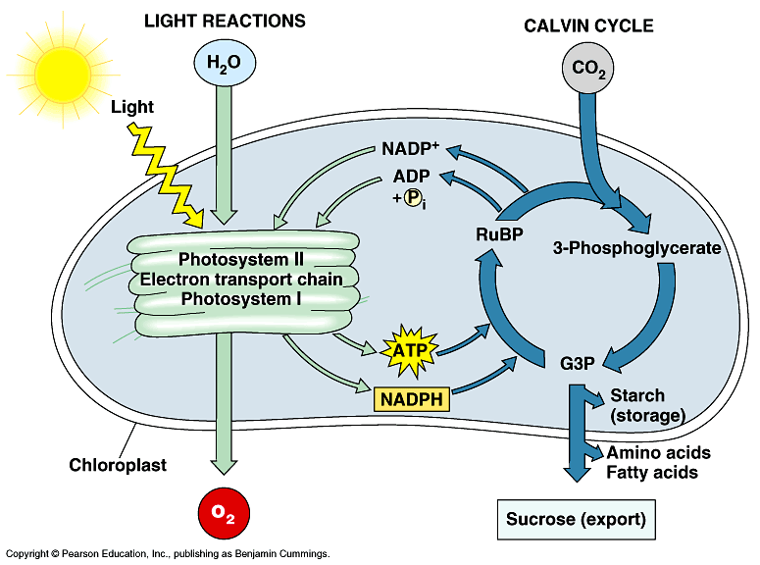
Why Physics First?
Notes:
Bob
Makes sense - physics foundation of all sciences
Make science something that students do rather than memorize
Foster interest in STEM

Slide 3
Why Algebra 2?
Honors level students as our “guinea pigs”
Have taken algebra 1 in middle school
Most likely interested in STEM careers
Content mobility between Precalculus & Algebra 2
Notes:
Angela

Slide 4
Why Combine?
Notes:
Bob
Math is the language of science - why be in separate silos?
After learning about a tool why not build something with it?
Available Physics First curriculums are math “lite”
Physics teachers spend a lot of time teaching math
Angela
“Students use mathematical language to communicate effectively and to describe their work with clarity and precision. Students demonstrate how, when, and why their procedure works and why it is appropriate. Students can answer the question, ‘How do we know?’”
Math Teacher’s Perspective
Need for realistics & relatable context
Deep connections aid in retention
Why are we learning this?
Rigor

Slide 5
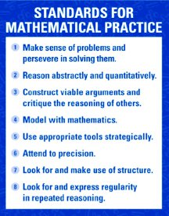
Developing Thinkers
Notes:
Angela
When students think about mathematics in relatable and interesting contexts, they develop the intuition behind the principles and formulas of mathematics.
This intuition then allows them to apply their thinking to problem-solve in new and unique situations.

Slide 6
Constructing the Curriculum
Notes:
Bob
Started with Physics Modeling Instruction™ curriculum and matched to state standards
Analyzed math standards and content to see where they overlapped & supported the physics content
Modified/added Modeling Instruction™ curriculum to physics to include as much Algebra 2 content as possible
When Algebra 2 content did not have matching physics content we created stand alone math units
Used MMR/Advanced Quantitative Reasoning Pilot to improve math lessons

Slide 7
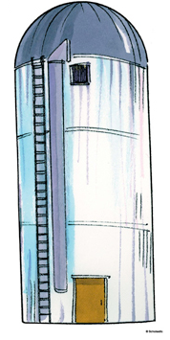
Collaboration
(A Learning Experience of Its Own)
Math
Science
Language science vs. math
Gotta let go some
Finding time to meet
Numbers as measurements
Units on slopes?
Using variables other than x & y due to context?
Notes:
Angela

Slide 8
Scope & Sequence
1 – Experimental Thinking and Model Building
2 – Qualitative Introduction to Energy
3 – Constant Velocity and Momentum
4 – Constant Acceleration
5 – Balanced Forces & Fields
6 – Unbalanced Forces and Impulse/Momentum
7 – More about Triangles and Trig
8 – Quantitative Energy
9 – Complex Numbers
10 – Projectile Motion
11 – Polynomials
12 – Rotational Motion
13 – Combination of Functions
14 – Oscillating Particle Model
15 – Mechanical Wave Model
16 – Exponential and Logarithmic Models
17 – Rational Functions
Notes:
Angela
Maroon colored units are stand alone math
Green are combined

Slide 9
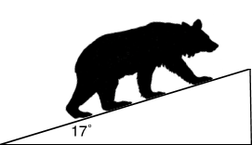
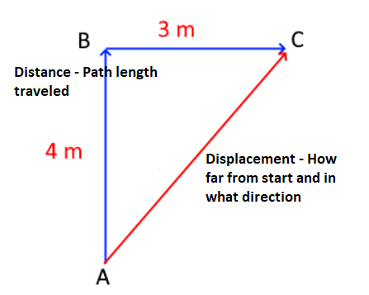
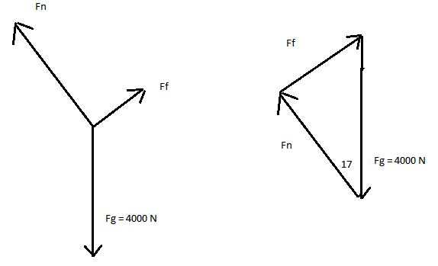
Balanced Force Model
Example Unit
Notes:
Bob -
Learned about 1d vectors in kinematics/motion
Learned to distinguish distance and displacement
Now what if we can move in 2 dimensions?
Learn head to tail addition, start graphically using graph paper, rulers and protractors
Is there an easier, more accurate way to find side lengths and angles?
See that we can find length of legs using pythagorean theorem, what about angles?
Let students discover patterns of relationships between acute angles to side length ratios in similar right triangles and use this to make predictions
Introduce names of acute angle to triangle leg length ratios as sine, cosine, tangent and how we can use them to find unknown lengths/angles
Introduce balanced forces at 90° and determine net forces (vector sum = 0)
Introduce balanced forces at angles and ask students to determine net forces (vector sum = 0) using what they know about right triangles
Use interactive simulations such as PhET to visualize 2D vector addition
Vector components are introduced in the following unit once students have firm grasp on vector addition and when vector sum is non-zero.

Slide 10
Pathways after HAPS
Honors Geometry
Honors Pre-Calculus
Honors or AP Calculus
AP Statistics
CCP Trigonometry
Other CCP Math Courses
Other Algebra 2 equivalency course
Notes:
Angela
Calculus-based Physics as seniors

Slide 11
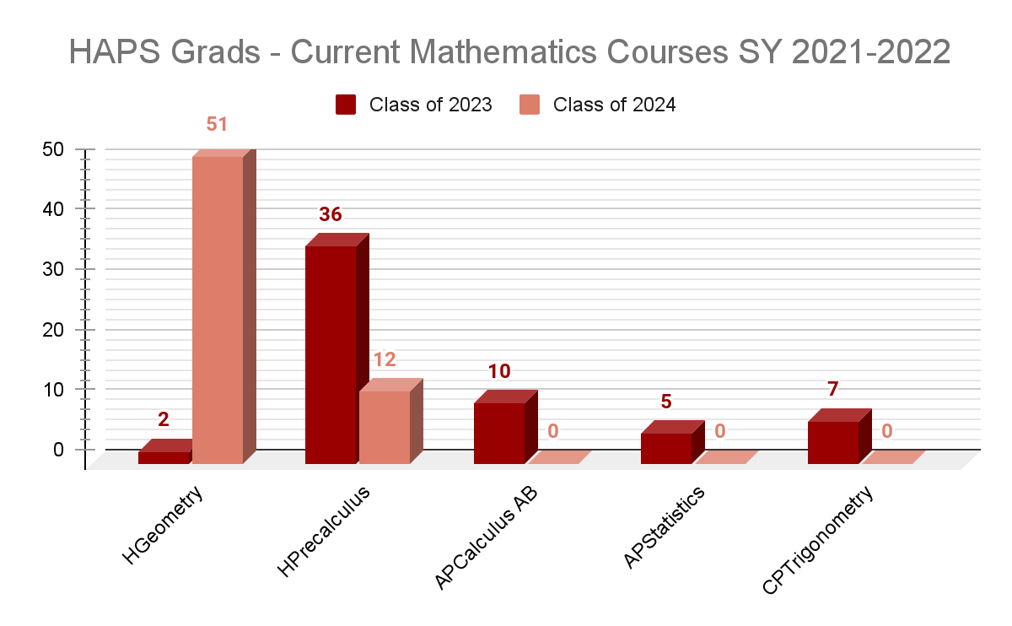
Notes:
Angela
Get data on #’s in each section & #’s in subsequent courses

Slide 12
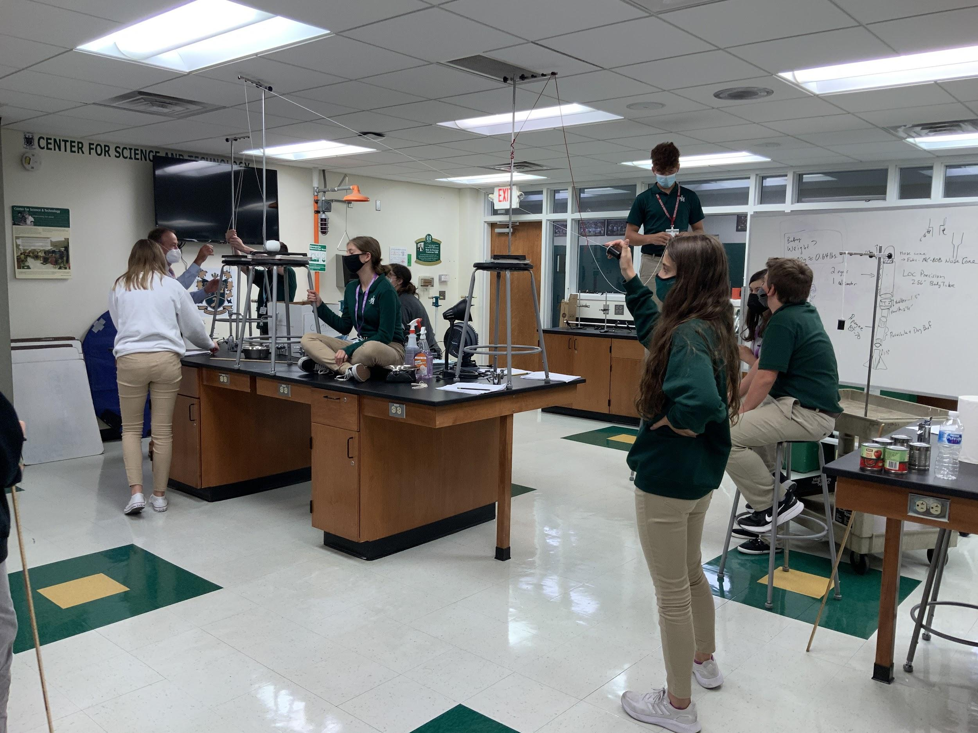
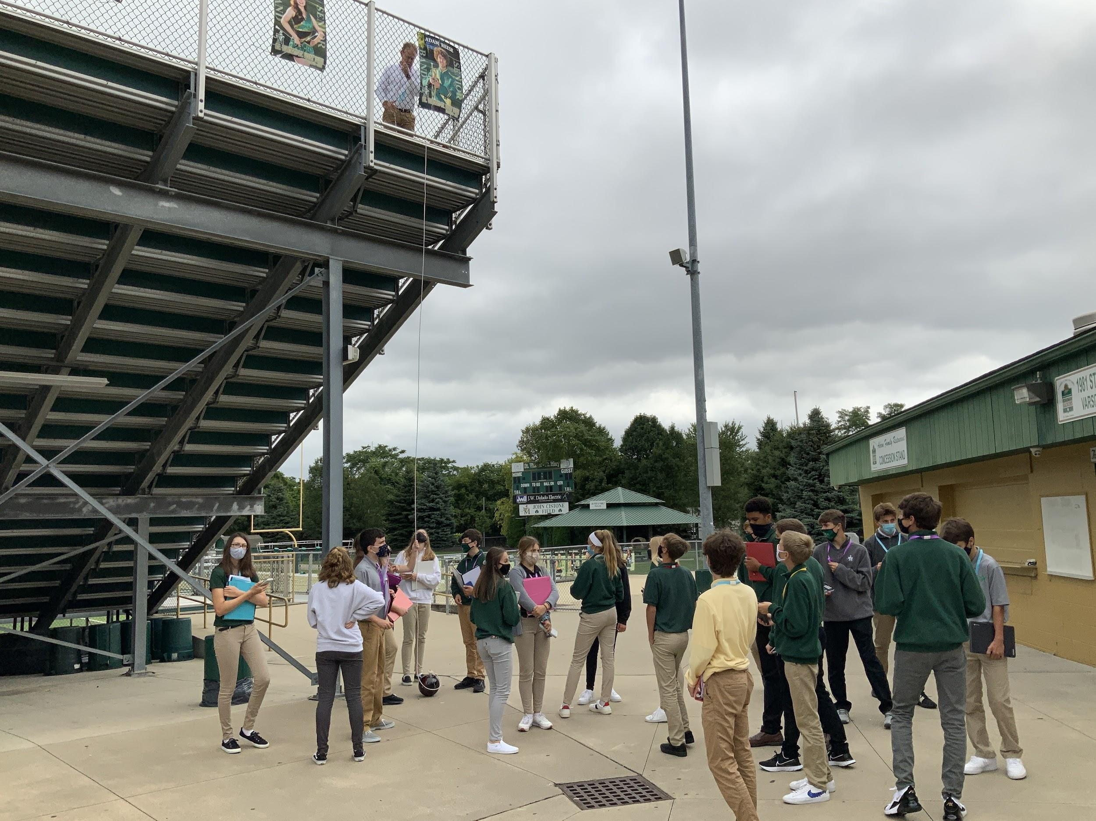
Pendulum Lab
Ever tried. Ever failed. No matter. Try again. Fail again. Fail better.
- Samuel Beckett
Notes:
Opening Problem/Brainteaser
Whiteboard Homework
Lab/Investigation
Task
Activity

Slide 13
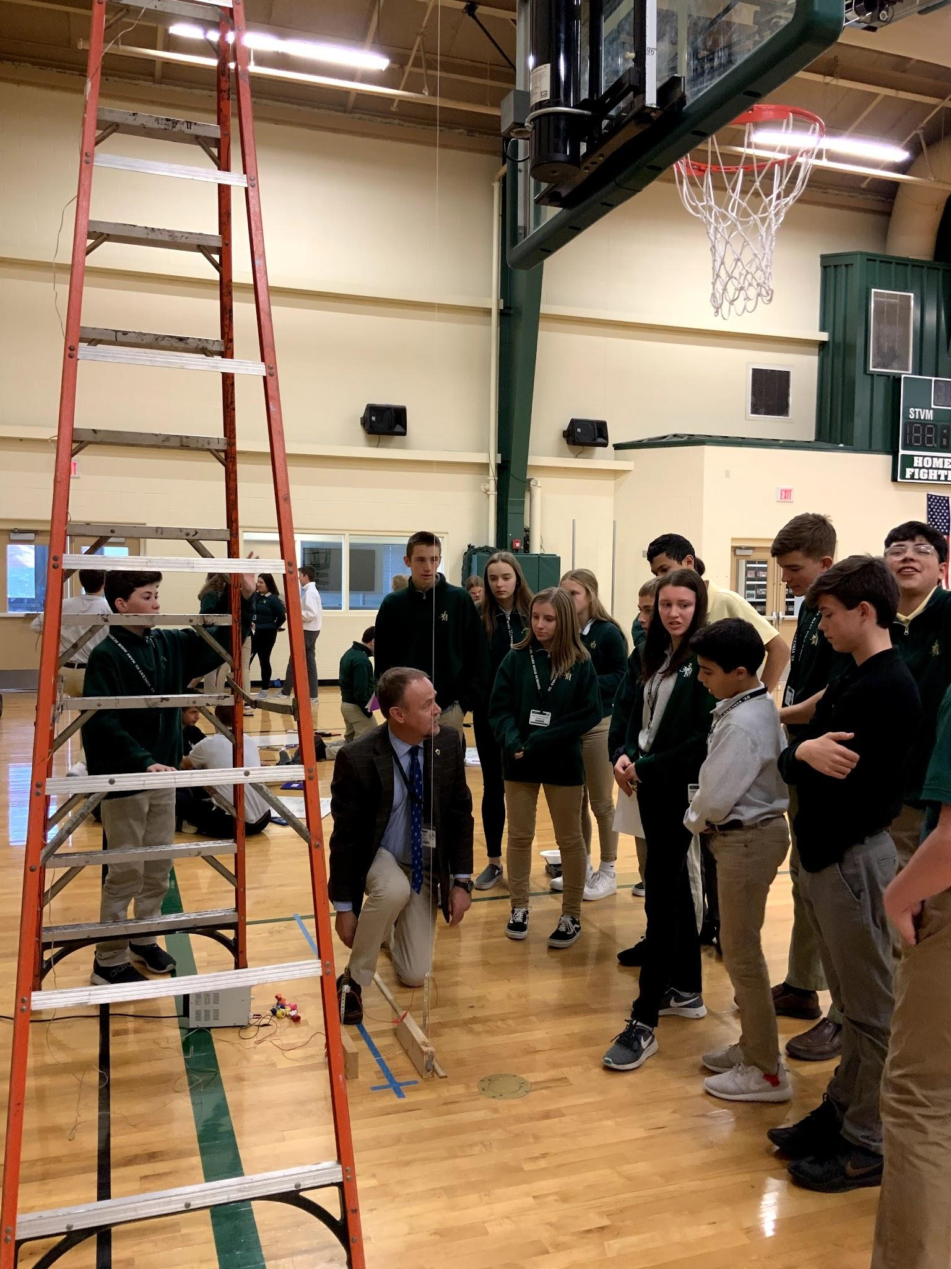
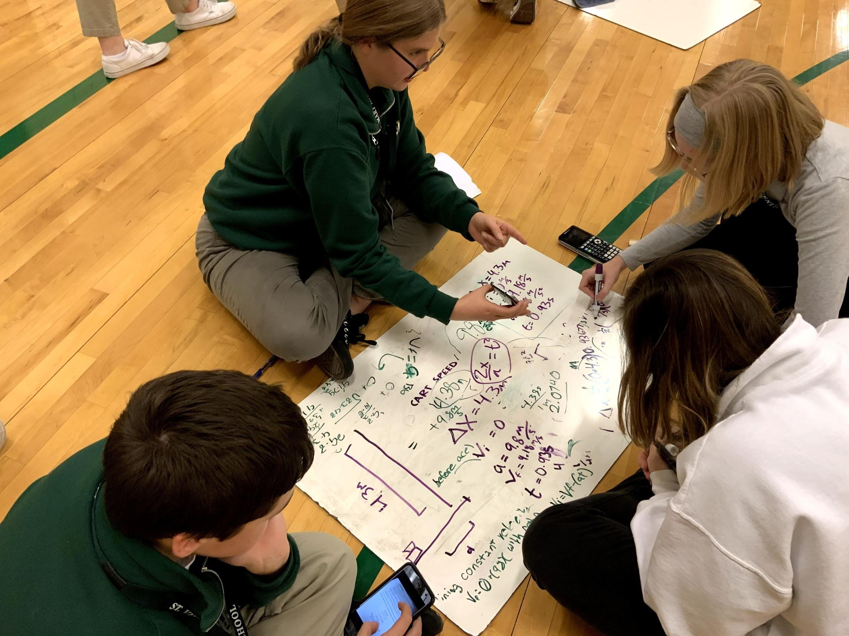
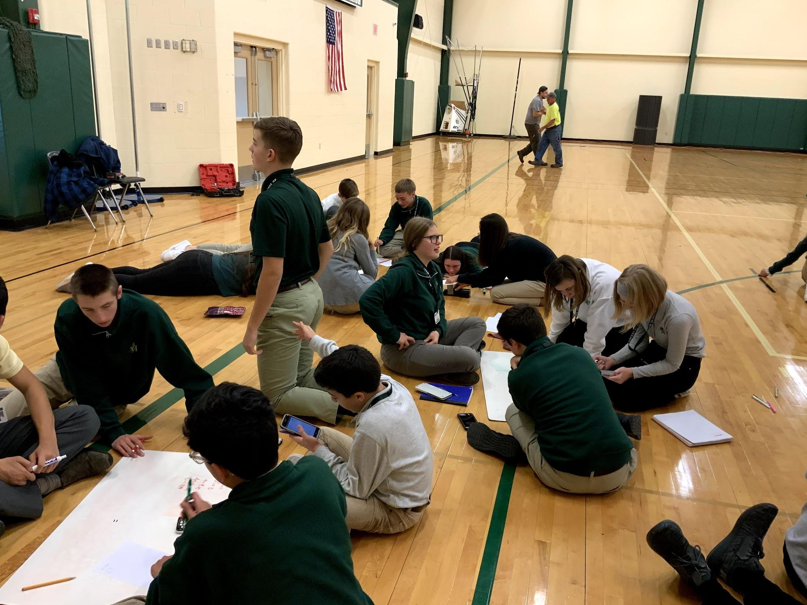
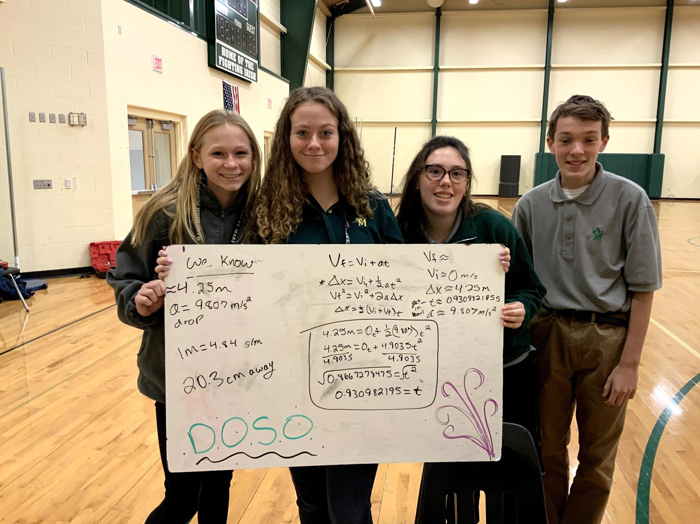
Paw Patrol Drop
Notes:
Student Focused
Collaborative
Random Groups of 3
Math 360/Vertical Whiteboards

Slide 14
Students' Thoughts
“The HAPs class was very different than other science and math classes because it gave us more practical and realistic applications of the math we were learning by showing, through physics, how it was applicable in real life, thus reinforcing both the math and physics material. Other science and math courses I have taken have been largely theoretically based and while you can still learn the material fairly well, when the more engaging approach of hands on learning and a more comprehensive and inclusive course that was manifested in HAPs, students are more engaged and are able to better understand the subject matter.”
“The class was challenging, but the challenge really pushed me to new limits and helped me to think. I'm glad I took this class as a freshman so it could set me up for the rest of high school.”
“I definitely gained a greater appreciation for math and science after taking HAPS and enjoy STEM activities more. It also helped me take classes such as Precalculus and Ap Calculus AB earlier than I would have. The class was challenging and it pushed me to learn and give it my all, not just for that class but future classes as well.”
“Before I took the class, I didn't realise how much I enjoyed math. HAPS brought a new level of interest in mathematics and physics. The class was challenging, however what they taught us has fully been absorbed and comprehended. I found after taking the class I would begin to apply some of the things into my daily thought process. After going through HAPS, I feel much more confident in my mathematical capabilities and have found that I really enjoy math. I also really enjoyed the fun experiments in physics which helped connect the concepts to daily life.”
“I really loved the HAPS class because it gave me a nice challenge, especially for freshman year. It taught me to always keep up with my work, to always work my hardest, and accept failures in order to find success.”
Notes:
Quotes on this slide

Slide 15
Next Steps
Physics for all College Prep level freshmen
Collaboration between Algebra 1 & Physics teachers.
Calculus-based Physics C Mechanics & Electricity/Magnetism

Slide 16
Contact Information
Bob Engels rengels@stvm.com
Angela Sanor asanor@stvm.com

