Slide 1
High School Math Pathways
Anna Cannelongo

Slide 2
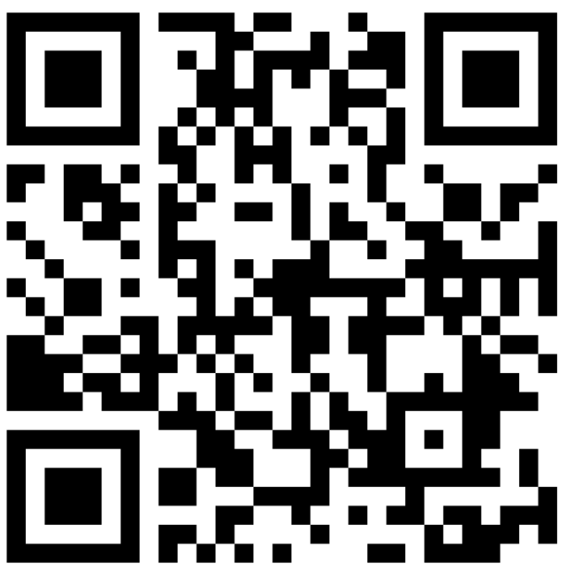
Padlet
This session will be recorded, so it can be posted on the Department’s website. The recording will begin at the end of this slide.

Slide 3
Math Pathways

Slide 4
Jobs Landscape

Slide 5
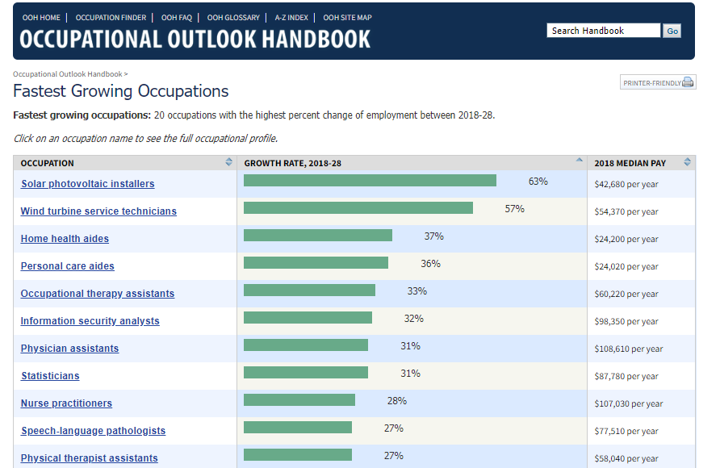

Slide 6
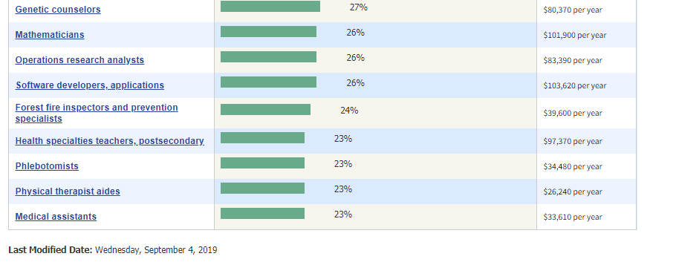
From U.S. Bureau of Labor Statistics: https://www.bls.gov/ooh/fastest-growing.htm

Slide 7
Notice the emphasis on Data and Computers

Slide 8
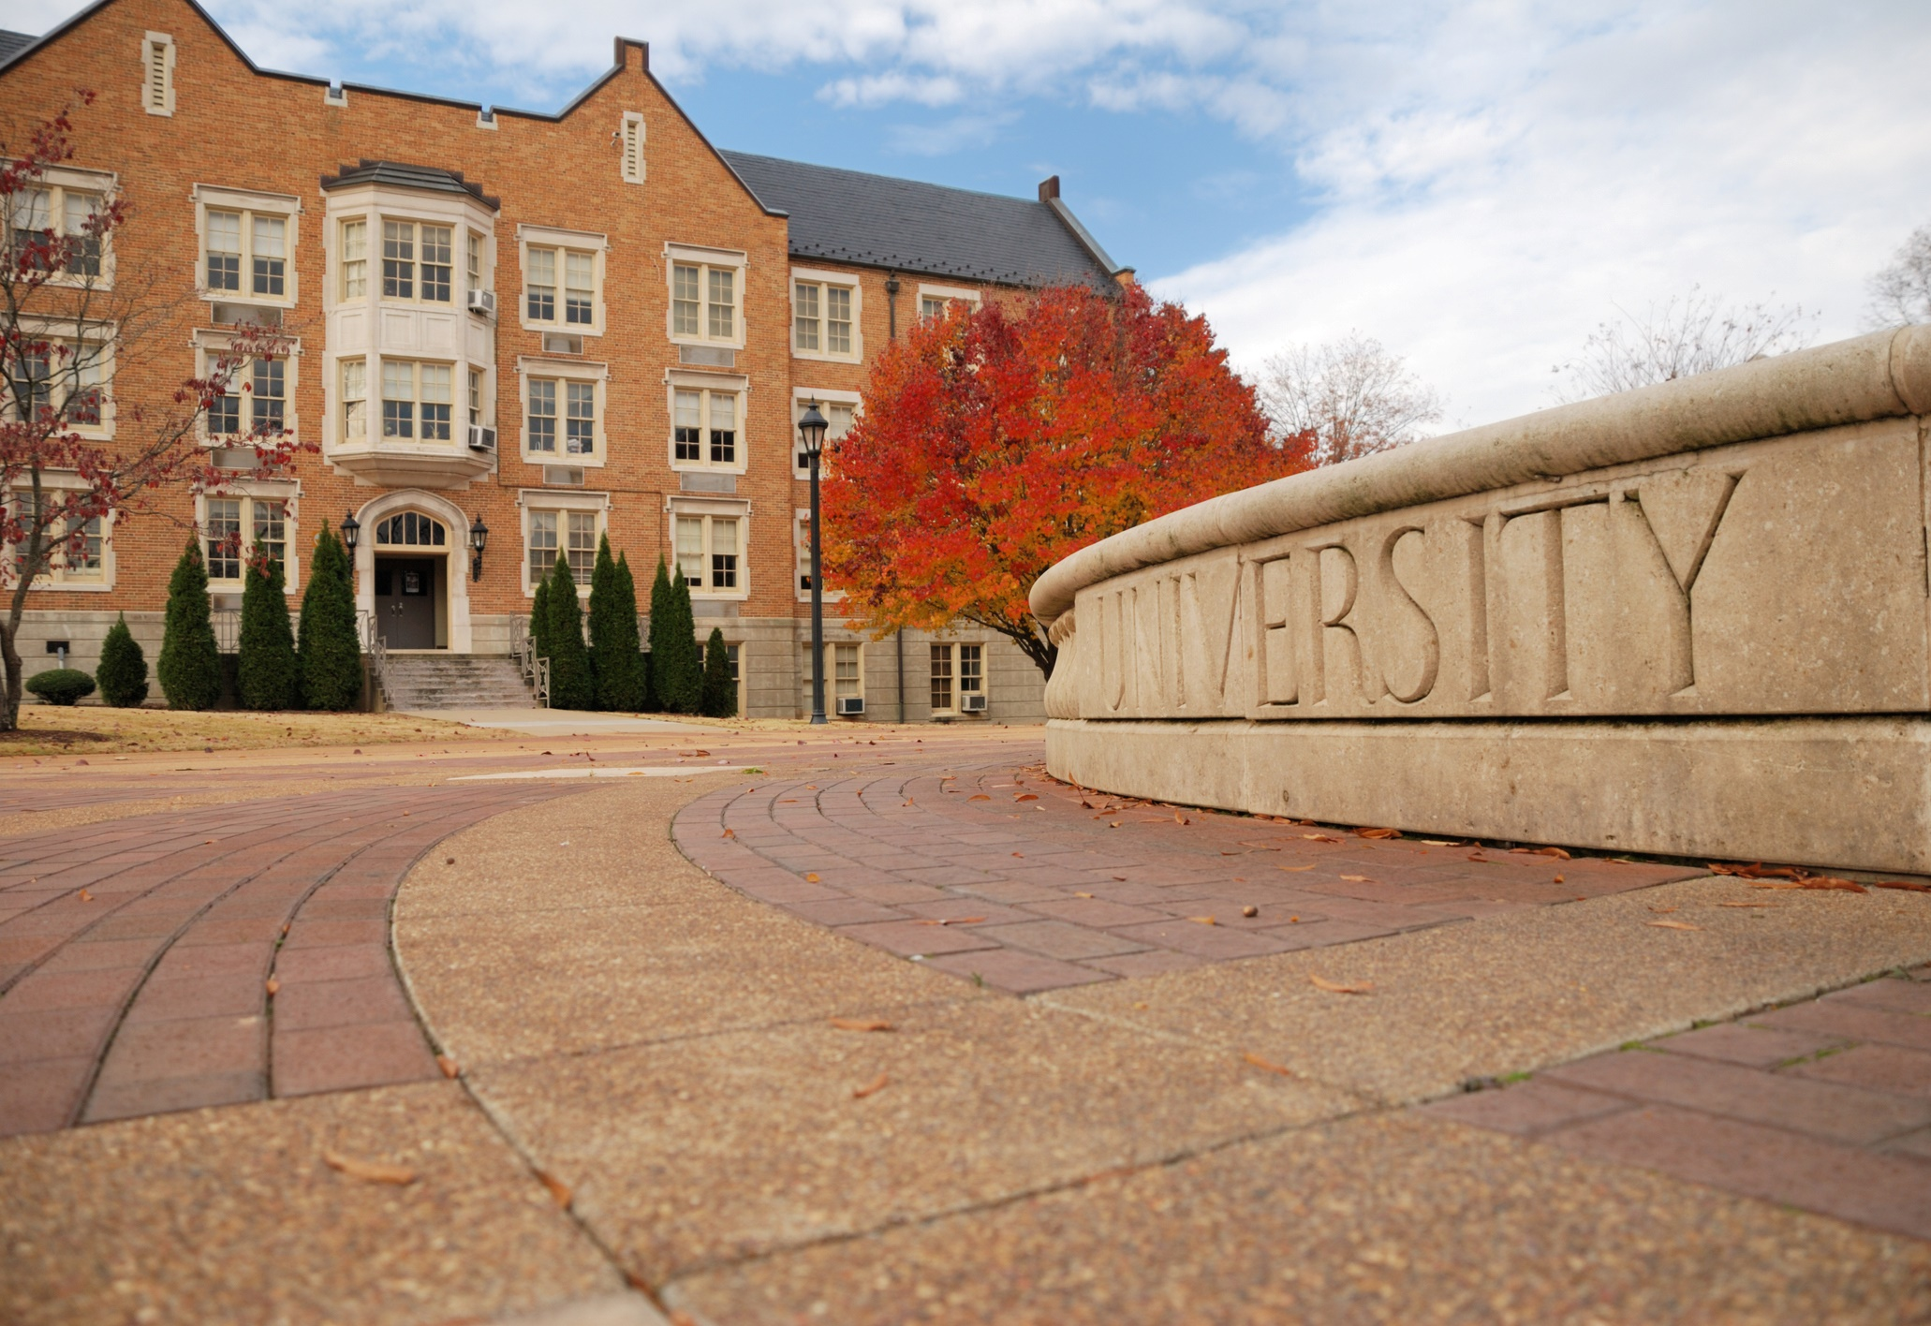
Higher Education Landscape

Slide 9
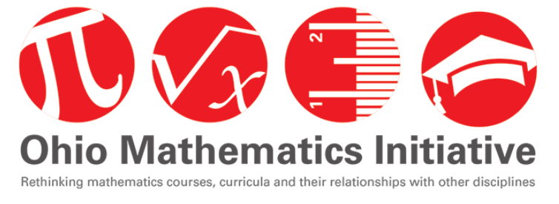

Slide 10
OMI’s Subgroups
1
New and Alternative Pathways
2
Revision of the Ohio Transfer Module Criteria
3
Communication Outreach and Engagement
4
Data collection, Analysis and Sharing
5
Secondary and Postsecondary Alignment
Notes:
Most of the responsibility for implementing the Steering Committee’s recommendations lies with the mathematics department chairpersons and their colleagues in the state’s public colleges and universities. They will have the support of the Mathematics Chairs Network, the Ohio Department of Higher Education and an emerging statewide mathematics community.
Day by day, five OMI subgroups are working to turn the Steering Committee’s recommendations into concrete action. The subgroup most pertinent to Ohio’s transition course is Subgroup 5.

Slide 11
Structured Degree Pathways
Math Gateway Courses
Corequisite Remediation
Notes:
What is the Ohio Mathematics Bridges to Success (B2S) Initiative?
The B2S initiative strives to help public colleges and universities improve student success by systemically linking three successful strategies: structured degree pathways, redesigned mathematics gateway courses, and corequisite remediation.
Why Does It Matter?
The sooner students take courses that count toward a college degree, the greater the chance that they will earn a degree.[i] Yet, for many students, access to credit-bearing courses is delayed. Traditional remediation models in which some students take a series of remedial classes to acquire the skills needed to move forward to college-level mathematics courses generally do not result in students progressing to graduation. Nationwide, more students need developmental coursework in mathematics than any other subject; moreover, more students are likely to view mathematics as barriers to academic success more than other general education requirements.
Rather than continuing to place all students in traditional calculus pathway in mathematics, there is a movement to match the right mathematics course to different majors; students in many programs of study (such as health sciences, social sciences, liberal arts, education and business) can be suitably prepared with alternative gateway math courses in quantitative reasoning or statistics. Redesigned options in mathematics gateway courses, particularly those with just-in-time academic support for students who are underprepared for college level courses, have the potential to increase student success in gateway courses as well as help students to more quickly begin credit-bearing courses on their degree pathway. These approaches require effective connection and collaboration between faculty, advisors and administrators to build new systems that enhance student success.

Slide 12
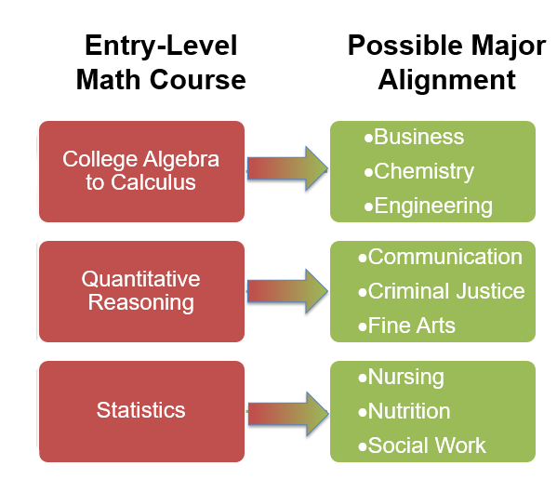
Higher Education Mathematics Gateway Courses
Notes:
Ohio’s colleges and universities currently use a two-prong approach to help students complete appropriate gateway mathematics courses early in their postsecondary careers. First, higher education faculty, working in concert with ODHE, have created three different, fully transferable college gateway mathematics courses: Quantitative Reasoning, Statistics and College Algebra to help students progress in their chosen pathway. These gateway courses enable colleges and universities to advise students into the appropriate mathematics based on their majors rather than placing all students in a “default” College Algebra (STEM) pathway.
Second, Ohio’s colleges and universities are placing more and more students directly into credit bearing courses with co-requisite remediation rather than stand-alone developmental education sequences. The co-requisite remediation model shortens the time students take to complete gateway courses by providing just-in-time support as a student simultaneously takes the gateway credit-bearing course.

Slide 13
New Emerging Pathways in Ohio
Data Science (still being drafted)
Technical Math (recently posted)
Discrete Math (recently posted)
Math for Elementary Education (recently posted)

Slide 14
Research
Students randomly assigned to statistics corequisite courses were 50 percent more likely to graduate from CUNY compared to those randomly assigned to a remedial Algebra course. (Burdman, 2019, Logue 2019)
Statistics was not easier than the Algebra. The statistics students were 39 percent more likely to graduate and were more likely to pass advanced quantitative courses. (Burdman, 2019, Logue 2019)
Research implies that quantitative and statistical pathways have three to four times the success rate of traditional pathways in only half of the time. (Huang, 2018)
Notes:
“The new research [Logue, 2019] shows that students who were assigned to remedial algebra courses but instead enrolled in statistics corequisite courses were 50 percent more likely to graduate from CUNY within a three-year period. (Corequisites are an alternative to remedial prerequisites in which students needing additional support receive extra help while taking a college gateway course.)” (Burdman, 2019).
“The research also discredits the notion that statistics students perform well because statistics is easier. Looking only at students who passed whichever course they were assigned to, the researchers found that the stats students were still 39 percent more likely to graduate. They also were more likely to pass advanced quantitative courses than the students who took algebra.” (Burdman, 2019).
“Students (even those pursuing STEM) who take a statistics or data science course instead of an Algebra 2 or College Algebra course may be better prepared for 21st century careers.” (Burdman, 2019).
“In fact, research implies that quantitative and statistical pathways have three to four times the success rate of traditional pathways in only half of the time.” (Huang, 2018).
Burdman, P. (2019, June 27). Re-thinking the role of Algebra 2 in college readiness. Just Equations. https://justequations.org/news/rethinking-the-role-of-algebra-two/.
Huang, M. (2018, January). 2016-2017 impact report: Six years of results from the Carnegie Math Pathways. Carnegie Foundation for the Advancement of Teaching, Stanford: CA. Retrieved from https://storage.googleapis.com/cmp-wordpress-public-uploads/1/pathways_descriptive_report_january_2018.pdf.

Slide 15
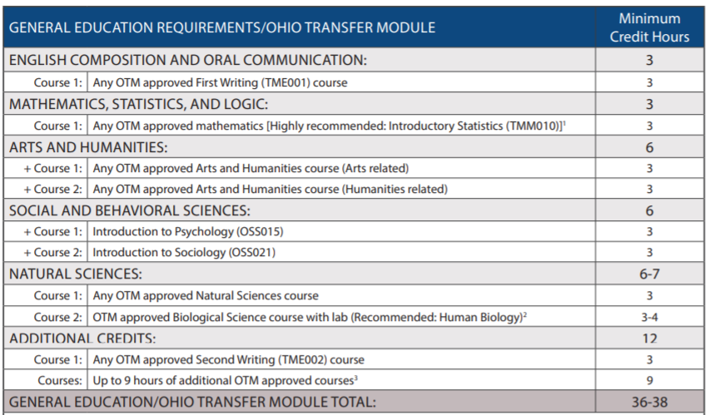
https://www.ohiohighered.org/OGTP

Slide 16
Completed | Gateway Course | Completed | Gateway Course
Business Business Social & Behavioral Sciences Anthropology Economics Geography Political Science Psychology (B.A.) Psychology (B.S.) Social Work Sociology Still Undecided Social & Behavior Sciences for Undecided Students | Calc 1 or B. Calc Intro Stats Calc 1 or B. Calc Intro Stats Intro Stats Intro Stats College Algebra Intro Stats Intro Stats Intro Stats | Arts & Humanities Art History Communication Studies English History Music Philosophy Studio/Fine Arts Theatre STEM Biology Chemistry Geology Mathematics Physics | QR QR QR QR QR QR QR QR Calc 1 Calc 1 Calc 1 Calc 1 Calc 1

Slide 17
Under Construction
Business Applied Business Social & Behavioral Sciences Social/Human Services Arts & Humanities Journalism Public Relations/Advertising Telecommunications Education AYA Middle Intervention Specialist ECE | Public Safety Fire Science/EMT EMS/Paramedic Criminal Justice Health Sciences Dietetics Exercise Science/OT/PT Health Information Management Medical/Clinical Laboratory Nursing Respiratory Therapy | STEM Aerospace, Agricultural & Mechanical Engineering Civil Engineering Civil/Construction Engineering Technology Computer/Electrical Engineering Computer Science Information Systems Information Technology

Slide 18
The Problem
College Algebra was not meeting the needs of all students
Coherence between high school and college math
The workforce recognizes that all students need reasoning skills to be successful

Slide 19
Other States
California University Systems
Students in 11th and 12th Grade can take other courses to satisfy the third math credit.
Examples of such courses include, but are not limited to, applied mathematics, calculus, computer science, data science, discrete mathematics, linear algebra, pre-calculus (analytic geometry and mathematical analysis), probability, statistics and trigonometry
Notes:
https://edsource.org/2020/university-of-california-expands-list-of-courses-that-meet-math-requirement-for-admission/643173
https://hs-articulation.ucop.edu/guide/a-g-subject-requirements/c-mathematics/

Slide 20
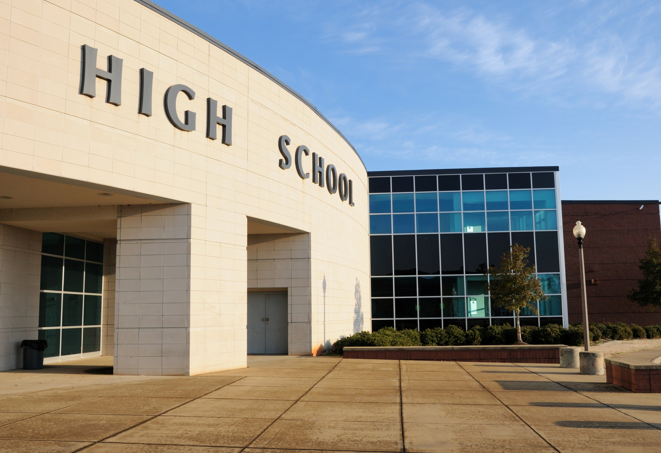
K-12 Landscape

Slide 21
Notes:
The “placemat.” Do not crop or distort.

Slide 22
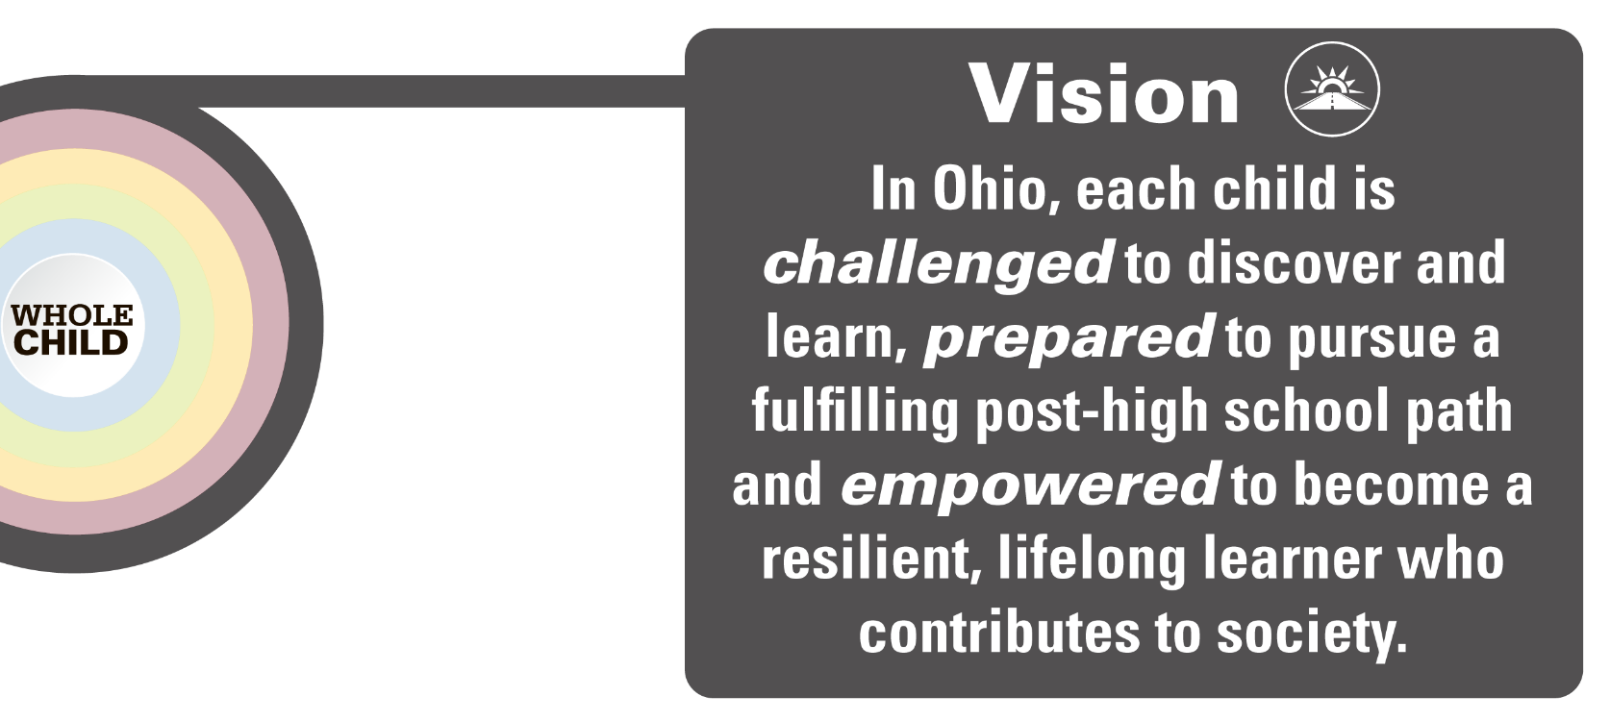
Each Child, Our Future
Notes:
Vision graphic – Because the text is large and inviting, be aware when planning narration and accompanying text that there will be a natural inclination by the viewer to “tune out” momentarily while reading the Vision statement.

Slide 23
Each Child, Our Future
Notes:
This is the first of two slides featuring the One Goal.
One possible use of this graphic is to display it while narrating the verbiage of the four elements.
Display this graphic no larger than shown here – it also can be scaled down – see examples on Slides 15+
It currently is physically aligned with second graphic on next slide

Slide 24
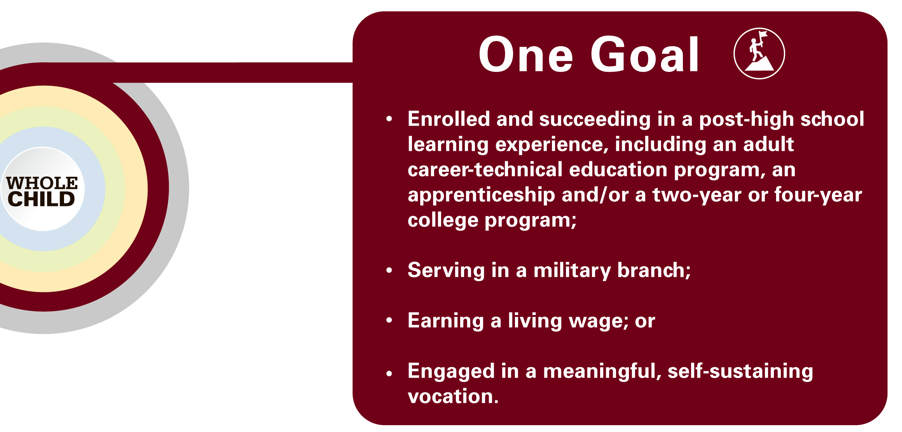
Each Child, Our Future
Notes:
This is the second of two slides concerning the One Goal.
One possible use of this graphic is to display it illustratively after displaying first part.
WARNING – Be aware of the large amount of type on this graphic. Many viewers naturally will be drawn to reading instead of absorbing your narration!

Slide 25
Problem Statement
Ohio has a diverse student body, where each child has unique postsecondary aspirations.
Diverse career aspirations, one math pathway!
Notes:
However, traditionally there has only been one math pathways that leads through Algebra 2. Even though Ohio had a diverse student body where each child has unique postsecondary aspirations. There is a problem that even though there are diverse career aspirations, there is only one math pathway.

Slide 26
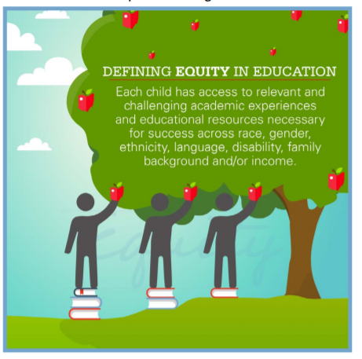
Algebra 2
VS.
Equity
Roadblock
Notes:
This law was put in place to promote equity, which it did for some students. More students than previously have access to the learning and thinking surrounding Algebra 2. however, the law which has provided access to some had been a road block to others who do not need the content of Algebra 2 for their future. All students need the level of thinking and reasoning required by Algebra 2. Not all students need the content embedded in Algebra 2.

Slide 27
Algebra 2
Not meeting the need for ALL students
Notes:
Therefore, although Algebra 2 is meeting the need for some students, it is not meeting the need for all students.

Slide 28
New Initiative: Strengthening Ohio’s High School Math Pathways

Slide 29
Equivalence
Mathematics units must include one unit of Algebra 2 or the equivalent of Algebra 2.
Notes:
We want to leverage the word “equivalent” that is in law and provide more guidance to districts about what it means to be equivalent.

Slide 30
Equivalence
Equivalent thinking and reasoning but NOT equivalent content
Ohio Secondary and Postsecondary Math Faculty have come together to define rigor which is the basis of creating equivalent courses.

Slide 31
Rigor
It has been decided that equivalent refers to the level of rigor and reasoning, not content. There are many branches of mathematics that are equally rigorous but have different content focuses. All equivalent courses should have the same level of rigor and reasoning that are needed to be successful in an entry-level, credit-bearing postsecondary mathematics course.
Ohio has defined rigor as the following:
“Students use mathematical language to communicate effectively and to describe their work with clarity and precision. Students demonstrate how, when and why their procedure works, and why it is appropriate. Students can answer the question, ‘How do we know?’”

Slide 32
Goals of Initiative
Ohio needs to develop pathways for high school mathematics that provide a seamless transition to a student’s postsecondary aspirations.
To promote equity, any courses that are created should be equally rigorous to the traditional math pathway.
Pathways should be relevant to a student’s future career goals. Not only will relevant courses help a student achieve their goals, but they will also create more buy-in from the students and help develop a positive math identity.
Pathways should also be flexible in case a student changes his or her mind about his or her future plans.
Pathways should be coherent with pathways in higher education to provide students with a seamless transition.
Notes:
The goal of this initiative is to develop new high school math pathways that provide a seamless transition to a student’s postsecondary aspirations. To accomplish this goal, the pathways must be rigorous, relevant to a student’s future career goals, flexible to allow students to shift between pathways, and coherent with the pathways in higher education.

Slide 33
What this initiative is NOT about
Changing graduation requirements
Reducing rigor
Tracking
Notes:
This initiative is not about: changing graduation requirements, reducing rigor, or tracking. It is about working to give more guidance to schools surrounding what should be determined as Algebra 2 equivalency.

Slide 34
What is this initiative about?
Relevance
Equity
Rigor
Math Identity
Student Success!!
Notes:
This initiative is about relevance, equity, rigor, math identify, student success.

Slide 36
Math Pathways
ALL Pathways are college preparatory
Notes:
Check on updated version

Slide 37
Descriptions of Courses
Course | Description
Statistics and Probability | In-depth study of probability, data analysis, and statistics including applying the concept of random variables to generate and interpret probability distributions, transforming data to aid in interpretation and prediction, and testing hypotheses using appropriate statistics
Quantitative Reasoning | Application of mathematics skills such as algebra to the analysis and interpretation of quantitative information (numbers and units) in a real-world context to make decisions that are relevant to daily life. Critical thinking is its primary objective and outcome.
Data Science | Data Science is a blend of various tools, algorithms, and machine learning principles with the goal to discover hidden patterns from raw data. The difference between data science and statistics is that where statistics focuses on explaining the data, data science focuses on using data to make predictions and decisions.
Discrete Math | The study of mathematical properties of sets and systems that have a countable number of elements including applications of systematic counting techniques and algorithmic thinking to represent, analyze, and solve problems.

Slide 38
Why these courses?
Statistics & Probability
It aligns to a primary higher-education math pathways course.
There is a need for a statistically literate society.
Quantitative Reasoning
It aligns to a primary higher-education math pathways course.
The reasoning and communication around quantitative information is what is needed in both higher education math courses and careers.
Students positively respond to the pedagogy underlying the course.
Data Science Foundations
There are many, many emerging jobs around big data requiring various levels of education and this course exposes students to foundational concepts of data science.
With the rise of big data, understanding data is essential for citizenship and to understand our world.
It aligns to a higher-education math pathways course.
Note: Students who want to pursue a Data Science degree requiring Calculus should take Algebra 2 as a follow-on course.

Slide 39
Why these courses?
Discrete Math/ Computer Science
There are many, many jobs in computer science and technology and students need exposure to these concepts.
More students will have access to computer science concepts because math teachers can teach the course.
By Ohio law students can use Advanced Computer Science to satisfy the Algebra 2 curricular requirement. However, Advanced Computer Science does not need to contain any advanced mathematics.
Most jobs in computer science and technology need some knowledge of advanced mathematics and computational thinking.
Discrete Math is the mathematics of computer science. Integrating Discrete Math into a computer science course gives students the reasoning they need to be successful in a computer science field.
Note: Students who want to pursue a computer science major requiring calculus should also take Algebra 2 in tandem with AP Computer Science A as follow-on courses.

Slide 40
Equity
Students choose pathways based on their future aspirations. Students are NOT placed based on perceived preparation levels.

Slide 41
Tre is undecided about his future. He likes fixing things but has not always had positive experiences with math.
The electronics area has always fascinated Mia but she doesn’t take an interest in math while at school.
Hana is undecided about her future but has always held a passion for English language arts.
Noah loves art and would like to pursue it as a future career.
Year Three
He takes a quantitative reasoning class and his interest in math grows when it is applied to the real world. Tre would like to pursue the engineering field.
Year Three
Mia takes a quantitative reasoning class and finds out that she really likes math when it is connected to real-world applications.
Year Three
While she is undecided, Hana elects to take a quantitative reasoning class.
Year Three
He takes quantitative reasoning and is amazed how math connects to art. He wants to major in graphic design.
Year Four Tre decides to take Algebra 2 and move into the calculus-based STEM path.
Year Four She decides to pursue an associate degree in engineering technology and takes College Credit Plus Technical Math 1.
Year Four Hana becomes more interested in social work, so she takes AP Statistics and Probability.
Year Four Noah takes a College Credit Plus quantitative reasoning class for dual credit.

Slide 42
Changing from A STEM to a Non-STEM Major
Key Findings from National & State Studies
Of students who entered four-year Ohio public colleges in fall 1998, most (95%) students intending to major in non-STEM fields stayed in non-STEM fields with only 5% changing to STEM majors (Bettinger, 2010).
An analysis of first-time students enrolled in postsecondary education examined student entrance, persistence, and attainment in STEM fields from 1995 to 2001 (Chen, 2009). The study found 36% of intending STEM students changed their majors to non-STEM fields and 7% of intending non-STEM students changed their majors to STEM fields.

Slide 43
Changing from A STEM to a Non-STEM Major
Key Findings from National & State Studies
Enrollment and completion data from the National Student Clearinghouse from 2004 to 2010 revealed that of the 34,616 students who graduated with a STEM degree, only 17% had originally intended to pursue a non-STEM major (Eagan, Hurtado, Figueroa, & Hughes, 2014).
“The evidence from these studies overwhelmingly shows that the vast majority of students who start in a non-STEM field will remain in a similar field. Therefore, institutions should design normative practice of mathematics pathways to serve the needs of the greatest number of students possible and ensure that appropriate options exist for students who change to STEM majors.”
https://dcmathpathways.org/sites/default/files/resources/2018-01/STEM-transfers-brief%5B1%5D.pdf

Slide 44
Proposed Timeline
Fall 2020
Course Development
Fall 2021
The initiative is launched on the website.
Quantitative Reasoning and Data Science Foundations are piloted.
Fall 2022
Schools implement pathways and Algebra 2 equivalency courses.
Computer Science/Discrete Math piloted.
Quantitative Reasoning and Data Science Foundations Pilots are expanded in phases across the state.

Slide 45
Toolkits
Counselors
Administrators
Parents
Teachers
*

Slide 46
Contact Information
Name | Phone | Email
Annie Cannelongo | 614-644-5905 | Anna.Cannelongo@education.ohio.gov
Annika Moore | 614-728-2373 | Annika.Moore@education.ohio.gov
Brian Bickley | 614-644-6814 | Brian.Bickley@education.ohio.gov
Yelena Palayeva | 614-387-7561 | Yelena.Palayeva@education.ohio.gov

Slide 47
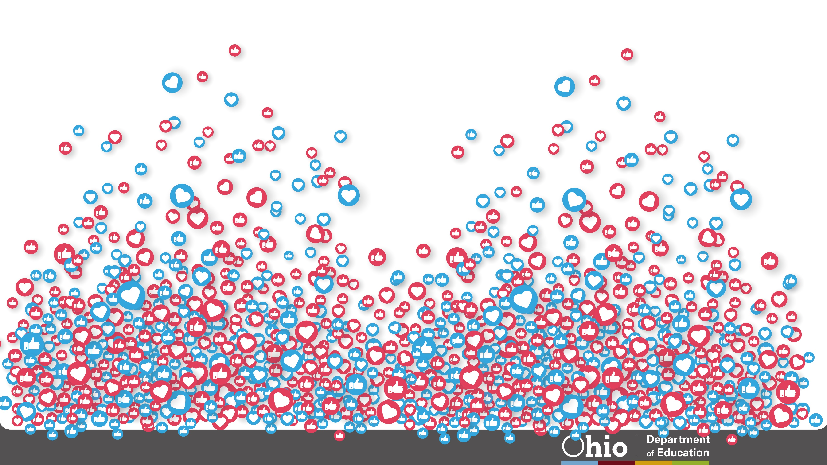
@OHEducation

Slide 48
Share your learning community with us!
#MyOhioClassroom
Celebrate educators!
#OhioLovesTeachers

