Slide 1
Math Pathways Update
January 11, 2023

Slide 2
Welcome and Introductions

Slide 3
What is the Why?
Notes:
The Math Pathways Initiative is a bridge between the third and fourth mathematics courses to college and career readiness.

Slide 4
Jobs Landscape
Notes:
Over the next couple slides we are going to talk briefly about the job landscape, what’s going on in Higher Education, and the high school landscape.

Slide 5
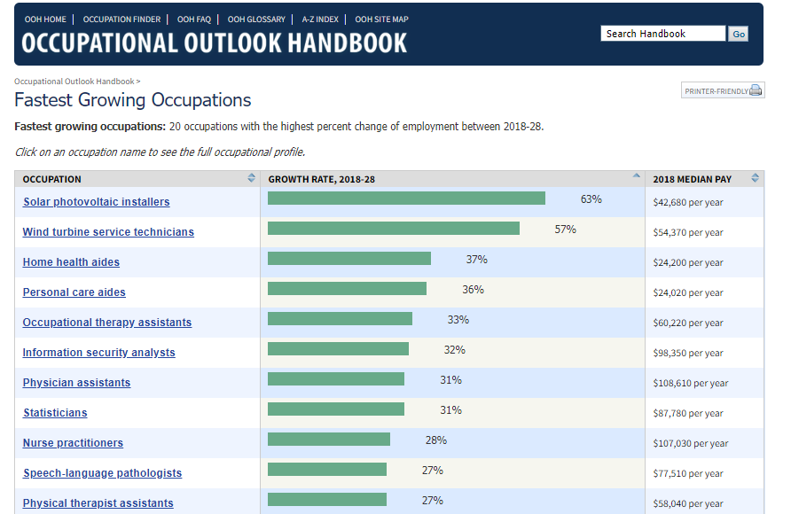
2018-2028
Notes:
The job market has changed greatly in the past 2-years as a direct result of the COVID-19 Pandemic. But, prior to the pandemic, there was already a noticeable change in the job market taking place. Here we have some data from the U.S. Department of Data showcasing the “Fastest Growing Occupations”. In this slide, want to draw your attention to a couple of career fields. I want you to look at the specifically, the ‘Information Security Analysts’ and the ‘Statisticians’ fields. These are not only in demand, but they are also high paying careers. For example, the median pay of a Statistician in 2018 was over $87,000 per year while the median for an Information Security Analyst at the same time was over $98,000 per year. Both careers have an anticipated growth outlook greater than 30% from 2018-2028.

Slide 6
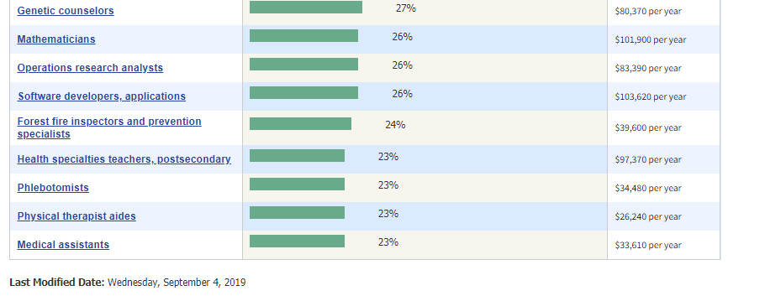
From U.S. Bureau of Labor Statistics: https://www.bls.gov/ooh/fastest-growing.htm
Notes:
I also want to draw your attention to a couple other fast-growing careers such as “operations research analyst” and “software developers, applications”. I want to highlight these career fields because of their commonality. These are all fast-growing careers that involve math but may not always be the first ones that come to mind when you think about ‘fast growing, in-demand careers or jobs that involve math’. Another commonality among the jobs I just listed is they all involve big data, statistics, and computer science. I wanted to show you this to get you thinking about these possible jobs and careers that are in demand with attractive median salaries that all involve math and may be of interest to high school students when they explore potential career fields.

Slide 7
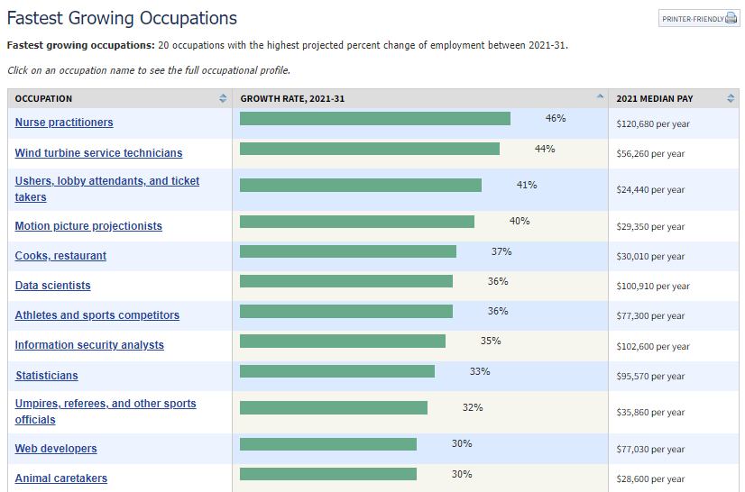
2021-2031
(Projections Updated Sept. 2022)
From U.S. Bureau of Labor Statistics: https://www.bls.gov/ooh/fastest-growing.htm
Notes:
Statisticians is projected to growth 35% over the next decade. This is up almost 4% from 2018 when the anticipated growth was 31%. Also, the median salary has increased by more than $7,700. Meanwhile, Information Security Analysts, is up another 1% from 2018 with the median income. The median salary for the position has increased by over $4,200 in the last four-years.
I also want to draw your attention to a couple other fast-growing careers such as “operations research analyst” and “software developers, applications”. I want to highlight these career fields because of their commonality. These are all fast-growing careers that involve math but may not always be the first ones that come to mind when you think about ‘fast growing, in-demand careers or jobs that involve math’. Another commonality among the jobs I just listed is they all involve big data, statistics, and computer science. I wanted to show you this to get you thinking about these possible jobs and careers that are in demand with attractive median salaries that all involve math and may be of interest to high school students when they explore potential career fields.

Slide 8
Notice the emphasis on Data and Computers
Notes:
This slide contains data from the World Economic Forum that identifies the “Top 10 Emerging Jobs by 2022” and the “Top 10 Declining Jobs by 2022”. In the list of “Top 10 Emerging Jobs” you will notice they are all involve computer science, big data, and statistics. I show you these slides because I want to illustrate to you where the research is showing the job market is now and will be heading in the future. In both cases, you will notice computer science, big data, and statistics are among the highly sought-after topics of mathematical understanding employers are looking for. This will be important to keep in mind as we continue on through the rest of the presentation.

Slide 9
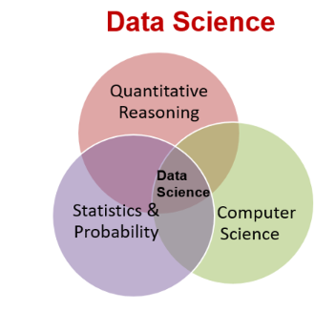
Data Science Foundations
Students will
Reason with and think critically about data in all forms.
Develop their understanding of
data analysis, sampling, correlation/causation, bias
uncertainty, probability, modeling with data
Make and evaluate data-based arguments
Learn the power of data in society and more.
Notes:
Touch on how moving away from UCLA and R we have enough trainers!!! No need to say anything about it.

Slide 10
Why Data Science Foundations?
Student Choice Student buy-in to content Expressive and Creative | Career Options Opens up options that students may not be aware of Often students find that they have an interest in math that they were unaware existed
Teacher Evaluation - OTES 2.0 Course fulfills major domains in the teacher evaluation rubric Opportunities for differentiation, questioning, feedback, and community involvement are built into the curriculum | Assessment Options Rubric based/standard based assessments Projects, labs, Google forms, and traditional assignments and assessments are possible in this course
Notes:
This will be conversational.
Student Choice:
· The math pathways is one of the first times that students have been provided an opportunity for choice in their math curriculum. By giving students choice in their courses, it increases student buy-in to the content. Data science is a great option for students because they don’t feel like it’s a math class. It is conversational, collaborative, and has a large component of writing and creativity. Students who enjoy English, Journalism, and the arts like the aspects of this class that encourage creativity and expression. Students see a reason for the curriculum – I’ve never been asked “When am I ever going to use this” in the data science class!
Career Options
· Many times students don’t know what they don’t know. While there are some students that enjoy algebra and the traditional path, it doesn’t speak to everyone, and often times those students incorrectly associate that dislike with not liking math, rather than just one area of math. I’ve had many students say that they have realized it’s not math that they don’t like, it was a specific type of math. Data science opens up options for students, often to jobs, majors, and certificate programs that they didn’t even know existed before, and I have had students change their future plans after experiencing excitement about data.
OTES 2.0
· While taking on new curriculum as a teacher can be scary, especially if it is an evaluation year, Data Science fits right into the areas of OTES 2.0. The curriculum is designed for student centered learning through choice, reflection, collaboration, timely feedback, and even community involvement. The rigorous curriculum allows for high level questioning, purposeful interaction, and differentiated instruction and assessment.
Assessment
· Assessments in this course are varied. Often times there are not single correct answers that are seen in a traditional math course. Grading is often completed on a rubric to allow for the student choice involved in all large assignments. Projects, called practicums, are at the end of each unit section, and are large assessments opportunities in the course. Smaller assessment opportunities would be lab reports, which are written out by students as the labs are completed, lesson assignments within the curriculum as new skills are taught and opportunities are given to be practiced, as well as entrance and exit tickets. Often times Google Forms can be used as quizzes. While traditional written quizzes and tests can be used, the content doesn’t lend itself to this type of assessment all the time, so thinking about assessment in the broader sense is necessary to assess the standards being learned.

Slide 11
Implementation
Although this is a course addition, it does not change FTE’s because it is the same number of students needing to be scheduled into a math class. It changes the number of sections of other courses, rather than increasing overall.
Consider “hand-picking” students for the course the first year based on a criteria for success
Year 2 students can begin self-scheduling - but be sure to educate your teachers and counselors on the pathways and how to best mentor students to choose their path!
Notes:
Implementing a new program can be scary – especially when it’s new for the teacher, administrator, and possibly the district. But getting started doesn’t have to be a complex puzzle. The first thing to remember is that this is not impacting FTE’s for teachers – the same number of students are in the building needing to take a math class. Since this is an algebra 2 equivalent class, the first year my school implemented, we decreased the number of sections of algebra 2 by one to allow for my one section of Data Science. If the data science teacher is already an algebra 2 teacher, this switch is easy to do for teacher schedule. In my situation, I didn’t teach algebra 2, so one of our algebra 2 teachers took one section of one of my other preps, which freed up the period for me to teach data science, and decreased the algebra 2 sections.
The first year, consider “hand picking” students. Do you have students that may be earmarked already to have great difficulty in algebra 2 – maybe they are credit deficient from past years, or took more than one year to pass algebra 1, maybe students who have expressed a dislike for algebra based math but show interest in computers, design, English, the arts, or other areas. Do you have students in career center programs that are already using data and this would be a natural blend with their interest? Do you have students who work really hard at school but struggle to complete homework? Be careful to not make this a dumping ground though – students with poor attendance, or a refusal to work attitude will not be successful in this collaborative hands-on class where they are active participants each day during their class period! A student who “may not pass algebra 2” might be a good fit for this class, but may not be – it’s all dependent on the reason behind that projection and how they will respond in this new environment. Students must be willing to try and work with others – and understand that nothing in this class can be “googled” or “photomathed”.
After the first year, we opened scheduling up to student choice. We educated our teachers on the math pathways, how courses are aligned to student interest and outcomes, and what is best for kids. Teachers were able to have conversations with students during the course recommendation process to determine what pathway best met their interest and future plans. Again – this didn’t change FTE’s! Although my sections grew for Data Science, we decreased in other areas and balanced out to the same overall number of sections requested.

Slide 12
What about SWDs?
This course is for everyone! All are successful!
Areas to consider:
Need to update math goals to be applicable to the data science content
Extra time built in class rather than extension to work on deadline meeting
Co-taught inclusion models can be successful
Notes:
Is this class suitable for students on IEP’s or 504’s? YES! In the two years that I have taught this class, over half of my students have been on some sort of education plan. I have taught students from cognitively impaired through gifted in math, and all students are able to thrive in the environment and learn. There are a few things to point out, specifically with students on IEP’s that have math goals. Traditionally these goals would be linked to their math curriculum, and these often need to be modified from an algebra-based content to the statistics and data content. Since this would require an amendment, it is important that counselors and intervention specialists work to identify students that may need these modifications to be in compliance for the new school year.
The most common accommodation provided to students is extended time. With the high population of students with this need in my class I have chosen to take care of this accommodation within the classroom. On any project I provide double time in class. Students who finish early have extension opportunities that they are offered. This also allows students to meet a deadline, which is an important career skill needed for success after high school. All assignments, projects, and assessments (including my midterm) are open note. In the professional world, searchable things are always able to be found, but it is what can be done with that which is the task. That is how assessments are designed in this class as well – the assessment is of the analysis, the collaboration, the presentation, and the questioning are executed, not if they memorized a random fact. This is another way that students who are on plans find great success – this takes “test anxiety” out of the picture because there isn’t memorization, it’s all in how deep you can take the analysis to find meaning. The idea that there are not “right answers” is also empowering to all students, not just those on plans, because they realize that they can be successful and “right” even if that has been an area of struggle in the past. These areas of “win” help these students thrive and have buy in from early in the year and I have seen them truly blossom as learners in this alternative math environment.
Data science can be a successfully implemented inclusion class, but I would suggest having the intervention specialist receive the same training right alongside the classroom teacher so that they can have a strong co-taught environment, and both have a deep content understanding for the instances where modification is needed. I have had an educational aide for the past two years that assists a few of my students, and that model has also worked to have a support adult in the room while the class as a whole is not inclusion.

Slide 13
Discrete Math / Computer Science

Slide 14
Graduation Requirements Updates

Slide 15
Honors Diplomas
Notes:
High school students can gain state recognition for exceeding Ohio’s graduation requirements through an honors diploma. Students challenge themselves by taking and succeeding at high-level coursework and in real-world experiences.
To be eligible for an honors diploma, students must complete units, or credits, in specific subjects. For mathematics, the requirement is that students must take algebra I, geometry, algebra II (or equivalent), and one other higher-level course OR a four-course sequence that contains equivalent or higher content. As more districts offer the High School Math Pathways courses as Algebra 2 equivalents, know that any of these A2E these courses can be used to satisfy the mathematics requirements for an Honors Diploma regardless of the order in which the student earns their four credits. For example, a student can satisfy the mathematics credit requirements for an Honors Diploma by taking A1, G, DM/CS, and then A2. Another example, the student can take A1, G, DSF, and then a Statistics and Probability course. The same goes for a student who takes M1, M2, M3, and AQR. The list goes on, but hopefully you can see the sequential themes.
In the honors diploma requirements, students can use Advanced Placement, International Baccalaureate, College Credit Plus and Credit Flexibility coursework to meet the unit requirements of an honors diploma. A single course can meet multiple criteria if it fits under multiple subject areas.
Students also can design their own independent study courses through Credit Flex. This requires that someone with proper licensure in the subject area must teach or co-teach the courses used for an honors diploma.

Slide 16
Ohio’s Graduation Requirements for
Classes of 2023 and Beyond

Slide 17
Graduation Requirements for Classes of 2023 and Beyond
Course Completion
Competency Demonstration
Readiness Demonstration
Notes:
Ohio Revised Code section 3313.618
Students in the classes of 2023 and beyond (those who entered grade 9 on or after July 1, 2019) are now required to meet a new set of graduation requirements. These new graduation requirements consist of three key components:
1. Course Completion Students will satisfy Ohio’s curriculum requirements and any additional local requirements. Students will complete the state minimum 20 units, with specific units required in each content area.
2. Competency Demonstration Students will demonstrate competency in the foundational areas of English language arts and mathematics or through alternative demonstrations, which include College Credit Plus, career-focused activities, their ACT or SAT scores, or military enlistment.
3. Readiness Demonstration Students will demonstrate readiness for their post-high school paths by earning two diploma seals that allow them to demonstrate important foundational and well-rounded academic and technical knowledge, professional skills, and leadership and reasoning skills.

Slide 18
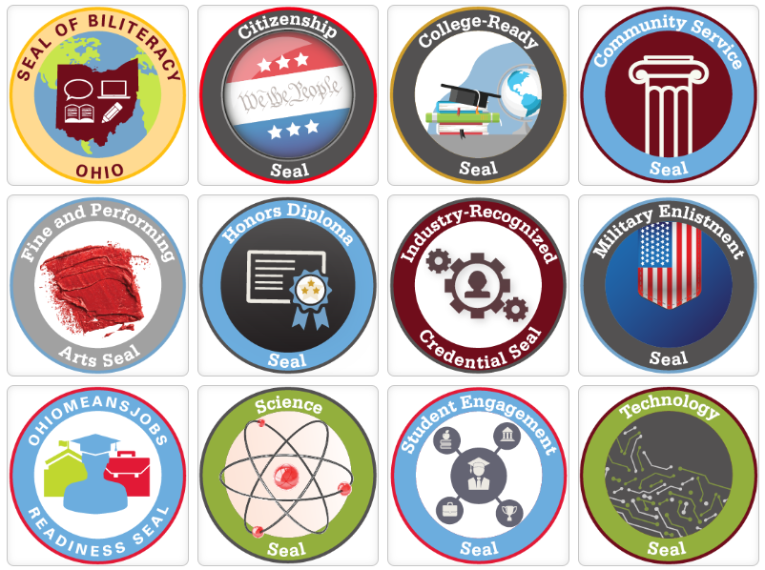
Readiness Demonstration
Notes:
In addition to fulfilling curriculum requirements and meeting the competency requirements listed above, students also must show they are prepared for their next steps after high school. State law created 12 diploma seals for students to demonstrate academic, technical and professional readiness for careers, college, the military or self-sustaining professions. Each seal allows students to demonstrate knowledge and skills essential for future success in their chosen post-high school paths. Students will demonstrate readiness by earning at least two diploma seals, one of which must be state defined. Seals help students develop an array of critical skills that are valuable to them as they transition to the next steps after high school. Schools should consider encouraging students to pursue seals that meet their individual interests and skills. Graduation planning will be an important step in supporting students in earning their seals.

Slide 19
Honors Diploma Seal
Notes:
Guidelines for Schools and Districts
Under Ohio’s long-term graduation requirements, students must demonstrate readiness as a part of their pathway to earning a high school diploma. To demonstrate readiness, students must earn at least two seals, one of which must be a state-defined seal. The Honors Seal is a state-defined seal. Students will earn the Honors Seal by satisfying the requirements for one of six honors diplomas.
To receive the Honors Seal, students must earn one of six honors diplomas outlined below:
Academic Honors Diploma;
Career-Tech Honors Diploma;
International Baccalaureate Honors Diploma;
STEM Honors Diploma;
Arts Honors Diploma;
Civics and Social Sciences Honors Diploma.
All honors diplomas except for the STEM Honors diploma require a minimum of 4 credits of mathematics. The STEM Honors diploma requires a minimum of 5 credits.

Slide 20
Technology Seal
Notes:
Transition slide

Slide 21
Technology Seal
Requirements:
Students can earn the Technology Seal in one of three ways:
Advanced Placement or International Baccalaureate; or
Earning a “B” or higher in an approved College Credit Plus course; or
Completing a course offered through the student’s district or school that meets guidelines set by the Ohio Department of Education
Notes:
Guidelines for Schools and Districts
Under Ohio’s long-term graduation requirements, students must demonstrate readiness as a part of their pathway to earning a high school diploma. To demonstrate readiness, students must earn at least two seals, one of which must be a state-defined seal.
The Technology Seal is a state-defined seal. Students who earn Ohio’s Technology Seal will understand the global impact of technology and use it to design solutions and communicate ideas. Students will earn the Technology Seal by demonstrating knowledge and skills on Advanced Placement and International Baccalaureate courses and tests, through College Credit Plus coursework or by completing a qualifying technology course.
Technical Seal – General Requirements Ohio Revised Code Section 3313.6114(C)(7)
To earn Ohio’s Technology Seal, students must satisfy at least one of the requirements below:
Earn a score equivalent to proficient on an appropriate Advanced Placement or International Baccalaureate test; or
Earn a “B” or higher in an appropriate College Credit Plus technology course; or
Complete a technology course that meets criteria established by the Ohio Department of Education (below).
LOCAL TECHNOLOGY COURSE GUIDELINES
A technology course that qualifies students to earn Ohio’s Technology Seal must meet all the following guidelines:
Address content that is at an advanced level (determined locally) and aligned to at least one of the following sets of Ohio high school standards:
Ohio’s Learning Standards for Technology;
Ohio’s Learning Standards for Computer Science; or
Ohio’s Career Field Technical Content Standards.
Have a technology focus that engages students in the following:
Applying technology tools and processes in real-world situations to effectively design solutions, solve problems and accomplish goals; and
Critical analysis of the impact of technology development and use, including ethical, legal and global impacts.
Address technology knowledge and skills critical to college and workforce readiness;
Provide a full-year credit or the equivalent (for example, two individual semester courses or credit earned through credit flexibility);
Demonstrate knowledge and skills developed during the course through a culminating product (for example, an electronic portfolio or design brief) that includes:
Documentation of a student’s learning process with evidence of progress made during the course;
A final course product of original student work;
Student reflections; and
Student self-evaluation and evaluation by the course instructor.
https://education.ohio.gov/Topics/Ohio-s-Graduation-Requirements/Ohio%E2%80%99s-Graduation-Requirements/Graduation-Seals/Technology-Seal-1#FAQ4689

Slide 22
Technology Seal Local Technology Course Guidelines
A technology course that qualifies students to earn Ohio’s Technology Seal must meet all the following guidelines:
Address content that is at an advanced level (determined locally) and aligned to at least one of the following sets of Ohio high school standards:
Ohio’s Learning Standards for Technology;
Ohio’s Learning Standards for Computer Science; or
Ohio’s Career Field Technical Content Standards.
Have a technology focus that engages students in the following:
Applying technology tools and processes in real-world situations to effectively design solutions, solve problems and accomplish goals; and
Critical analysis of the impact of technology development and use, including ethical, legal and global impacts.
Notes:
LOCAL TECHNOLOGY COURSE GUIDELINES
A technology course that qualifies students to earn Ohio’s Technology Seal must meet all the following guidelines:
Address content that is at an advanced level (determined locally) and aligned to at least one of the following sets of Ohio high school standards:
Ohio’s Learning Standards for Technology;
Ohio’s Learning Standards for Computer Science; or
Ohio’s Career Field Technical Content Standards.
Have a technology focus that engages students in the following:
Applying technology tools and processes in real-world situations to effectively design solutions, solve problems and accomplish goals; and
Critical analysis of the impact of technology development and use, including ethical, legal and global impacts.
Address technology knowledge and skills critical to college and workforce readiness;
Provide a full-year credit or the equivalent (for example, two individual semester courses or credit earned through credit flexibility);
Demonstrate knowledge and skills developed during the course through a culminating product (for example, an electronic portfolio or design brief) that includes:
Documentation of a student’s learning process with evidence of progress made during the course;
A final course product of original student work;
Student reflections; and
Student self-evaluation and evaluation by the course instructor.
https://education.ohio.gov/Topics/Ohio-s-Graduation-Requirements/Ohio%E2%80%99s-Graduation-Requirements/Graduation-Seals/Technology-Seal-1#FAQ4689

Slide 23
Technology Seal Local Technology Course Guidelines (cont.)
Address technology knowledge and skills critical to college and workforce readiness;
Provide a full-year credit or the equivalent (for example, two individual semester courses or credit earned through credit flexibility);
Demonstrate knowledge and skills developed during the course through a culminating product (for example, an electronic portfolio or design brief) that includes:
Documentation of a student’s learning process with evidence of progress made during the course;
A final course product of original student work;
Student reflections; and
Student self-evaluation and evaluation by the course instructor.
Notes:
LOCAL TECHNOLOGY COURSE GUIDELINES
A technology course that qualifies students to earn Ohio’s Technology Seal must meet all the following guidelines:
Address content that is at an advanced level (determined locally) and aligned to at least one of the following sets of Ohio high school standards:
Ohio’s Learning Standards for Technology;
Ohio’s Learning Standards for Computer Science; or
Ohio’s Career Field Technical Content Standards.
Have a technology focus that engages students in the following:
Applying technology tools and processes in real-world situations to effectively design solutions, solve problems and accomplish goals; and
Critical analysis of the impact of technology development and use, including ethical, legal and global impacts.
Address technology knowledge and skills critical to college and workforce readiness;
Provide a full-year credit or the equivalent (for example, two individual semester courses or credit earned through credit flexibility);
Demonstrate knowledge and skills developed during the course through a culminating product (for example, an electronic portfolio or design brief) that includes:
Documentation of a student’s learning process with evidence of progress made during the course;
A final course product of original student work;
Student reflections; and
Student self-evaluation and evaluation by the course instructor.
https://education.ohio.gov/Topics/Ohio-s-Graduation-Requirements/Ohio%E2%80%99s-Graduation-Requirements/Graduation-Seals/Technology-Seal-1#FAQ4689

Slide 24
Integrated Coursework and Simultaneous Credit
Notes:
State law (3313.603 (I)) allows districts, schools, community schools and chartered nonpublic schools to integrate content standards from multiple subject areas into a single course for which students can earn simultaneous credit. The Department recently updated the Integrated Coursework and Awarding Simultaneous Credit Guidance for Schools. Check out the updated document for more information. The link to the document is below.
https://education.ohio.gov/getattachment/Topics/Career-Tech/Integrated-Coursework-And-Awarding-Simultaneous-Cr/Integrated-Coursework-and-Awarding-Simultaneous-Credit-Guidance-for-Schools.pdf.aspx?lang=en-US
WHY IT’S GOOD FOR YOUR STUDENTS?
Meet multiple learning expectations through a single course
Experience real-world applications for authentic learning
WHY IT’S GOOD FOR YOUR DISTRICT?
More dynamic learning environments
Students can meet graduation requirements faster

Slide 25
Traditional Credit (Separate Courses)
Math Course
Discrete Mathematics
Discrete Mathematics
EMIS Code 111300
Computer Science with In-depth Study
EMIS Code 290250
Computer Science Course
Computer Science
Notes:
In a traditional course sequence, students take courses independently of one another. Here is an example using discrete math and computer science.

Slide 26
Simultaneous Credit with Co-teachers
1
Discrete Mathematics
Discrete Mathematics
EMIS Code 111300
Computer Science
Computer Science
EMIS Code 290250
2
Notes:
Under a co-teacher or co-taught model, both teachers provide direct instruction to students at different times in the course. This can be done in whatever makes sense for the instruction. For example, teachers can alternate days, split time during an instructional period, combine periods into a block instructional format, take turns as the lead teacher for a few days at a time before switching off, etc. There not one-way to do this.
Under this co-taught model, Teacher “1” is properly certified 7-12 Mathematics teacher. Teacher “1” evaluates the student understanding of the discrete mathematics content in the course. The district uses the Discrete Mathematics EMIS Course code 111300 to record credit earned in the course.
Next, Teacher “2” is either:
A properly certified in computer science;
Holds a computer technology endorsement and have successfully passed the computer science Ohio Assessments for Educators (OAE) exam (currently OAE #054); or
Holds a full teaching license in any area and add computer science through a supplemental pathway that includes passing the computer science OAE exam.
Additional Licenses-There are two additional licenses available to individuals who do not hold a professional or alternative license:
• The 12-hour Teaching Permit allows an individual to teach up to 12 hours a week. Applicants must hold a baccalaureate, master's or doctoral degree or show evidence of significant experience, verified by the employing district, in the subject to be taught.
• The 40-hour STEM School Teaching Permit allows an individual to teach up to 40 hours a week at a Science Technology Engineering Math (STEM) designated school. Applicants must hold a
baccalaureate, master's or doctoral degree or show evidence of significant experience, verified by the employing district, in the subject to be taught.
Teaching Advanced Placement (AP) Computer Science Courses-To teach an AP computer science course, in addition to holding a proper license, an individual must complete a professional development program endorsed or provided by the organization that creates and administers national advanced placement examinations. For this purpose, the individual may complete the program at any point during the
calendar year.
In this example, Teacher “2” is evaluates the student understanding of the computer science content in the course. The district uses the Computer Science EMIS Course code 290250 to record credit earned in the course.

Slide 27
Simultaneous Credit with 1-Teacher
Discrete Mathematics
Discrete Mathematics
EMIS Code 111300
1
Credit Flex:
Computer Science
2
Notes:
In this example, only one teacher provides most (if not all) of the instruction. In this model, both teachers co-plan the course even though only one of them would provides the direct instruction. Both teachers would contribute to the design of the course assessments or evaluation tasks. The same Teacher “1” as the previous slide(s) is teaching a Discrete Mathematics/Computer Science course. Teacher “1” teaches the course and evaluates the students on the discrete mathematics content of the course. Meanwhile, a properly certified Computer Science teacher in the district evaluates the students on the computer science standards; including the Advanced Computer Science standards in the course. Under Integrated Coursework for Simultaneous Credit, the district can award BOTH a mathematics credit for discrete mathematics and a computer science credit for computer science for the same course.

Slide 28
Credit Flexibility
Notes:
At this point, we want to share with you an idea for how you can apply Credit Flexibility to offer courses to your students and provide more local options.

Slide 29
Credit Flex with Non-Building Teacher
Teacher 1 Provides Instruction
Licensed Teacher 2 Evaluates
Notes:
Credit Flexibility reaches beyond earning traditional course credit to allowing credit to be earned toward graduation curriculum requirements through experiences meaningful to individual students. A Credit Flex can be written to include a distance learning or even an online learning model. Under either of these applications, the teacher providing the instruction in the course does not have to be a teacher in the building. Instead, the teacher could be a properly certified 7-12 mathematics teacher in the district. The teacher could be a properly certified 7-12 teacher from another district or a nearby ESC who is providing instruction in the course. In any of these cases, the Credit Flex Plan can be written to allow the teacher who does not work in the building to provide the instruction through a distance learning or online delivery model. Then a properly certified teacher in the school building evaluates the learning in the course. Under this application, a district who may have limited ability to offer a wide arrange of high school mathematics courses could expand its course offerings to allow more options to their students.

Slide 30
Questions

Slide 31
Thank you
Ohio Department of Education Math Pathways webpage:
bit.ly/odemathpathways

Slide 32
Contact Information
Name | Phone | Email
Annika Moore | 614-728-2373 | Annika.Moore@education.ohio.gov
Brian Bickley | 614-644-6814 | Brian.Bickley@education.ohio.gov
Yelena Palayeva | 614-387-7561 | Yelena.Palayeva@education.ohio.gov
Notes:
If after this presentation, you have any questions or would like more information on anything shared during the session, here is the contact information for the Math Team at the Department. For faster responses, please use email.

Slide 33
Math Pathways
Application Questions?
Tom Reed
reed@oesca.org

Slide 34
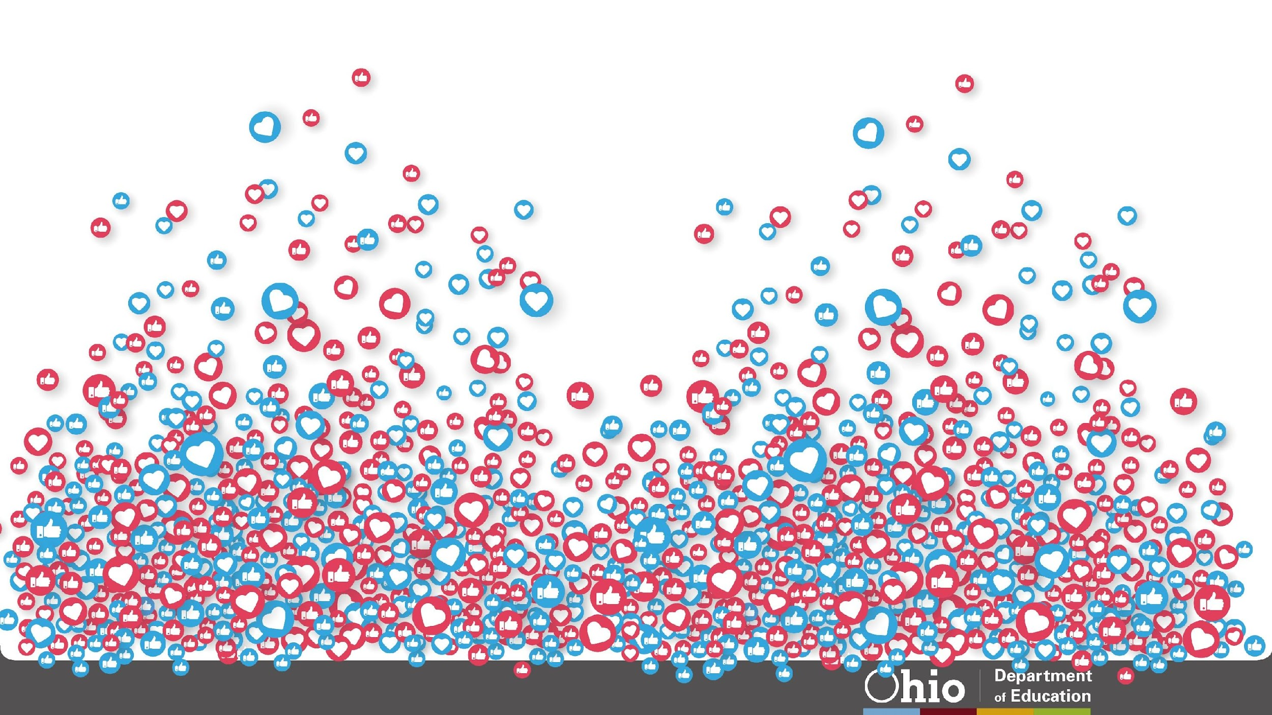
@OHEducation

Slide 35
Share your learning community with us!
#MyOhioClassroom
Celebrate educators!
#OhioLovesTeachers

