Slide 1
Welcome to the Ohio
High School Mathematics
Pathways Symposium
In the chat answer one of the following questions. Type the number of your question along with your answer:
What is your name? What brings you here?
What is your most used emoji?
InstructUp
Notes:
Erika and Chandra
Courtesy of https://museumhack.com/list-icebreakers-questions/

Slide 2
High Quality Instructional Materials
Ohio High School Mathematics
Pathways Symposium
Notes:
Erika

Slide 3
Instruction Partners Team
Erika Cook, Ph.D.
Sr. Managing Director of State Partnerships
Chandra Boone
Associate Director of Instructional Support
InstructUp
Notes:
Erika

Slide 4
About Instruction Partners
Instruction Partners works shoulder to shoulder (and screen to screen) with educators to support care and continued learning for students during the COVID-19 pandemic, from crisis through recovery, with a specific focus on supporting the needs of students in poverty, students of color, students learning English, and students with disabilities.
Notes:
Erika
One thing I really love about this team is we really are all content nerds who love working with and learning alongside of educators. We work shoulder to shoulder, and more recently screen to screen, with educators to support great teaching and accelerate student learning through ensuring equitable access to great instruction for our priority students.

Slide 5
Welcome
Kerry Martinez
Assistant Director
Office of Learning and Instructional Strategies
Brian Bickley
Yelena Palayeva
Mathematics Consultants
Office of Learning and Instructional Strategies
Notes:
ODE

Slide 6
Norms:
Be present and engaged
Strive for equity of voice
Challenge with respect
Stay solutions oriented
Embrace the challenge
Use student first language
Virtual Norms:
Unmute your mic to share out, but keep your mic muted otherwise to reduce background noise.
Treat the chat like a group conversation.
Take care of yourself as needed
InstructUp
Notes:
Chandra

Slide 7
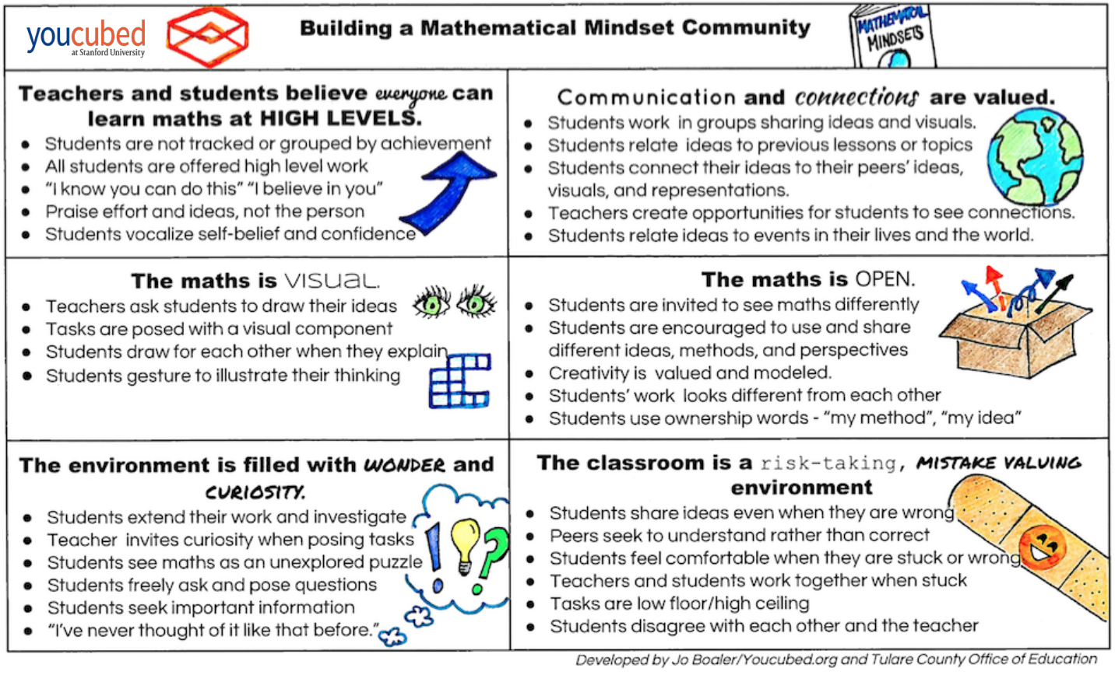
Norms
InstructUp
Notes:
Chandra Jo Boaler created these norms to support the learning of mathematics. tied to her research. Being that we are focusing on the adoption of HQIM for math, these norms are used to ground today’s work. Let’s take a moment to read over these norms.

Slide 8
Objectives
Participants will explore the tenets of HQIM and a rationale for the need.
Participants will apply their understanding of HQIM to identify components of effective mathematics curriculum.
Participants will be introduced to the Ohio Curriculum Support Guide.
#
InstructUp
Notes:
Chandra

Slide 9
Agenda
Timing |  | Topic |  | Description
5 minutes |  | Introductions & Welcome |  | Introduce teams and roles Describe the purpose of our time together
15 minutes |  | What is HQIM and their components? |  | Reflect on current curricula and the tenets of HQIM
15 minutes |  | Is it HQIM? |  | Look at an example of HQIM and non HQIM
5 minutes |  | Overview of Ohio Curriculum Support Guide |  | Introduction to the Ohio Curriculum Support Guide
5 minutes |  | Closing |  | Take a survey
InstructUp
Notes:
Chandra

Slide 10
The Case for High-Quality Instructional Materials
Notes:
Chandra

Slide 11
Equitable Access to High-Quality Curriculum Materials
47%
No Cohesive Curriculum
31% Career-Ready Curriculum
13% College-Ready Curriculum
8%
College and Career Ready Curriculum
InstructUp
Bromberg & Theokas, 2016.
Notes:
Chandra According to The Education Trust report “Meandering Toward Graduation” this is the data regarding the percent of high school graduates who were exposed to a college and career ready curriculum (8%). The report also noted that students of color and students facing poverty are less likely to experience a high-quality curriculum at all.
What are the implications of having no cohesive HQIM across 12 years of instruction?

Slide 12
Consequences of Not Having High-Quality Instructional Materials
InstructUp
“The Opportunity Myth” by TNTP, 2018.
Notes:
Chandra

Slide 13
“When students who started the year off behind grade level were given more grade-appropriate assignments, stronger
instruction, deeper engagement, and higher expectations, the gap between these students
and their higher achieving peers began to narrow substantially.”
“The Opportunity Myth” by TNTP, 2018.
Notes:
Chandra

Slide 14
Exploring Criteria of High Quality Instructional Materials
Explore the EdReports Review Criteria Indicators for High School Math.
Choose one of the following questions to answer and share it in the chat.
After exploring EdReports, answer the following. Please be prepared to share.
Which criteria from EdReports interested or excited you the most?
How does this compare to materials you’ve used in the past?
How do these criteria add to your definition of High Quality Instructional Materials?
Notes:
Chandra
Say: Take about 5 minutes to review these resources and be prepared to answer one of the following questions in the Chat.
Chandra Paste links in chat:
https://drive.google.com/file/d/1u5kgyEkOXEBK7q0o_SWF1JhUDiA7Id73/view

Slide 15
Criteria of High-Quality Instructional Materials: Mathematics
Gateway 1: Focus & Coherence
Gateway 2: Rigor & Mathematical Practices
Text here
Gateway 3: Usability
InstructUp
Source: EdReports, 2021
Notes:
Chandra
Gateway One: DO the materials assess grade-level content, give all students extensive work with grade-level problems to meet the full intent of the standards, and are they coherent and consistent with the standards?
Gateway Two: :Do the materials meet the CCSS expectations for rigor and mathematical practices? developing students’ conceptual understanding; procedural skill and fluency;
and engaging applications
Gateway Three: Do the materials support teachers to fully utilize the curriculum, understand the skills and learning of their students, and support a range of learner?
As we transition to looking more closely at HQIM, I want to bring our attention to Ed Report’s Review Criteria looking more closely at Gateway 2- Rigor and Mathematical Practices.

Slide 16
How Ohio Defines Rigor
Students use mathematical language to communicate effectively and describe their work with clarity and precision. Students demonstrate how, when and why their procedures work and why they are appropriate. Students can answer the question, “How do we know?”
Notes:
Chandra I want to ground us in OH Dept of Ed’s explanation of rigor to support the selection of HQIM. As the chart in the chat outlines, there are experiences that reflect rigor and those that do not. Two that stick out to me are: rigorous activities “are not always tidy, and can have multiple paths to possible solutions” and “require the memorization of rules and procedures without understanding”. Another thing to keep in mind is that rigorous lessons offer opportunities for students to reflect on their thinking.

Slide 17
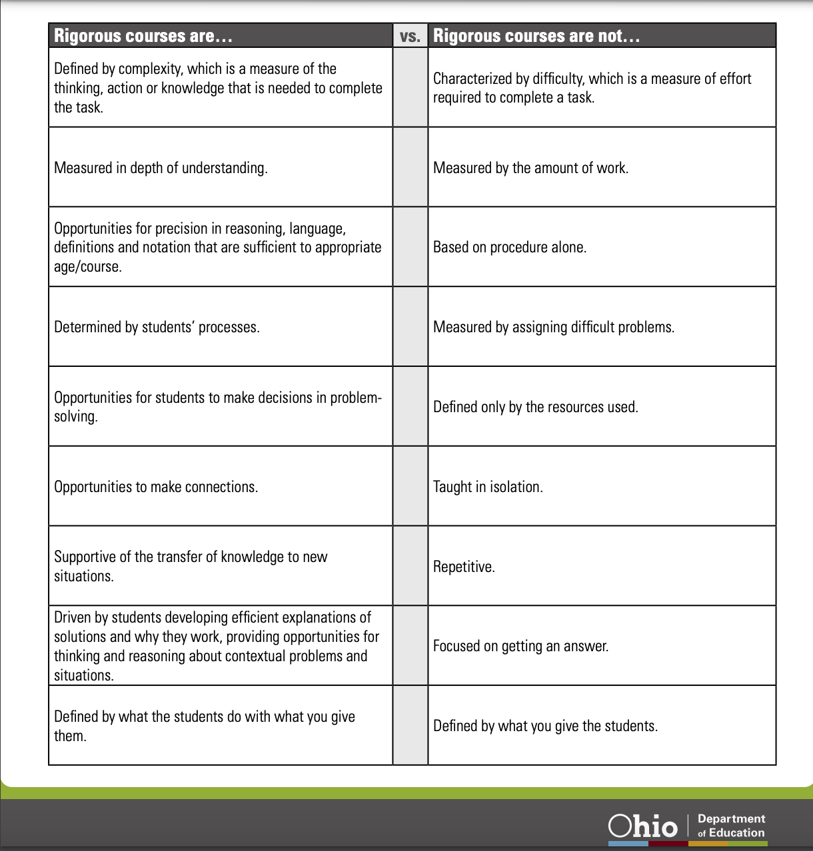
Rigorous vs. Non-Rigorous
Notes:
Chandra

Slide 18
Example and Non-Example
Notes:
Chandra

Slide 19
A.APR.3
Identify zeros of polynomials, when factoring is reasonable,
and use the zeros to construct a rough graph of the function defined by the polynomial.
Notes:
Chandra In addition to defining rigorous mathematical experiences, the standard itself provides information about the expected rigor of the standard as well by looking at the verbs. For standard, A.APR.3, the action verbs used are identify, use, and construct. Reviewing this standard indicates that students should identify in this case zeros of polynomials through mostly factoring and then using these zeros to graph. Using a DOK chart, all 3 actions verbs are within the Level 2 realm that is about the skill or concept.
DOK Chart: https://static.pdesas.org/content/documents/m1-slide_19_dok_wheel_slide.pdf Ohio Math Standards: https://education.ohio.gov/getattachment/Topics/Learning-in-Ohio/Mathematics/Ohio-s-Learning-Standards-in-Mathematics/MATH-Standards-2017.pdf.aspx?lang=en-US

Slide 20
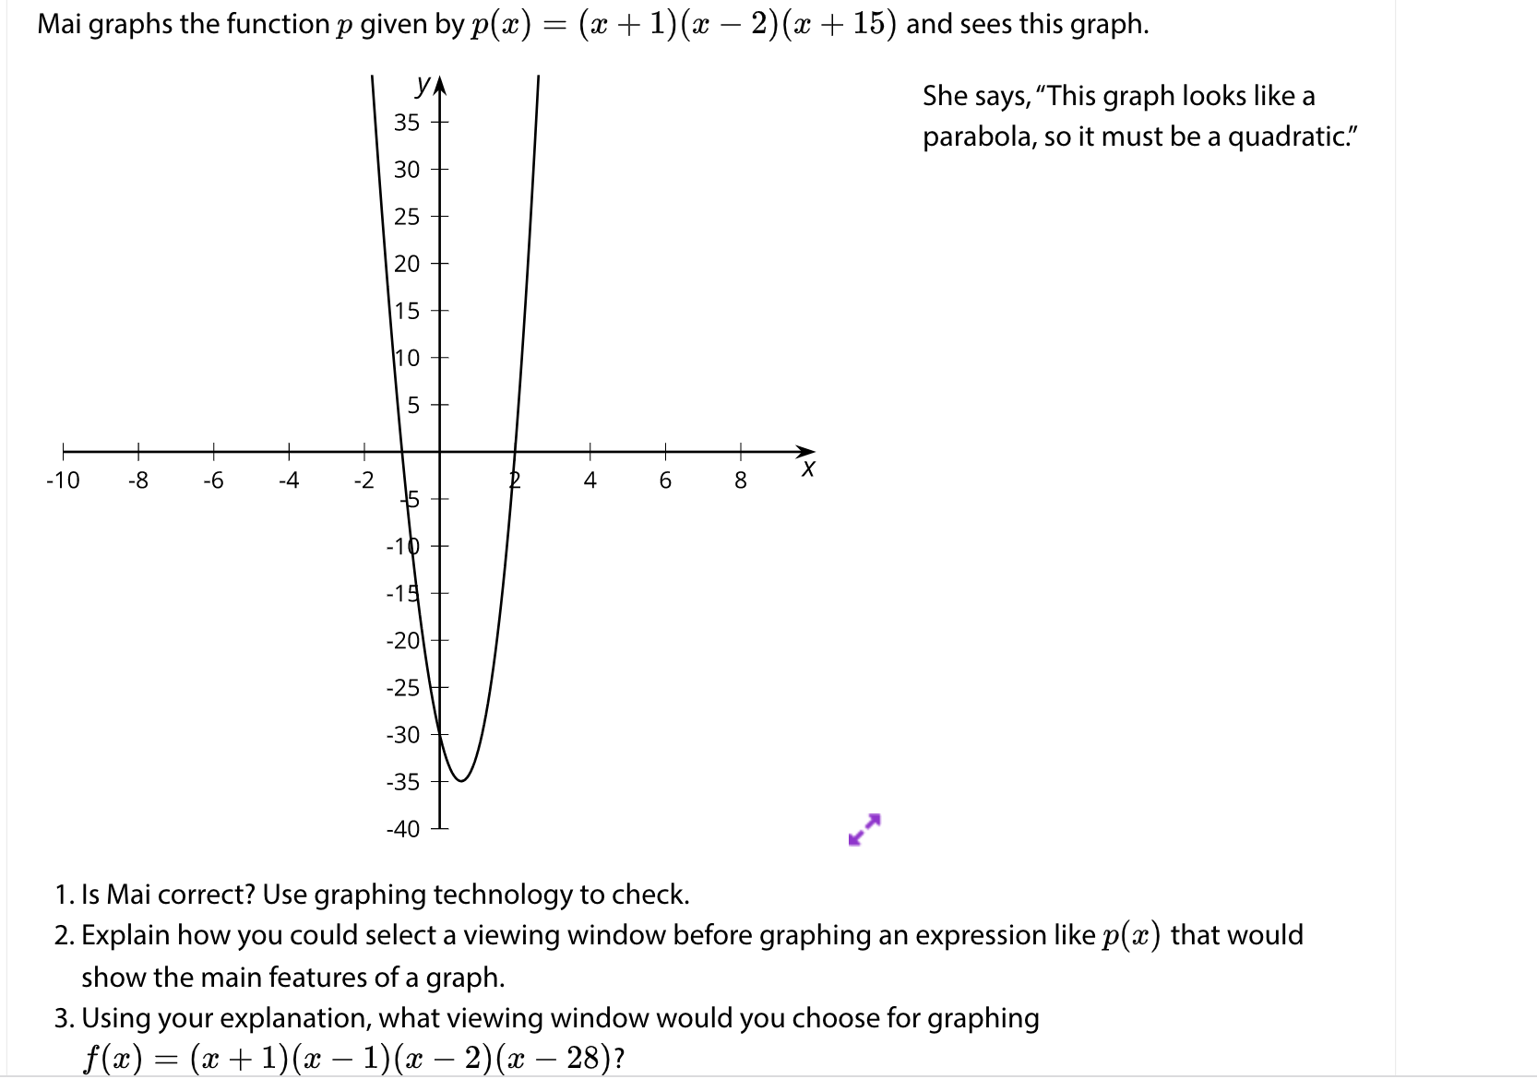
What do you notice?
Notes:
Chandra Share out whole group
Reflect back on the HQIM Review Criteria, what are some things you see within this lesson that align to the criteria? How would you rate the lesson based on the Gateways outlined by Ed Reports?

Slide 21
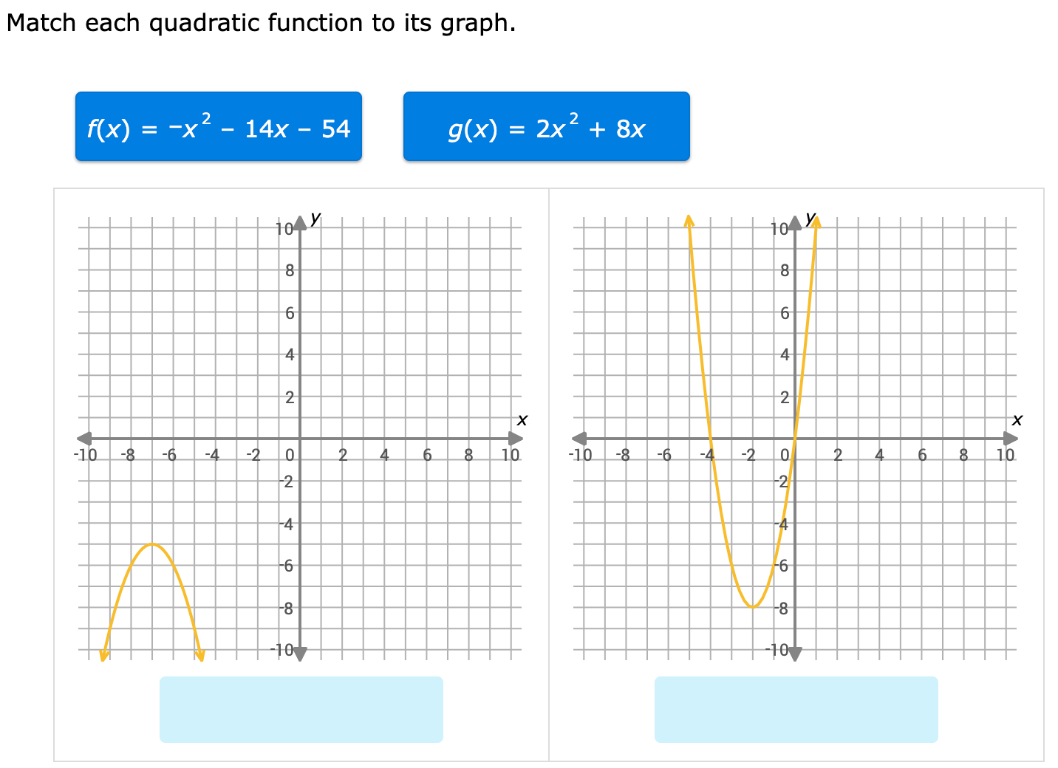
What do you notice?
Notes:
Chandra Non example aligned to standards
Reflect back on the HQIM Review Critieria, what are some things you see within this lesson that align to the criteria? How would you rate the lesson based on the Gateways outlined by Ed Reports?

Slide 22
www.ohiocurriculumsupport.org
www.curriculumsupport.org
Notes:
Chandra Post in chat:
www.ohiocurriculumsupport.org

Slide 23
We built the Curriculum Support Guide to help with the “how”
Framework
Guiding Questions
Notes
Resources
Online Tools
Workbooks
All steps
Guiding questions, notes, and resources for all key actions
Vignettes
Teacher
District leader
Guidance Documents
“Where do I start?”
Timelines
Implementation plan
Notes:
Chandra This website includes….
All are free -

Slide 24
Ohio Curriculum Support Guide
Notes:
Chandra We then found districts that had avoided these pitfalls and studied what they did differently than others using the same materials that experience these challenges. From there, we created the CSG.
There are three phases - Phase I is selection, Phase II is everything after you know what materials you are using and before training, Phase III begins with training and is the journey through teaching and learning support and continuous improvement. Each phase contains a replicable set of actions and – when we tested these with our partners beginning the journey – we found these actions did in fact make a difference to the success of implementation.

Slide 25
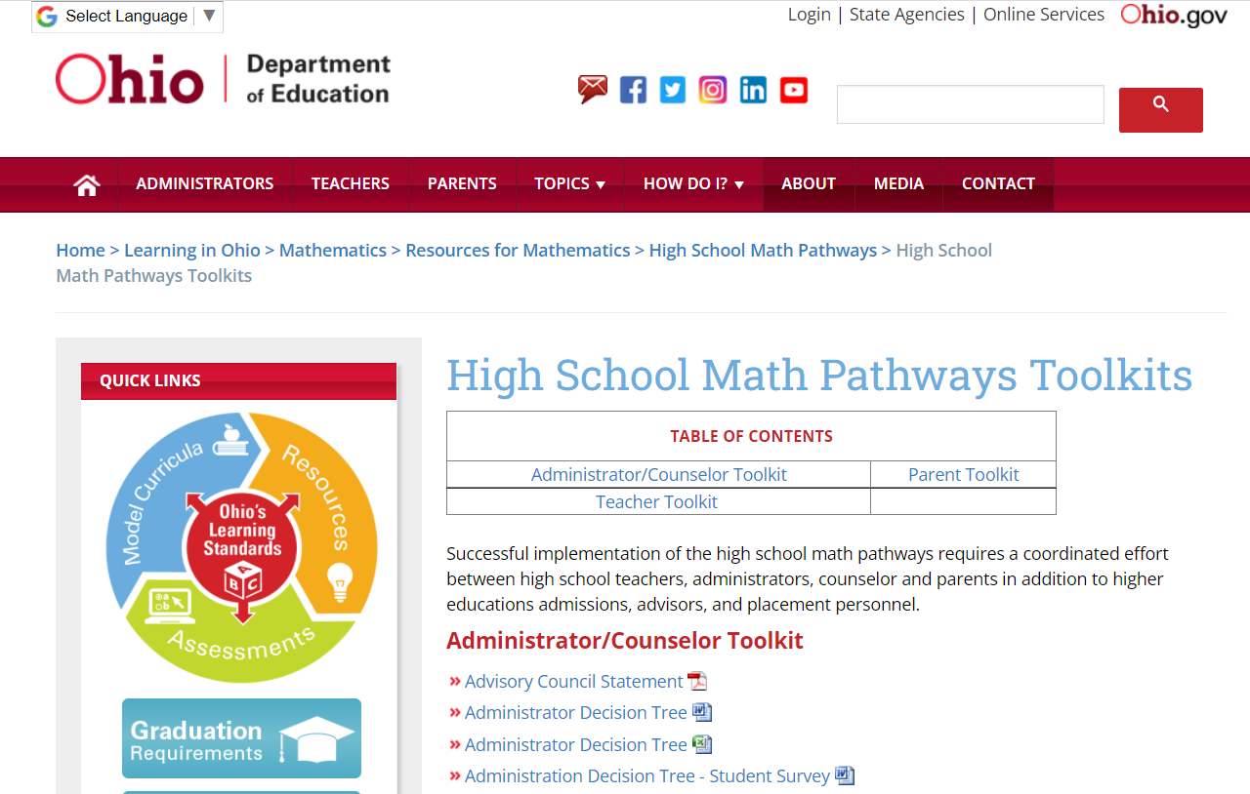
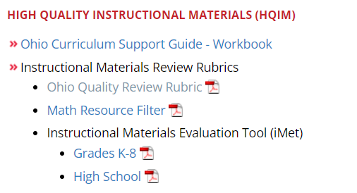
Ohio Resources
Notes:
ODE

Slide 26
Q&A
InstructUp
Notes:
Chandra

Slide 27
Session Survey
We’d love your feedback!
https://bit.ly/Ohio11-10
InstructUp
Notes:
Chandra

Slide 28
THANK YOU
Facebook: instructionpartners
www.instructionpartners.org
Twitter: @instructup
Notes:
Chandra

