Slide 1
Math Pathways and Admissions
November 2021

Slide 2
Admissions Breakout
FAQ and Toolkit Enhancements
Equity Updates and Approach
Impacts
  College Credit Plus
  Transcripts/Profiles
  ACT/SAT Preparation

Slide 3
FAQ and Toolkit Review
Current: FAQ Draft, sans admissions specific FAQs
Topics covered
  Graduation Requirements
  Advising/Counseling
  Implementation
  Other

Slide 4
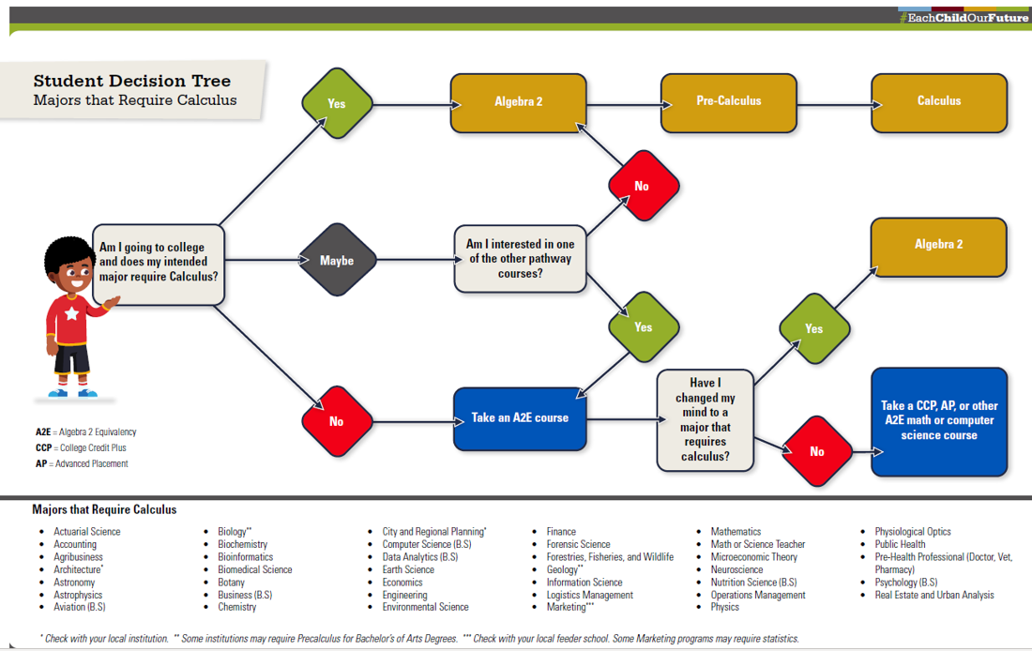

Slide 5
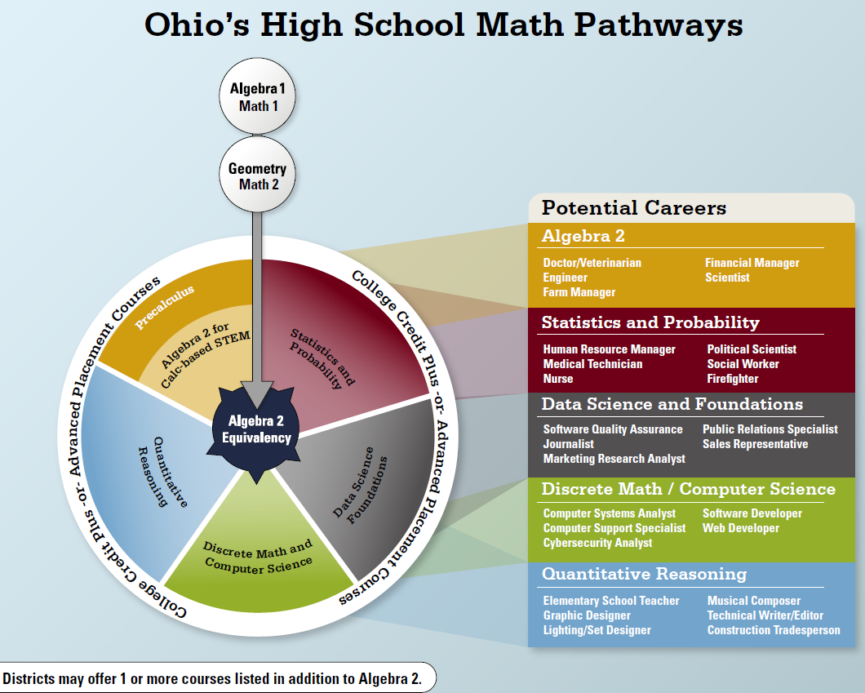
Math
Pathways
ALL Pathways are college preparatory
Note: Districts may offer one or more courses.
Notes:
Check on updated version

Slide 6
FAQ and Toolkit Review
What specific questions may be beneficial to add from an admissions perspective?

Slide 7
Equity Updates and Approach
Designed by Math Pathways Architect Group
Guidance on Maintaining Equity
-Designed for school administrators and counselors
-What does admissions need in this space, i.e. recommendations for how to consider students?

Slide 8
Impacts for Consideration
CCP
Transcripts/Profiles
ACT/SAT Preparation
  -Test optional through _?
These may help build the FAQ or the Toolkit

Slide 9
Descriptions of Courses
Course | Description
Statistics and Probability | In-depth study of probability, data analysis, and statistics including applying the concept of random variables to generate and interpret probability distributions, transforming data to aid in interpretation and prediction, and testing hypotheses using appropriate statistics
Quantitative Reasoning | Application of mathematics skills such as algebra to the analysis and interpretation of quantitative information (numbers and units) in a real-world context to make decisions that are relevant to daily life. Critical thinking is its primary objective and outcome.
Data Science | Data Science is a blend of various tools, algorithms, and machine learning principles with the goal to discover hidden patterns from raw data. The difference between data science and statistics is that where statistics focuses on explaining the data, data science focuses on using data to make predictions and decisions.
Discrete Math | The study of mathematical properties of sets and systems that have a countable number of elements including applications of systematic counting techniques and algorithmic thinking to represent, analyze, and solve problems.

Slide 10
Proposed Timeline
Fall 2021
The initiative is launched on the website.
Quantitative Reasoning and Data Science Foundations are piloted as A2E courses.
Math Pathways symposium is held on Nov. 9-10.
Fall 2022
Schools implement pathways and Algebra 2 equivalency courses.
Discrete Math/Computer Science is piloted.
Pilot schools may be interested in CCP QR course or CCP Stats course.

Slide 11
Proposed Timeline
Fall 2023
Students from pilot schools applying to universities may not have Algebra 2 on their transcripts.
Students from statewide schools may be interested in other CCP entry-level math courses.
Fall 2024
Students statewide applying to universities may not have Algebra 2 on their transcripts.
Students statewide may be interested in other CCP entry-level math courses.

Slide 12
Thank you!

