Slide 1
Parent Discussion
Brian Bickley ∙ Nov. 10, 2021

Slide 2
Ohio’s High School Graduation Requirements

Slide 3
Education.ohio.gov
Search:
High School Math Pathways
Notes:
https://education.ohio.gov/

Slide 4
Notes:
https://education.ohio.gov/Topics/Learning-in-Ohio/Mathematics/Resources-for-Mathematics/Math-Pathways

Slide 5
Notes:
https://education.ohio.gov/Topics/Learning-in-Ohio/Mathematics/Resources-for-Mathematics/Math-Pathways/Higher-Ed-Entry-Level-Math-Pathways-Course-Descrip

Slide 6
Student Decision Tree Parts 1 & 2
Notes:
https://education.ohio.gov/getattachment/Topics/Learning-in-Ohio/Mathematics/Resources-for-Mathematics/Math-Pathways/Higher-Ed-Entry-Level-Math-Pathways-Course-Descrip/Student-Decision-Tree-Parts-1-and-2.pdf.aspx?lang=en-US

Slide 7
Career Cluster Inventory
Notes:
https://jobseeker.k-12.ohiomeansjobs.monster.com/ExploreIt/DefaultCci.aspx#/welcome

Slide 8
Career Cluster Inventory
1
2
3
Get started
Budget Calculator
Lifestyle Calculator
Notes:
Which career is right for your student? Your student can begin their search here. Not sure what career might be best? Have your student answer the questions in the Career Cluster Inventory. The results will suggest career options that best relate to their interests. The questions should take around 20 minutes to complete. Simply click on the "Get Started" button and they’re on their way to finding the career opportunity that's right for them.
The Budget Calculator allows students to answer a few questions to determine their target salary. Your student(s) can use this target salary to help choose the right occupation for them.
The Lifestyle Calculator allows students to answer a few questions to determine their target salary. Students can use this target salary to help them choose the right occupation for them.

Slide 9
Student Decision Tree Parts 1 & 2
Notes:
Now, going back to the “Student Decision Tree Parts 1 & 2” document for a moment again, we will
https://education.ohio.gov/getattachment/Topics/Learning-in-Ohio/Mathematics/Resources-for-Mathematics/Math-Pathways/Higher-Ed-Entry-Level-Math-Pathways-Course-Descrip/Student-Decision-Tree-Parts-1-and-2.pdf.aspx?lang=en-US

Slide 10
K-12 Career Clusters

Slide 11
Notes:
This document provides brief descriptions of career clusters that they can use to help identify one or more career pathway(s) of interest. Career pathways are typical paths by which an individual might reach employment in a certain occupation. While they are by no means the only way to become employed in a given occupation, they offer a general guideline. While these career pathways are organized by their primary industry, it should also be noted that career pathways and occupations can be found across multiple industries.

Slide 12
Student Decision Tree Parts 1 & 2 (Page 2)
Notes:
Again, going back to the “Student Decision Tree Parts 1 & 2” document for a moment again, we will
https://jobseeker.k-12.ohiomeansjobs.monster.com/ExploreIt/CareerClusters.aspx
In a moment we are going to visit the “Ohio Means Jobs Career Clusters” website. Once there, I will give you all about 10-12 minutes to explore the career clusters found on the webpage.
Career pathways are located on the left side of each specific career cluster page. Click on all the pathways and review the available jobs. • List up to 10 careers you are interested in based on your salary and postsecondary educational preferences?

Slide 13
Ohio Means Jobs Career Clusters
Notes:
Soon, I am going to give you 5-10-minutes to explore this website. For now, I want to share a little about this resource. Career pathways are typical paths by which an individual might reach employment in a certain occupation. You will notice similarities between the “Career Cluster” found on this webpage and the Career Clusters we looked at just a moment ago. While they are by no means the only way to become employed in each occupation, they offer a general guideline. While these career pathways are organized by their primary industry, it should also be noted that career pathways and occupations can be found across multiple industries.

Slide 14
Ohio Means Jobs Career Clusters
Level of Education Needed
Name of Career
Annual Salary
Projected Openings
Identifies Relevant Courses
Notes:
When you click on one of the career clusters, you will be taken a new webpage where you will find a list of careers. Careers are going to be broken down starting with the minimum level of education needed. Next, you will notice the name of the career. As you read down the list of information you will come to the annual salary range. This is an important topic of discussion with your student as you think back to the earlier slide with the budget and lifestyle calculator. Talk with your student about how they plan to budget their finances as an adult and what type of lifestyle they want. You can discuss with them the salary range they will need to satisfy their desired lifestyle. As you continue to look at the information for the career, you will see the ‘yearly projected job openings’ in Ohio. Is this a high demand career? This information will help you talk with your student about the number of job opportunities across Ohio in this career to help gage their interest in whether they want to possibly pursue it as a career. Lastly, you can click on the “Show Courses” link to access a document that helps identify the required courses for this career. This document can be very helpful as you work with your student to develop or update their graduation plan. The document will provide suggestions for which courses your student may need in their pursuit of this career. The

Slide 15
Notes:
Here is a screenshot for a career as a “Farm Labor Contractor”. The document provides a list of required and recommended courses. Included in the document are suggestions for when these courses can be taken in middle and high school. Information in this document can be helpful for students as they develop and implement their graduation plan. The document helps guide thinking about the possible courses your student may need with a suggestion on when during middle or high school they may want to be taking these courses as they prepare for their career.
Looking at the blue colored squares, you will notice this career requires courses like Algebra 1 (or Math 1), Geometry (or Math 2), Algebra 2 (or Math 3), and Quantitative Reasoning of Pre-Calculus.

Slide 16
Questions to Consider
Think about the types of careers your student may be interested in?
Look at the pay/salary ranges.
Identify the mathematics courses that are most applicable.
Does this career require calculus?
Does this career require a college degree?
If so, is it a 2-year? 4-year degree? Or advanced degree?
Notes:
Now, take 10-minutes to explore the website based on what you think your student(s) will be or already is interested in. As you explore, you will want to pay attention to the information provided by the website. On the screen is an example from the
Before you select a Career Cluster below to begin exploring:
Think about the types of careers your student may be interested in?
Look at the pay/salary ranges.
Identify the mathematics courses that are most applicable.
Does this career require calculus?
Does this career require a college degree?
If so, is it a 2-year? 4-year degree? Or advanced degree?
I will put these questions for you in the chat and on the screen while you explore the website.

Slide 17
Debrief

Slide 18
Student Decision Tree Part 3
Notes:
https://education.ohio.gov/cmsctx/pv/ID-10131609/culture/en-US/wg/42667fc7-e562-46e3-9bbe-51ce0c96a19d/h/266823795fdf0360c76653ce3f49e829c6027767adda7473b1e9a8d2bbcc6ef9/-/getattachment/Topics/Learning-in-Ohio/Mathematics/Resources-for-Mathematics/Math-Pathways/Higher-Ed-Entry-Level-Math-Pathways-Course-Descrip/Student-Decision-Tree-part3.pdf.aspx?lang=en-US&uh=76a179e7a8938c1abd9dd754991ed33e92b96fed09a2a985a450a6ecefd0d8c2
This decision tree shows alignment between majors/careers and high school math pathways courses. The information is broad and should be used for general guidance only, as alignments may vary by higher education institutions. Please check your local community colleges or four-year feeder schools and adjust the chart as necessary.
For their third unit of mathematics, students may wish to explore one of their new pathway courses such as Statistics & Probability, Data Science Foundations, or Computer Science/Discrete Math. However, if students decide to pursue a major within that pathway that requires Calculus, they should take Algebra 2 for their fourth unit of mathematics.

Slide 20
Connecting the High School Math Pathways to College Credit Plus (CCP) and the Ohio Guaranteed Transfer Pathways
Notes:
https://education.ohio.gov/cmsctx/pv/ID-10131609/culture/en-US/wg/42667fc7-e562-46e3-9bbe-51ce0c96a19d/h/266823795fdf0360c76653ce3f49e829c6027767adda7473b1e9a8d2bbcc6ef9/-/getattachment/Topics/Learning-in-Ohio/Mathematics/Resources-for-Mathematics/Math-Pathways/Higher-Ed-Entry-Level-Math-Pathways-Course-Descrip/Connecting-the-Math-Pathways-to-CCP-and-OGTP-GW-LH_LS.pdf.aspx?lang=en-US&uh=4c353f6ab289d648e27bd18940c0d5892ae4e229f4e92a45e3315dc168307aba

Slide 21
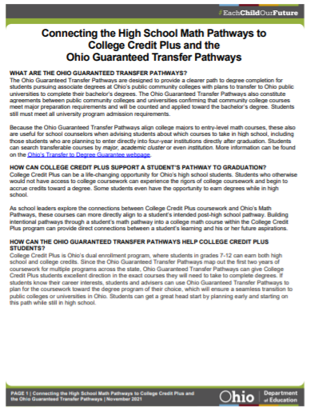
WHAT ARE THE OHIO GUARANTEED TRANSFER PATHWAYS?
HOW CAN COLLEGE CREDIT PLUS SUPPORT A STUDENT’S PATHWAY TO GRADUATION?
HOW CAN THE OHIO GUARANTEED TRANSFER PATHWAYS HELP COLLEGE CREDIT PLUS STUDENTS?
WHAT ARE APPROPRIATE COLLEGE CREDIT PLUS MATH COURSES FOR STUDENTS TO TAKE BASED ON THE ALGEBRA 2 EQUIVALENCY COURSE?
Notes:
https://education.ohio.gov/cmsctx/pv/ID-10131609/culture/en-US/wg/42667fc7-e562-46e3-9bbe-51ce0c96a19d/h/266823795fdf0360c76653ce3f49e829c6027767adda7473b1e9a8d2bbcc6ef9/-/getattachment/Topics/Learning-in-Ohio/Mathematics/Resources-for-Mathematics/Math-Pathways/Higher-Ed-Entry-Level-Math-Pathways-Course-Descrip/Connecting-the-Math-Pathways-to-CCP-and-OGTP-GW-LH_LS.pdf.aspx?lang=en-US&uh=4c353f6ab289d648e27bd18940c0d5892ae4e229f4e92a45e3315dc168307aba
In this document you will find answers to the following questions. (read the slide from here)

Slide 22
Algebra 2-Equivalent Courses and the ACT/SAT
Notes:
https://education.ohio.gov/getattachment/Topics/Learning-in-Ohio/Mathematics/Resources-for-Mathematics/Math-Pathways/Higher-Ed-Entry-Level-Math-Pathways-Course-Descrip/Math-Pathways-and-ACT-SAT.pdf.aspx?lang=en-US

Slide 23
Algebra 2-Equivalent Courses and the ACT/SAT
Notes:
https://education.ohio.gov/getattachment/Topics/Learning-in-Ohio/Mathematics/Resources-for-Mathematics/Math-Pathways/Higher-Ed-Entry-Level-Math-Pathways-Course-Descrip/Math-Pathways-and-ACT-SAT.pdf.aspx?lang=en-US
More university systems are moving away from using standardized tests, such as the ACT/SAT, in admissions as there has been growing research indicating measures other than the ACT/SAT, such as grade-point average, are better predictors of student success in postsecondary institutions (Morrison, 2020). This move away from standardized testing and placement has been accelerated since the COVID-19 pandemic. Although there is movement in this direction, the Ohio Department of Education realizes the ACT and SAT still are factors for many students. This guide can help educators, parents and students navigate the ACT and SAT test blueprints and standards for Algebra 2-equivalency courses.
Equivalency to Algebra 2 is defined in terms of rigor not content. All the new math pathways courses promote critical thinking and analysis needed for standardized testing such as the ACT and SAT. No single course, not even Algebra 2, incorporates all tested standards. It is recommended ACT and SAT prep occur naturally in conversations throughout the lessons reviewing application of previously learned content. Analyzing the ACT College and Career Readiness Standards and ACT Blueprint and SAT Blueprint, students who have been successful in Algebra and Geometry should be able to get a remediation-free score in mathematics (ACT of 22, SAT of 530, Accuplacer NextGen 263). Students aiming for top scores on standardized tests such as the ACT and SAT will need exposure to a variety of courses, including Algebra 2 and an equivalent course that covers advanced statistics concepts. See the individual test blueprints for more information.

Slide 25
Contact Information
Name | Phone | Email
Annie Cannelongo | 614-644-5905 | Anna.Cannelongo@education.ohio.gov
Annika Moore | 614-728-2373 | Annika.Moore@education.ohio.gov
Brian Bickley | 614-644-6814 | Brian.Bickley@education.ohio.gov
Yelena Palayeva | 614-387-7561 | Yelena.Palayeva@education.ohio.gov

Slide 26
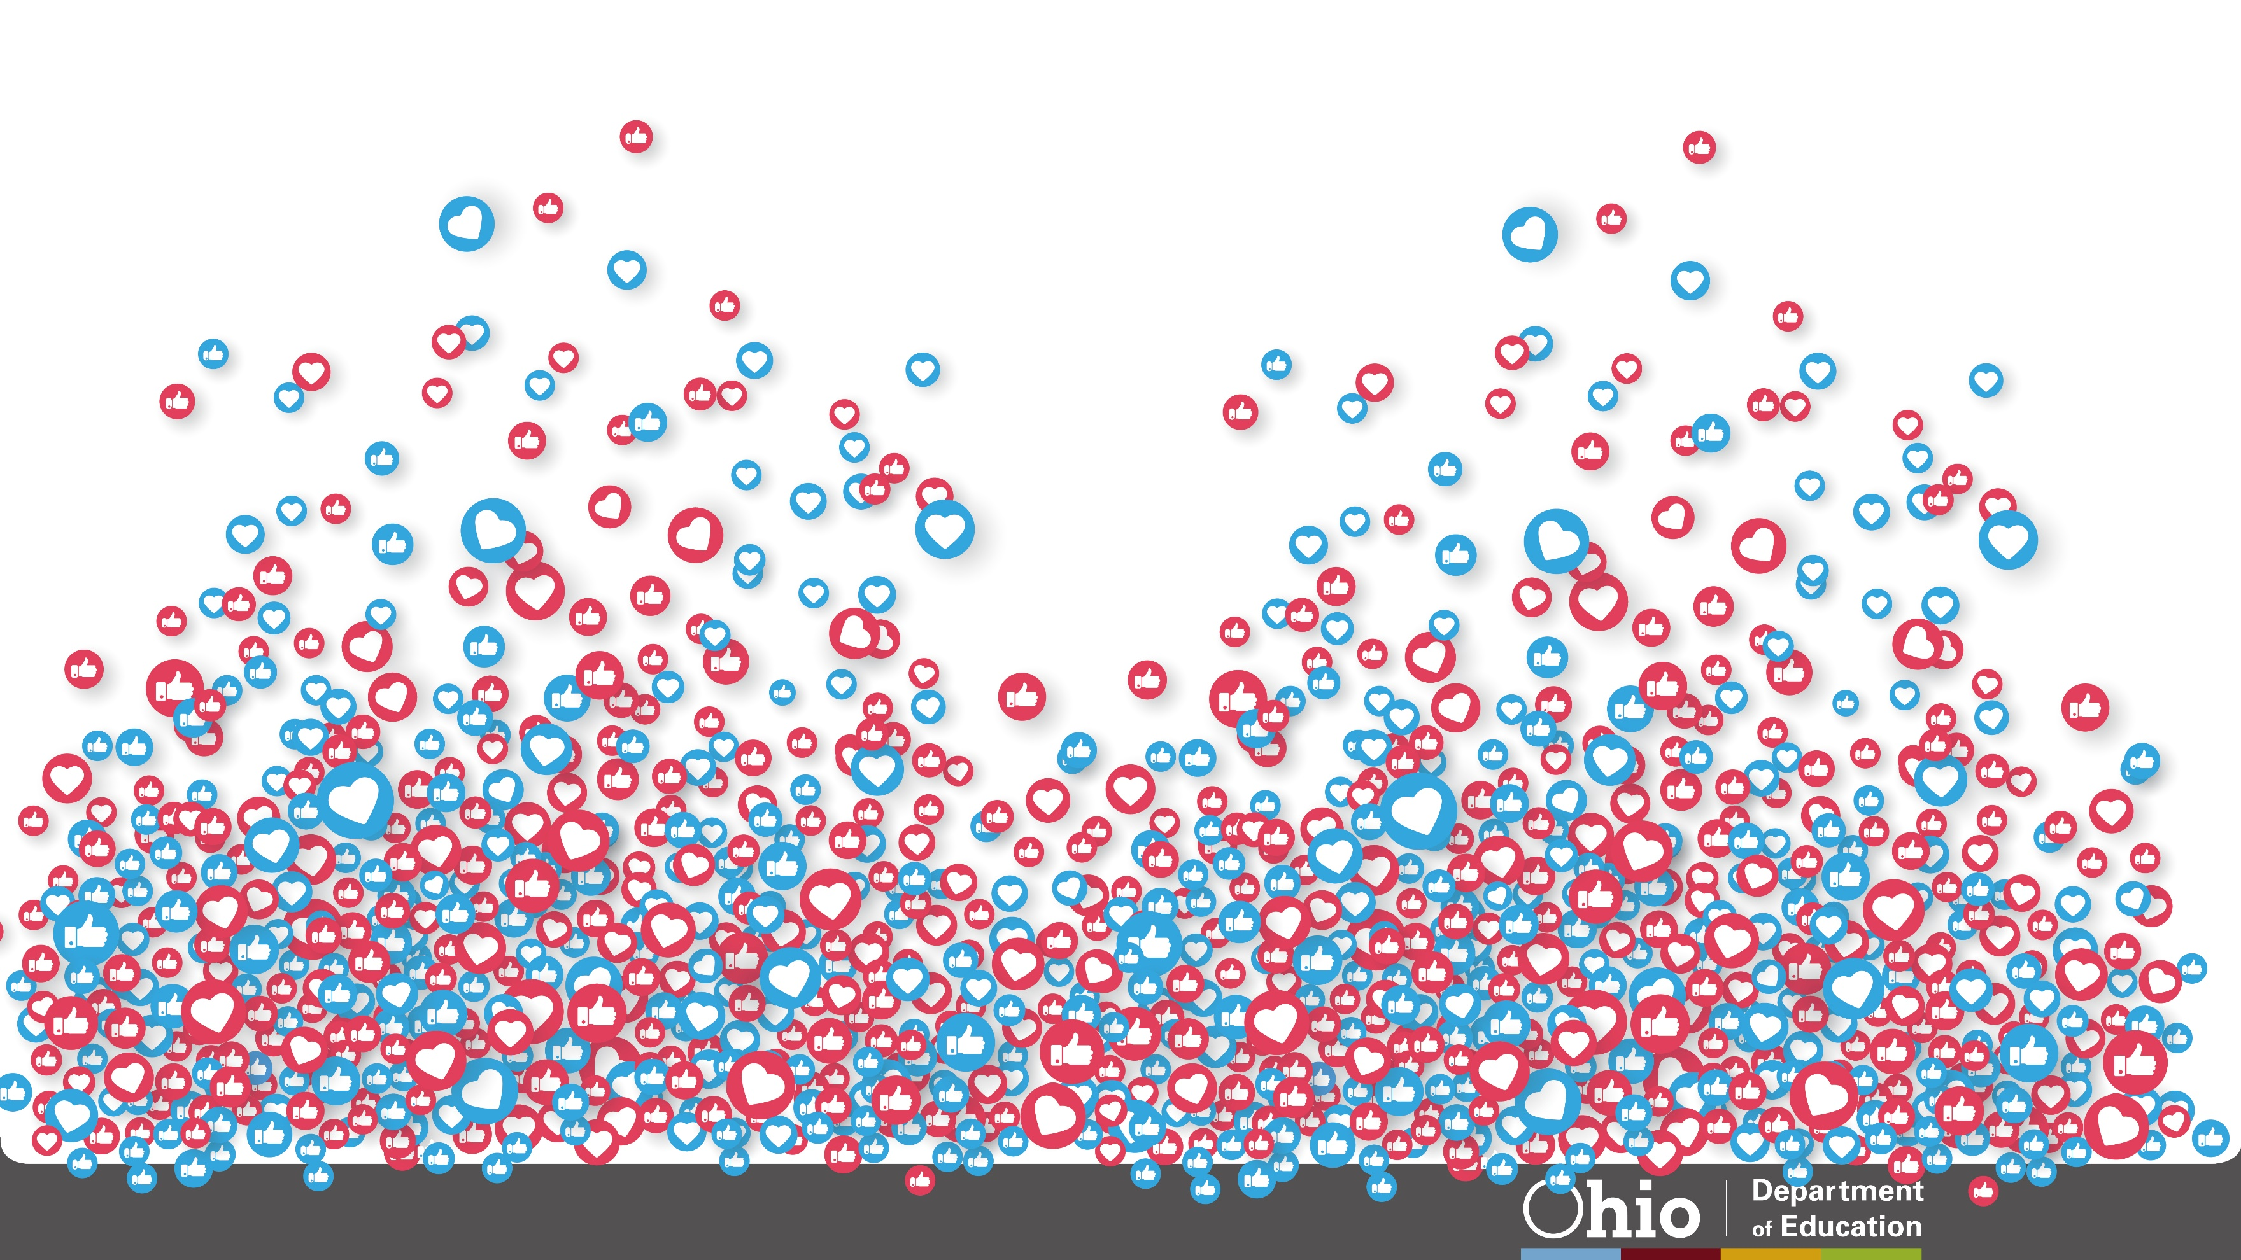
26
@OHEducation

Slide 27
Share your learning community with us!
#MyOhioClassroom
Celebrate educators!
#OhioLovesTeachers

Slide 28
Math Pathways
ALL Pathways are college preparatory
Notes:
Check on updated version

