Slide 1
Statistics and Probability Course
High School Math Pathways Symposium
Nov. 9-10, 2021

Slide 2
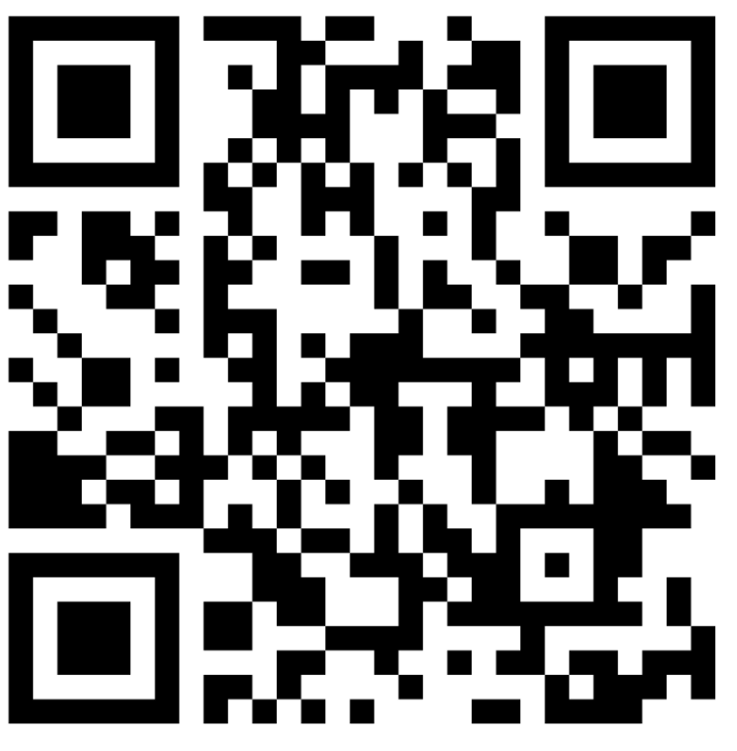
4. Statistics and Probability
Facilitated by
Idrissa Aidara, Cuyahoga Community College
Peter Petto, Retired Teacher, Lakewood City Schools
Angela Sanor; St. Vincent-St. Mary High School
Give feedback on our Padlet!
This session will be recorded, so it can be posted on the Department’s website. The recording will begin at the end of this slide.
Notes:
Note: Annie will introduce and press record.
Padlet Link: https://padlet.com/annacannelongo/k1iiu6ny9gzvlg8c
Main Meeting: https://oh-tech.webex.com/oh-tech/j.php?MTID=m7444e64559756ac8716e269b7eed3a40

Slide 3

Rigor
“Students use mathematical language to communicate effectively and to describe their work with clarity and precision. Students demonstrate how, when, and why their procedure works and why it is appropriate. Students can answer the question, ‘How do we know?’”
Notes:
Presenter: Peter

Slide 4
Rigorous courses are… | Rigorous courses are not…
Defined by complexity, which is a measure of the thinking, action or knowledge that is needed to complete the task | Characterized by difficulty, which is a measure of effort required to complete a task
Measured in depth of understanding | Measured by the amount of work
Opportunities for precision in reasoning, language, definitions and notation that are sufficient to appropriate age/course | Based on procedure alone
Determined by students’ process | Measured by assigning difficult problems
Opportunities for students to make decisions in problem solving | Defined only by the resources used
Notes:
Presenter: Peter

Slide 5
Rigorous courses are… | Rigorous courses are not…
Opportunities to make connections | Taught in isolation
Supportive of the transfer of knowledge to new situations | Repetitive
Driven by students developing efficient explanations of solutions and why they work, providing opportunities for thinking and reasoning about contextual problems and situations | Focused on getting an answer
Defined by what the student does with what you give them | Defined by what you give the student
Notes:
Presenter: Peter

Slide 6
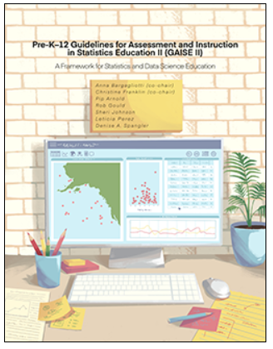
GAISE II
“It is critical that statisticians, or anyone who uses data, be more than just data crunchers. They should be data problem solvers who interrogate the data and utilize questioning throughout the statistical problem-solving process to make decisions with confidence, understanding that the art of communication with data is essential.” (GAISE II)
https://www.amstat.org/asa/files/pdfs/GAISE/GAISEIIPreK-12_Full.pdf
Notes:
Presenter: Idrissa

Slide 7
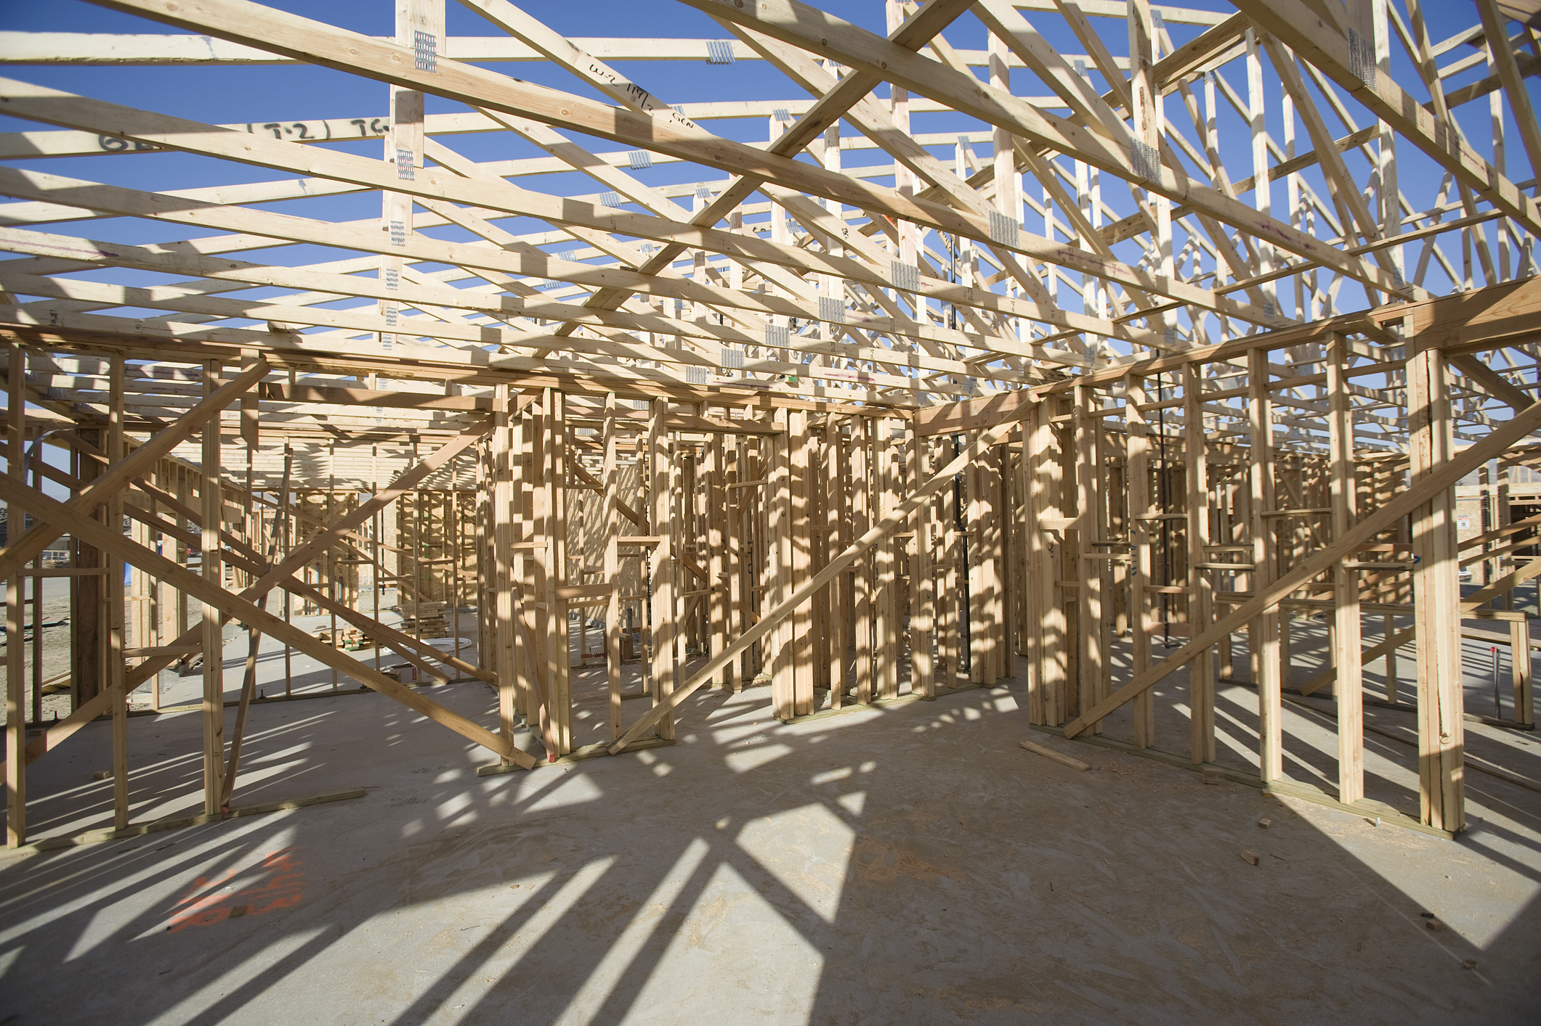
Framework for teaching students to be statistically literate
Notes:
Presenter: Idrissa
What is GAISE and why do we need it?
It’s a framework for teaching students to be statistically literate for a changing world that is driven by data.

Slide 8
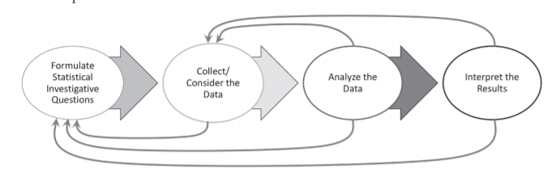
GAISE Process
Formulate Statistical Investigative Questions
Collect/Consider the Data
Analyze the Data
Interpret the Results
Notes:
Presenter: Idrissa

Slide 9
GAISE II Levels
Level A
(Middle School and Early High School)
Level B
(Middle School and Early High School)
Level C
(Advanced High School Courses)
Notes:
Presenter: Idrissa

Slide 10
Critical Areas of Focus
Communication and Analysis
Exploring One-Variable Data
Exploring Two-Variable Data
Collecting Data: Sampling Techniques and Experimental Design
Probability, Randomness, and Distributions
Inference for One-Sample Categorical and Quantitative Data
Notes:
Presenter: Angela

Slide 11
Follow-on Courses
AP Statistics
CCP TMM 010-Introductory Statistics
CCP TMM Introduction to Data Science (Coming Soon)
CCP TMM 011-Quantitaitive Reasoning
CCP TMM 021-Mathematics in Elementary Education 1
Algebra 2
Other Math Pathways Course
Note: Students who want to pursue a Calculus-based STEM Pathway should take Algebra 2 as a follow-on course to this course or in tandem with this course.
Notes:
Presenter: Angela

Slide 12
How is this course different than AP Statistics?
Not Included in Course But Included in AP Statistics | Included in this Course But Covered in Greater Depth in AP Statistics
Inference for two proportions and two means | Formal inference for proportions and means
Inference for regression | Normal probability plots (the high school stats course would use them as a tool only if they can be easily generated with technology)
Inference for multiple categorical variables (Chi-square) | The Central Limit Theorem
Verifying conditions for inference | Residual plots
Type I, Type II errors and power | Linearizing data
Geometric distributions
Combining random variables
Confidence level interpretation (confidence interval interpretation is included)
Z-scores with means
Notes:
Presenter: Angela

Slide 13
How is this course different than
TMM 010-Introductory Statistics?
Not Included in Course But Included in TMM 010-Introductory Statistics | Included in this Course But Covered in Greater Depth in TMM 010-Introductory Statistics
Inference for two proportions and two means | Formal inference for proportions and means
Inference for regression | The Central Limit Theorem
Type I error | Residual plots
Confidence level interpretation (confidence interval interpretation is included) | Linearizing data
Z-scores with means
Notes:
Presenter: Idrissa

Slide 14
What kind of support will teachers have to implement this course?
Standards Document
Instructional Supports for the Model Curriculum
Align with Ohio Materials Matter Work
(See Nov. 10 High Quality Instructional Materials session from 6:30-7:15 p.m. for more information. )
Notes:
Presenter: Angela
https://education.ohio.gov/Topics/Learning-in-Ohio/Mathematics/Resources-for-Mathematics/Math-Pathways/Higher-Ed-Entry-Level-Math-Pathways-Course-Descrip

Slide 15

Instructional Supports for the Model Curriculum
Each cluster will include:
  How is this different from Algebra 1/ Geometry?
  Description of Cluster at A2E Level
  GAISE II Connection
  How is this different from
  TMM 010-Introductory Statistics?
  How is this different from
  AP Statistics?
Notes:
Presenter: Angela

Slide 16
ACT Math Blueprint
Reporting Category | Reporting Subcategory | # of Items | % of Test
Integrating Essential Skills (topics learned before 8th grade using higher complexity) |  | 24-26 | 40-43%
Preparing for Higher Mathematics |  | 34-36 | 57-60%
 | Number & Quantity | 4-6 | 7-10%
 | Algebra | 7-9 | 12-15%
 | Functions | 7-9 | 12-15%
 | Geometry | 7-9 | 12-15%
 | Statistics and Probability | 5-7 | 8-10%
Modeling |  | >16 | >27%
Total |  | 60 | 100%
As our group did an analysis, most ACT standards in the 28-32 range are below A2.
Notes:
Presenter: Peter
https://www.act.org/content/act/en/products-and-services/the-act/test-preparation/description-of-math-test.html

Slide 17
SAT Math Blueprint
Reporting Category | Reporting Subcategory | # of Items | % of Test
Heart of Algebra (Algebra 1 or Middle School) | Analyzing and fluently solving linear equations and systems of linear equations Creating linear equations and inequalities to represent relationships between quantities and to solve problems Understanding and using the relationship between linear equations and inequalities and their graphs to solve problems | 19 | 33%
Problem Solving and Data Analysis (Middle School and Statistics & Probability) | Creating and analyzing relationships using ratios, proportional relationships, percentages, and units Representing and analyzing quantitative data Finding and applying probabilities in context | 17 | 29%
Notes:
Presenter: Peter
https://www.act.org/content/act/en/products-and-services/the-act/test-preparation/description-of-math-test.html

Slide 18
SAT Math Blueprint
Reporting Category | Reporting Subcategory | # of Items | % of Test
Passport to Advanced Math (Algebra 1 & Algebra 2) | Identifying and creating equivalent algebraic expression Creating, analyzing, and fluently solving quadratic and other nonlinear equations Creating, using, and graphing exponential, quadratic, and other nonlinear functions | 16 | 28%
Additional Topics in Math (Geometry and some Middle School & Algebra 2) | Solving problems related to area and volume Applying definitions and theorems related to lines, angles, triangles, and circles Working with right triangles, the unit circle, and trigonometric functions | 6 | 10%
Total |  | 58 | 100%
Notes:
Presenter: Peter
https://www.act.org/content/act/en/products-and-services/the-act/test-preparation/description-of-math-test.html

Slide 19
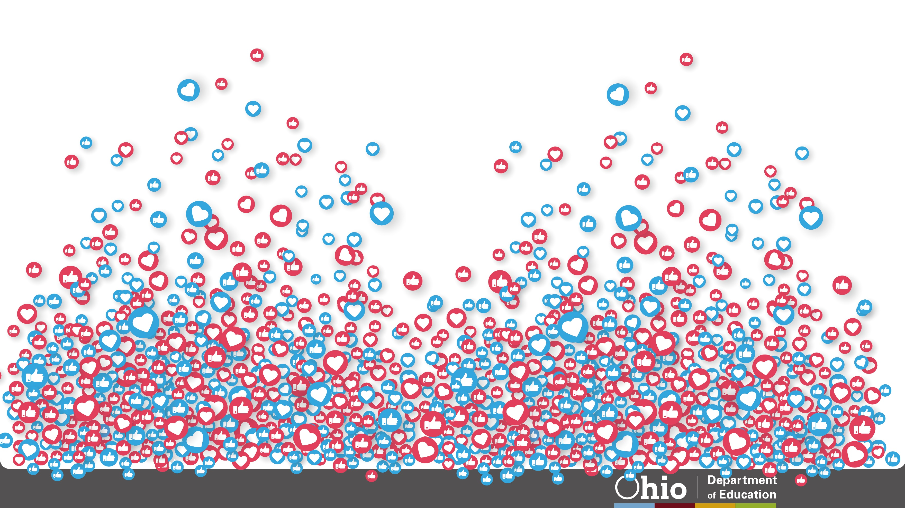





@OHEducation

Slide 20


Share your learning community with us!
#MyOhioClassroom
Celebrate educators!
#OhioLovesTeachers

