Slide 1
The Right to Math
Ensuring the Next Generation of Math Pathways Center Equity
Dr. Elisha Smith Arrillaga
November 10, 2021
Notes:
‘Ensuring the Next Generation of Math Pathways Center Equity’

Slide 2
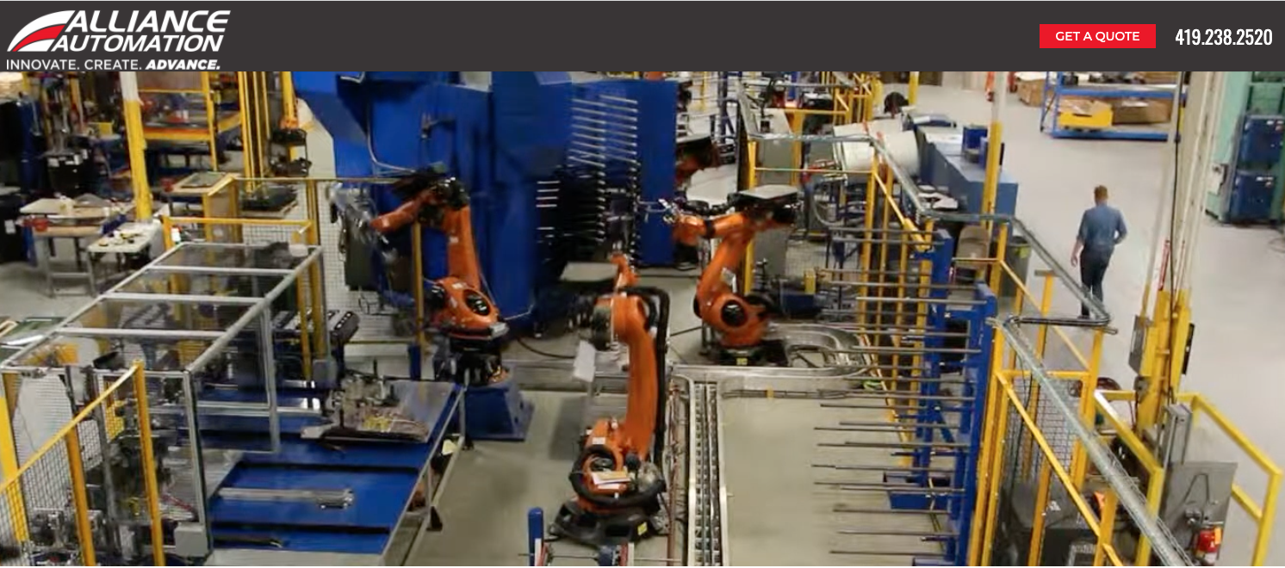
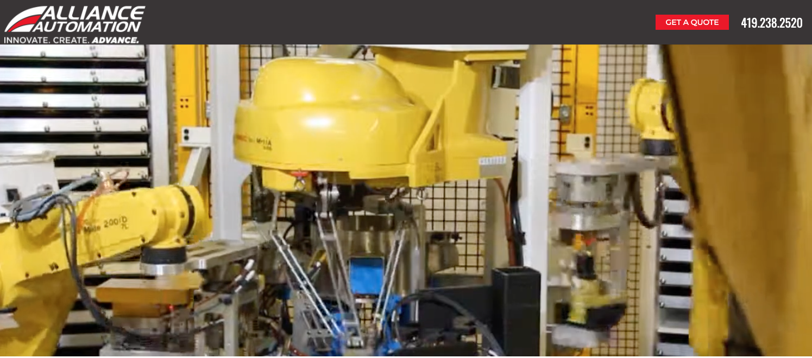
Website 1

Slide 3
Website 2

Slide 4
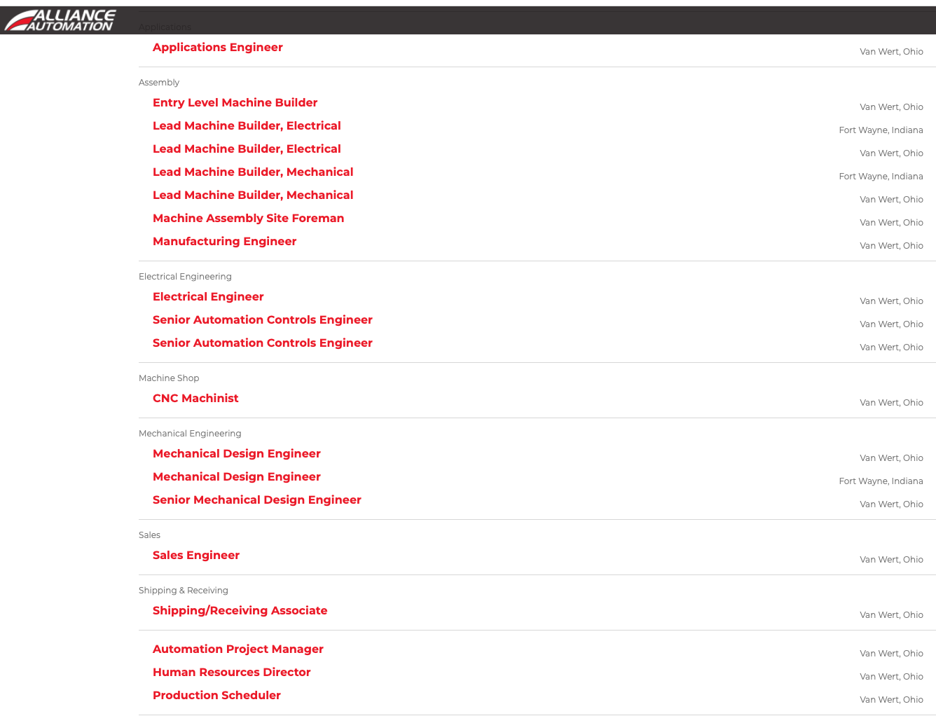
Website 3

Slide 5
Job Demand Trends
Shrinking Demand
Data Entry Clerks
Administrative & Executive Secretaries
Accounting, Bookkeeping and Payroll Clerks
Accountants and Auditors
Assembly and Factory Workers
Growing Demand
Data Analysts and Scientists
AI & Machine Learning Specialists
Big Data Specialists
Digital Marketing and Strategy Specialists
Process Automation Specialists
Notes:
Source: https://www3.weforum.org/docs/WEF_Future_of_Jobs_2020.pdf

Slide 6
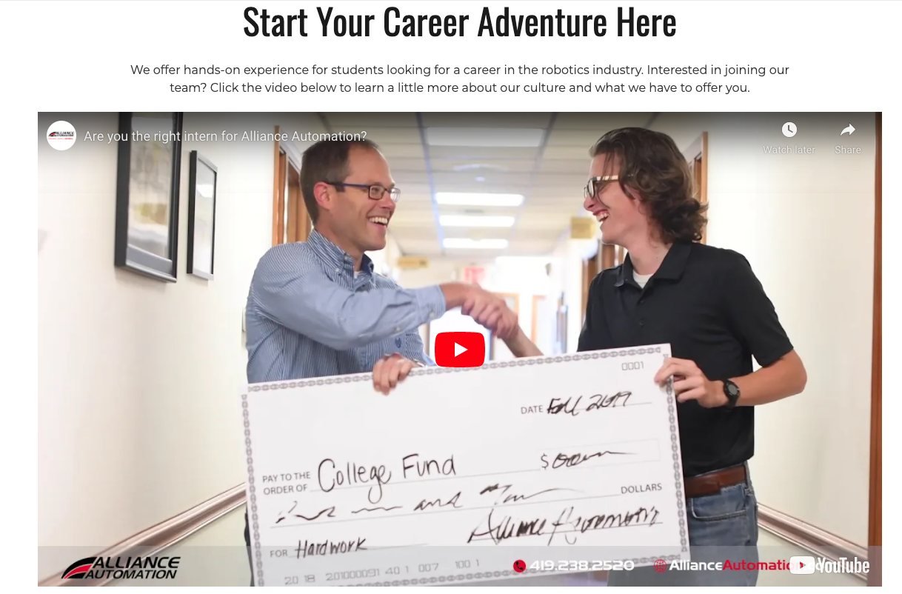
Careers

Slide 7
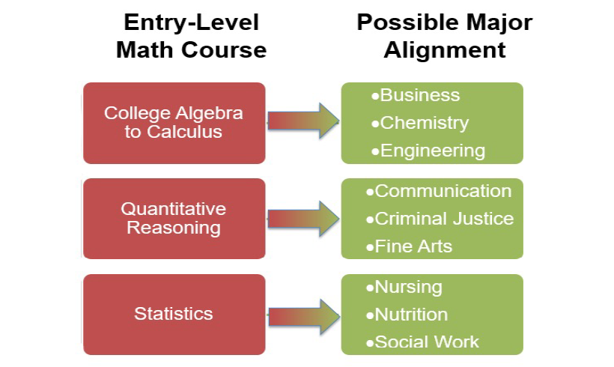
From One Pathway to Many: Then & Now
K-8 Math
Algebra I
Geometry
Algebra II
Pre-Calculus
Calculus

Slide 8
Family Engagement Building Blocks
Inform
Provide families & communities with relevant information regarding current inequities and plans to address them
Consult
Seek input from students, parents/families, and the community to inform solutions to address educational inequities. Provide information as to how decisions & plans are made
Involve
Promote family participation in school site councils to ensure student, parent, community needs are met; Open up clear decision-making channels for participation in crafting solutions
Collaborate
Partner directly with parent groups, student groups, and/or community orgs focused on educational equity to design and implement solutions; Allow room for change/adjustment
Defer To
Foster community ownership of educational equity by co-developing community schools that serve as hubs for a holistic approach to educational success & community well-being

Slide 9
Elisha Smith Arrillaga
To Learn More…
elisha.smitharrillaga@austin.utexas.edu
@ESArrillaga
Facebook.com/utdanacenter
UTDanaCenter.org
Twitter.com/utdanacenter

