Slide 1
Gifted Advisory Council
September 22, 2021

Slide 2
Welcome!
Notes:
Joe

Slide 3
Roll Call and Introductions
Notes:
Jackie

Slide 4
Stats about GAC
Title | Number
Directors of Curriculum and Instruction | 4
General Education Teachers | 3
Gifted Coordinators | 5
Gifted Intervention Specialists | 4
Parents | 3
Principals | 2
Psychologists | 2
Representatives from Higher Education | 4
Superintendents | 2
Ohio Association for Gifted Children | 1
State Board of Education Representative | 1
Ohio Department of Education | 5
Notes:
Joe

Slide 5
Meeting Norms
Pausing
Paraphrasing
Posting Questions in the Chat Box
Putting Ideas on the Table
Providing Data
Paying Attention to Self and Others
Presuming Positive Intentions
Notes:
Joe

Slide 6
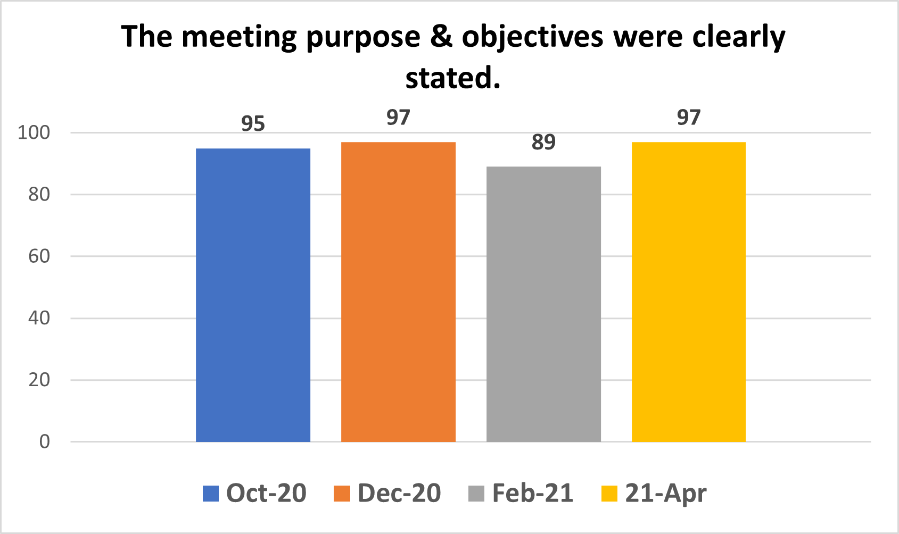

Slide 7
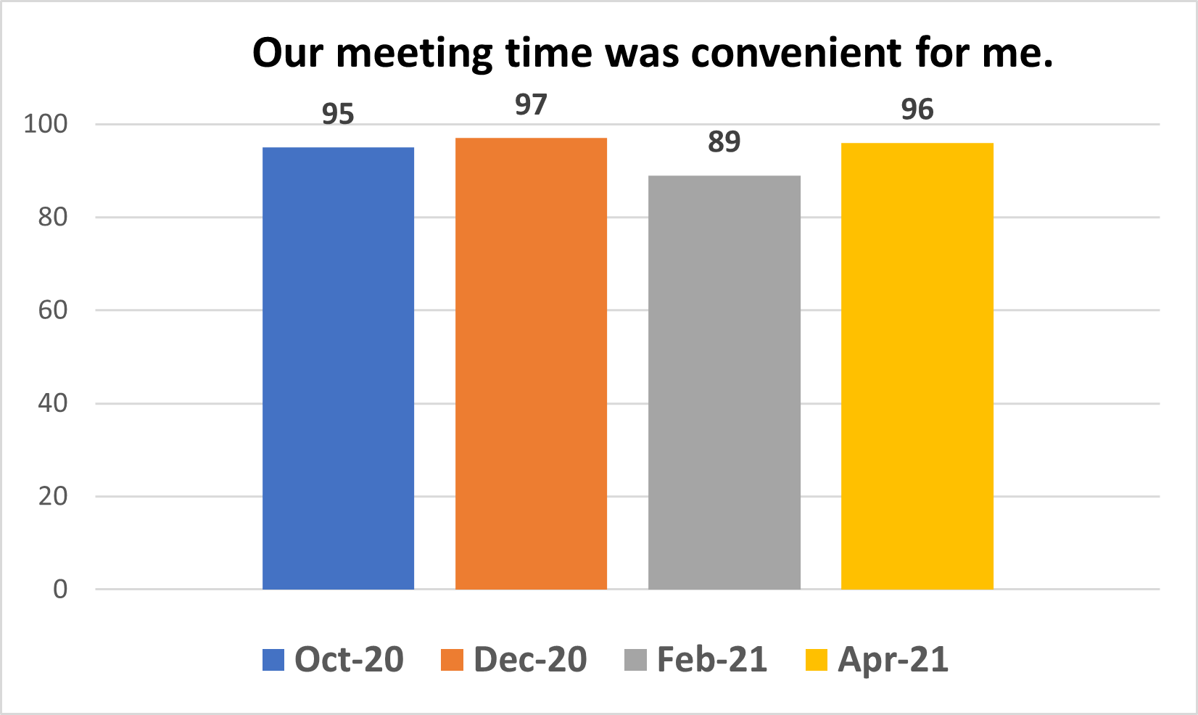

Slide 8
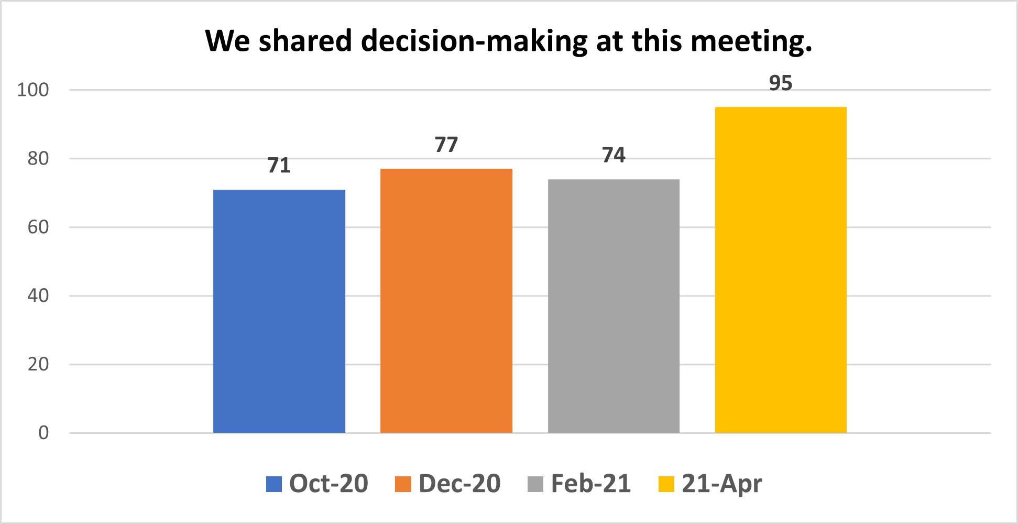

Slide 9
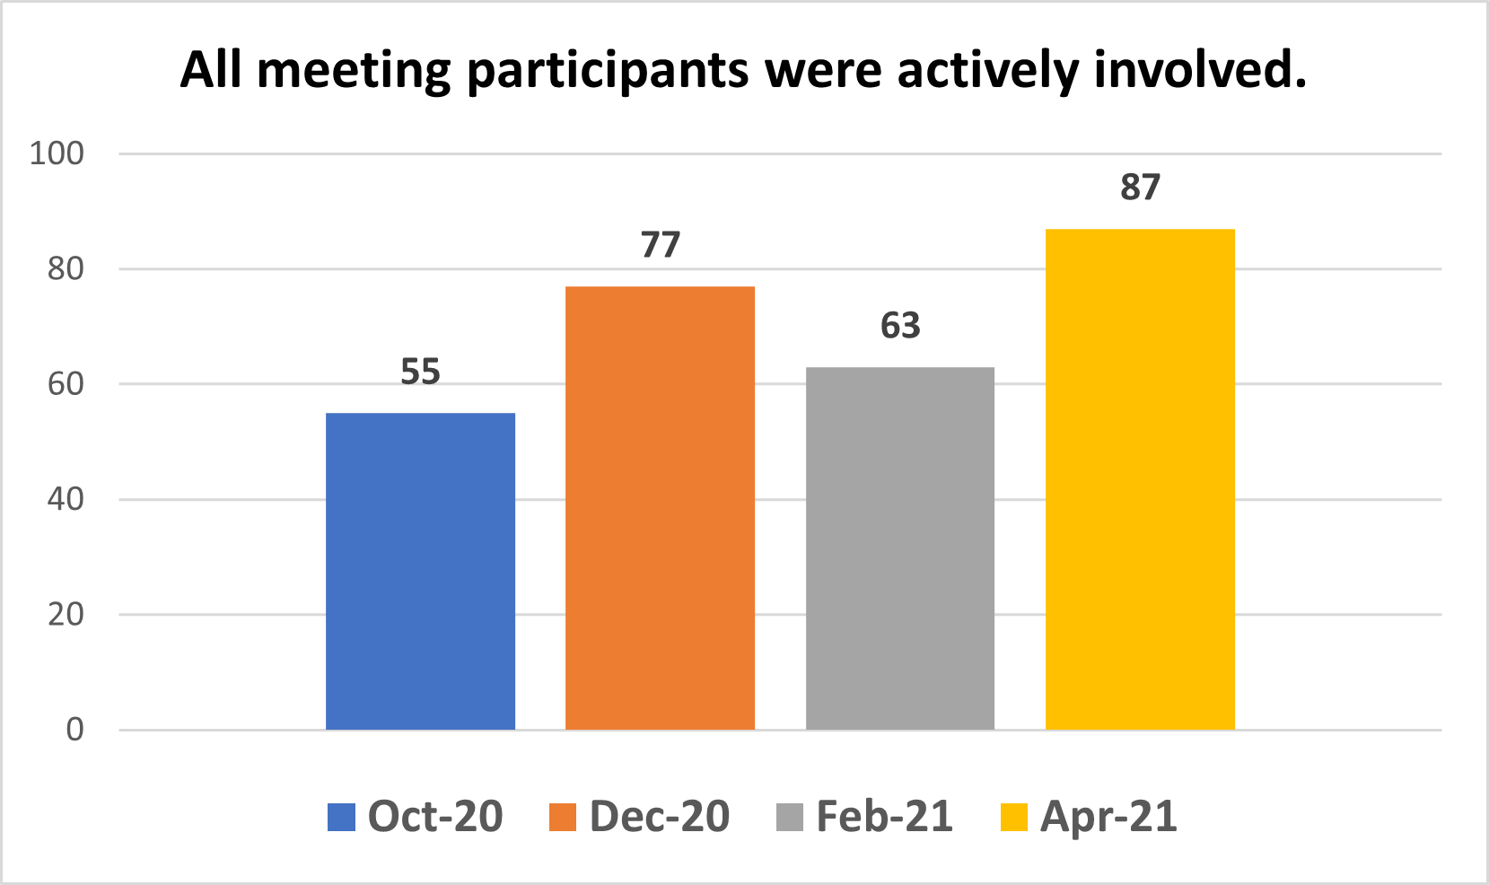

Slide 10
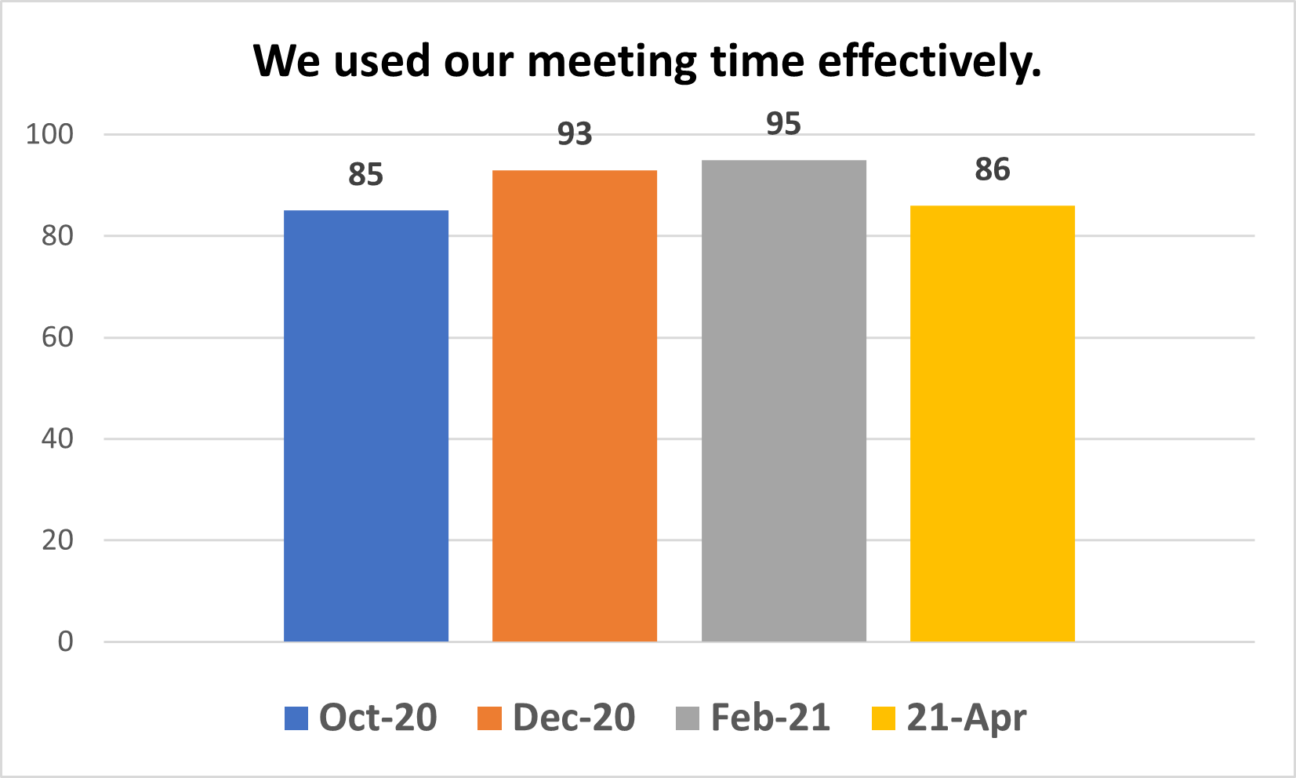

Slide 11
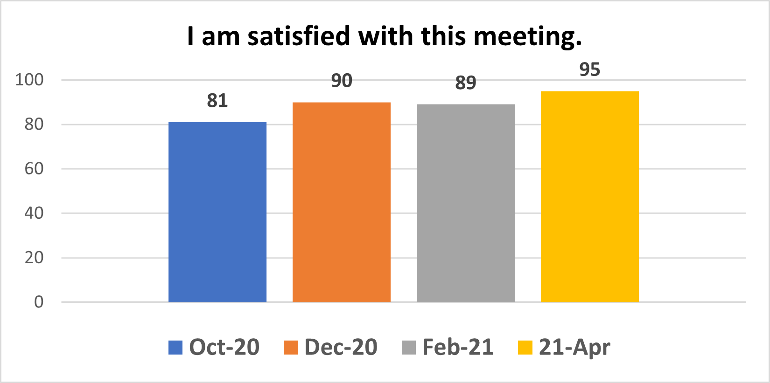

Slide 12
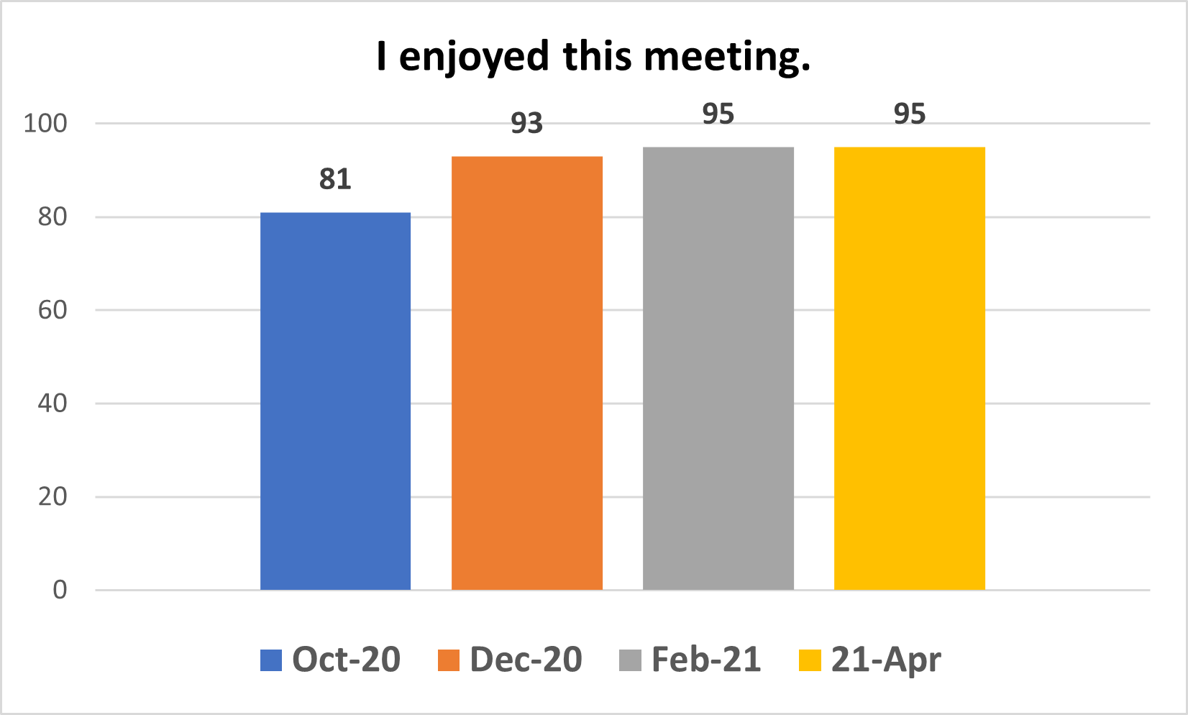

Slide 13
Comments - Themes
Excited about the direction of the work!
Love the data and research presented.
Happy about the workgroups and seeing that talent development is a theme in all three.
Appreciate the thoughtful and responsive planning and preparation that goes into these meetings.
Hope we can meet in person soon.
We need more time during the meetings.

Slide 14
Agenda
Discussion of Voting Items
Workgroups
Updates and Closing Comments
Evaluation
Next Meeting Dates
Notes:
Joe

Slide 15
Chair-elect Nominations
Role and duties of the Chair-elect include the following:
Calls roll at each meeting
Assumes duties of the chair at Gifted Advisory Council meetings in the absence of the chair
Assumes the role of the chair upon either the expiration of the chair’s term or upon the resignation of the chair
Serves one-year term and then moves to chair role the following year and the past chair the year after
Notes:
Jackie
Reminder – Say the name of the motioner and seconder

Slide 16
Bylaws
Chair-Elect Vote
Chair-elect
Define Quorum
Extension of Service
Ex-Officio Members
Public Speaks
Notes:
Joe

Slide 17
Bylaws
Chair-Elect Vote
Chair-elect Proposed Change: With the exception of this first meeting, propose to add to by-laws that the chair-elect will be voted on at the spring meeting. Rationale: Solidifies the election of council members. Pros: Provides an opportunity for new members to have a full year of experience with the GAC before determining if this is a commitment they want to make; provides a smoother transition between chair and chair-elect positions. Cons: At the first fall meeting, we will select a chair-elect and vote again in the spring.
Notes:
Joe

Slide 18
Bylaws
Define Quorum
Proposed Change: Add and define quorum to our by-laws. Propose that a quorum be 50% + 1 of voting members. Rationale: Public meetings need to have a defined quorum. Pros: A simple majority, as opposed to something like a two-thirds majority, allows for the work of the Council to continue and for meetings to be held in person. Cons: None
Notes:
Joe

Slide 19
Bylaws
Extension of Service
Proposed Change: In the case of a resignation of an office, the previous holder of that position may be asked to complete the term. If the individual is no longer a member of the Council or is unable to complete the tenure of the position, then the position will remain vacant until the next election of officers. Rationale: We just had the past chair resign; adding this language ensures that we have someone to fill the role. Pros: We will have a full slate of officers Cons: NA
Notes:
Joe

Slide 20
Bylaws
Ex-Officio Members
Extension of Service of GAC Officers
Proposed Change: The Gifted Advisory Council shall also include Ex‐officio members representing the Ohio State Board of Education and the Ohio Department of Education. Ex‐officio members cannot run for office nor can they vote on items before the Council and do not count as part of a Quorum. Rationale: ODE needs to be listed in our by-laws as participants but non-voting and not part of the quorum. Pros: Makes the by-laws clearer and the role of the Department. Cons: None
Notes:
Joe

Slide 21
Bylaws
Public Speaks
Public Speaks: Three minutes Proposed Change: Add the following language to allow the public to address the Council: The Gifted Advisory Council respects the rights of the public to address the Council during Gifted Advisory Council meetings. Members of the public can address the Council by signing the public comment form prior to the meeting and will have 3 minutes to address the Council. The Facilitator of the Council (the Associate Director) will monitor the time and the Council Chair will ensure that the ground rules are followed. The Council Chair will determine if a response will be made to any public comment. Rationale: Public meetings need to provide an opportunity for the public to address the Council. Three minutes is a standard amount of time for public statements used by other public meetings. Pros: The Council adheres to a public speaks requirement; keeping to three minutes and not addressing the comment in the moment allows the work of the Council to proceed without taking up time for members to engage in conversation with the speaker. Cons: None
Notes:
Joe

Slide 22
Workgroup Structure Options and Decisions
Current Structure
Pro: Gifted Advisory Council members on workgroups
Proposed Change:
External Stakeholders
Pro: Allows for virtual meetings, more efficient use of time, GAC members still lead work by serving as steering committee
Con: Work will be behind initially proposed schedule, current members cannot participate in stakeholder groups
Con: Workgroup meetings would have to be public (in-person) and with a quorum, causing potential delays to progress, increased burden on GAC members due to increased travel and time away from work/districts
Notes:
Joe

Slide 23
Moving Forward
Honoring the Work
Defining the Role of the Steering Committee
Identifying Stakeholders
Notes:
Joe, Maria, Mike, Jeff

Slide 24
Lunch Break
Please return at 12:00

Slide 25
Workgroup Recap
Equitable Identification Practices
Highly Effective Student Supports and Services
Job Embedded Professional Development
Notes:
Maria

Slide 26
Workgroup Pillars
Current Research
Best Practices
Opportunities for Change
Notes:
Maria, Mike, Jeff

Slide 27
Workgroup Members
Equitable Identification Practices | Highly Effective Student Supports and Services | Job Embedded Professional Development
Baer, Erica | Billings, Brian | Crabtree, Emily
Bradshaw, Curt | Copeland, Kara | Curtis, Aireane
Caughey, Melanie | Cruse, Amy | DePascale, Christine
Ford, Donna | Detmar, Jennifer | Hunt, Denise
Gulley, Christina | Eby, David | Laubernds, Krissy
Moore, James | Everette, Tonya | Uresti-Forman, Ronda
Murdock, Rachael | Fry, Abby | Winters, Rachel
Oplinger, Diane | Kuykendall, TK
Rausch, Jaclyn | Lee, Sarah
Rimm, Sylvia | Osterfeld, Jeanne
Rumley, Karen | Renegar, Becky
Sheldon, Ann | Shafer Kilgore, Jenny
Stanley, Todd | Watson, Sara
Williams Payne, Veronica
Notes:
Maria, Mike, Jeff

Slide 28
Equitable Identification Practices
Jamboard
Workgroup Folder
Logic Model
Research
Meeting Agendas and Notes
Notes:
Maria

Slide 29
Highly Effective Supports and Services
Workgroup Folder
Logic Model
Research
Meeting Agendas and Notes
Notes:
Mike

Slide 30
Job Embedded Professional Development
Workgroup Folder
Logic Model
Research
Meeting Agendas and Notes
Notes:
Jeff

Slide 31
Break
Please return at 1:15

Slide 32
Updates: Amended Substitute House Bill 110
State of Ohio’s Main Operating Budget
Significant Changes for Gifted Education
Incorporates recommendations from 2018 Gifted Cost Study
Many provisions only apply to FY2022 and FY2023
Notes:
Maria

Slide 33
Overview: Funding Calculations
Modifies calculations for identification, GIS, and gifted coordinator funds
Establishes new funding categories: referral and gifted professional development
Applies state share
Notes:
Maria

Slide 34
Overview: Gifted Expenditures
Requires school districts to spend gifted funds only on specified areas:
Gifted Identification
Gifted Coordinator Services
Gifted Intervention Specialist Services
Gifted Professional Development
Requires the Department to reduce foundation funding payments for districts not in compliance with spending requirements
Notes:
Maria

Slide 35
Overview: Required Reporting
Requires the Department to publish by October 30:
Gifted funding received
Gifted expenditures
Requires the Department to publish by October 31:
Services to identified students in grades K-3, 4-8, and 9-12
Number of licensed GIS and Coordinators
Notes:
Maria

Slide 36
Overview: Audit Requirements
Requires the Department to audit gifted service numbers in addition to identification numbers
Requires to Department to reduce foundation funding if a district continues to be out of compliance
Notes:
Maria

Slide 37
Next Steps and Closing Comments
Members of the Gifted Advisory Council - Beth will email the evaluation link to you immediately after the meeting adjourns
Proposed Next Gifted Advisory Council Meeting Dates
December 8, 2021
February 23, 2022
April 27, 2022
Notes:
Joe and Jackie Reminder – proposal to adjourn

Slide 38
Guidance
Coming Soon!
Notes:
Maria

