Slide 1
Credit Flexibility
A Pathway to Graduation
Third-Party Providers
Thomas D. Rutan
Ohio Department of Education
April 12, 2011

Slide 2

Web conference series cohosted with the
Great Lakes East Comprehensive Center
The regional comprehensive centers provide technical assistance designed to raise the capacity of states to help districts and schools meet the goals of the Elementary and Secondary Education Act (ESEA) with the emphasis on the Secretary’s key reform priorities.
Great Lakes East focuses its work in Indiana, Michigan, and Ohio, and is a part of the network of 16 regional comprehensive centers and five national content centers.
For more information, visit www.learningpt.org/greatlakeseast

Slide 3
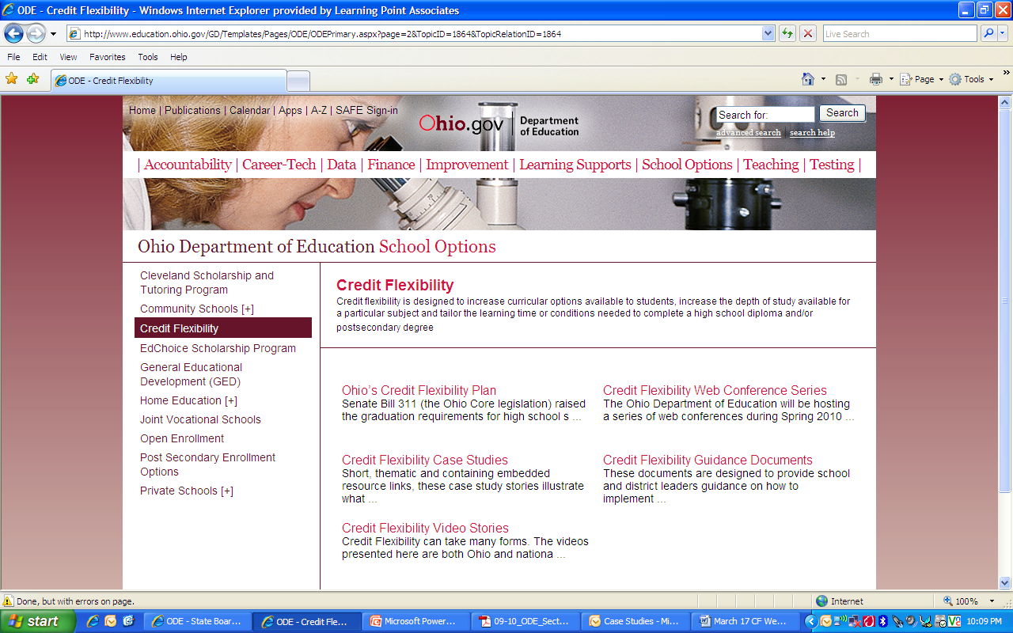
ODE Credit Flexibility Website
Guidance
Case Studies
Web Conference Series
Visit www.education.ohio.gov; Select School Options; Select Credit Flexibility

Slide 4
Credit Flexibility Guidance
Sections Currently Available on These Topics:
General Information (includes information on the Appeals Process and Procedures)
Highly Qualified Teachers
Funding
Assessment and Gifted
Physical Education and Athletic Eligibility
Career-Technical
Students with Disabilities
Implementation Guidance

Slide 5
Credit Flexibility Case Studies and Promising Practices
Upcoming Topics:
Testing out
Use of third-party providers
Highly qualified teachers/Teachers of record
Student credit flexibility plans
Communicating the credit flexibility opportunity
District-level appeal

Slide 6
Credit Flexibility Spring 2011 Web Conference Series
Hosted by the Ohio Department of Education
Intended to support local implementation of Ohio’s Credit Flexibility Policy
    Includes highlights from guidance documents
    Connects participants with Ohio schools, districts, organizations, and related resources for support

Slide 7
Spring 2011 Web Conference Series
Date | Topic
April 12 | Using Third-Party Providers for Credit Flexibility Plans
May 10 | Teacher of Record Planning 2011-12
Please note that recordings and information from these events will be available on ODEs website following each event.

Slide 8
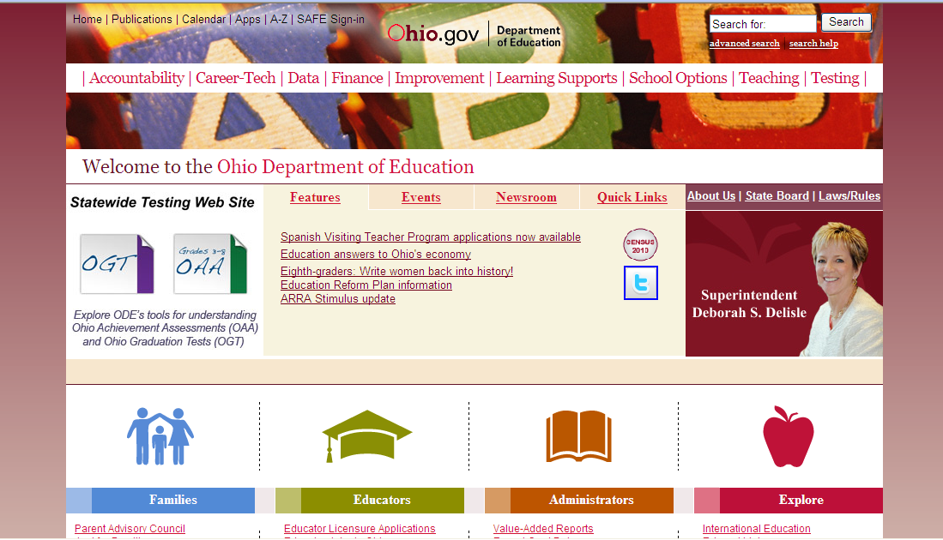
Ohio Department of Education www.education.ohio.gov

Slide 9
Web Conference Series
Materials from this Web conference will be available online:
    Video archive
    Transcript
    PowerPoint presentation
    Q &A Document
Visit www.education.ohio.gov; Select School Options; Select Credit Flexibility

Slide 10
Previous Web Conference
Series Information
Archives for previous events includes recordings, transcripts, and Q&A documents for the following topics:
Engaging Families and Community in Credit Flexibility
Credit Flexibility Focus on Physical Education, Career Technology Education, and Foreign Languages
Assessment Tips: Demonstration-Based and/or Testing Out
Communicate Effectively Your District’s Credit Flexibility Policy
Credit Flexibility Considerations for School Counselors
Teacher-Led Credit Flex Initiatives Using Technology

Slide 11
Previous Web Conference
Series Information
Archives for previous events includes recordings, transcripts, and Q&A documents for the following topics:
Developing Quality Student Credit Flex Plans
Credit Flexibility and Gifted and Special Education
Mastery-Based Assessment Models
Test Out Development and Implementation
School Finance and Credit Flexibility
Credit Flexibility and Highly Qualified Teacher Requirements

Slide 12
Credit Flexibility
A Pathway to Graduation
Third-Party Providers
Thomas D. Rutan
Ohio Department of Education
April 12, 2011

Slide 13
Objectives
Understand the Third Party Providers provision for credit flexibility
Understand the implications and components of Third Party Relationships
Find assistance and examples from the field with Third Party Providers

Slide 14
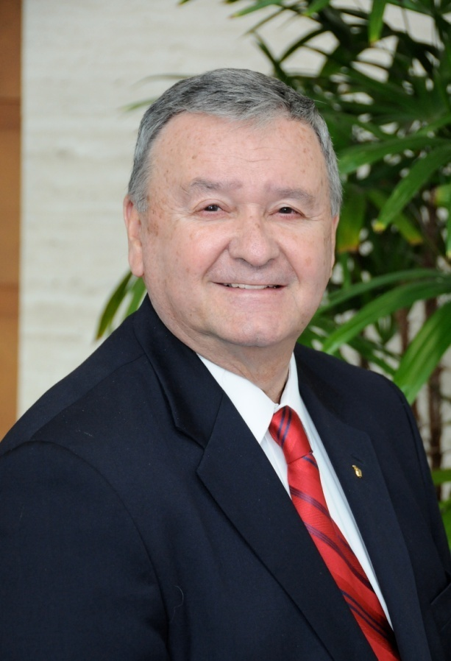
Contact Information
Tom Rutan
Associate Director
Curriculum and Instruction
Phone: (614) 728-1997
E-mail: Tom.Rutan@ode.state.oh.us
Ohio Department of Education
25 South Front Street
Columbus, OH, 43215
education.ohio.gov

Slide 15
Third-Party Providers
Accessing instruction via outside sources:
    Online instruction
    Distance learning
    Post Secondary Enrollment Options
    Dual Enrollment
    Internships/mentorships
    Organizational affiliations
    Credit Recovery Programs
    Private instructors/coaches

Slide 16
Third-Party Implications
Earning credit via external instruction
Allows for both advanced work and credit recovery
Pertains only to high school credit
No limit to kind of course work or number of credits
Provider signs off on the Credit Flex plan

Slide 17
Third-Party Implications
Academic credibility of the provider
Legal liability
Background checks
Transportation responsibilities
Contracting with an Outside Contractor (OC)
Memorandum of Understanding

Slide 18
Third-Party Examples
Traditional coursework
    Distance/online learning
Educational Options
    Educational travel - Foreign Study Tours
    Internship with community artisan
    Post Secondary Enrollment Options
    Dual Enrollment
    Apprenticeships
    Independent Study

Slide 19
Examples
Affiliation with local arts organization
  Community youth orchestra
  Local dance troupe
  Local theater group
Internship with local professional/artisan
  Veterinarian, attorney, banker, accountant
  Mechanic, welder, plumber, electrician, beautician

Slide 20
Examples
Private lessons/instruction/affiliations
  Music lessons
  Gymnastics club
  AAU/Olympic development sports teams
    Residential sports programs
    Cannot be quid pro quo for academic credit
    Must complete comprehensive CF Plan
    Summer camps, seminars, etc.

Slide 21
Third-Party Providers Considerations

Slide 22
Considerations
What are the credentials of the provider?
How will the experience justify the credit?
    Content covered in the course
    Depth and breadth of knowledge and skills expected from the course
Does the educational experience adequately cover the course content?
Who pays the bills?

Slide 23
Considerations
How will the experiences reflect the course of study?
    When will the assessments be taken?
    What types of assessments should they be?
How (who) will the grade be determined?
Can commercial programs be used?

Slide 24
Considerations
Can students use computer-assisted programs for credit recovery?
    Yes.
    The costs for such programs may be the responsibility of the student.

Slide 25
Who Administers?
Local governing authority policies govern.
Teachers of Record are still required for core academic subjects.
OC relationships eliminate the HQT requirement

Slide 26
Questions
To verbally ask a question
  click on the “Raise Hand” icon in the lower left-hand corner of the screen to let the facilitator know you have a question
  The facilitator will prompt you on how to un-mute your phone.
You can also submit questions or comments in the “Chat Pod”

Slide 27
Web Conference Series
Next Steps
  Archive, transcript, PowerPoint presentation, and Q&A document will be available online.
  Participants will receive a brief online survey following the Web conference.
  Credit flexibility Web conferences are currently scheduled through early May.
      The next Web conference is scheduled for Tuesday, May 10, at 1:30 p.m. EST.

Slide 28
Thank you
for participating in today’s Web conference.

