Slide 1
Credit Flexibility—A Pathway to Graduation: Teacher of Record and Highly Qualified Teacher Requirements
Wesley Williams II
Thomas D. Rutan
Ohio Department of Education
May 10, 2011

Slide 2
Web Conference Series cohosted with the Great Lakes East Comprehensive Center
The regional comprehensive centers provide technical assistance designed to raise the capacity of states to help districts and schools meet the goals of the Elementary and Secondary Education Act (ESEA) with the emphasis on the Secretary’s key reform priorities.
Great Lakes East focuses its work in Indiana, Michigan, and Ohio, and is a part of the network of 16 regional comprehensive centers and five national content centers.
For more information, visit www.learningpt.org/greatlakeseast

Slide 3
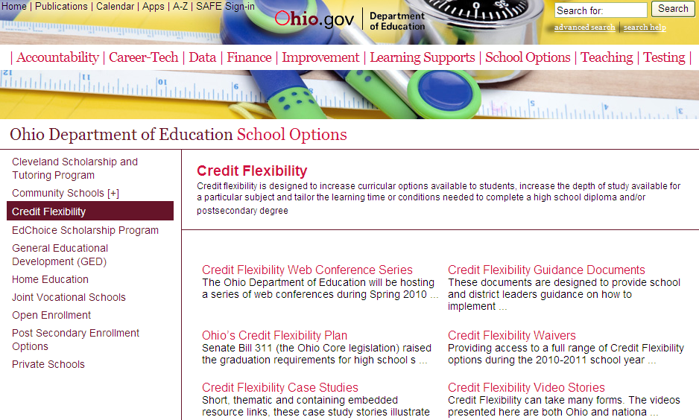
ODE Credit Flexibility Website
Guidance
Case Studies
Web Conference Series
Visit www.education.ohio.gov; Select School Options >> Credit Flexibility

Slide 4
Credit Flexibility Guidance
Sections currently available on these topics:
General information (includes information on the Appeals Process and Procedures)
Highly Qualified Teachers
Funding
Assessment and Gifted
Physical Education and Athletic Eligibility
Career-Technical
Students with Disabilities
Implementation Guidance

Slide 5
Credit Flexibility Case Studies and Promising Practices
Upcoming Topics:
Testing out
Use of third-party providers
Highly qualified teachers/Teachers of record
Student credit flexibility plans
Communicating the credit flexibility opportunity
District-level appeal

Slide 6
Credit Flexibility Spring 2011 Web Conference Series
Hosted by the Ohio Department of Education
Intended to support local implementation of Ohio’s Credit Flexibility Policy
Includes highlights from guidance documents
Connects participants with Ohio schools, districts, organizations, and related resources for support

Slide 7
Spring 2011 Web Conference Series
Date | Topic
March 29 | Test Out Development and Implementation
April 12 | Using Third-Party Providers for Credit Flexibility Plans
May 10 | Teacher of Record and HQT Requirements
Please note that recordings and information from these events become available on the ODE website following each event.

Slide 8
Ohio Department of Education www.education.ohio.gov

Slide 9
Web Conference Series
The following materials from this Web conference will be available online:
Video archive
Transcript
PowerPoint presentation
Q&A document
Visit www.education.ohio.gov; Select School Options >> Credit Flexibility

Slide 10
Previous Web Conference Series Information
Archives for previous events include recordings, transcripts, and Q&A documents for the following topics:
Engaging Families and Community in Credit Flexibility
Credit Flexibility Focus on Physical Education, Career Technology Education, and Foreign Languages
Assessment Tips: Demonstration-Based and/or Testing Out
Communicate Effectively Your District’s Credit Flexibility Policy
Credit Flexibility Considerations for School Counselors
Teacher-Led Credit Flex Initiatives Using Technology

Slide 11
Previous Web Conference Series Information
Archives for previous events include recordings, transcripts, and Q&A documents for the following topics:
Developing Quality Student Credit Flex Plans
Credit Flexibility and Gifted and Special Education
Mastery-Based Assessment Models
Test Out Development and Implementation
School Finance and Credit Flexibility
Credit Flexibility and Highly Qualified Teacher Requirements

Slide 12
Credit Flexibility—A Pathway to Graduation: Teacher of Record and Highly Qualified Teacher Requirements
Wesley Williams III
Thomas D. Rutan
Ohio Department of Education
May 10, 2011

Slide 13
Guidance Documents to Support Today’s Web Conference
The following guidance documents are available on the ODE website:
HQT Requirements
HQT Update: Expert Contracted from Outside Company, Computer as Instructor
Visit www.education.ohio.gov; Select School Options >> Credit Flexibility >> Credit Flexibility Guidance Documents

Slide 14
Objectives
Increase understanding of HQT credit flexibility requirements and considerations
Share information on the new curriculum element and delivery method in Educational Management Information System (EMIS) that supports credit flexibility
Respond to questions related to HQT requirements and credit flexibility implementation

Slide 15
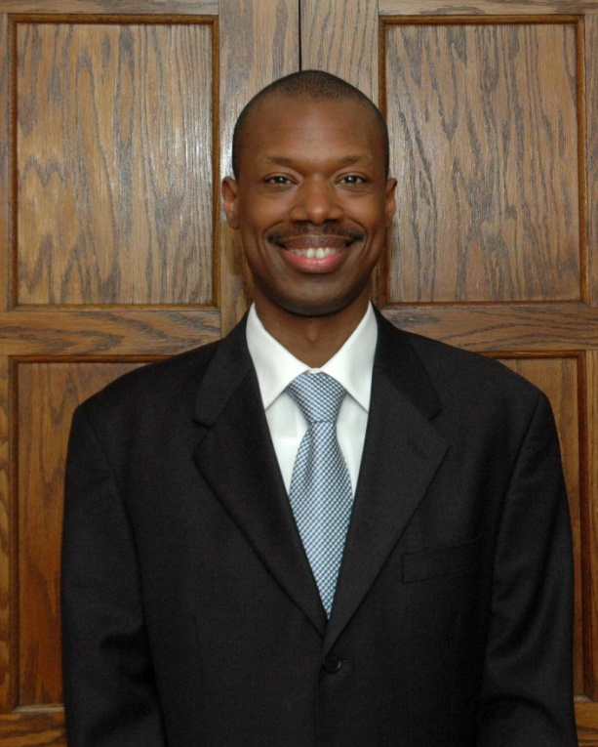
Contact Information
Wesley Williams II
Director
Educator Equity
Phone: 614-728-1726
E-mail: wesley.williams@ode.state.oh.us
Ohio Department of Education
25 South Front Street
Columbus, OH 43215
education.ohio.gov

Slide 16
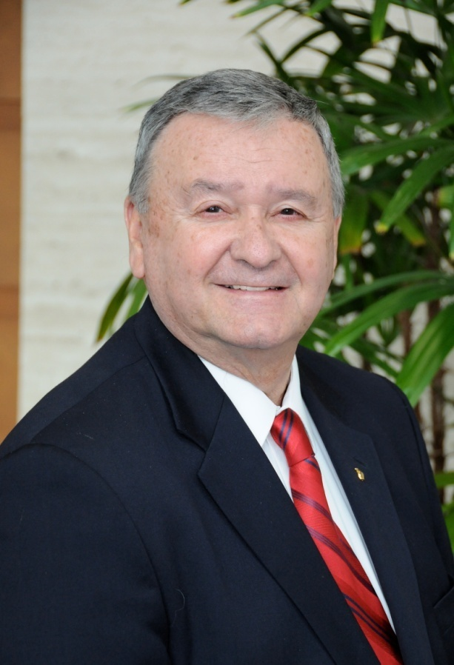
Contact Information
Tom Rutan
Associate Director
Curriculum and Instruction
Phone: 614-728-1997
E-mail: Tom.Rutan@ode.state.oh.us
Ohio Department of Education
25 South Front Street
Columbus, OH 43215
education.ohio.gov

Slide 17
Meeting HQT Requirements
Teachers must have at least a bachelor’s degree.
Teachers must have a certificate/license that is appropriate to their teaching assignment.
Teachers must be able to demonstrate their subject area expertise in the core academic subjects (CAS) as they teach.
(CAS: English, language arts, reading, science, mathematics, arts [dance, music, drama, visual arts], foreign language, government and civics, history, economics, and geography)

Slide 18
Big Ideas
The appropriate credentialed educator at the building level should play an integral role in a student’s credit flexibility plan.
Use highly qualified teachers in core academic subject areas.
Use credentialed teachers or credentialed educator professionals in non-core academic subject areas (e.g., counselor, principal, assistant principal).

Slide 19
Educational Management Information System (EMIS) Requirements
Delivery Method | HQT Requirements (Yes or No?)
Correspondence Course (CC) | Yes (No if an Educational Option)
Educational Travel (ET) | Yes (No if an Educational Option)
Face-to-Face Classroom Instruction (FF) | Yes
Home Instruction (HI) | Yes
Interactive Distance Learning (ID) | No
Independent Study (IS) | Yes
Online (OL) | Yes
Other Delivery Method (OT) | Yes (No if an Educational Option)
Districts continue to adhere to the existing EMIS Reporting Requirements. Any additional guidance on EMIS Reporting for Credit Flex will be provided before the 2011–12 school year.

Slide 20
New Delivery Method in EMIS: Computer as Instructor (CI)
Instruction provided by a computer, with no instruction of any kind provided by a teacher, either in person or from a remote location.
Any teacher monitoring a student in this course:
Would not be involved in adapting or modifying lessons and/or clarifying core academic subject content.
May assign the grade for the course, provided the assignments and/or evaluations are scored by the computer program.
HQT is not required for a teacher who monitors a course described by this new delivery method (CI).

Slide 21
New Curriculum Element in EMIS: Expert Contracted from Outside Company/ Organization (OC) for Credit Flex
OC is a course taught by a content area expert who is employed by an outside company or organization.
The OC provides the instructor under a contract or memorandum of understanding (MOU) to a school district as part of a personalized learning experience under a credit flexibility plan.
HQT is not required for the contracted teacher on the credit flex plan described by this new curriculum element (OC).

Slide 22
Considerations
Use MOUs or agreements between organizations or companies.
Content area experts (CAEs) are employed by a company or organization.
Agreement or MOU is with that entity, not the CAE.
HQT is not required.
Avoid contracting with individuals.

Slide 23
Other Considerations
Credit Flex Plans for students with IEPs
HQT is still required for Credit Flex Plans involving core academic areas for students with IEPs.
Career Technical Education (CTE)
Credit Flex Plans for students seeking mixed or blended credits involving core academic areas with CTE pathways require HQT.

Slide 24
Questions
To verbally ask a question:
Click on the “Raise Hand” icon in the upper left-hand corner of the screen to let the facilitator know you have a question.
The facilitator will prompt you at the appropriate time on how to un-mute your phone.
You also can submit questions or comments in the pod “Submit Questions Here”

Slide 25
Web Conference Series Next Steps
Archive, transcript, PowerPoint presentation, and Q&A document will be available online.
Participants will receive a brief online survey following the Web conference.

Slide 26
Thank you for participating in today’s Web conference.

