Slide 1
Ohio’s Special Education Ratings
July 2021

Slide 2
Topics
What are Special Education Ratings?
What do the ratings measure?
How are student results measures calculated?
How is the overall rating category determined?
How do ratings differ from Special Education Profiles?

Slide 3
What are
Special Education
Ratings?
Notes:
Let’s start with talking about what Special Education Ratings are.

Slide 4
Special Education Ratings
IDEA 2004 requires each state to make annual ratings on the performance of each local district
Ratings evaluate implementation of IDEA requirements
Notes:
Every year, districts and community schools receive a rating on the performance of their special education programs, known as their Special Education Rating.
Annual special education ratings for states and local school districts are part of the Individuals with Disabilities Education Act of 2004, or IDEA. These ratings evaluate implementation of IDEA requirements.
Ohio and every other state receives an annual Special Education Rating from the U.S. Department of Education.

Slide 5
Special Education Ratings Categories
1
Meets Requirements
2
Needs Assistance
3
Needs Intervention
4
Needs Substantial Intervention
Notes:
To make annual Special Education Ratings for districts, the Ohio Department of Education uses final data that districts submit through the Education Management Information System, or EMIS. These data result in one of four ratings:
1) Meets Requirements;
2) Needs Assistance;
3) Needs Intervention; or
4) Needs Substantial Intervention.

Slide 6
Ohio’s Special Education Ratings
2021 district ratings based on procedural compliance data from the 19-20 school year
Ohio’s District Ratings
Notes:
Student results data have been included in the calculation of Special Education Ratings since 2018. However, statewide assessment data are not available for the 2019-2020 school year due to the ordered school-building closure and the impact of the COVID-19 pandemic.
2021 district ratings will be based entirely on procedural compliance data from the 19-20 school year

Slide 7
2021 Ratings Include:
Performance on compliance indicators;
Timely correction of noncompliance;
Submission of valid, reliable and timely data;
IDEA-specific audit findings; and
2019-20 statewide testing data not available
Performance on results measures.
Notes:
In 2019, the Department added student results measures to the Special Education Ratings process.
The 2021 ratings are based on the same measures as 2020, with a couple exceptions. Statewide testing data for 2019-20 is unavailable due to the ordered school-building closure as a result of the COVID-19 pandemic.

Slide 8
2021 Compliance Indicators
Discipline Discrepancies (Indicator 4b)
Disproportionality in Identification for Special Education (Indicators 9 & 10)
Timely Initial Evaluations (Indicator 11)
IEP Developed & Implemented by Third Birthday (Indicator 12)
Secondary Transition Planning (Indicator 13)
Timely Correction on Noncompliance (Indicator 15)
Timely & Accurate Data (Indicator 20)

Slide 9
Informational Results Indicators
Percentage of SWD graduating by meeting standard requirements (federal graduation rate)
Notes:
One additional informational result indicators is included
The percentage of students with disabilities graduating by meeting the same requirements as students without disabilities (federal graduation rate)
This is intended to draw attention to areas of focus from our state determination. This indicator is currently for informational purposes only and is not included in the calculation of the 2021 rating.

Slide 10
Calculating Ratings
The Office for Exceptional Children:
Calculates an average compliance score
Identifies the district by linking the average to the corresponding rating category
Notes:
The 2021 ratings are only based on compliance indicators.
To determine each district’s overall rating based on nine different measures, the Department:
Calculates an average score by dividing the district’s total points across measures by the number of measures for which the district has data (this will be no more than eight, but not every district has data for every measure each year).
After calculating the average, ODE identifies the district’s rating by linking the average to the corresponding rating category.

Slide 11
Calculating Compliance & Results Scores
Total points across compliance measures
Number of measures with data N=9
Compliance Score
Overall Score
Rating | Criteria
Meets Requirements | 3.75 – 4.00 points
Needs Assistance | 3.00 – 3.74 points
Needs Intervention | 1.25 – 2.99 points
Needs Substantial Intervention | <1.25 points
Notes:
We total the points across the compliance measures and divide that total by the number of measures for which the district has data. That total can be up to eight, but many community schools do not have data for every measure. This is the compliance score.

Slide 12
How are
Special Education Ratings
different from
Special Education Profiles?

Slide 13
Profiles vs. Ratings
Special Education Profiles
Special Education Ratings
Sent in late fall
Sent the following summer
Display longitudinal data in graphical format
Based on data from the previous school year
Include results & compliance indicators
Include results and compliance indicators, as well as audit findings
Notify districts of any required actions for the year
Indicators with lower scores already have been/are being addressed
Compliance rates <100% have required actions
Credit given for substantial compliance (≥95%)
Notes:
Special Education Profiles and Special Education Ratings are Ohio’s two primary special education accountability initiatives. These are issued to every district by ODE every year.
It is often helpful to examine the primary differences between the two.
Special Education Profiles are sent in December and provide a preview for the rating. Special Education Ratings are sent the following summer and are based on a subset of data from the profile.
2) While both are web-based reports, Special Education Profiles display the district’s data for the last five years, in table and graph format. Special Education Ratings display data only for the previous school year. So, the 2021 ratings will be based on data from 2019-2020.
3) Special Education Profiles include compliance indicators and results indicators, while Special Education Ratings included only compliance indicators, until 2018, when results indicators were added. Now, both profiles & ratings include both compliance & results indicators. And ratings also include audit findings.
4) Special Education Profiles are used to notify districts of any required actions for the school year, based on findings of noncompliance, data investigations, or selection for survey participation. By the time Special Education Ratings are issued, indicators with required actions have already been or are being addressed.
5) Special Education Profiles include required actions for compliance rates of less than 100%, while Special Education Ratings give full scores for “substantial compliance” rates of 95% or above.

Slide 14
Percentage of Districts Receiving Ratings
*Preliminary counts; subject to change after appeals period
Notes:
This graph identifies the percentage of districts that will receive each of the four special education ratings in 2021 compared to last year.
Fortunately, there have been zero districts in the state that have needed substantial intervention over the last three years.
According to the preliminary 2021 ratings, there is lower percentage of districts in needs assistance and needs intervention than in 2020, with a greater percentage of districts meeting requirements. Of note, the 2021 ratings are based entirely on compliance indicators, while the 2020 ratings also included results indicators.

Slide 15
Number of Districts Receiving Ratings
Rating | Number of Districts Overall Rating
 | 2020 | 2021*
Meets Requirements | 640 | 886
Needs Assistance | 292 | 98
Needs Intervention | 95 | 0
Needs Substantial Intervention | 0 | 0
*Preliminary counts; subject to change after appeals period
Notes:
This is not an apples-to-apples comparison, as the 2020 ratings included compliance and results indicators, while the 2021 ratings are based entirely on compliance indicators.
Interestingly, we have the same number of districts receiving a rating needs substantial intervention as in 2020.
There is also a pretty large increase in the number of districts meeting requirements.
Important to note that there are 43 fewer districts receiving a rating this year than in 2020.

Slide 16
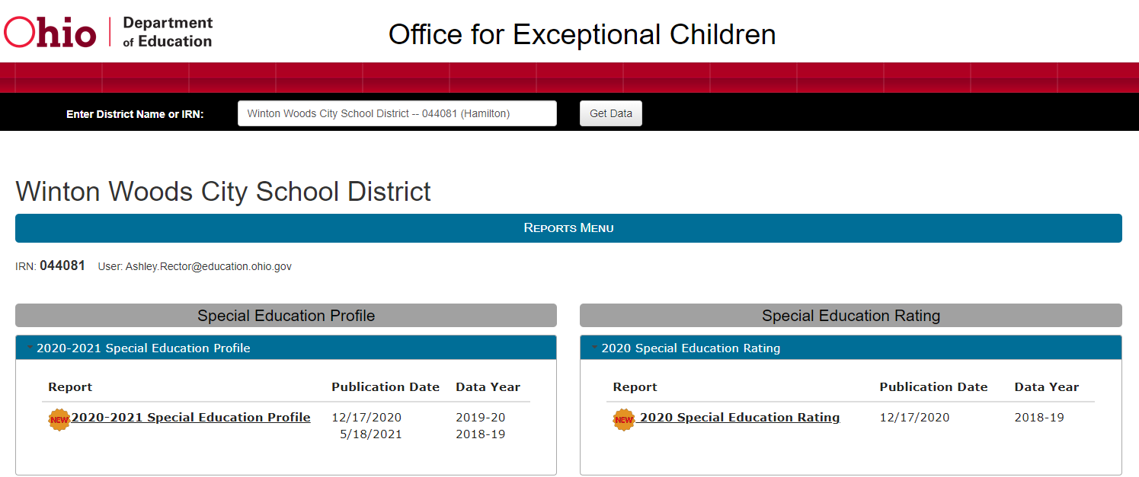
Accessing Special Education Ratings
Districts access their Ratings & Profiles through the OH│ID Portal
Notes:
Special Education Ratings are accessed through the OH | ID portal. Here a district can find both their Ratings and their Profiles.
At the time of the July release, districts will see new links to their 2021 Special Education Ratings. The rating report will be based on a subset of the 19-20 data from the profile.

Slide 17
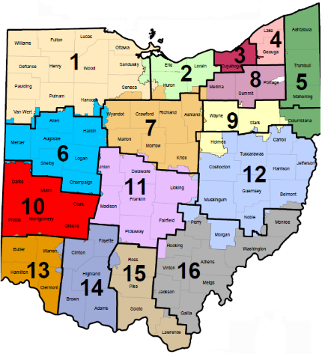
Resources
Send questions to determinations@education.ohio.gov
For assistance with improving your rating, contact your State Support Team.

Slide 18
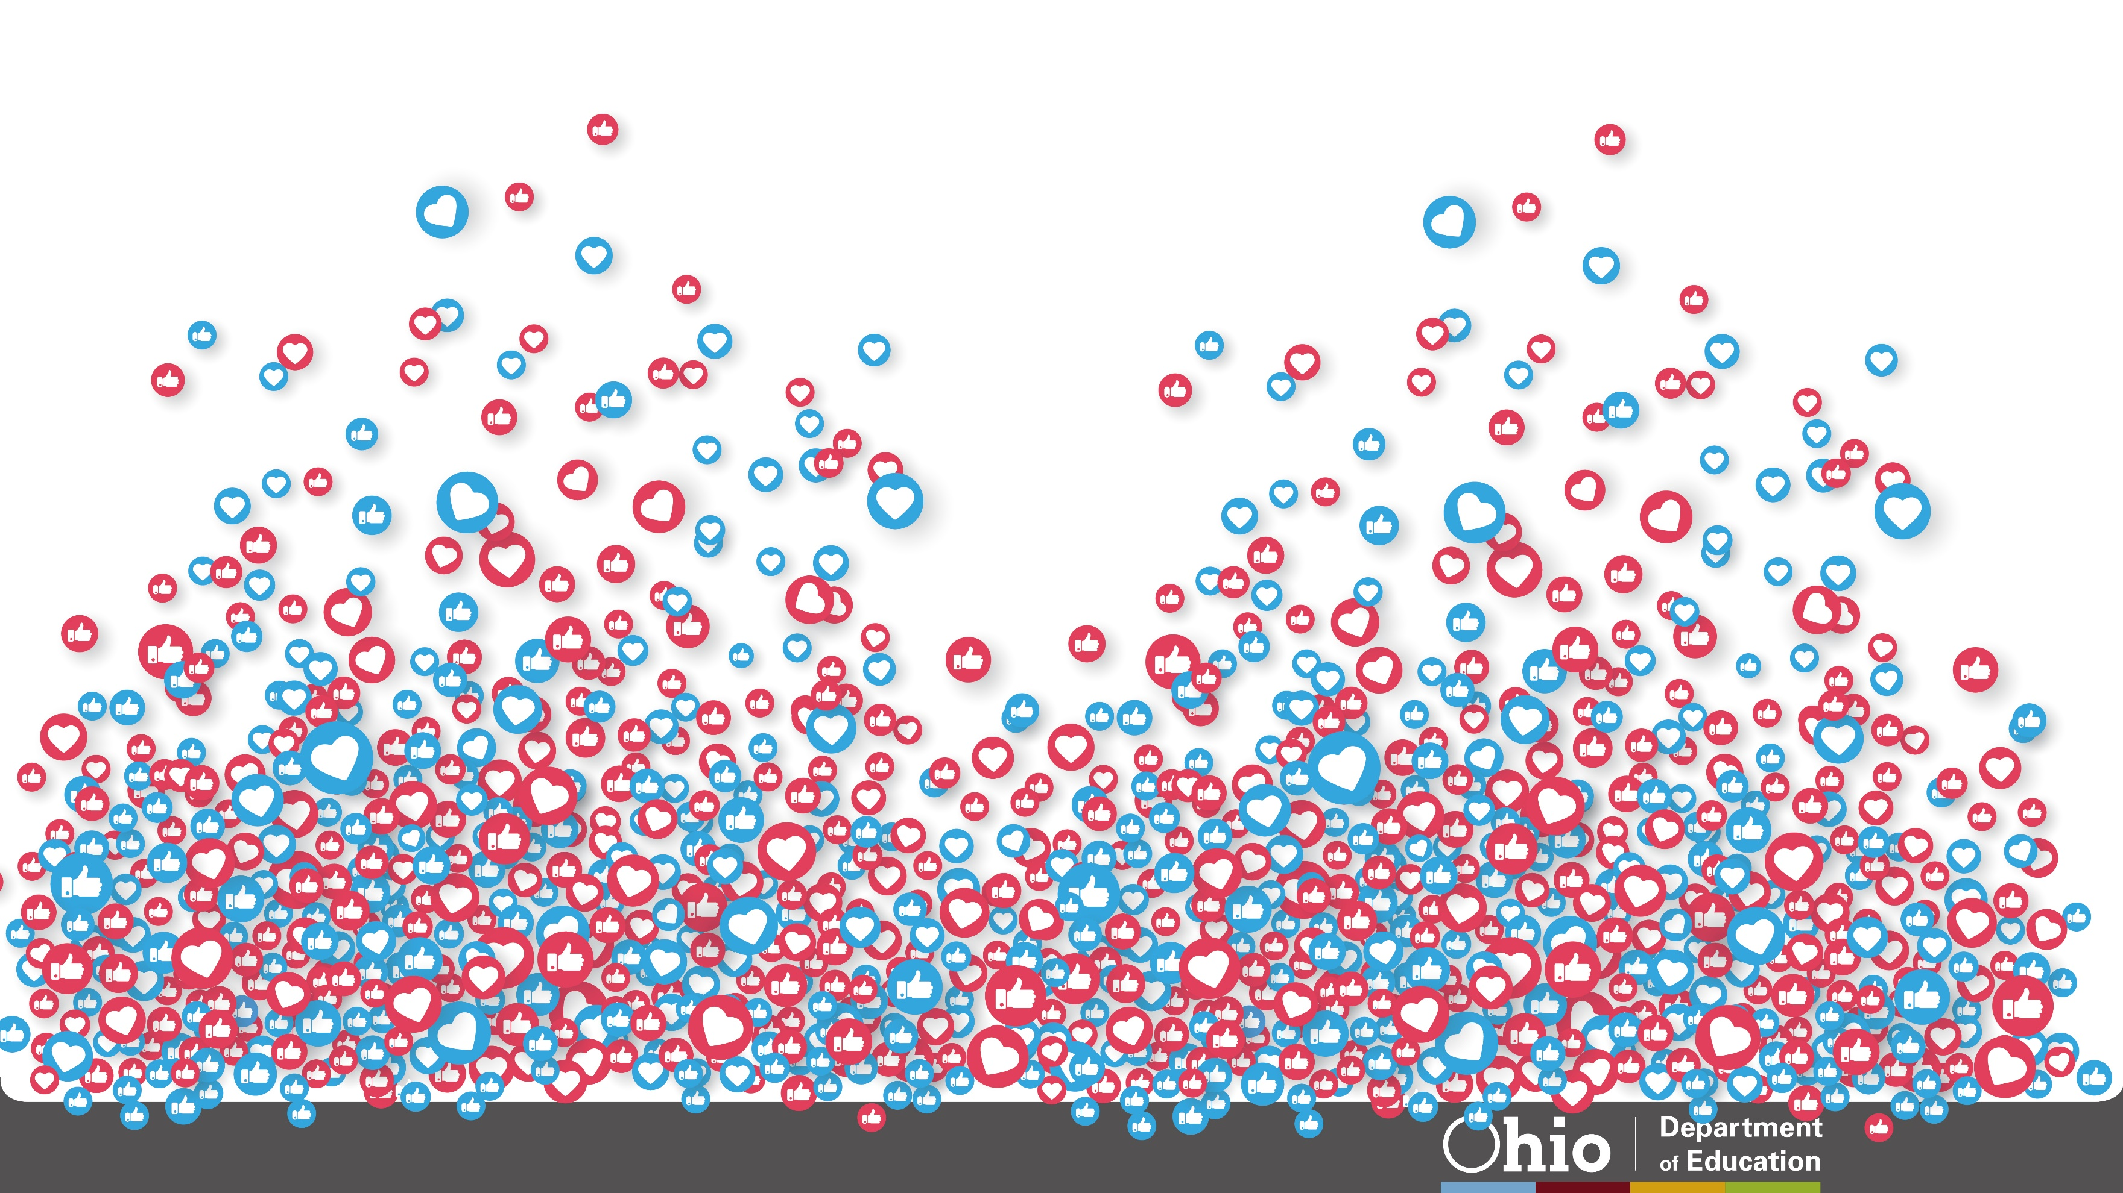
@OHEducation

