Slide 2
Community Partnerships
Patrick Hickman
Ohio’s Attendance Advisor
Office of Whole Child Supports
Department of Education and Workforce
October 2024

Slide 3
Topics
Attendance Webinar Housekeeping
Community Partnerships Overview
Partnership Categories
Peer Examples
Your Stories
Notes:
Starting Point – place to build and stretch our muscles

Slide 4
Family Engagement Critical
Upcoming Webinar Topics
Family Engagement and School Climate – January 13
Mental Health – February 24
Participant Choice – March and April
Feedback link at end
Notes:
Note:

Slide 5
Community Partnerships
Collaborative
Sustainable
Responsive
Mutually Beneficial

Slide 6
How To Begin?
Clearly define needs and goals
Map existing assets and resources
Reach out to collaborate
Maintain open communication channels
Focus on the long-term

Slide 7
Who Does This Include?
Medical Community
Nonprofits
Tech and STEM Organizations
Sports and Recreation Organizations
Local Business
Agricultural and Food Organizations
Higher Education
Faith-based Organizations
Libraries/Cultural Institutions
Media and Communications Outlets
Civic and Government Agencies
Legal and Advocacy Organizations
Senior and Veteran Organizations

Slide 8
Recent Data

Slide 9
Example from Southwest Ohio
Southwest Ohio Council of Governments brought together districts such as Middletown City Schools and Hamilton City Schools to collaborate on family engagement strategies.
Developed a comprehensive family outreach model, where they share resources and collaborate on creating consistent messaging around the importance of attendance.
Programs coordinate support for families:
offering workshops that focus on improving attendance
addressing barriers like transportation
helping families understand the importance of regular school attendance
Pooling resources, providing more to families than they could on their own
Notes:
Recent Ohio-based work done by Innovate K12 – gathering information and stories from schools and districts over past several months.

Slide 10
Where Can You Start?
Notes:
Is anyone willing to share an example of a partnership they have experienced? Whether it’s still budding or long-lasting or somewhere in between?

Slide 11
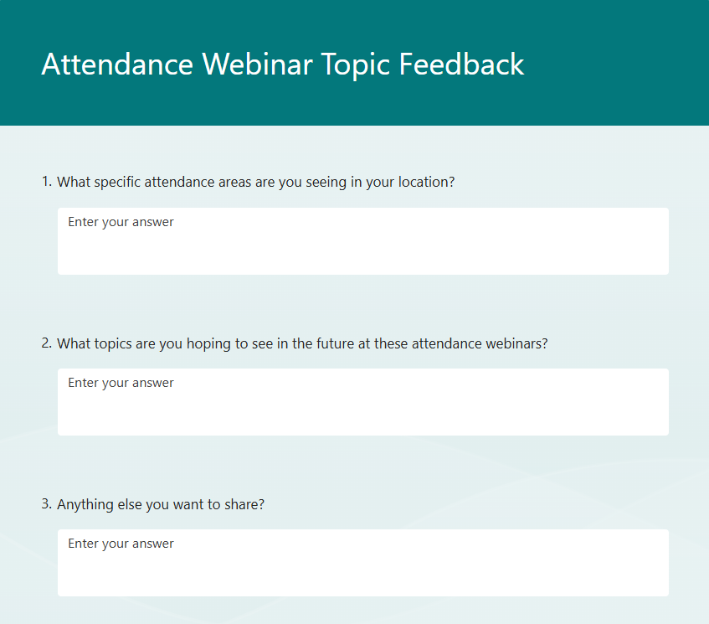
Webinar Feedback
What do you want to see?
Notes:
Note:

Slide 12
Additional Resources
Community and Agency Partners – Attendance Works
Stay in the Game! Attendance Network
DC Public Schools Partnership Toolkit
Seattle Public Schools Partnership Playbook
Notes:
Recent Ohio-based work done by Innovate K12 – gathering information and stories from schools and districts over past several months.

Slide 13
Patrick Hickman
Ohio’s Attendance Advisor
Patrick.Hickman@education.ohio.gov

