Slide 2
Attendance Messaging
Patrick Hickman
Ohio’s Attendance Advisor
Office of Whole Child Supports
Department of Education and Workforce
November 2024

Slide 3
Topics
School Communications
Attendance Messaging
Holiday Messaging
Next Steps

Slide 4
School Communications
Considering all communications:
How often do you send messages and why?
Who sends messaging?
What role do teachers play?

Slide 5
Attendance Communications
Which communications influence student attendance?
All of them!

Slide 6
Notes:
https://www.youtube.com/watch?v=vbyhao0FtaQ&t=13s

Slide 7
Holiday Messaging
Does it include:
Overall attendance messaging
Return dates
Reasons to attend
Family needs while schools are closed

Slide 8
Where Can You Start?

Slide 9
Examine Current Processes
Language Support
Physical Communication
Staff Training
Feedback Collection

Slide 10
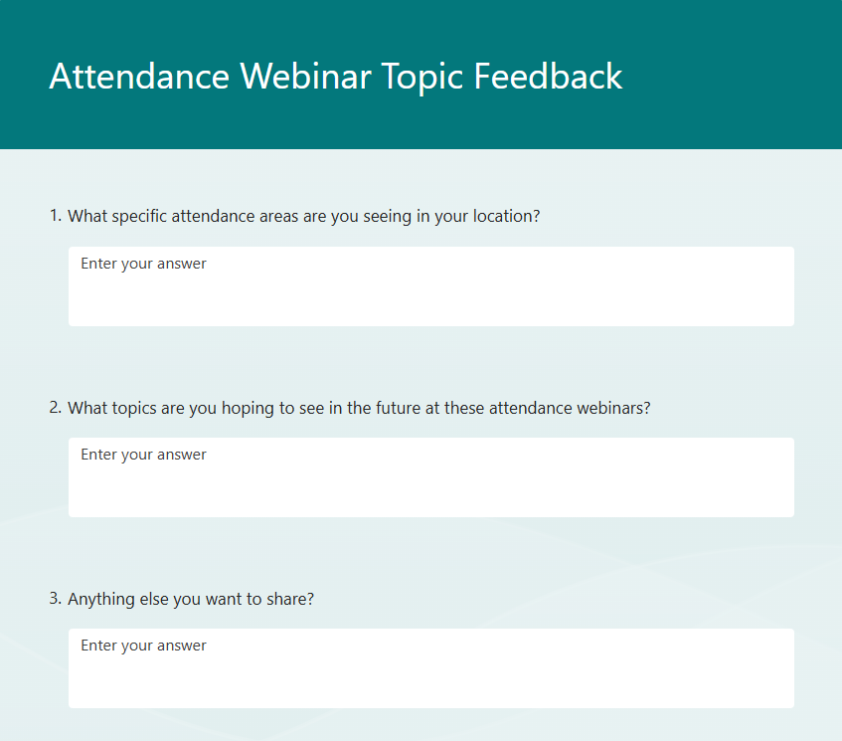
Upcoming Webinar Feedback
What do you want to see?
Examples seen so far:
Mental Health
MTSS Support
Tardies
Specific Examples
Notes:
Note:

Slide 11
Additional Resources
Holiday Messaging– Attendance Works
7 Ways to Promote Positive Communication With Families
Writing for Busy Readers Checklist
Today’s Video

Slide 12
Patrick Hickman
Ohio’s Attendance Advisor
Patrick.Hickman@education.ohio.gov

