Slide 2
Attendance Tools and Resources
Patrick Hickman
Ohio’s Attendance Advisor
Office of Whole Child Supports
Department of Education and Workforce
August 2024

Slide 3
Who’s Here Today?
Notes:
Thank you for coming – who’s here?
And why are you here? What are you hoping to learn? What is top of mind?

Slide 4
Topics
Brief Chronic Absence Overview
Mindset Shift
Attendance Task Force Recommendations
Resource Exploration
Q&A

Slide 5
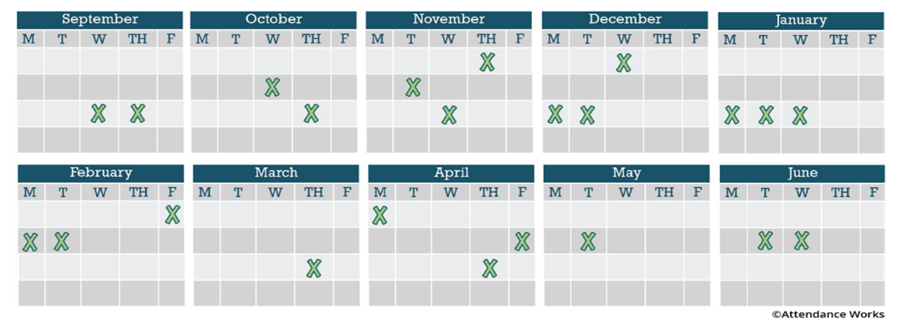
Absences Add Up!
Missing just 2 or 3 days a month can lead to chronic absence.
10% of the school year = 18 days of absence
This translates to almost one month of missed learning

Slide 6
Pathway For Change
Mindset
Actionable Data
Capacity
Strategies
Outcomes
Notes:
Turn and talk: what does your school community currently think about “attendance”?

Slide 7
Notes:
Reference DEW Legislative Team as carrying Rec 5.

Slide 8
Attendance Support Page

Slide 9
Patrick Hickman
Ohio’s Attendance Advisor
Patrick.Hickman@education.ohio.gov

