Slide 2
A Look at Local Data
Patrick Hickman
Ohio’s Attendance Advisor
Office of Whole Child Supports
Department of Education and Workforce
September 2024

Slide 3
Topics
Ohio Chronic Absence Data
Gathering Local Data
Next Steps
Q&A

Slide 4
What is Chronic Absence?
Chronic absence is defined as missing 10 percent or more of school for any reason.
Chronic Absence
Excused
absences
Unexcused
absences
Suspensions
Chronic absence is different from truancy (unexcused absences only) or average daily attendance (how many students show up to school each day).​
Notes:
Chronic absence is defined as missing 10 percent or more of school for any reason.- this includes all time out of school excused, not excused and suspensions.
Chronic absence is a student based statistic

Slide 5
Chronic Absence Statewide

Slide 6
Chronic Absence by Grade Level

Slide 7
Chronic Absence in Ohio by Typology

Slide 8
Chronic Absence – Students At-risk
Notes:
% Of the kids in the vulnerable group who were chronically absent.

Slide 9
Chronic Absence - Economically Disadvantaged
Notes:
% Of the kids who were chronically absent are represented in blue/red with those who are also economically disadvantaged red.

Slide 10
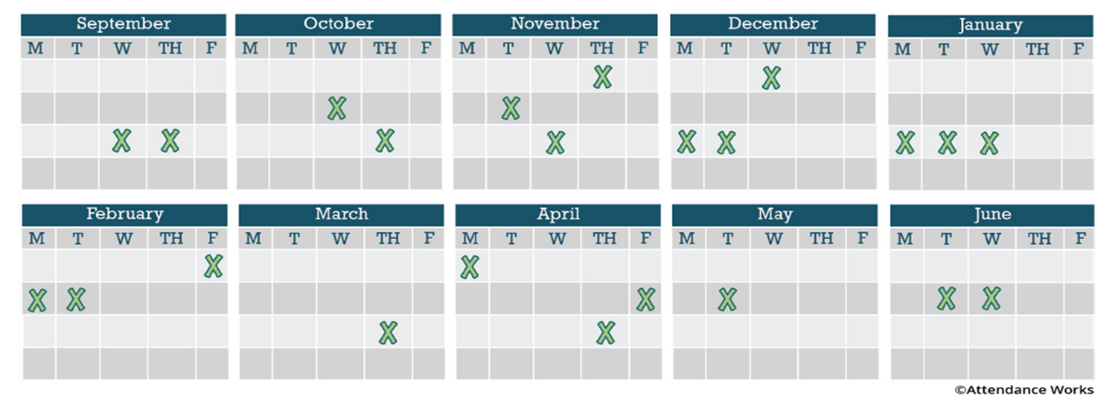
Absences Add Up!
Missing just 2 or 3 days a month can lead to chronic absence.
10% of the school year = 18 days of absence
This translates to almost one month of missed learning

Slide 11
Pathway For Change
Mindset
Actionable Data
Capacity
Strategies
Outcomes
Notes:
30 second note: what does your school community currently think about “attendance”? What about students? Parents and families? The role of school?

Slide 12
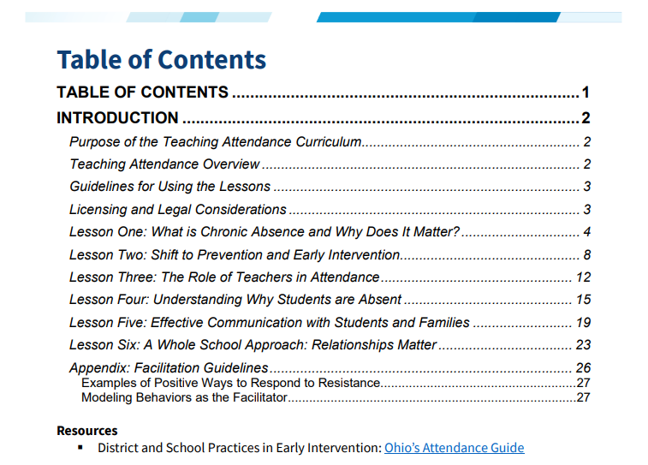
Tools for Mindset

Slide 13
Local Look

Slide 14
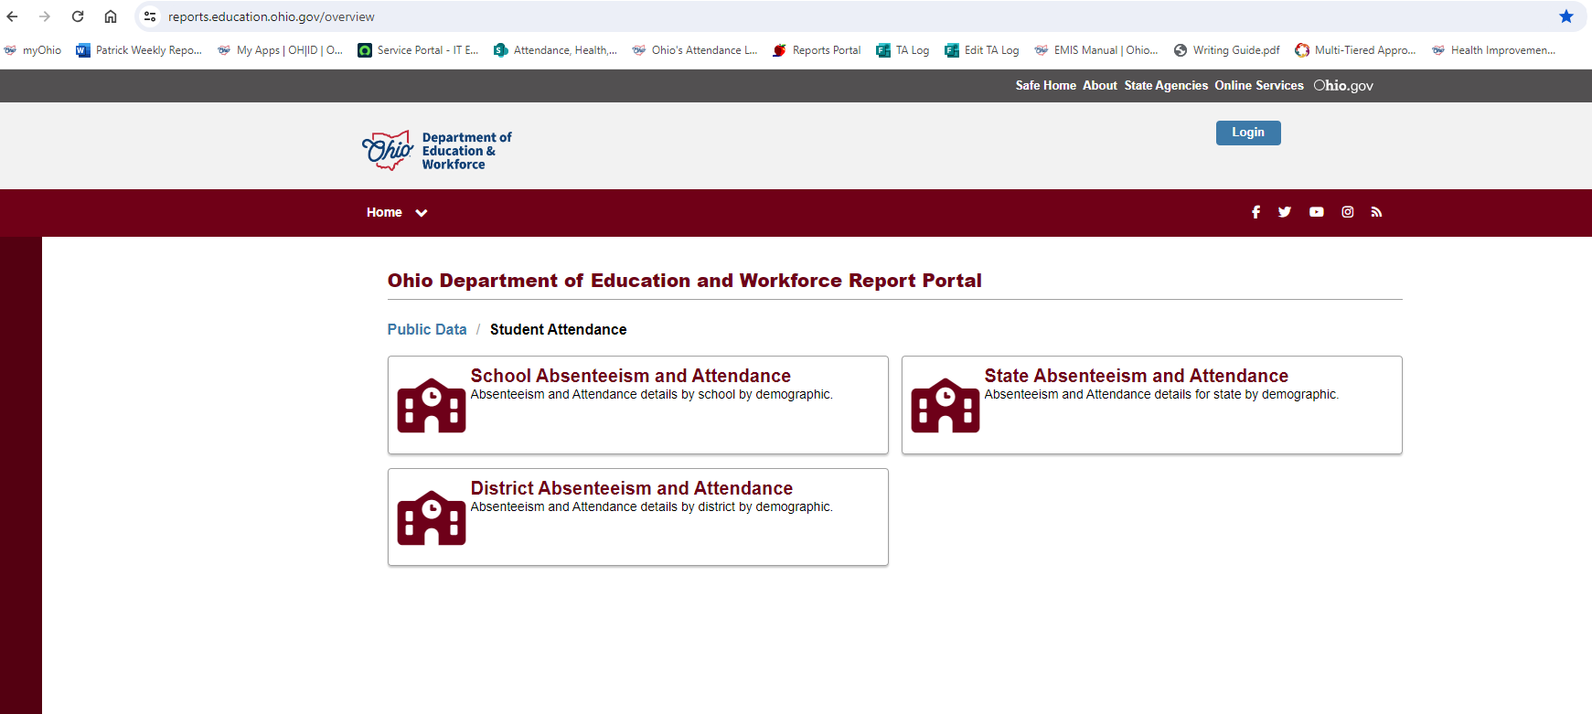

Slide 15
Next Steps

Slide 16
What Do We Notice About:
Students in grades K-3 who were never chronically absent were 6.7x more likely to pass the 3rd Grade Reading Guarantee
Grade Levels?
Student Subgroups?
Disaggregated Data?
Notes:
Things maybe working/not working. Groups/individuals to talk with?

Slide 17
Gathering Qualitative Data
Student Shadowing
Toolkit included
Relationship Mapping
Attendance Works Resources
Empathy interviews and Student focus groups
Root causes
Notes:
We need to do root cause and understand before we start throwing interventions at our students.

Slide 18
Patrick Hickman
Ohio’s Attendance Advisor
Patrick.Hickman@education.ohio.gov

