Slide 1
Reducing Absenteeism through a Wellness Lens
Nicole Kahler, MSSA, LISW-S
Mental Health Consultant
Office of Whole Child Supports
Feb. 24, 2025

Slide 2
Agency Priorities
Literacy
Literacy
Accelerated Learning
Wellness
Workforce Readiness
Workforce Readiness
Accelerating Learning
Student Wellness
Notes:
As you know, the Department has 4 priorities for the students we serve. Those are literacy, workforce readiness, accelerating learning, and student wellness. All of these priorities are interconnected, and our team could present a very strong case that without student wellness, none of these could happen. Students must be healthy physically and mentally to be able to physically attend school and reach their full learning potential.

Slide 3
Office of Whole Child Supports
Safe and Supportive Schools
Safety
Family and Community Engagement
School Wellness
Mental Health
Prevention
Vulnerable Youth
Military
PBIS
School Climate
Attendance
Student Voice
School-Based Health
Medicaid in Schools
Justice Involved
Foster Care
English Learners
Homeless
Out of School Time
21st Century Community Learning Centers
Summer Learning
Notes:
The Department prioritizes student wellness and aims to overcome obstacles to learning, such as experiencing violence or feeling unsafe. Safety issues impact student’s mental, emotional and behavioral health and prevent students from engaging in learning. When schools prioritize both educator and student safety and wellness, educators are in a better position to support students’ needs.
The Office of Whole Child Supports focuses on providing districts, schools, staff, students, and families with resources to support the whole child.

Slide 4
Student Wellness Needs and Challenges
Notes:
Share some of the needs our students are experiencing and then talk about how our data sources can be used to help inform policies and interventions to support students

Slide 5
U.S. Mental Health Landscape
Pre-Pandemic (2009-2019)
1 in 5 youth have a mental or behavioral health diagnosis
40% increase in high school students feeling sad or hopeless
Suicide rates among ages 10-24 increased by 57%.
During Pandemic (2020-2022)
Depressive and anxiety symptoms doubled for youth
Notes:
In discussing mental health trends, many tend to connect the pandemic with a rise of mental health concerns
National surveys of youth PRE-covid have shown major increases in certain mental health symptoms, including depressive symptoms and suicidal ideation.
2009-2019, mental health challenges were the leading cause of disability and poor life outcomes in young people, with up to 1 in 5 children ages 3 to 17 in the U.S. having a mental, emotional, developmental, or behavioral disorder.
Between 2007 and 2018, suicide rates among youth ages 10-24 in the US increased by 57%. Second leading cause of death for individuals in that age range (behind car accidents)
From global health surveys Symptoms of depression and anxiety in youth doubled during 2020-21 and feelings of isolation increased significantly

Slide 6
Ohio Students Mental Health Challenges
1 in 3 Ohio students reports challenges with anxiety
1 in 3 Ohio students reports feeling sad and hopeless
Almost 115,000 high-school aged kids in Ohio have experienced depression
Workforce Shortages
Notes:
Statistic on depression is impactful because research shows that students diagnosed with depression are 2x less likely to complete high school
Mental health in Ohio, NAMI (https://www.nami.org/NAMI/media/NAMI-Media/StateFactSheets/OhioStateFactSheet.pdf)
Behavioral Health Barometer, Ohio, Volume 6, SAMHSA (https://www.samhsa.gov/data/sites/default/files/reports/rpt32852/Ohio-BH-Barometer_Volume6.pdf)
Mental Health in Ohio, NAMI (https://www.nami.org/NAMI/media/NAMI-Media/StateFactSheets/OhioStateFactSheet.pdf)
OHYES! Entire State Report for 2020-2021 (https://ohyes.ohio.gov/Portals/0/assets/Results/AllOHYES/2020-2021.pdf)
2019 High School YRBS Mental Health, Suicide, and Self-Harm Report (https://odh.ohio.gov/know-our-programs/youth-risk-behavior-survey/high-school-data/2019-hs-mentalhealth-suicide-self-harm-report)

Slide 7
Possible Impacts on Learning
Learning
Behavior
Organizing narrative material
Cause and effect
Taking another's perspective
Attentiveness
Regulating emotions
Engaging in curriculum
Lack of motivation
Reactivity and impulsivity
Aggression and defiance
Withdrawal
Perfectionism
Fight, flight, freeze
Notes:
When discussing mental health risk factors and the prevalence mental health diagnoses, it’s important to know how it can impact learning. ​
Wide variety-Large list on the slide
POSSIBLE impacts- not everyone will experience and not all of them/not all inclusive
Also, not all students experiencing symptoms of depression and anxiety have a diagnosis, but could still demonstrate some of these behaviors and benefit from interventions discussed later in the webinar.
Mental health symptoms can impact our memory, our ability to problem solve, and our responses to various situations. ​
Children who have experienced trauma are 2.5 times more likely to fail a grade in school​.
Students experiencing mental health concerns may (if untreated or not receiving supports):
They score lower on standardized tests​
They suspended & expelled more ​
Struggle with attendance

Slide 8
Attendance and Wellness

Slide 9
Factors Impacting Attendance
Poverty and trauma
Lack of belonging
Bullying
Physical Health Concerns
Mental health challenges
Hopelessness
Academic gaps
Transportation
Hopelessness
Peer relationships
Notes:
There is no one reason why children and young people might have difficulties attending school. It varies by individual, and is usually caused by a combination of various factors and their interaction, rather than a single cause. Potential risk factors for non-attendance can typically be split into three main categories: aspects specific to the child or young person, factors to do with the family and home, and issues to do with school. You can see by the list that there are many themes that may overlap with wellness, safety, and school climate.

Slide 10
Ohio Student Safety
In the past year, 8.3% of students rarely or never felt safe and secure at school.
During the past 30 days, 15.6% of students missed at least one day of school because they felt unsafe at school or on their way to or from school.
Of students that had been bullied in the past year, 60.8% were bullied on school property.
23.2% of students did not feel like they belonged at their school.
Notes:
OHYES! 2023-2024 Data
The Ohio Healthy Youth Environments Survey (OHYES!) measures the prevalence of the behaviors and experiences that pose a risk to youth wellness, and those that help to protect it.
The data represents students that participated in the OHYES! during the 2023-2024 school year. The data is not representative of all students in Ohio. Participation is anonymous and voluntary; students may skip questions or opt out.

Slide 11
Student Wellness and Learning
Psychological Safety
Science of Learning and Development
Students learning occurs through the interconnection between cognitive, social, affective, and emotional functions occurring simultaneously.
Notes:
School safety is linked directly to student and school outcomes. When students feel safe, they are better able to focus on learning, leading to increased academic achievement
It’s important to consider both emotional and physical safety in school. Students experiencing physical or emotional harassment are at risk for poor attendance, course failure, and school dropout. A secure environment that fosters physical and emotional growth can support learning, build trust, and improve mental health.
Students learn best in environments that foster positive relationships, safety, belonging, provide rich learning experiences, self-directed learning, teach social skills, habits and mindsets and provide supports and services that reduce barriers to learning.

Slide 12
Chronic Absence Statewide
Notes:
I’m not going to spend time reviewing Ohio’s attendance data because I believe Patrick and other presenters in this series have talked about it at length. But I wanted to include this graph just as a reminder of how significant Ohio’s chronic absenteeism rate is and remind you that it is a State priority to cut it by over 50% over the next 5 years

Slide 13
Importance of Attendance
Connection between student wellness and absenteeism
Students who were never chronically absent were 3x more likely to be proficient in ELA​
Students who were never chronically absent were 3.9x more likely to be proficient in Math​
Notes:
So why do we focus on attendance data as an important driver for state priorities? This is the only data we collect for all students, regardless of population or openness to reporting
Connection between student wellness and absenteeism but Data around mental physical health is protected
Physical health, mental health,, and social factors all cause children to be chronically absent from school. Untreated asthma, dental concerns, depression, and anxiety are the top reported medical conditions for school absence.
Attendance to school has a direct correlation to long-term academic success.
Students who were never chronically absent were 3x more likely to be proficient in ELA​
Students who were never chronically absent were 3.9x more likely to be proficient in Math​
All tied together- students are well, more likely to come to school, perform better. Improving attendance allows more time to support student social, emotional, behavioral, and academic needs.
The Link Between School Attendance and Good Health | Pediatrics | American Academy of Pediatrics

Slide 14
Supporting Student Wellness and Attendance
Notes:
Spend some time looking at wellness strategies to support students.

Slide 15
Wellness: a Multi-tiered Approach
Continuum of Care to promote:
Academic success
Reduced absenteeism
Decreased behavioral concerns
Improved school climate
Notes:
For some students, mental health symptoms may first present at school. Mental health treatment in schools is effective in reducing mental health symptoms especially when treatment is integrated into the academic setting. Partially because they are a captive audience but also because of the ability to have a strong team of professionals to support and monitor the child.
A comprehensive approach to student wellness should be a continuum of care that includes:
Positive school climate;
Developing Social skills;
Promoting Mental health and well-being;
Support for students and staff;
Trauma-informed practices.
Studies from The National Alliance on Mental Illness and the National Research Council have shown that implementing these strategies contribute to improved student and school outcomes
:Greater academic success;
Reduced absenteeism;
Decreased behavioral concerns;
Improved school climate; and
Improved academic outcomes.

Slide 16
What Schools and Districts Can Do
Use data to inform decisions
Develop partnerships
Prioritize evidence-based practices and strategies
Implement universal wellness supports
Strengthen Tier II and III supports
Offer professional development
Notes:
Suggestions on the screen are part of a Comprehensive school Mental Health Framework recommended by the University of Maryland’s National Center for School-Based Mental Health (more resources at end). Comprehensive school mental health systems are built on the work and collaboration of district and school professionals), in strategic partnership with students, families and community health and behavioral health partners.
Actionable steps that schools and districts could consider include:
Looking at your data so all school staff and partners are able to see what the students are experiencing. It will help guide decisions about supports and show gaps of services within the school. Later in the presentation we will dive more into Ohio specific data sources
Engage in partnerships for gaps because we know schools can’t provide everything on their own. Community partners can support districts by providing content expertise, data, planning support and human or financial capital. They may be able to fill gaps and remove barriers, help establish new programs or expand existing programs.​
Prioritize EBP throughout all processes: teaming approaches, continuum of services (consider prevention, mental health, wrap around support)
Implement wellness supports for students and staff​
Strengthen tier II and III-Looking at Data and partnerships
Professional Development- Behavioral Interventions, Mental health literacy, Wellness, Trauma informed practices​

Slide 17
Universal Strategies as a Priority
School Climate
Connectedness
Protective Factors
Resiliency
Notes:
As discussed earlier in the webinar, more and more of our students are experiencing mental health symptoms. Again, I will reiterate that does not mean they all have diagnoses, but the symptoms have been increasing over the last 20 years and are impacting how they learn, connect, and thrive each day. This means our approach to supporting all students must also account for that.
Taking a whole-school approach to student wellness has benefits for students, staff and families. It means involving all aspects of the school community in promoting and supporting wellbeing. Schools are environments that can foster positive relationships, safety, belonging, and provide supports and services that reduce barriers to learning. Not only are those factors important to having a positive school climate, which will lead to higher student academic success, but they are opportunities to build resilience in students.
When students feel supported and cared for in their school environments, they can be less likely to abuse substances, to become involved in violence, and to participate in other problematic behaviors. These students are also more likely to develop positive attitudes toward themselves and prosocial attitudes and behaviors toward others.
The daily contact schools have with children is a unique opportunity to build a positive school climate by promoting protective factors.
Protective factors are positive experiences, resources and assets that can buffer children and families against the harmful effects of Adverse childhood experiences and trauma. They are also associated with improved health and well-being. Protective factors can be a universal strategy regardless of what a student has experienced.
Stress is an unavoidable consequence of life. Stress in small doses is healthy, and helps foster problem solving, excitement, brain growth, and tolerance. (Think a new job or project) However when it is consistent over time, it can cause physical and mental health concerns. Resilience and the ability to manage stress contribute to academic and professional success, healthy interpersonal relationships, confidence in oneself, and is a positive predictor of life satisfaction.
​

Slide 18
Trauma-Informed Schools Build Resiliency
Focus on relationships
Promote safety and trustworthiness
Engage in choice and collaboration
Encourage skill-building and competence
Notes:
Trauma informed schools can also help build resiliency and reduce the harm adversity may cause in students.
Again, schools are in a unique position to support this. Trauma-informed schools create school policies, practices and cultures that are sensitive to the needs of their population and ensure that all individuals meet their maximum potential.
Trauma-sensitive schools acknowledge the prevalence of traumatic occurrence in their students/staff’s lives & create a flexible framework that provides universal supports.
Examples on the screen are directly connected to what research shows the brain needs to both overcome adversity and build resilience..
Building safe, supportive relationships (most effective neurobiological interventions) helps the brain stay regulated
When students are regulated, they feel safe. This allows them to learn and practice new skills. When students feel successful in school, they are also more likely to come regularly.

Slide 19
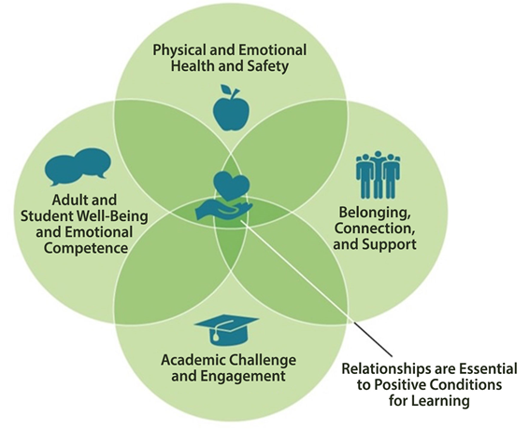
Strategies to Support Positive Conditions for Learning
Healthy learning environments
Welcoming, safe school climate
Access to food and other basic needs
Access to health care and mental health supports
Trauma-informed practice
Staff self-care
Active student and family engagement
Advisories and meetings to build community
Enrichment and clubs
Positive peer connections
Access to tech and internet
Learning supports
Project-based learning
Credit recovery opportunities
Internships or community service
Alternative scheduling options
Notes:
When our office works with schools and districts, here is a good visual for recommendations on increasing positive conditions for learning. I’m sure you’ve seen this graphic before, but I want to highlight some components from a wellness lens. If schools offer a safe, welcoming, inclusive environment, students are more likely to attend school and have higher academic achievement.
An important recommendation on increasing student attendance is focusing on universal strategies to improve school climate.
Basic needs, School and learning can’t/won’t be a priority- how can you help? What community partners?
Supports, services for students and staff
Regulation/Focused Attention practices: Building a school culture that recognizes all emotional reactions as normal helps students feel safe to express their
Students must be regulated in order to learn and move lessons from working memory to short term to long term memory. Dysregulated adult can not regulate a child.
Regulation practices leads to increased engagement, task perseverance, creativity, decrease in class removal and overall school wide decrease in behavior challenges
Brain breaks vs this. Energizing focused attention activity-activates the learning part of brain.
Help students stay at baseline to enhance learning or reduce likelihood of intense emotions.
Staff- where do they go? Regulation opportunities,
Staff education Awareness
Build teacher competencies
Reflect on what kind of PD is being done with TIC and similar topics
How can you promote this/fold into other frameworks like PBIS?
Consider schoolwide data or information and how it impacts practices.

Slide 20
Tier II and Tier III Supports (Individualized)
Skills instruction and individualized regulation
Increased connection (staff, peers, mentoring)
Case management and counseling services
Notes:
Tier 2 and 3 interventions are more specified interventions for a student who has shown signs of risk of chronic absenteeism. It is important that school's address each of these as a case-by-case basis to ensure that they are identifying the barriers the family faces and then can provide them with adequate needs to overcome these barriers
Social Skills Instruction-deficits in social skills can look like behavior problems, which can lead to consequences or internalizing behaviors; groups also fosters connection with school adults and peers
-Breakfast club: soft start intervention in alternative location. Helpful for kids who can’t make the quick transition from home/bus to academics
Regulation- I mentioned how regulation should be a universal approach but some students may need more opportunities or different strategies
Connection :
When students feel supported and cared for in their school environments, they can be less likely to abuse substances, to become involved in violence, and to participate in other problematic behaviors. These students are also more likely to develop positive attitudes toward themselves and prosocial attitudes and behaviors toward others.
Walk/talk with staff or older students, learn more about what may be happening at home)
-Check in/Check out (can you do it with a regulating?)
-When engaging in plans like previous slide, consider who can be utilized (other students and staff)
Case management or counseling services
- Parent engagement early on to let them know this is a possibility and get buy in

Slide 21
Family Engagement
Feelings of belonging
Frequent check-ins
Plans
Community partners
Notes:
Families:-bring parent/caregiver voice to the table:
Ensuring that caregivers feel connected and involved with the school is key to supporting children’s mental health. Some may have had difficult times at school themselves when they were younger, and their confidence in the ability of the school to support their child may be low. By finding ways to involve them in school life and communicating and working in partnership with them, you will build caregivers’ trust in the school. If they trust that school staff will listen to them and their child, they will be more able to support the child to attend school, as they know that they will be cared for and their needs will be met. Schools that have strong family engagement strategies have been shown to have higher attendance rates.
Some recommendations at the school level include:
Identify programs as supports and resources, not consequences.
Remember they May be experiencing their own MH concerns
Encourage healthy habits and routines - sleep education, routine in the morning to get to school
Co-produce a return to school action plan in collaboration with the student, their family and relevant school staff. . If the student is finding the idea of returning to school particularly difficult, the plan could focus on smaller steps – like meeting a friend from school or completing a piece of work – to begin the process of returning to school.
Communicate your programs and supports to families and community partners (basic needs)

Slide 22
Importance of Staff Wellness
Engagement
Regulation
Community of support and resources
Notes:
Staff wellness has been mentioned throughout the webinar, but it’s important to continue to highlight its importance in maintaining positive school climate. Studies show that occupational wellness aligns with job engagement. Our motivation to give back or make a difference drives our work.
Healthy engagement requires us to be balanced and set boundaries with priorities, time, and energy.
As mental health and behavioral concerns have risen over the past several years, it is important to consider the impact this had on our school staff. Acknowledging this at the universal level can show support, build capacity and confidence in handling difficult situations.
Dysregulated adult can not regulate students. You can support staff in identifying their own triggers.
Coping in and out of school
How can you offer staff a break? (app example)
Physical movement throughout the day
Consider- What do you have in place to promote wellness in the district or building level?
Are staff aware of resources to support their needs? Things like EAP or other staff wellness programs. How can staff build a cohort? There are plenty of online communities now.

Slide 23
Informed Decision-Making and Sustainability
Notes:
Now that you have some knowledge about strategies and frameworks to support wellness and attendance, I will share some resources to help you make informed decisions about what would fit best for your school or district

Slide 24
youthsurveys.ohio.gov
24
Notes:
Nicole
The state leads a coordinated youth survey effort led by the Departments of Mental Health and Addiction Services, Health, and Education and Workforce
These youth survey include the OHYES!, the Youth Risk Behavior Survey/Youth Tobacco Survey (YRBS/YTS), and School Health Profiles.
These are voluntary surveys that offer a look into the experiences of youth in different communities across Ohio. The surveys measures the frequency of the behaviors and experiences that pose a risk to youth wellness, and those that help to protect it. For example, may ask about substance use or feelings of connectedness to an adult.
Using these insights, we can learn where Ohio students are thriving and plan supports to create environments in which youth can learn and grow.

Slide 25
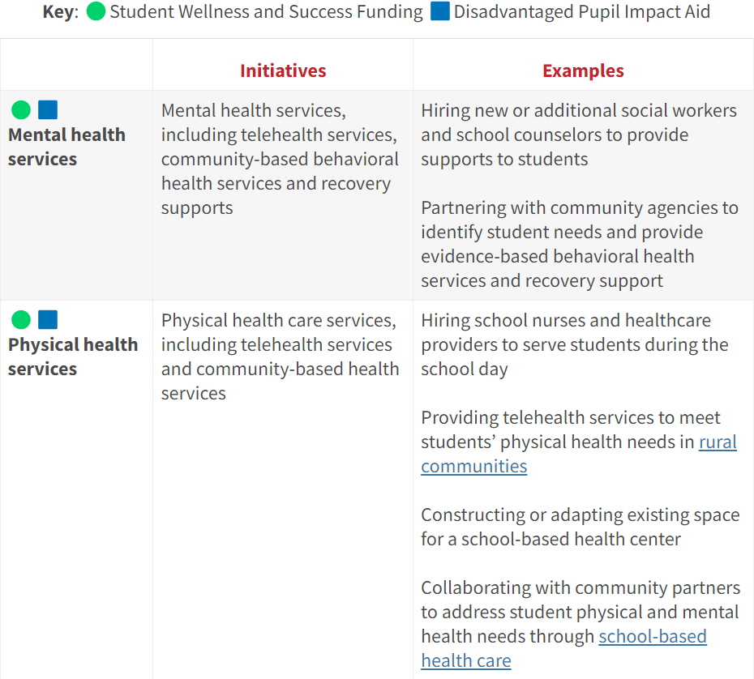
Supporting Student Wellness
School Payment Reports
Supporting Student Wellness
At least 50% of SWSF must be used for mental or physical health services or a combination of both
Notes:
SWSF are state funds allocated yearly to traditional school districts, community schools, joint vocational school districts and STEM schools.
SWSF specifically require At least 50% of SWSF must be used for mental or physical health services or a combination of both

Slide 26
Resources
Mental Health
Ohio Department of Education and Workforce School-Based Mental Health
National Center for School Mental Health
Mayerson Center for Safe and Healthy Children
SAMHSA: Program Finder and Resource Center
National Attachment and Trauma Network
School-Based Center of Excellence for Prevention and Early Intervention

Slide 27
Resources
Attendance
Ohio’s Attendance Guide
Attendance Works: Attendance Playbook
Funding Attendance Programs
School and District Support

Slide 28
SchoolBasedMentalHealth@education.ohio.gov

