Slide 1
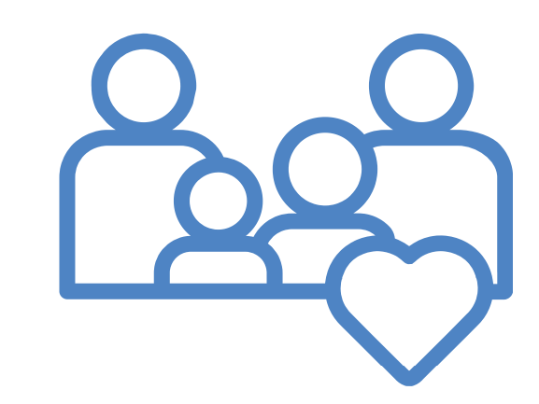
Family Regulation Kits

Slide 2
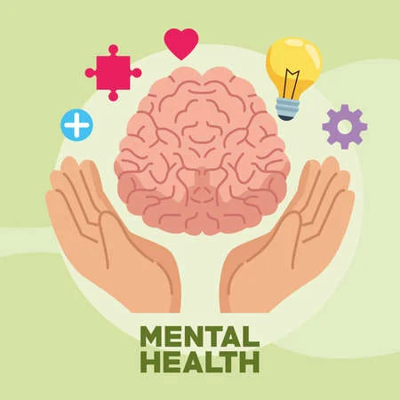
Purpose
Address increasing mental health impacts in our community
Provide education and tools to manage mental health proactively
Provide tools while child is on a waitlist for services
Understandable for all, don’t need a therapist to lead these.

Slide 3
What is different?
Engages family together
Families talking and supporting one another can have big impact
Helping parents to manage own mental health to be able to support their child.
This information is not new and is out there, but many families are not using it , this sets it up to be simple and fun.

Slide 4
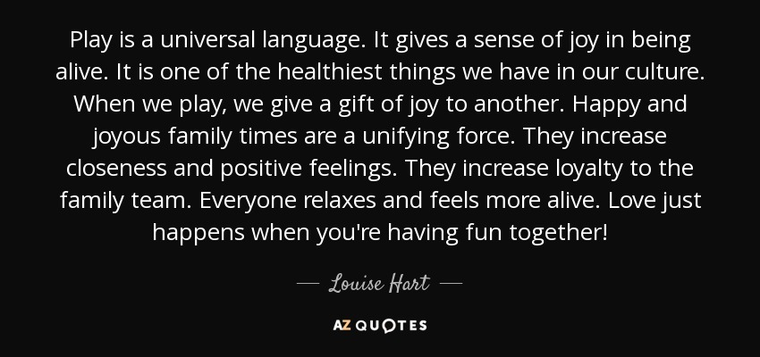
What is different?
Developmentally appropriate
Activities can be used for all ages of kids.
Teaches that kids (and most adults) communicate and process better through other strategies then just “how are you/what is wrong?”
This gives them many options of language and techniques that might work for their child.

Slide 5
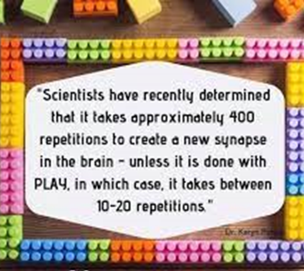
What is different?
Experiential and play-based
Surprise of each packet, can keep kids engaged
Starts helping families see the importance and powerful change that can happen through play!
More likely to continue be used as play-based

Slide 6
The Kit
Each family receives a kit that includes 4 “Mystery” envelopes
*The Mystery and “unboxing” is already a way to keep kids engaged.
*Don’t open them until it is time!
Ideal time frame is 1 a week, so that is a month of intentional mental health focus and connecting activities in the family!
The front of the envelope each offers a different way to check in with one another. It starts modeling that children (and adults) often need different tools to communicate than direct questions (which tend to shut down).
Inside
Brief education on the mental health tip
A few family and connecting strategies they can try
A play-based material to keep that aligns with the tip/activity

Slide 7
4 packets in the Kit (order does not matter)
15 minutes of Sunshine boosts mental health (Nature Play)!
Using our 5 senses to calm and regulate (Coping Skills)
Co-regulation (We best can help calm others by calming ourselves)
Finding the Positives (Change occurs and relationships improve with focus on the positive)

Slide 8
Packet 1
Check-in Activity

Slide 9
Mental Health Tip

Slide 10
Play-Based Strategies

Slide 11
Prop/Play-Based Material

Slide 12
Packet 2
Check-in Activity

Slide 13
Mental Health Tip

Slide 14
Play-Based Strategies

Slide 15
Prop/Play-Based Material

Slide 16
Packet 3
Check-in Activity

Slide 17
Mental Health Tip

Slide 18
Play-Based Strategies

Slide 19
Prop/Play-Based Material

Slide 20
Packet 4
Check-in Activity

Slide 21
Mental Health Tip

Slide 22
Play-Based Strategies

Slide 23
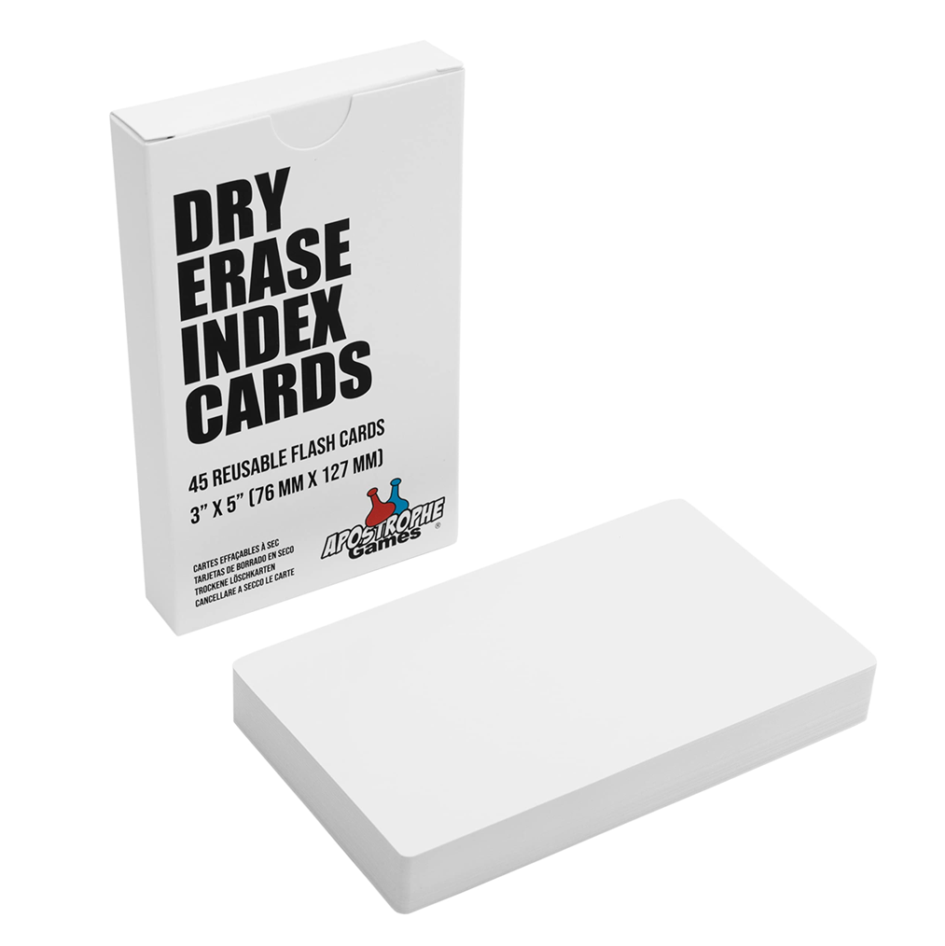
Prop/Play-Based Material

Slide 24
Funding Source
Goal: Reach 500 families
With each receiving 4 packets- that is 2000 Packets!
Budget $1887.46 (see attachment for details)
Will add list of acknowledgments of those who supported/funded project to directions page

Slide 25
Volunteers Needed
To assemble the Packets
Lunch will be provided

Slide 26
Distribution Plan
Ideas?
Wrap around workers
Community BH Providers with Waitlist
Community Resource Fairs
What else?
Acceptance Contract?
Packet is free but we ask workers that use them, provide us with their contact info so that we can later get feedback.
Thoughts?

