Slide 1
Resident Educator Program Orientation
2-Year RE Program
Rev. 7/20/23
SY 2023-24
Notes:
This orientation provides an introduction and overview of the Ohio Resident Educator Program.

Slide 2
The one question to never stop asking…
“How can I be a better educator tomorrow than I am today, and lead others
to do the same?”
Notes:
The process of becoming an effective educator never ends. The Ohio Resident Educator Program supports Resident Educators as they practice, refine and gain a deeper understanding of the art and science of teaching. The Ohio Resident Educator Program is a two (2)-year teacher induction program designed to accelerate the development of new teacher effectiveness to increase student learning. The mentoring component of the program is focused on creating collaborative, instructionally focused mentoring partnerships to foster reflective practice and life-long continuous improvement. The question for educators to keep asking is: “How can I be a better educator tomorrow than I am today, and lead others to do the same?”

Slide 3
Orientation Topics
Teacher Residency and Induction Programs
The Ohio Resident Educator Program
Resident Educator License types
Mentoring Principles and Best Practices
Resident Educator Summative Assessment (RESA)
Resources
3
Notes:
This orientation provides an overview of what Resident Educators (REs) can expect as they embark on their journey through the two-year Ohio Resident Educator Program. The presentation also discusses the support that will be provided to Resident Educators by the principal, program coordinator, mentor and facilitator. Tools and resources are available to ensure a successful “Journey to Excellence.”

Slide 4
Resident Educator License
STANDARD. Resident Educators receive a two-year license beginning April 23, 2023
EXTENSIONS. Standard license holders who complete Year 1 of the Resident Educator Program may apply to extend their 2-Year licenses for an additional year in order to complete the Resident Educator Program. There are no coursework requirements to extend this license.
ALTERNATIVE. Individuals must complete 4 full school years of teaching, even though the RE Program can be completed in 2 years. Changes are expected to this requirement in 2023-24.
Notes:
Our Office of Educator Licensure determines what license an educator is eligible to hold. Any specific questions about a license should be directed to our Office of Educator Licensure at educator.licensure@education.ohio.gov
Standard 2-Year Resident Educator license holders who have not yet completed Year 1 of the Resident Educator Program will be required to complete coursework and renew their licenses for two more years. If renewal or extension of the Alternative RE license is required to
complete the teaching experience requirement, the educator must first meet all exam and coursework requirements of the Alternative Resident Educator pathway to advance to the professional license. Changes to the requirement to teach 4 years under the Alternative license are expected in 2024. The license will become a two-year license.

Slide 5
Teacher Residency
A two-year entry-level program for classroom teachers that shall include:
Mentoring by teachers within the two years of the program
Counseling as determined by the school district or school to ensure participants receive needed professional development
Measures of appropriate progress which includes the performance-based summative assessment in the second year of the program
Notes:
Teacher Residency
The Ohio Resident Educator Program began in 2011 and is a comprehensive, two-year initiative to assist beginning teachers with mentoring and professional development as they start their education careers. The Ohio Resident Educator Program can be envisioned as a professional pathway to continued professional learning, leading educators to more effective practices and excellence in teaching. The two-year residency program consists of a system of support and mentoring, assessing teacher learning, and exploring leadership within the profession.
ORC 3319.223 indicates that the teacher residency program shall be a two-year, entry-level program for classroom teachers and shall include the 3 components listed on this slide.

Slide 6
What is Residency?
Residency is a time to practice, refine and gain a deeper understanding of the art and science of teaching under the
guidance of a certified mentor and the support of a professional learning community.
6
Notes:
The Ohio Resident Educator Program is a two-year program including mentoring support and the completion of a statewide summative, performance-based assessment and the advancement to the five-year professional educator license. The benefit of a two-year program is that it allows mentors and other colleagues to work with REs over time and move deeper into the process of being an effective teacher. As numerous studies have determined that teacher quality is the most important school-based factor affecting student learning, you can expect to see increased student growth as a result of your investment in and support of teachers through the Resident Educator program.
The Ohio Resident Educator Program provides a system of support that addresses challenges of beginning teachers such as:
Understanding district policies and school cultures
Designing and delivering instruction
Differentiating for a variety of learning styles and student needs
Assessing student learning formatively and summatively
Communicating with students, parents and colleagues
Teaching is not just a tough job; it’s a complex one that demands ongoing learning, constant recalibration, and flexibility that would stun a gymnast. Teaching isn’t something a person can do perfectly on Day One. And it isn’t something a person can do in isolation (Learning Forward, 2022)
Teacher residency can be compared the residency required in the medical profession. Doctors start as residents, meeting regularly with attending physicians to review their cases. Even after those first years, they engage in frequent clinical rounds to get advice and input. Teachers rarely have that kind of early and ongoing support. And yet they, too, are expected to save lives, sometimes quite literally.
The Resident Educator Program is an opportunity to create a systemic approach that ensures every new teacher is encircled by a web of support to become the best educator possible.
A high-quality mentoring and induction program can be the start of years of learning and growth. It can foster habits of collaboration, inquiry, and reflection and help build a culture that honors and expects professional learning and growth. And early career support from peers and colleagues can be cornerstones in an approach to long-term teacher retention. (Learning Forward, 2022)
Bouffard, S. “Don’t Just Prepare New Teachers, Nurture Them.” The Learning Professional, vol.43, no. 2, Aug. 2022, pp. 5, https://learningforward.org/journal/nurturing-new-teachers/dont-just-prepare-new-teachers-nurture-them/

Slide 7
Why Teacher Residency?
Increase teacher retention
Develop effective instructional practices
Improve student achievement
7
Notes:
In the past, beginning teachers often faced the realities of their first classroom on their own and in isolation. Supporting beginning teachers so that they can be effective instructionally and retaining them in the profession are two important goals of the Ohio Resident Educator Program. During the two years of the RE Program, Resident Educators receive instructional mentoring from a state certified mentor. The New Teacher Center in Santa Cruz, California found that the provision of high-quality mentoring focused on instructional practice and equity increases student achievement (2018). Residency provides a system of support that focuses on the knowledge, capabilities, and dispositions that are critical for new teachers to develop in their beginning years of practice.
Ingersoll and Strong (2011) found that induction programs have a consistently positive impact on these three areas: Teacher retention, classroom instructional practice and student achievement. Residency is a time to practice, refine and gain a deeper understanding of the art and science of teaching with the guidance of a certified mentor and the support of a professional learning community. The intention of residency is to provide the structure that maximizes new educators’ learning in the context of classroom experience and integrates educators into the school community. Supporting educators as they enter the profession increases teacher satisfaction and contributes positively to teacher retention.
Ingersoll, R. and M. Strong. “The Impact of Induction and Mentoring Programs for Beginning Teachers: A Critical Review of Research.” University of Pennsylvania, Scholarly Commons, 2011.

Slide 8
Ohio Resident Educator Program Foundation
Ohio Standards for the Teaching Profession
Ohio Standards for Professional Development
Resident Educator Program & Mentor Standards
Ohio Continuum of Teacher Development
Notes:
The Ohio Resident Educator Program is built on the foundation of:
The Ohio Standards for the Teaching Profession
The Ohio Continuum of Teacher Development
Ohio Standards for Professional Development
Resident Educator Program Standards and Mentor Standards
The RE Program Standards guide the work of the local districts and schools in the implementation and evaluation of local programs. The Resident Educator Program Mentor Standards provide principles of professional practice for mentors who support Resident Educators in the Ohio Resident Educator Program.

Slide 9
Resident Educator Program Eligibility Requirements
Possess the appropriate Ohio educator license.
Standard Resident Educator license
Alternative Resident Educator license
New Ohio teachers holding a one-year out-of-state educator license in Ohio
Note: Individuals teaching career-technical courses under the Provisional/Initial 2-year Career Technical Workforce Development license are exempt from participating in the local Resident Educator Program.

Slide 10
Resident Educator Program Eligibility Requirements
Meet the employment requirements for eligibility. To participate, Resident Educators must:
Be employed by an ODE-chartered educational entity, ODE or ODJFS licensed preschool, Ohio correctional facility or a private educational agency located in Ohio;
Teach at least two classes or work at least 25 percent full-time equivalent in their area of licensure* or in the area in which they hold an endorsement or a supplemental teaching license during the school year;
Be responsible for planning and delivering standards-based, preK-12 curriculum to students and evaluating their progress during the school year;
Will work during the school year for a minimum of 120 days as defined in Ohio Revised Code 3319.09, and;
Be assigned an ODE‐certified mentor in years 1 and 2 and a facilitator in year 2 (while taking the RESA)
*See slide notes for more information
Notes:
Your program coordinator will determine if you are eligible for the Resident Educator Program using these eligibility requirements. The chart on the following slide outlines each program year requirement for educators following a traditional pathway through the two-year residency.
* Note: Effective with the 2023-2024 school year, school districts will have the authority to employ an educator who holds a resident educator, professional educator, senior professional educator, and lead professional educator teaching license to teach not more than two grade levels outside of their current grade band for not more than two school years at a time.

Slide 11
Annual Program Requirements
Resident educators are required to participate in mentoring to occur during the 2-year program.
Resident educators are required to submit the Resident Educator Summative Assessment (RESA) in year 2.
Throughout the program, resident educators engage in a variety of locally determined activities designed to promote growth and professional learning for the new teacher.

Slide 12
Guiding Principles for Mentoring
Notes:
Mentors follow the guiding principles for mentoring as they support and engage with resident educators during mentor conversations, observations, lesson planning, and reflection. By focusing on the four components of Relationships and Communication, Instructional Practice and Building Capacity, Equitable Practice and Professional Growth and Development, mentors accelerate and strengthen the new teachers’ instructional practices. By engaging resident educators in conversations, feedback, reflective questioning and other activities related to these components, mentors advance new teachers’ understanding and skills and build capacity for reflective practice.
You may access a copy of this chart here.

Slide 13
Mentors are Key to New Teacher Growth
Mentors play a key role in supporting beginning teachers as they actively analyze and reflect about instructional decisions.
During the Resident Educator Program, educators are assigned a state-certified mentor to support them as they implement the Ohio Standards for the Teaching Profession and apply the teaching and learning cycle to their instructional practices.
Notes:
Each resident educator is assigned a mentor who supports the resident educator during the two-year program. Mentors are trained to facilitate mentor conversations and learning activities to advance the teacher practice of new teachers. Districts vary in the required frequency and length of mentor/mentee meetings. Both mentors and resident educators should become familiar with the Ohio Resident Educator Program Standards and the Ohio Resident Educator Mentor Standards. The overall program foundation and structures are set forth in the standards.

Slide 14
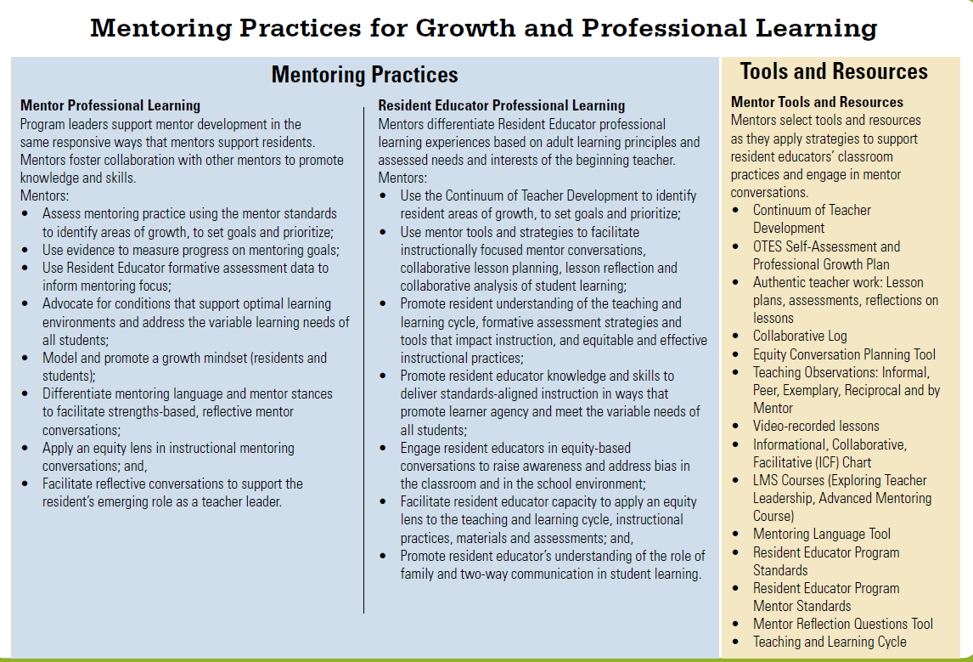
Mentoring Practices for Growth and Professional Learning
Notes:
Instructional mentors provide professional learning to new teachers during the 2-year program. While in the Resident Educator Program, resident educators are not required to participate in the LPDC. Their professional learning and development is structured through the mentoring process.
Mentors are supported by local school leaders as they collaborate with each other and attend professional learning activities to foster their own growth and development. In turn, mentors provide structured activities and processes designed to promote the professional growth and development of new teachers. This chart summarizes effective mentoring practices and shares tools and resources for both mentors and resident educators. You may access a copy of this chart here.
The Guiding Principles for Mentoring chart (shown in a previous slide), the Mentoring Practices for Growth and Professional Learning and the standards provide resident educators and school leaders with information and guidance to implement an effective Resident Educator Program.

Slide 15
Ohio Resident Educator Program
Notes:
The Teaching and Learning Cycle provides a framework for mentors and Resident Educators as they focus their discussions and conversations on instructional practice. The content of mentoring includes the components of the Teaching and Learning Cycle. Mentors communicate with their Resident Educators about planning, instruction, assessment and revision of their practice. Mentors collect evidence of practice during classroom observations, during collaborative planning, and when analyzing student work with their Resident Educator. Communicating through professional conversations and feedback, mentors support Resident Educators in analyzing and understanding the gathered evidence. It is through this process that Resident Educators come to understand reflective practice and become effective teachers.

Slide 16
Resident Educator Summative Assessment (RESA)
The RESA is a performance assessment that requires resident educators to demonstrate their knowledge and skills, as revealed in their day-to-day teaching. Performance assessments provide direct evidence, supported by written commentary, of what teachers do in the classroom.
The RESA consists of one task, the Lesson Reflection. Resident Educators are asked to provide evidence of how they implement the Teaching and Learning Cycle to support important learning outcomes for all students. As of 2023-24, there are no limits on the number of attempts to pass the RESA.
Notes:
The RESA is required in year 2 of the Resident Educator Program. In the Lesson Reflection, you are asked to record a single lesson that demonstrates your ability to teach meaningful content to your students. You will analyze your planning decisions for this lesson, illustrate your actual teaching in a video segment that is up to 20 minutes long, and reflect on the success of the entire lesson. Performance assessments provide direct evidence, supported by written commentary, of what teachers do in the classroom. As participants in the assessment, Resident Educators will be prompted to reflect upon and synthesize what they have learned throughout the Resident Educator Program.

Slide 17
What to Know About RESA
The Department’s vendor for the RESA is TeachForward (www.ohioresa.com)
The RESA Guidebook published by TeachForward provides directions to REs completing the assessment (www.ohioresa.com)
Districts are required to assign a RESA Facilitator to resident educators in year 2 when they are completing the RESA.
Notes:
The RESA Guidebook is the best resource for information about the RESA. The RESA website has many great resources and valuable information for RESA takers. The Facilitator is assigned in year 2 of the RE Program to provide support to the RE.

Slide 18
Resident Educator Email Address
New teachers often acquire a new email address when they leave the university and begin teaching. Be sure your correct email address is included in your CORE account.
TeachForward will use the email in CORE to communicate with you during the RESA process.
Ask your program coordinator or RESA facilitator to assist you if you have questions about how to update your email address.
Notes:
CORE is a different email system from the OH|ID system, and TeachForward requires the email stored in CORE to be used for activating a RESA account. Directions for how to change the email in CORE can be accessed at this link

Slide 19
Resident Educator Support System
Key to the success of the resident educator is a system of support imbedded in the structure of the program. The common goal is student learning and achievement.
RE
Mentor
Program Coordinator
Principal
Notes:
The illustration provides a visual representation of the complex relationships and interactions among mentors, REs, principals and program coordinators. Through communication and collaboration mentors, principals and program coordinators support the resident educator based on the individual needs of the new teacher.
A support system requires intentional planning and structures at the school/district level to be successful. It requires a district-level commitment to shift away from traditional mentoring that focuses on onboarding new staff to a program that leads to instructional growth and fits within a comprehensive induction approach.
1. Communication between REs and mentors must remain confidential for the necessary risk-taking and growth to occur.
2. Resident educators and principals must also work collaboratively to ensure that district and building goals and priorities are being met and that REs are meeting expectations in terms of employment and placement.
3. Principals must work with mentors to support this relationship, yet mentors must not breach the confidential relationship they have with REs. The common goal of these relationships is increased student learning and achievement.
A brief description of each of the program roles is provided on the next three (3) slides.

Slide 20
Principal Support
Create a culture of learning and a supportive environment in which resident educators can thrive
Provide time for mentor-resident educator collaboration
Provide opportunities for observations, including reciprocal observations and observations of exemplary teachers
Establish two-way communication with mentors and resident educators
Notes:
Principals are in a position to ensure that needed resources and structures are in place to support new teachers. Principals create a culture of learning and support and structures that provide time for mentors and resident educators to meet and collaborate. Principals honor the relationship of trust and respect that exists between a mentor and a resident educator. Principals communicate with mentors and resident educators and support the mentoring relationship.

Slide 21
Program Coordinator Support
Register resident educators in CORE for the program and when appropriate for RESA; confirm program completion
Provide orientation to Resident Educators, mentors and building leaders about program and district requirements
Share information about program eligibility, program requirements, dates and timelines
Ensure resident educators are assigned a mentor and a RESA facilitator as required
Provide ongoing training and support to mentors
Notes:
Each district with a Resident Educator (RE) Program must have at least one Program Coordinator. The Program Coordinator is the person who manages the RE Program at the local level. Resident educators should seek out the program coordinator and be sure the program coordinator has registered them for the Resident Educator Program. In addition to the mentor, the resident educator should have access to communication with the program coordinator.
Some schools/districts contract with the local Educational Service Center (ESC) for services to implement the RE Program. In these cases, the Program Coordinator will be a staff member from the ESC and not the local school/district.

Slide 22
Mentor Support
Create a collaborative and respectful instructionally-focused mentoring partnership with the resident educator
Facilitate collaborative conversations that impact instructional practices and meet the individual needs of the resident educator
Promote reflective practice through analysis of evidence that strengthens and advances classroom practice
Commit to ongoing, two-way communication, confidentiality and honesty
Communicate with principals and program coordinators to ensure a system of support
Notes:
Mentors are key to the success of the Resident Educator (RE) Program. Mentors are initially trained by the Ohio Department of Education. They become state-certified mentors when they successfully complete the training. However, mentors (as all educators) must continue their professional growth and development at the school/district level. Mentors have opportunities to meet and collaborate with each other and attend ongoing professional learning activities.
A review of the RE Program Mentor Standards provides an understanding of the role of the mentor in the RE Program. The resident educator who is familiar with the standards understands the role of mentors and school leaders.

Slide 23
Resources for Resident Educators
“For Resident Educators” is a webpage designed specifically for the needs of Resident Educators.
Important resources and documents
You can email the Resident Educator team at ODE at REProgram@education.ohio.gov

Slide 24
Resources
REP Website: http://education.ohio.gov/Topics/Teaching/Resident-Educator-Program
Program Questions: REProgram@education.ohio.gov
RESA Questions: resa@TeachForward.com
RESA Website: www.ohioresa.com
Licensure Questions: educator.licensure@education.ohio.gov
24
Notes:
As you move through each year of residency, you may find you have questions. Please feel free to email our office at the REProgram email address. Program coordinators are provided the most up-to-date information from ODE so please make sure to communicate with your Program Coordinator. In addition, ODE’s Resident Educator webpage is updated frequently.

Slide 25
The Challenge for Resident Educators
“Beginning teachers are asked to demonstrate skills (innovative practices) they do not yet have and can only attain through beginning to do what they do not yet understand…Teach, practice, and receive consistent, deliberate, and specific feedback from exemplary teachers/mentors, in a collaborative inquiry environment of discovery and wonder.”
Sharon Feiman-Nemser 2012
25
Notes:
The Resident Educator Program gives new teachers the support and opportunities for growth they need to accelerate their instructional practices in the beginning years of teaching.

Slide 26
@OHEducation

